Slide 1

1EM7
Membrane Protein
Author: Bernardo Augusto
Student number: 201800128
Curricular unit: Computational Biochemistry
Professors: Gonçalo Justino and Marta Justino

Slide 2
GROMACS version
gmx, version 2020.4-MODIFIED

Slide 3
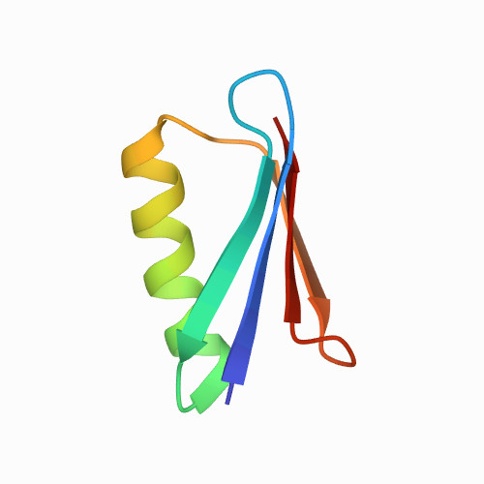
Chosen protein

Slide 4
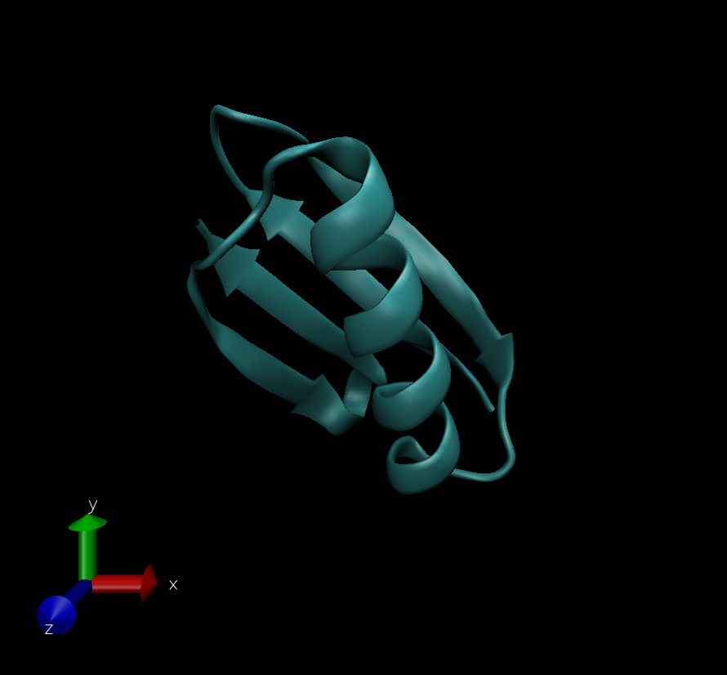
About the protein
PDB ID: 1EM7
Unique protein chains
Membrane protein

Slide 5
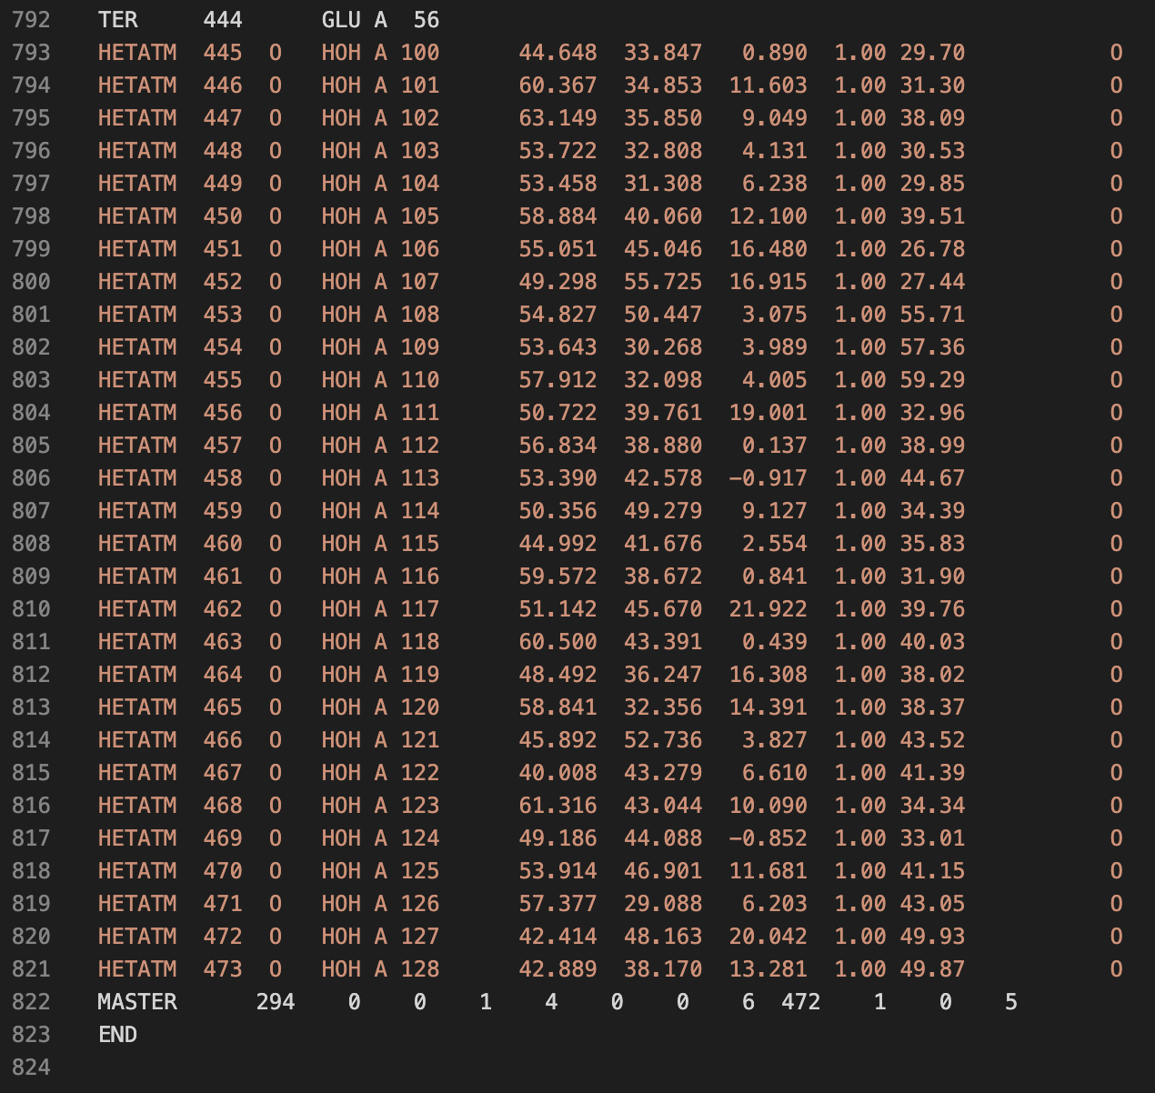
Cleaning Steps
Removed the crystallographic water molecules, and create a new file 1em7_clean.pdb

Slide 6

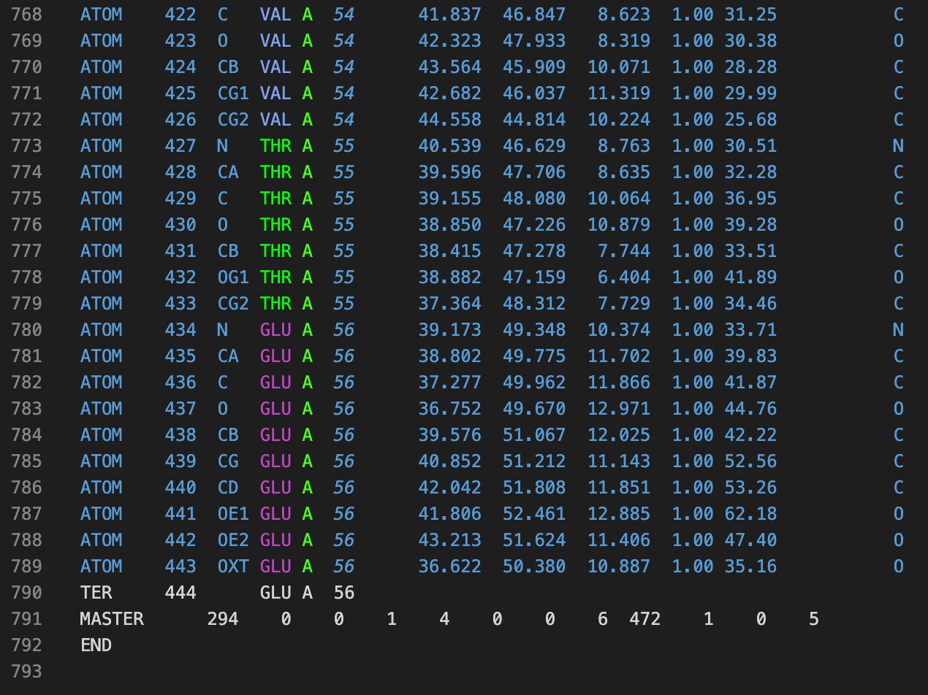
Cleaning Steps
The 1em7_clean.pdb doesn’t contain the crystallographic water molecules.

Slide 7
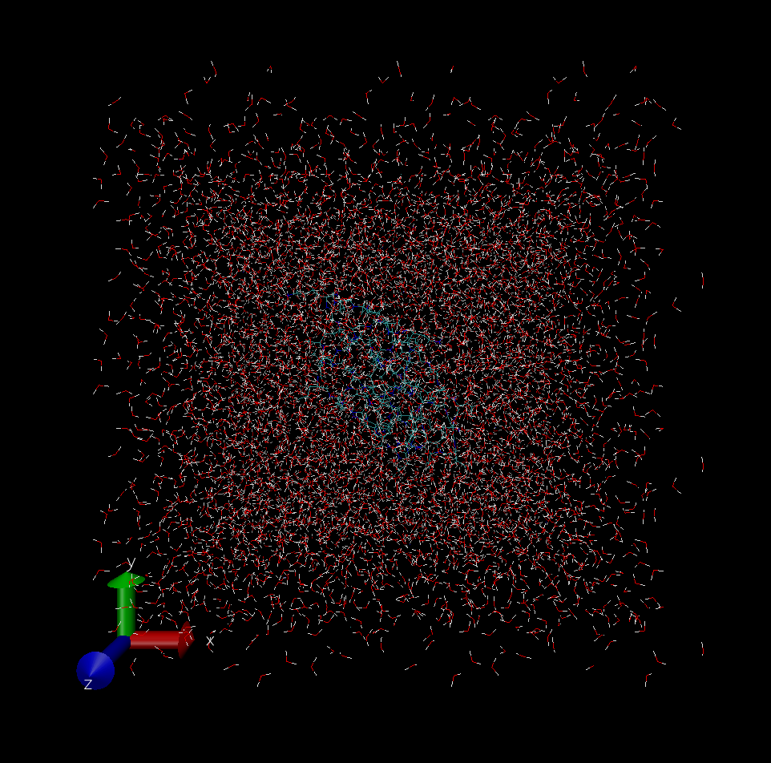
Simulation Box
Volume: 123.417 nm³

Slide 8
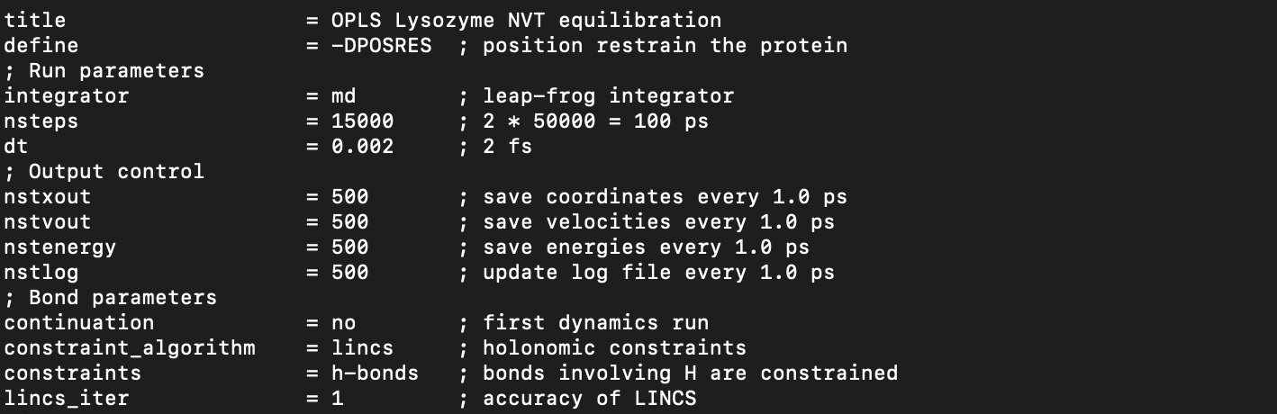
MDP file parameters
Changed the number of steps to 15000 because with this number of steps can be obtain a good sample and take conclusion with some ground.

Slide 9
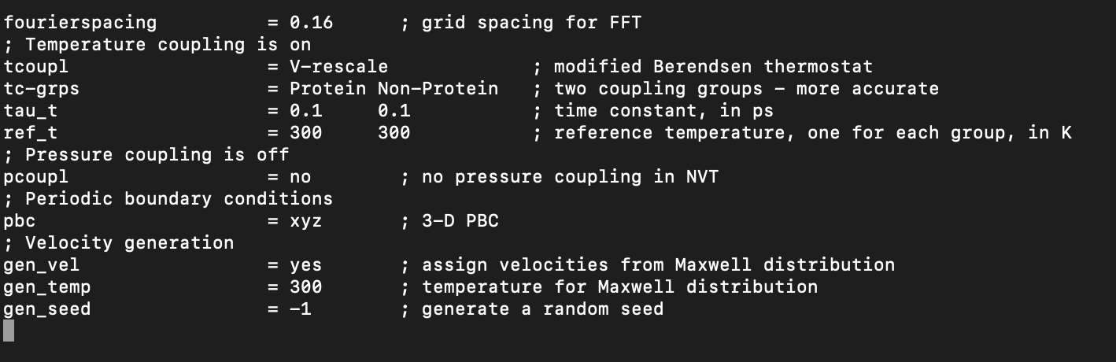
MDP file parameters
Created three files that had different temperatures, 273.15, 300 and 500 K.

Slide 10
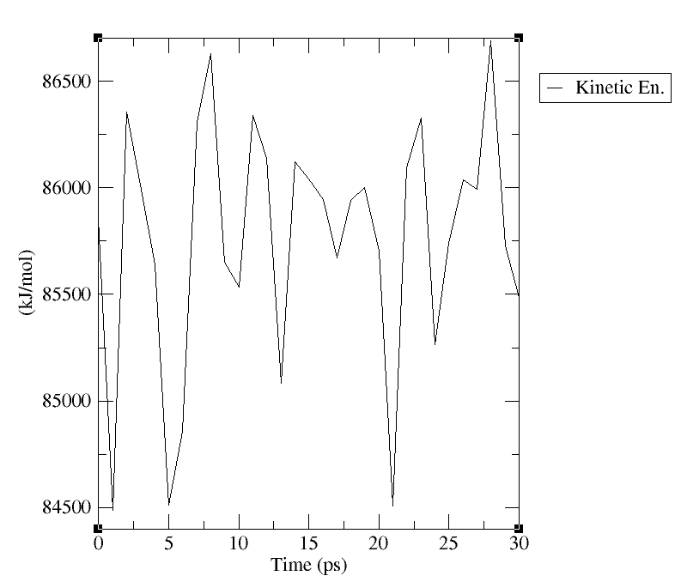
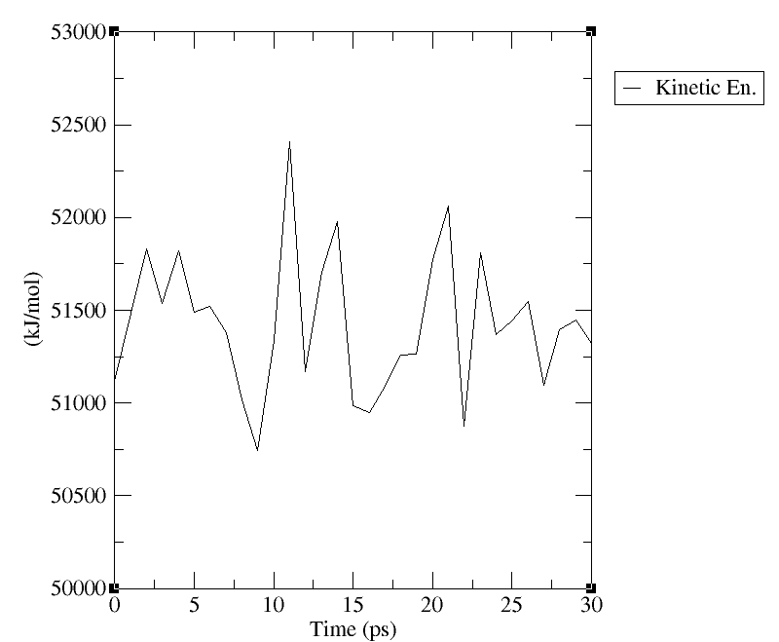
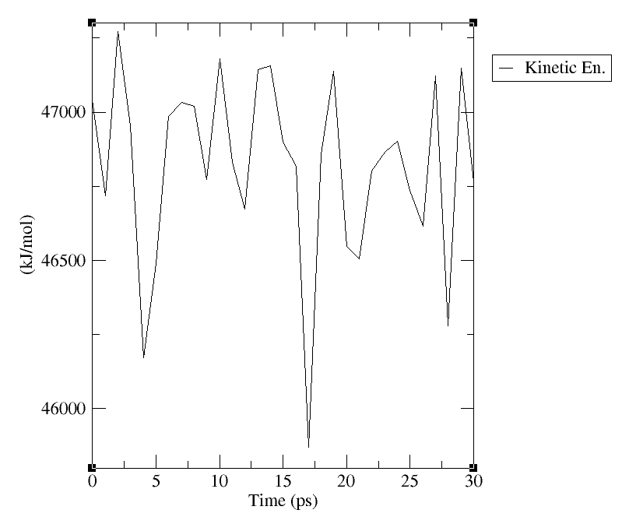
Variation of Energy according to Temperature
Variation of Kinetic Energy at 500 K
Variation of Kinetic Energy at 300 K
Variation of Kinetic Energy at 273.15 K
There is a lot of variation in all temperatures, but the 300 K is the most stable

Slide 11
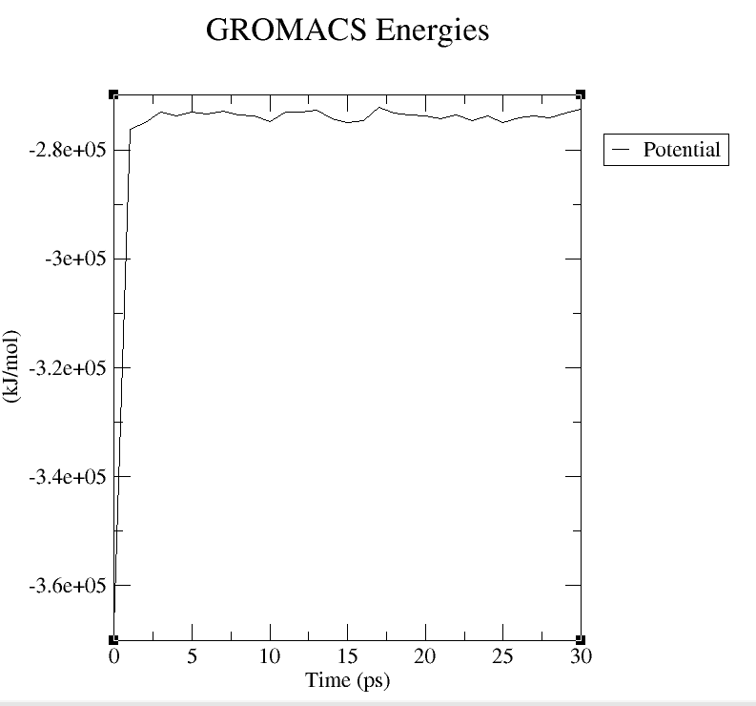
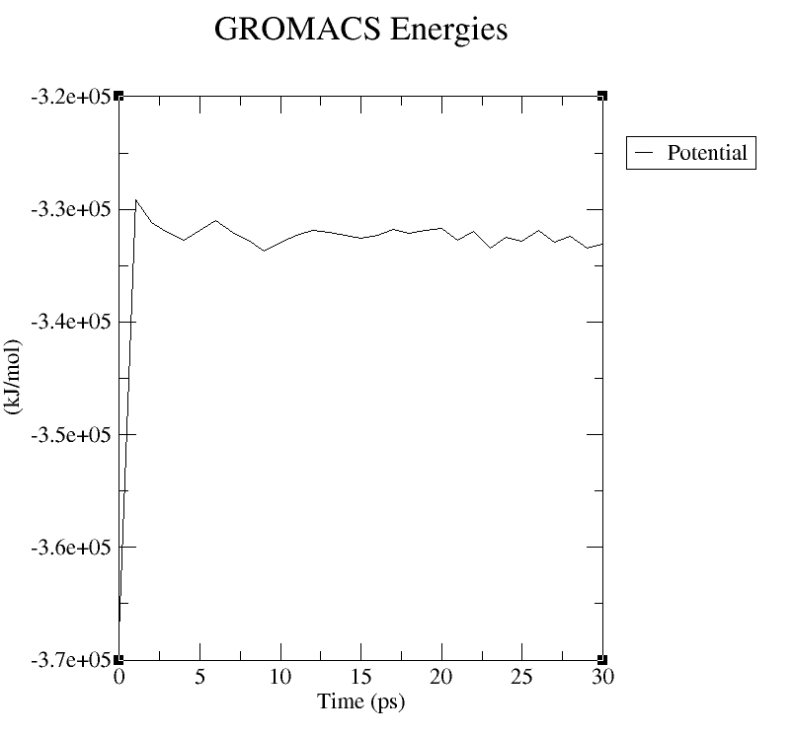
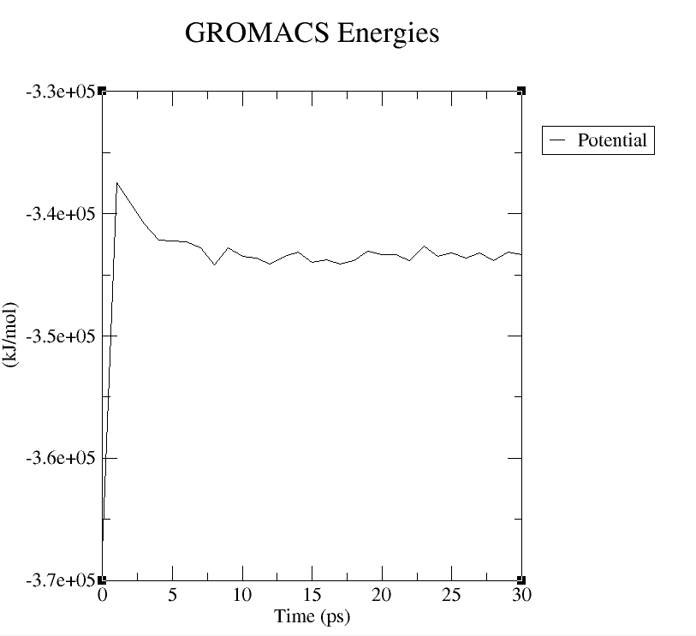
Variation of Energy according to Temperature
Variation of Potential Energy at 500 K
Variation of Kinetic Energy at 300 K
Variation of Kinetic Energy at 273.15 K
The three are very stable but at 300 K there is less energy and for that reason the system is most stable.

Slide 12
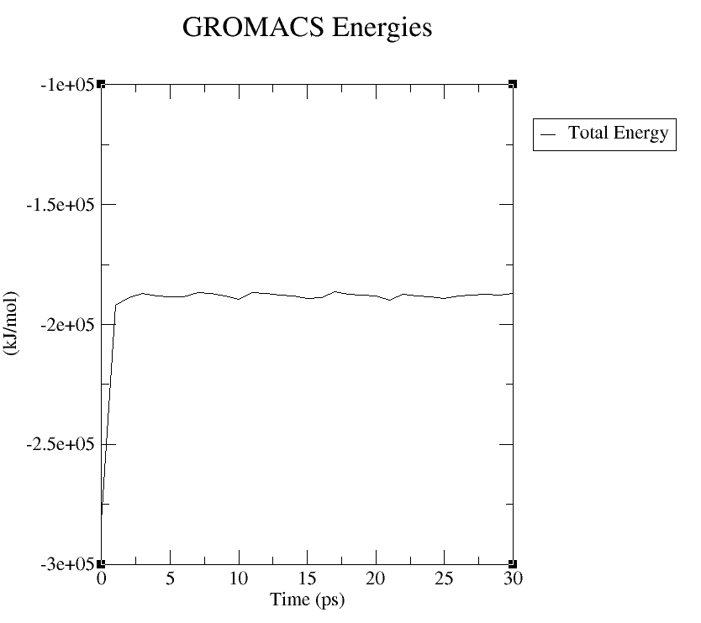
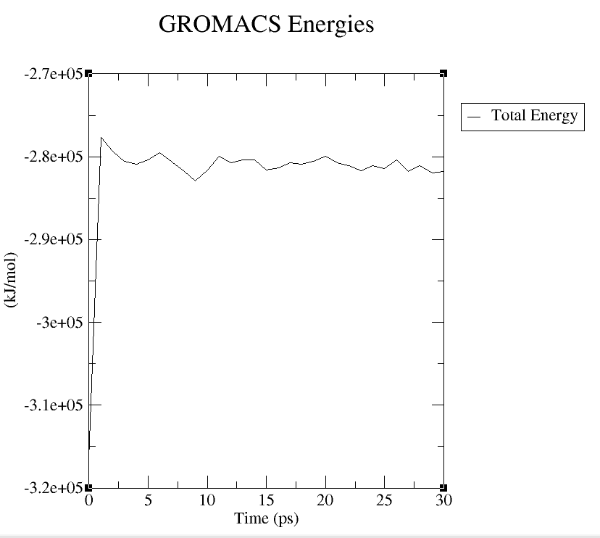
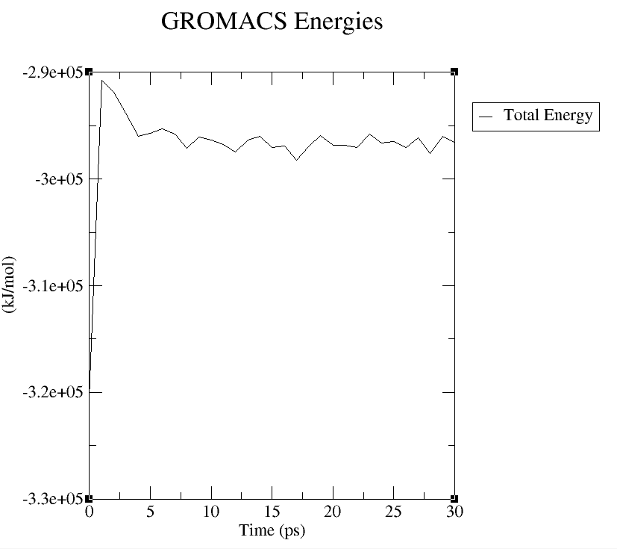
Variation of Energy according to Temperature
Variation of Total Energy at 500 K
Variation of Total Energy at 300 K
Variation of Total Energy at 273.15 K
The three are very stable but at 273.15 K there is less energy and for that reason the system is most stable.

Slide 13
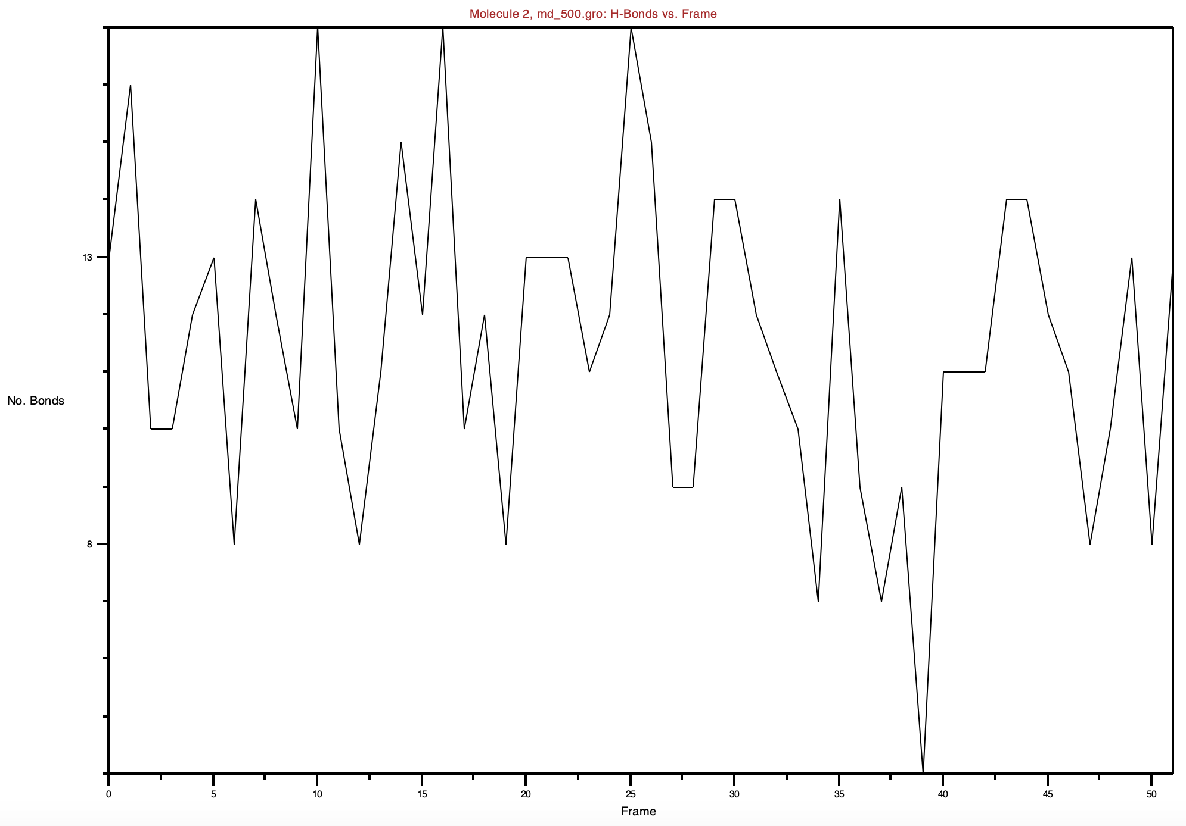
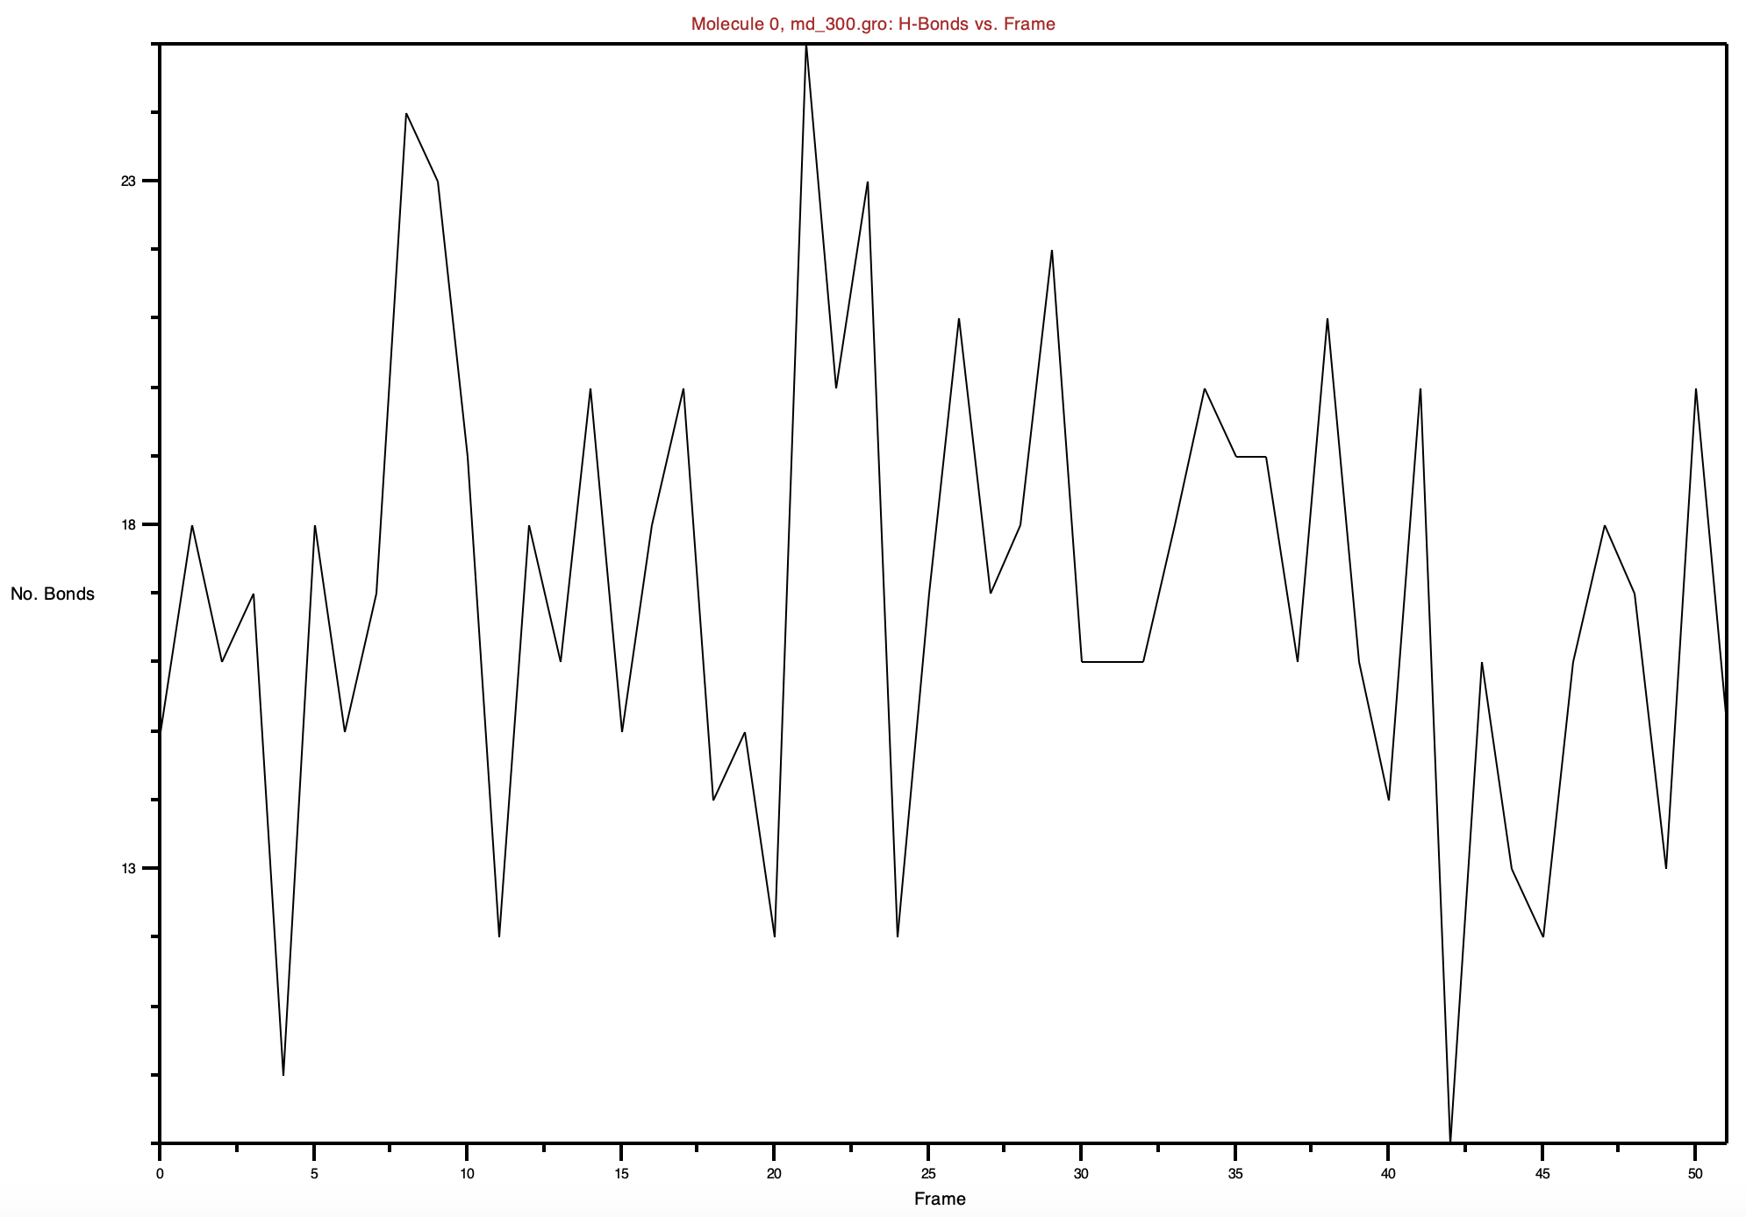
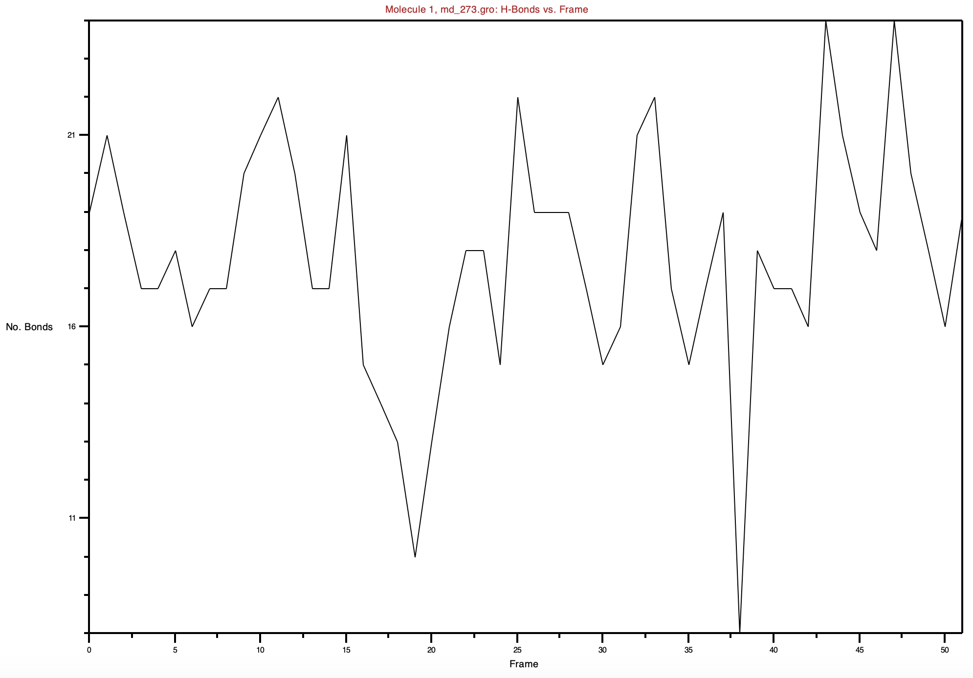
Hydrogen bonds vs Time
Hydrogen bonds vs Time at 500 K
Hydrogen bonds vs Time at 300 K
Hydrogen bonds vs Time at 273.15 K
All three are always varying but close to the 40 frame all of them have 0 hydrogen bonds.

Slide 14
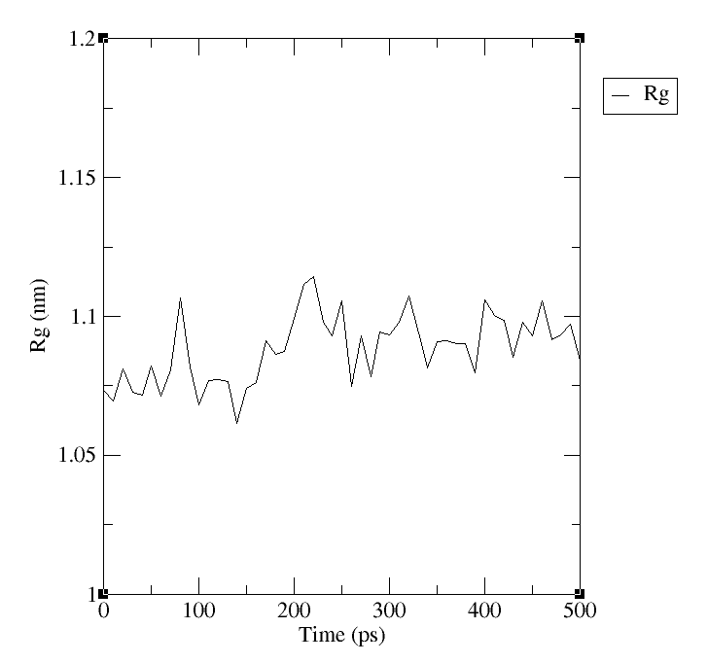
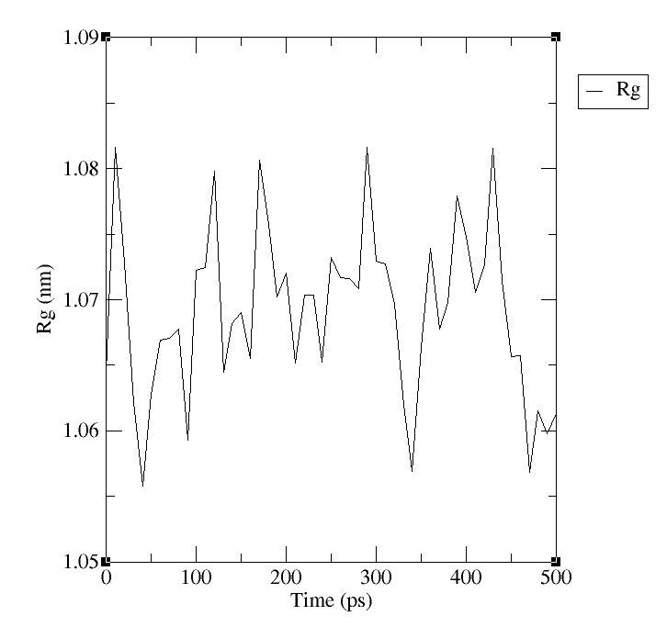
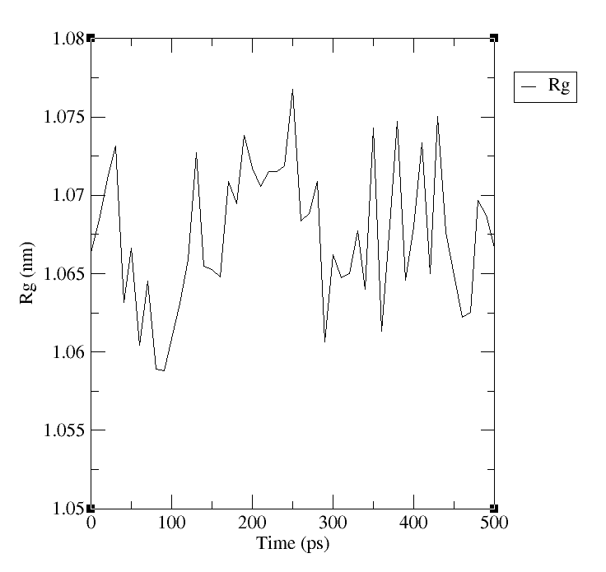
Radius of Gyration of the Protein
Radius of Gyration at 500 K
Radius of Gyration at 300 K
Radius of Gyration at 273.15 K
The radius of gyration of the protein is more stable at 500 K

Slide 15
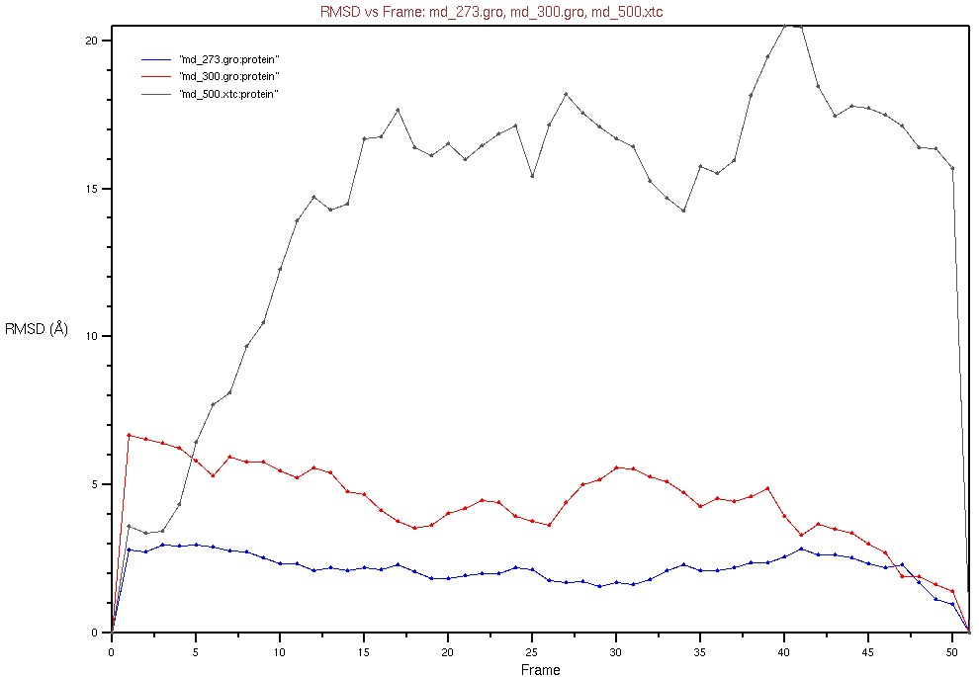
RSMD Values
The average distance between the atoms grows with the temperature

Slide 16
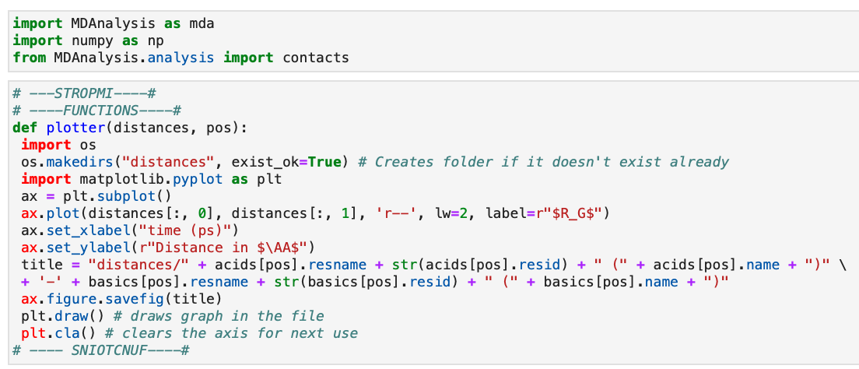
Python script to measure the distances

Slide 17
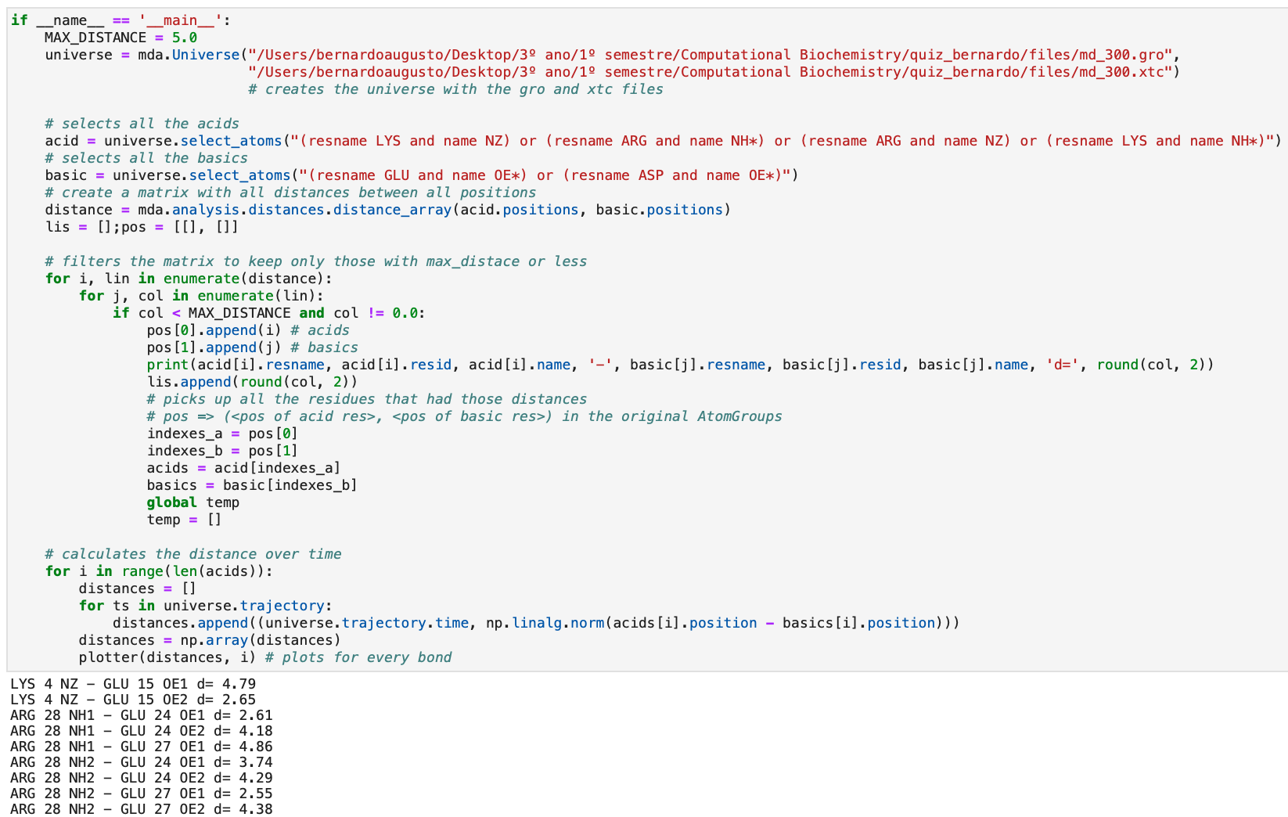
Python script to measure the distances

Slide 18
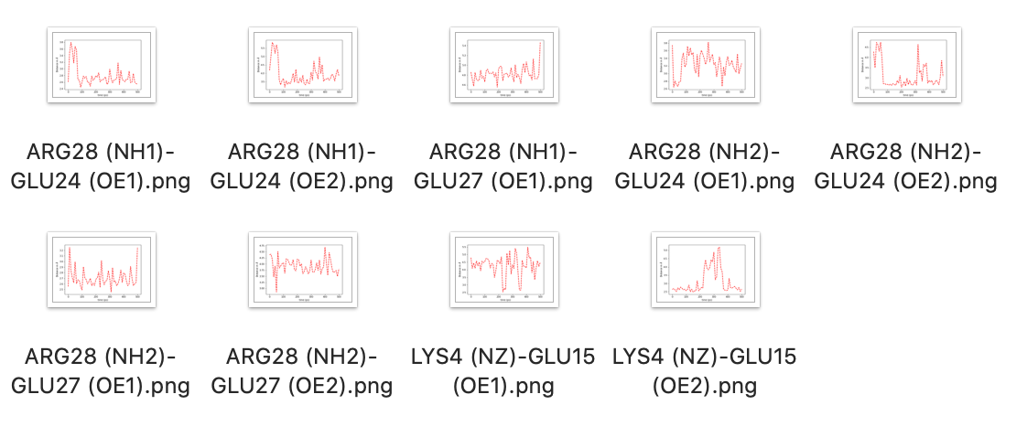
Python script to measure the distances
With the previous script, can be obtained these graphs

Slide 19
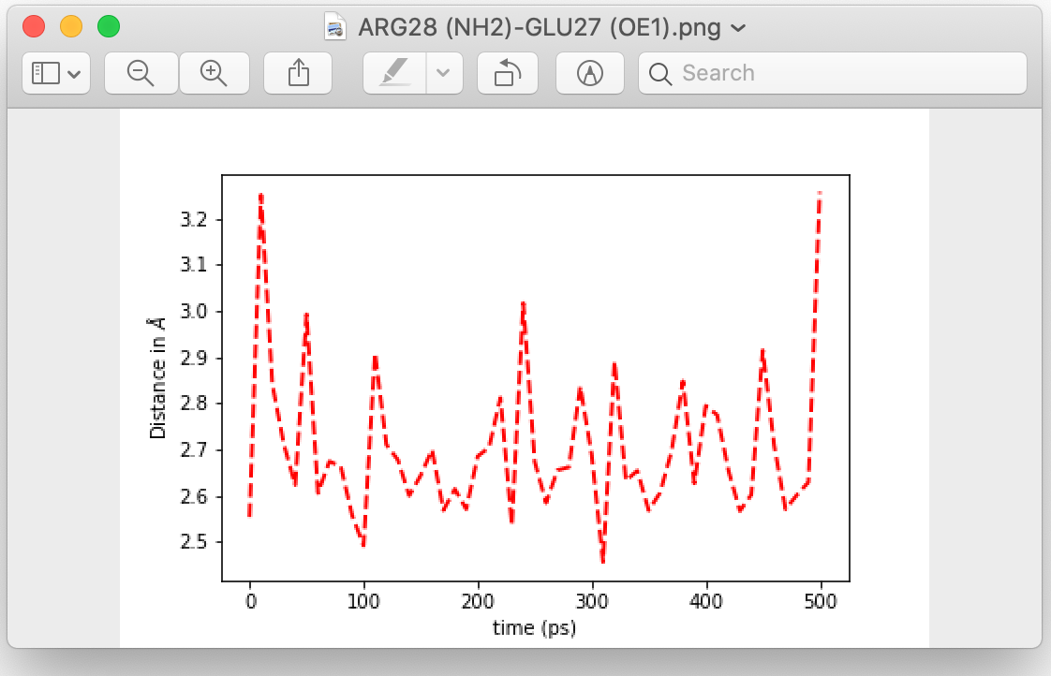
Python script to measure the distances
Chosen graph for the VMD analysis
Chose this one because of the smaller variation of values (2.5 - 3.2 Å)

Slide 20
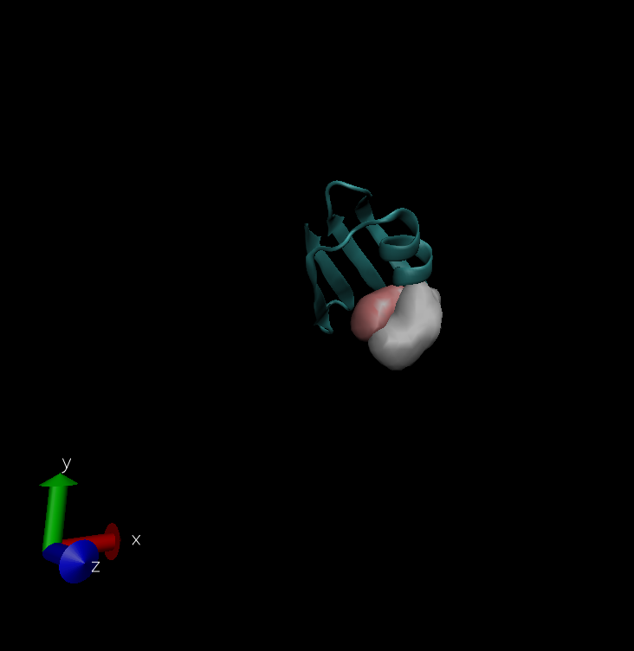
Relevant H bonds
At frame 50 (like the 500) is the moment they are further away, and they remain super close
The hydrogen bond is stable

Slide 21
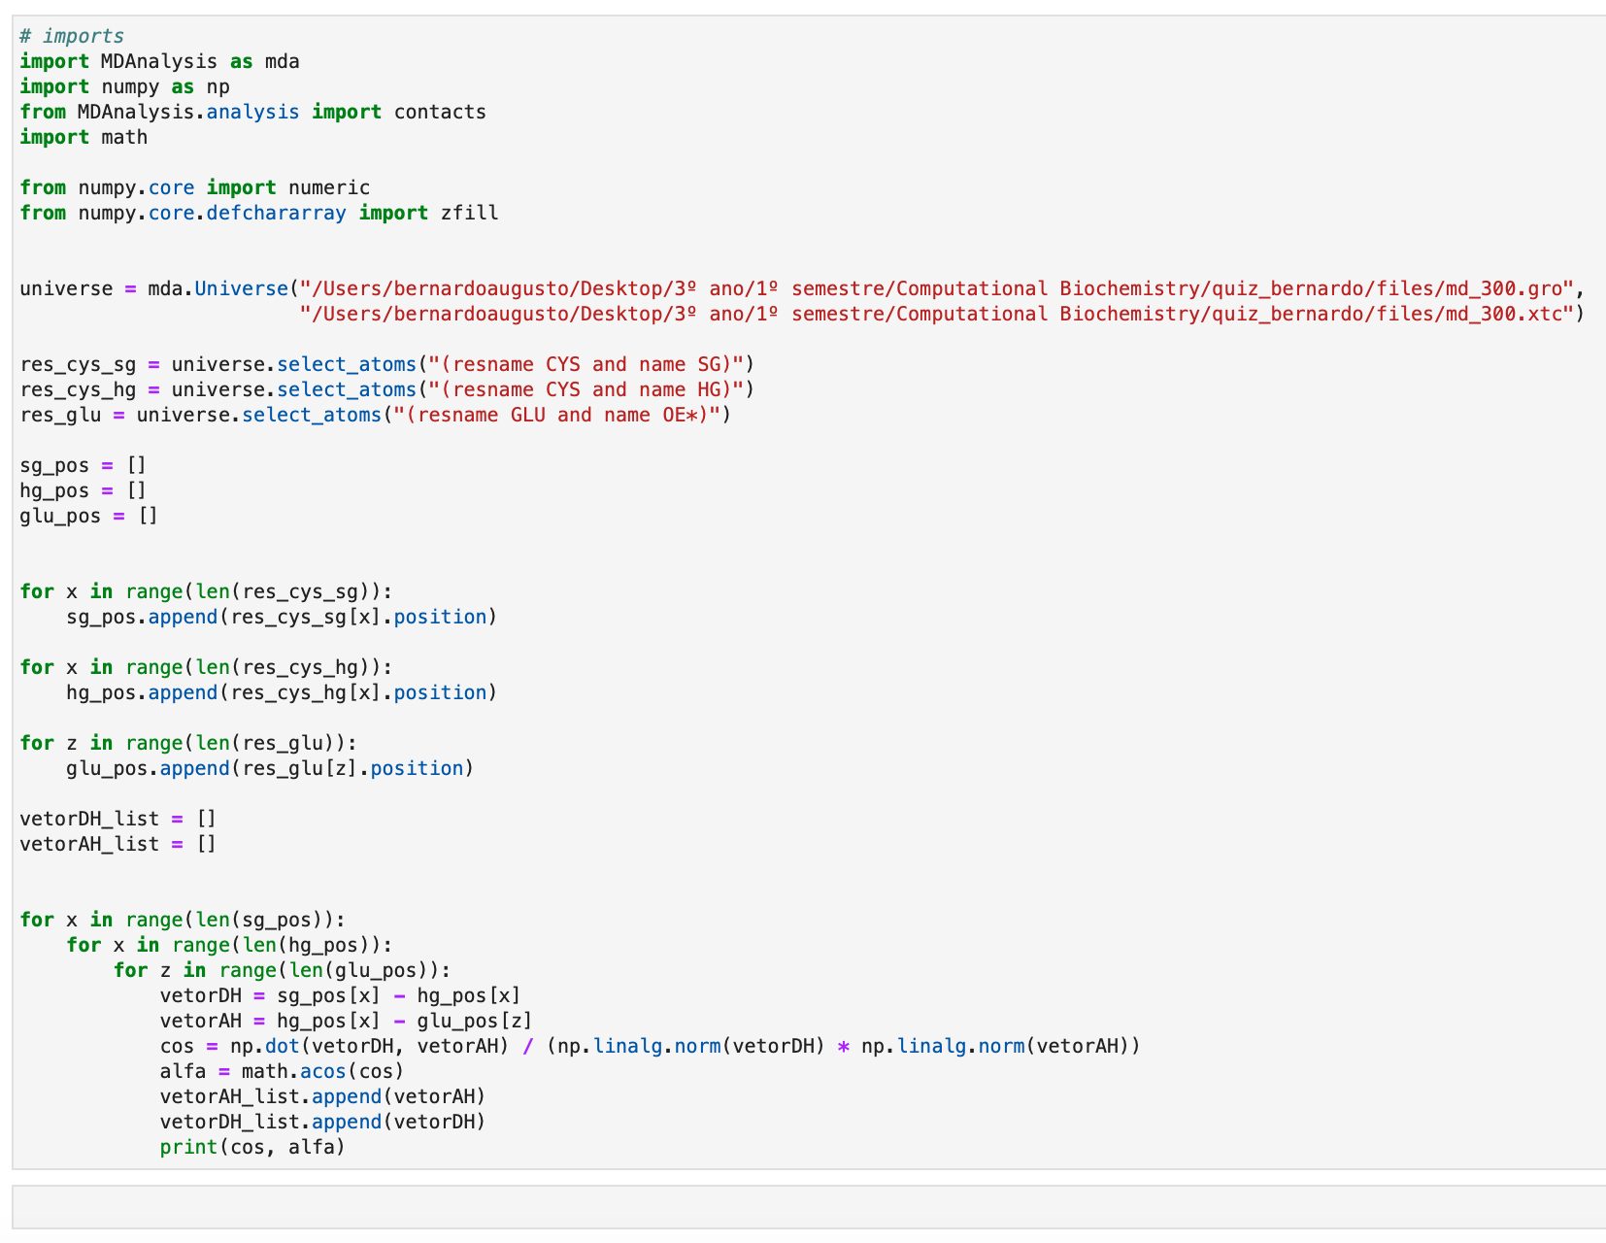
Python script H-A-AA and D-A-AA angles
Doesn’t print anything because this protein doesn’t have any residue of cysteine

Slide 22
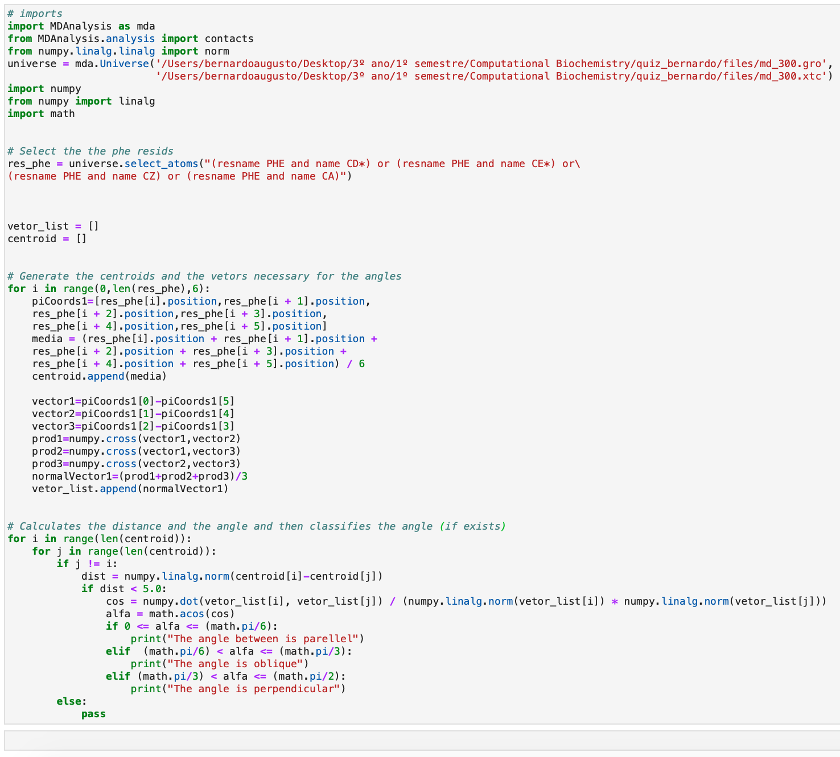
Python script to measure the dihedral angle 𝜏
Doesn’t classify any angle because none of the distances are inferior to 5.0 Å

Slide 23
References
Documents supplied by the professor on Moodle
https://www.mdanalysis.org
https://www.researchgate.net/post/Can-I-calculate-the-radius-of-gyration-using-GROMACS-package-How-do-I-install-the-GROMACS-package-in-a-windows-machine

