Slide 1
Portrait Photography
bernard.el-hagin@ergo.com

Slide 2
Equipment
Camera (hotshoe, manual mode)
Lens (85mm+)
Lighting gear

Slide 3
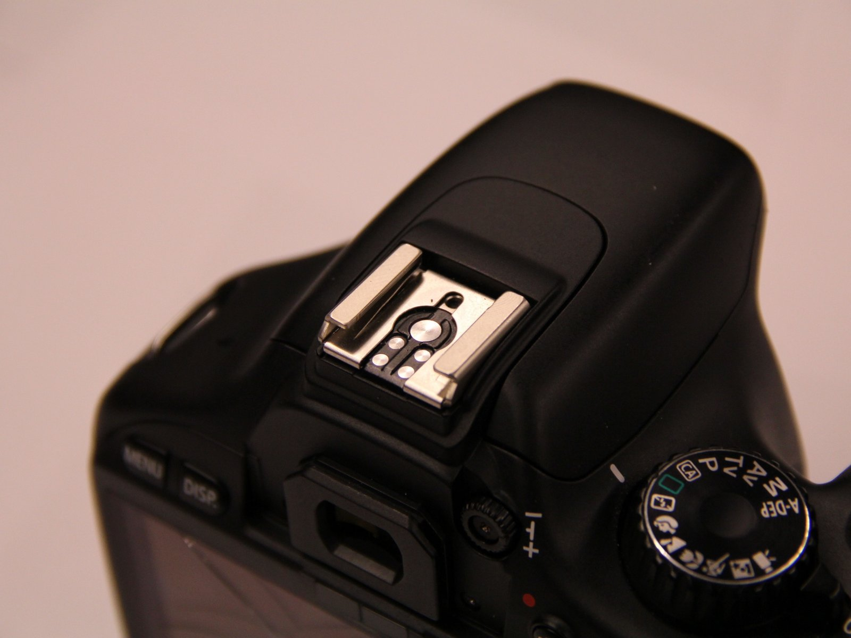
Camera

Slide 4
Lens
Perspective

Slide 5
Lighting
Flash unit
Remote trigger
Light stand
Modifiers

Slide 6
Flash unit
Any flash with manual power settings and rotatable head
Best quality to price ratio – Godox
Best value for learning - Yongnuo
Worst quality to price ratio – Nikon/Canon

Slide 7
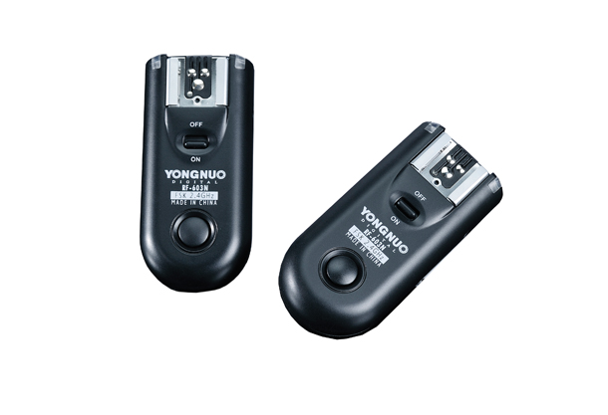
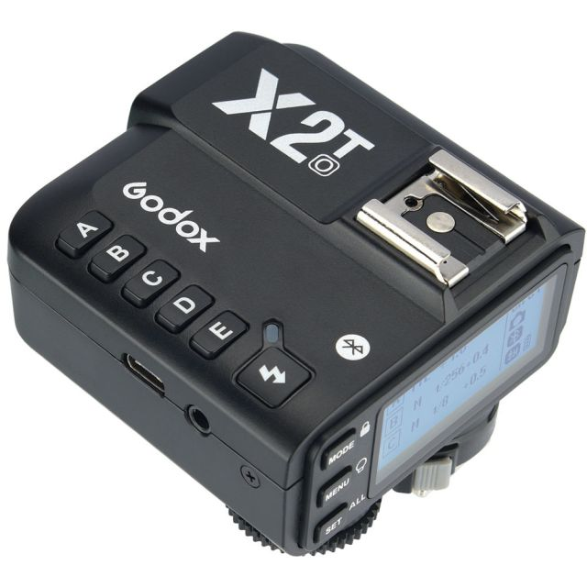
Remote trigger
Any radio trigger (eg. Godox, Yongnuo)
Do not use a cable!

Slide 8
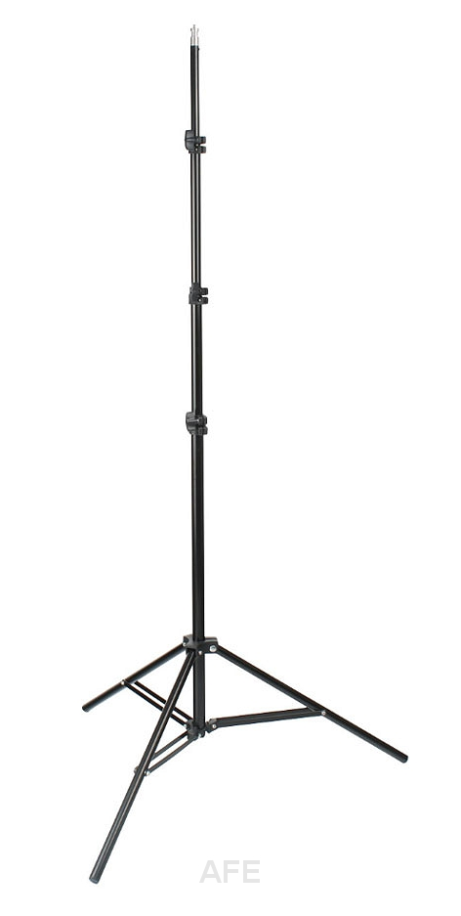
Light stands
Any light stand that will hold your flash and modifier

Slide 9
Modifiers
Used to change the quality of light

Slide 10
Characteristics of light
Power
Direction
Quality

Slide 11
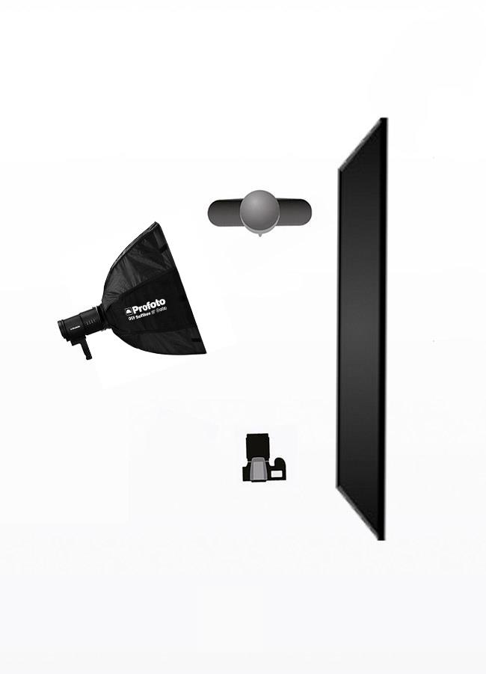
Light setups
Rembrandt Light

Slide 12
Conclusion
Practice, practice, practice!
'Light – Science and Magic' by Fil Hunter, Steven Biver, Paul Fuqua

