Slide 1

Photography Basics pt. 1 bernard.el-hagin@ergo.com

Slide 2
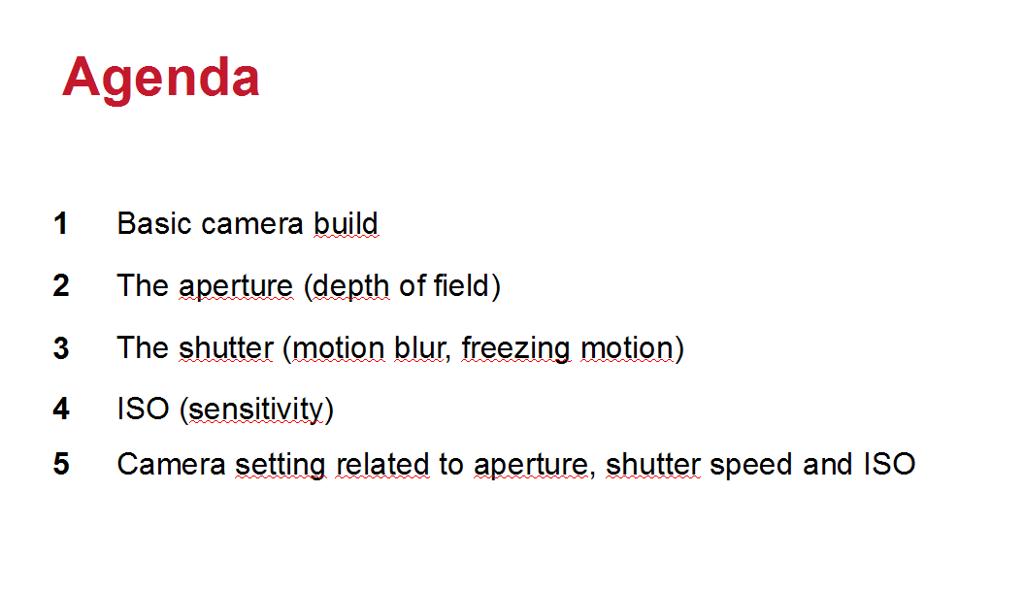

Slide 3
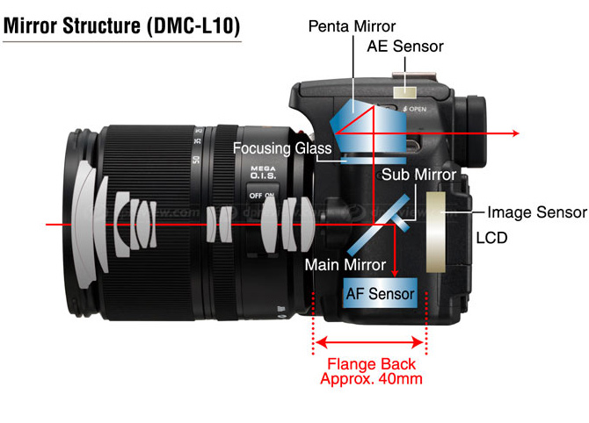

1. Basic camera build

Slide 4
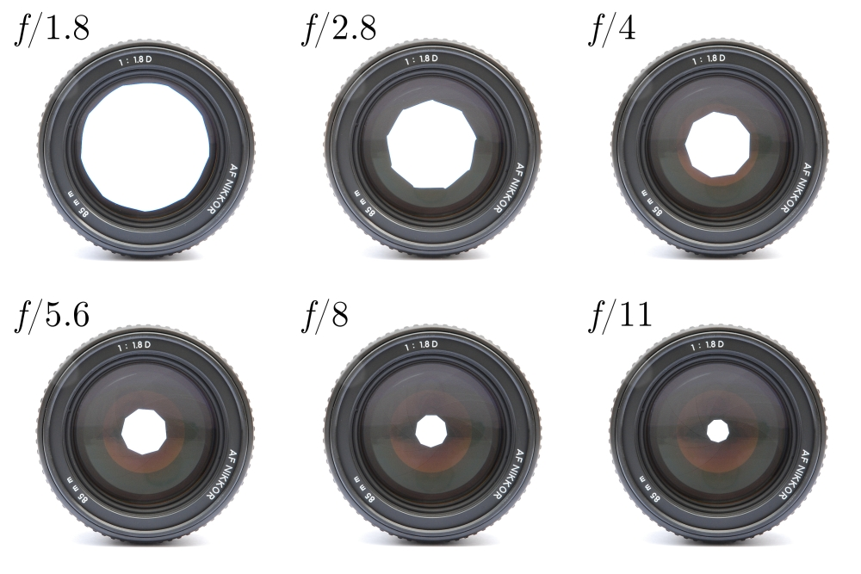
2. The aperture

Slide 5
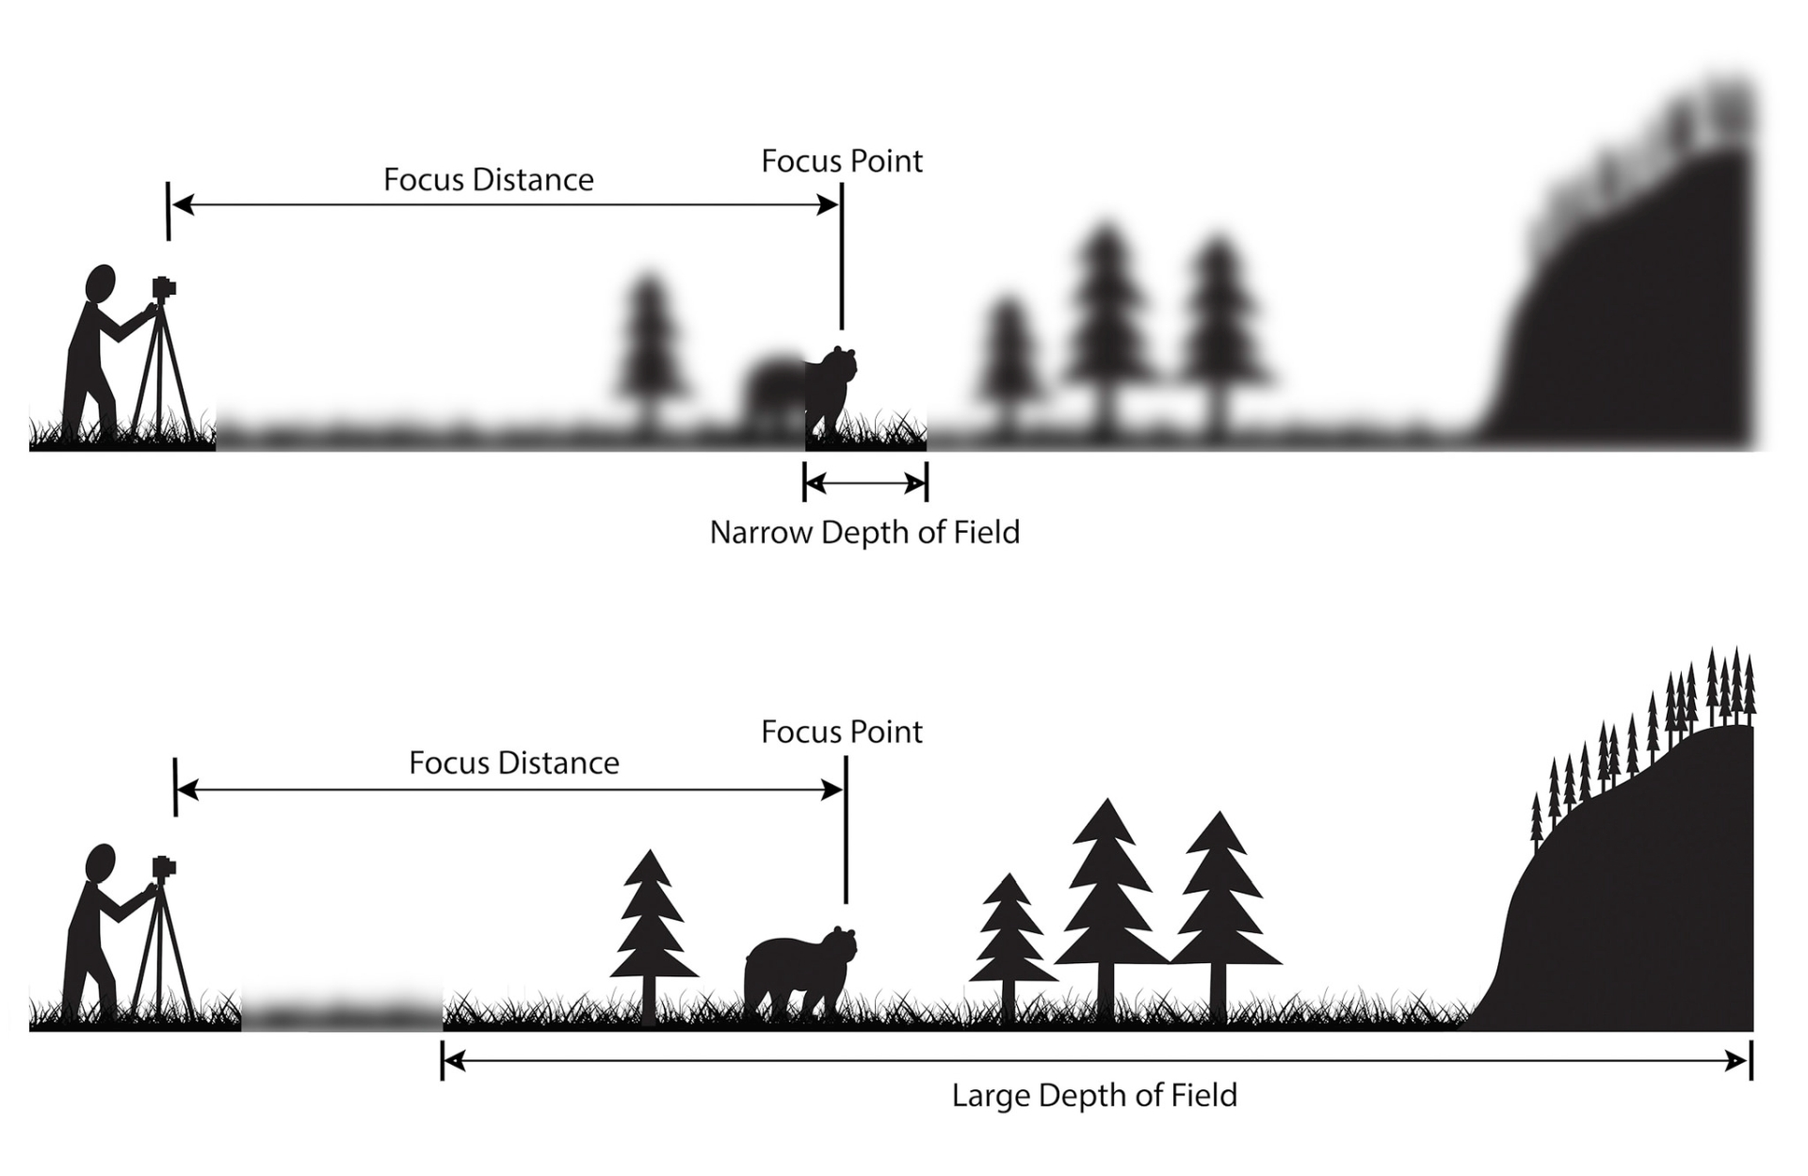

Slide 6
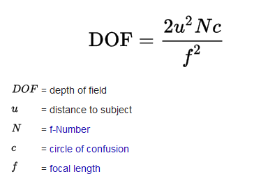

Slide 8


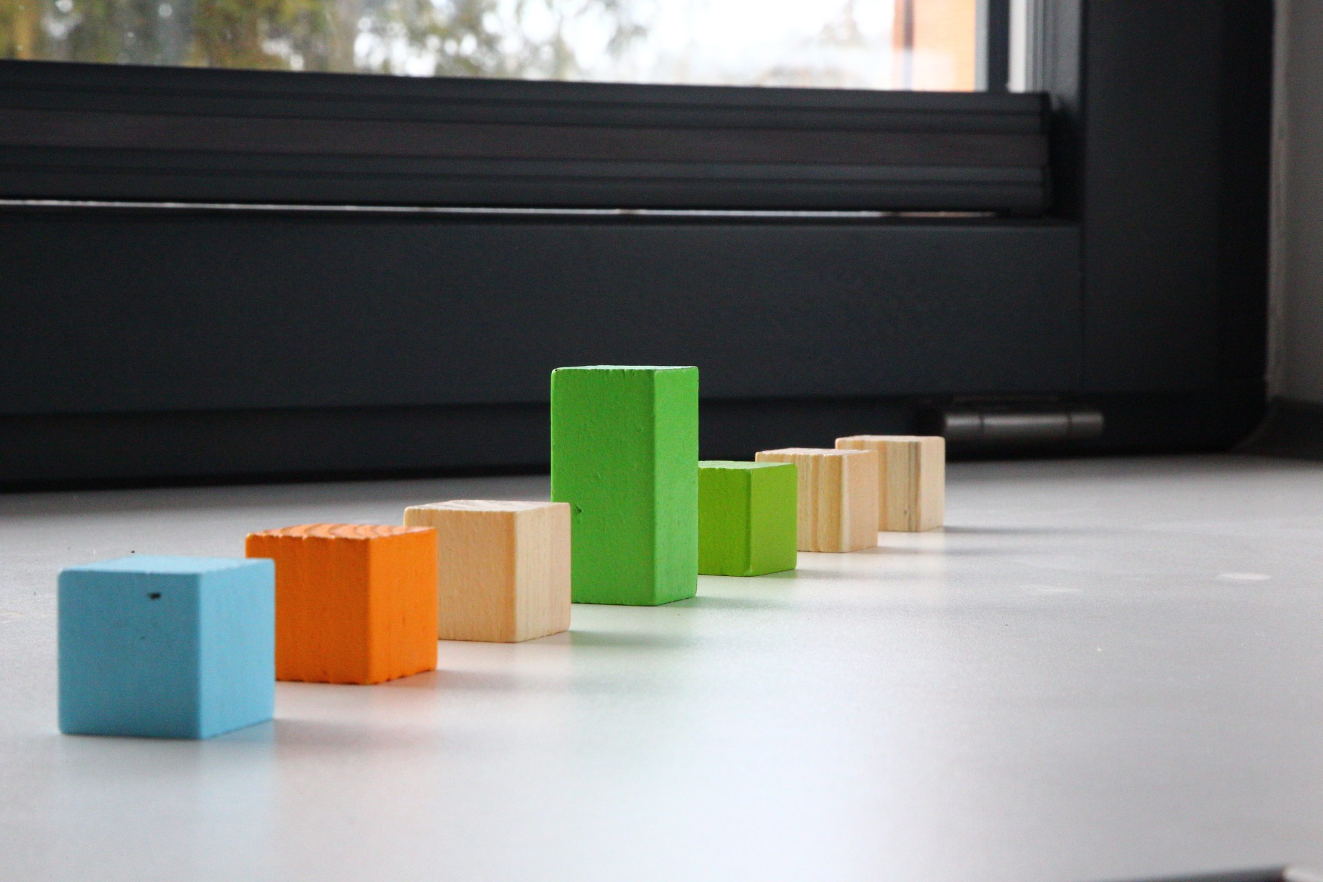
f4
f8
f22
Small f means small depth of field.
Large f means large depth of field.

Slide 9
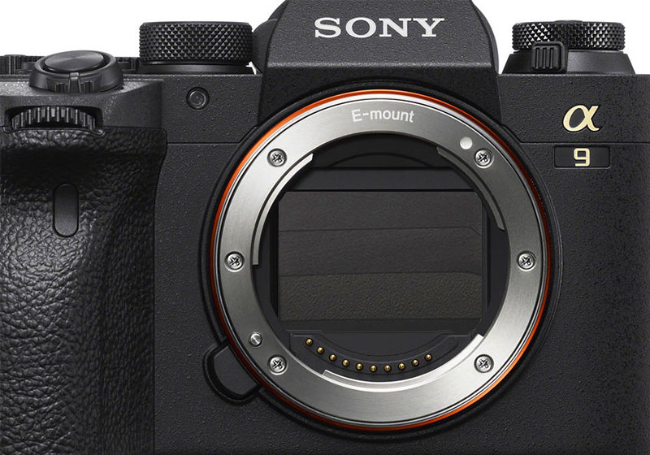
2. The shutter

Slide 10
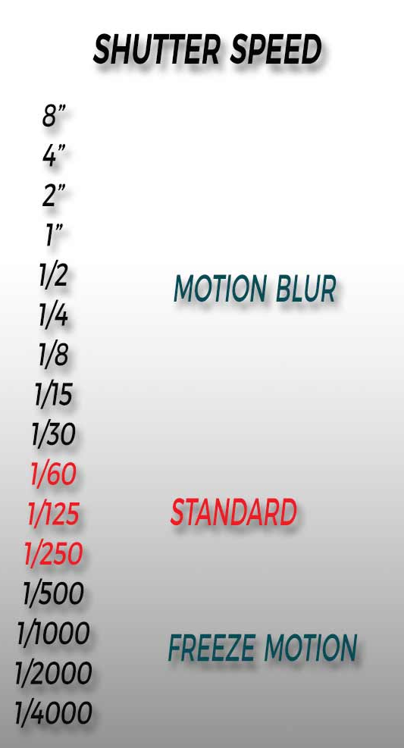
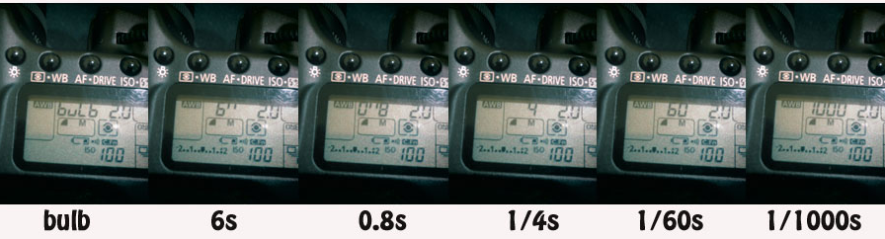

Slide 11
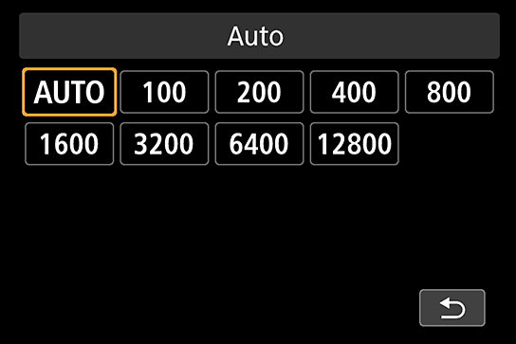
3. ISO
ISO affects the sensitivity of the sensor

Slide 12
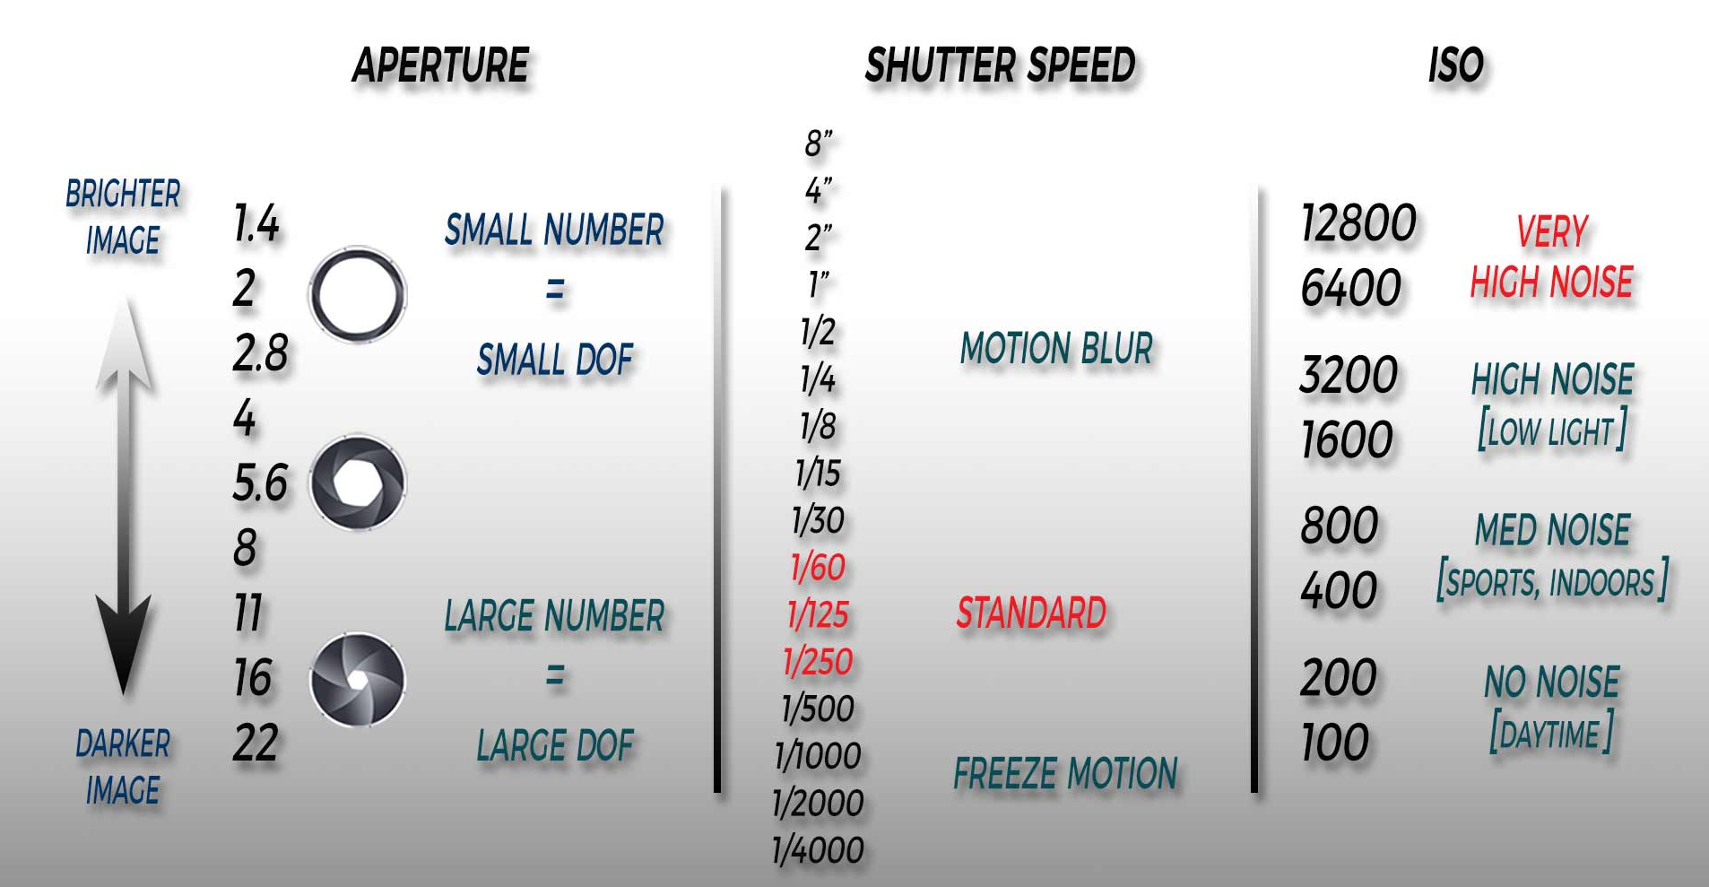
Exposure

