Slide 1
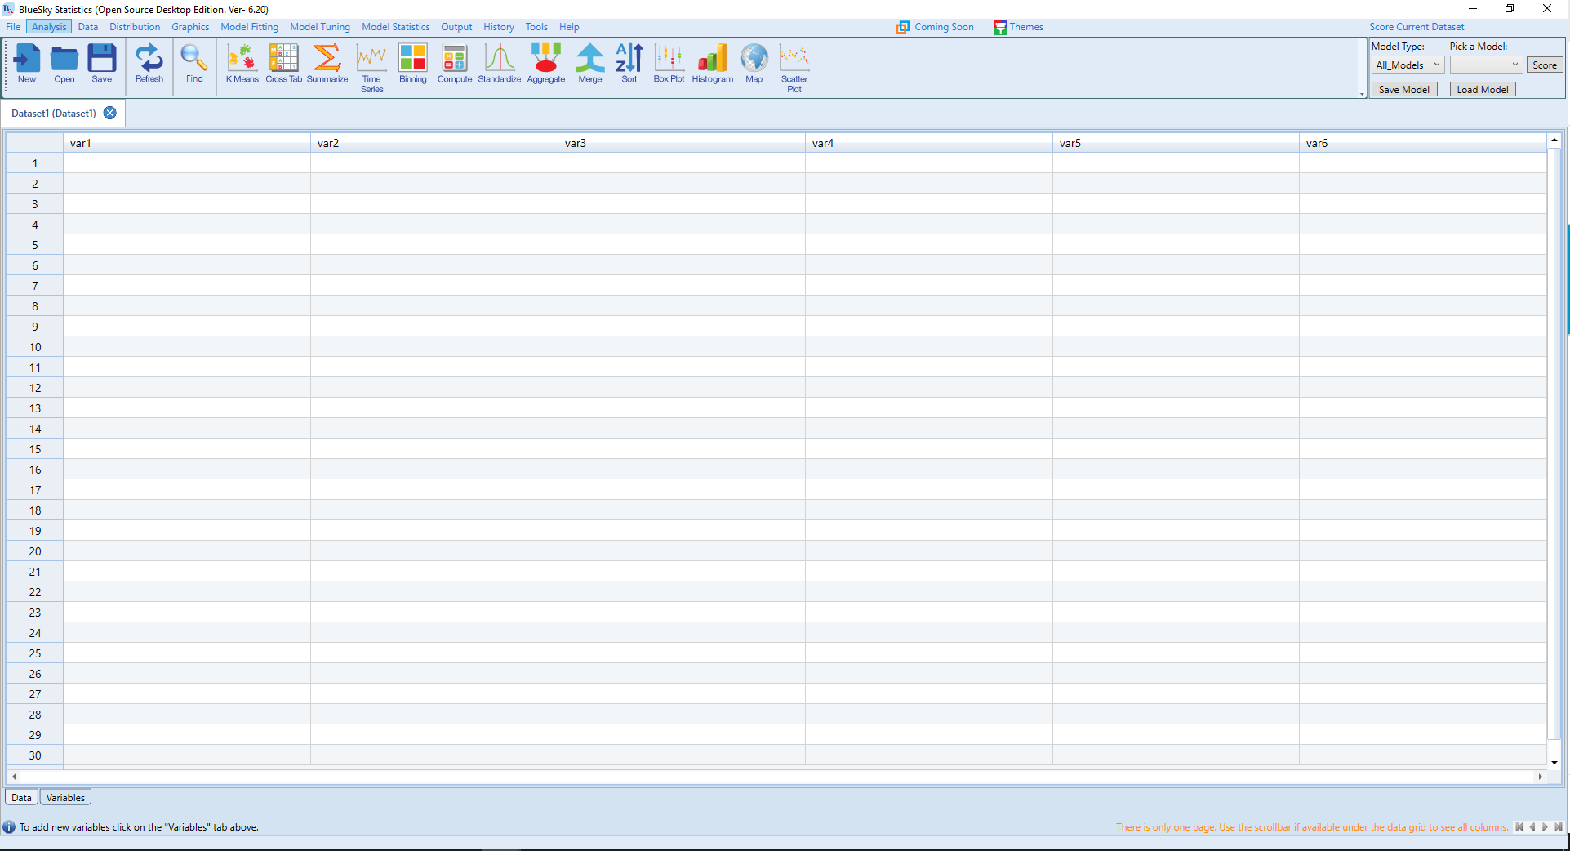
Looks like SPSS

Slide 2
Where you see data

Slide 3
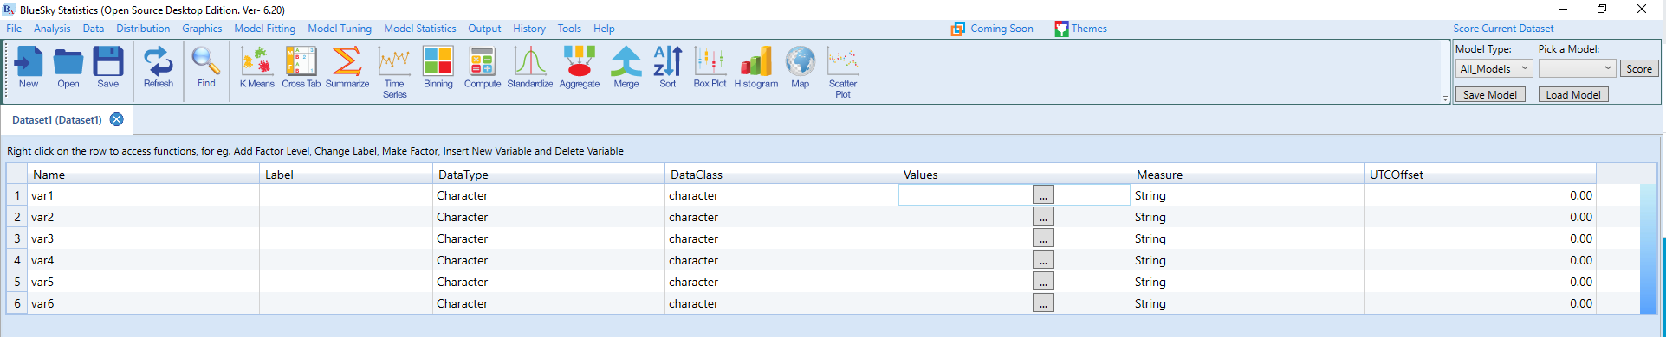
Where you define variables

Slide 4
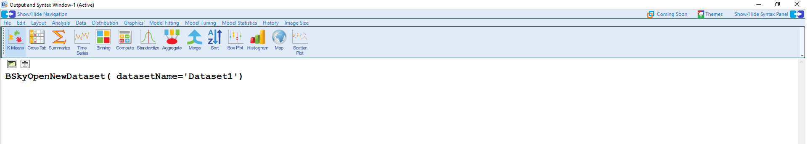
Click here to get script view
Where results are shown

Slide 5
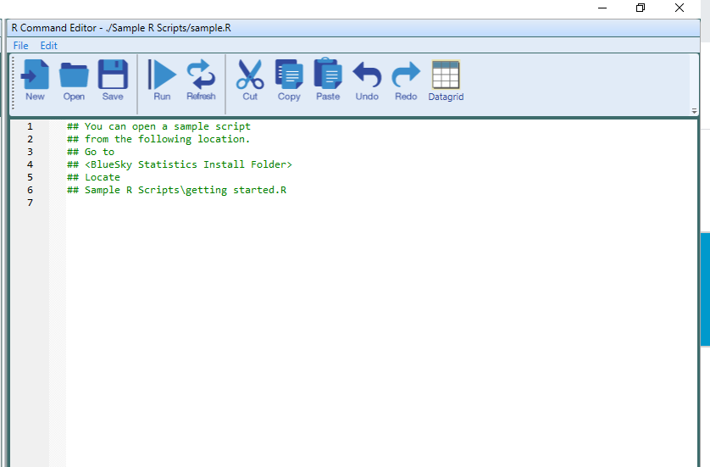
Where you type like a hacker

