Slide 1
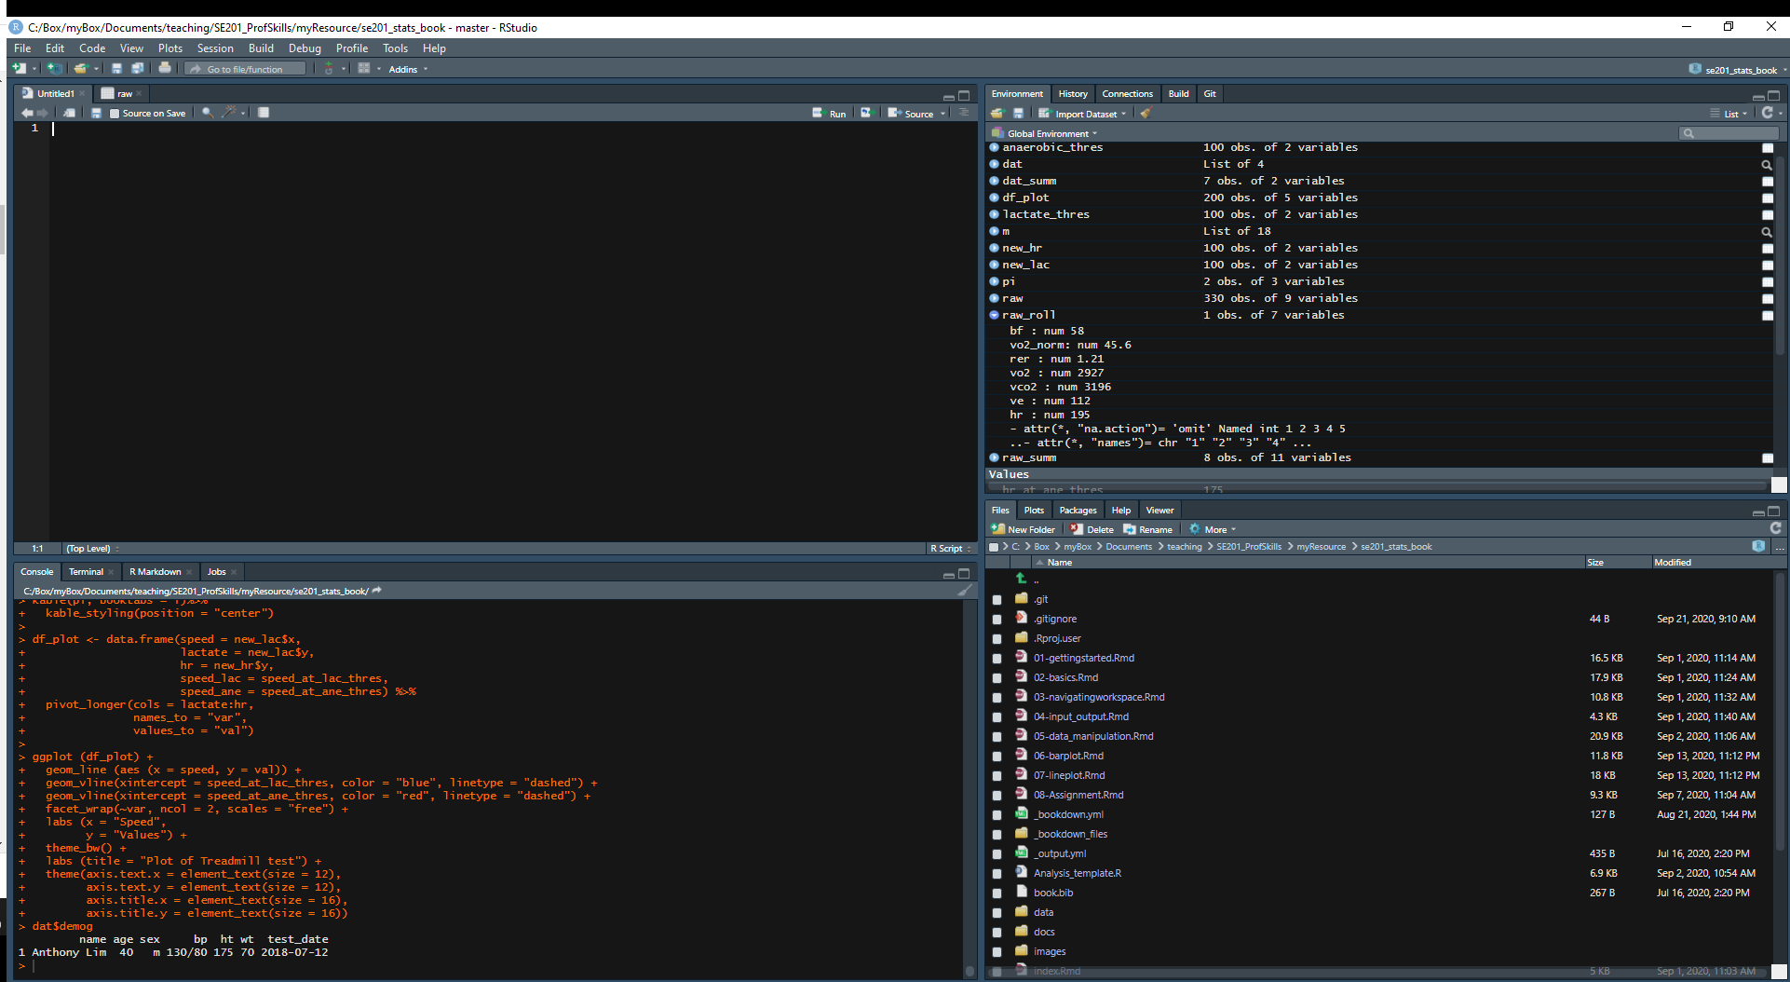
3. Environment/ History
1. Source
Click “Run” to send code to console
This is where you write your code!
Your code will not be evaluated until you “Run ” them to the console
Here you can see what objects are in your work space (Environment) or view your command history (History)
4. Files/Plots/Packages/Help
2. Console
Here you can see file directories, view plots, see your packages, and access R Help.
This is where your code from Source is evaluated.
You can also use the console to perform quick calculations that you don’t want to save.

Slide 2
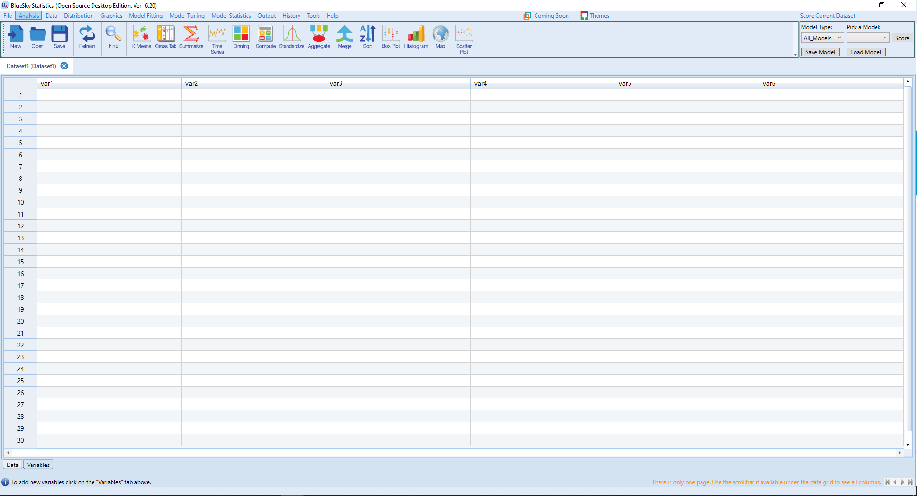
Looks like SPSS

Slide 3
Where you see data

Slide 4
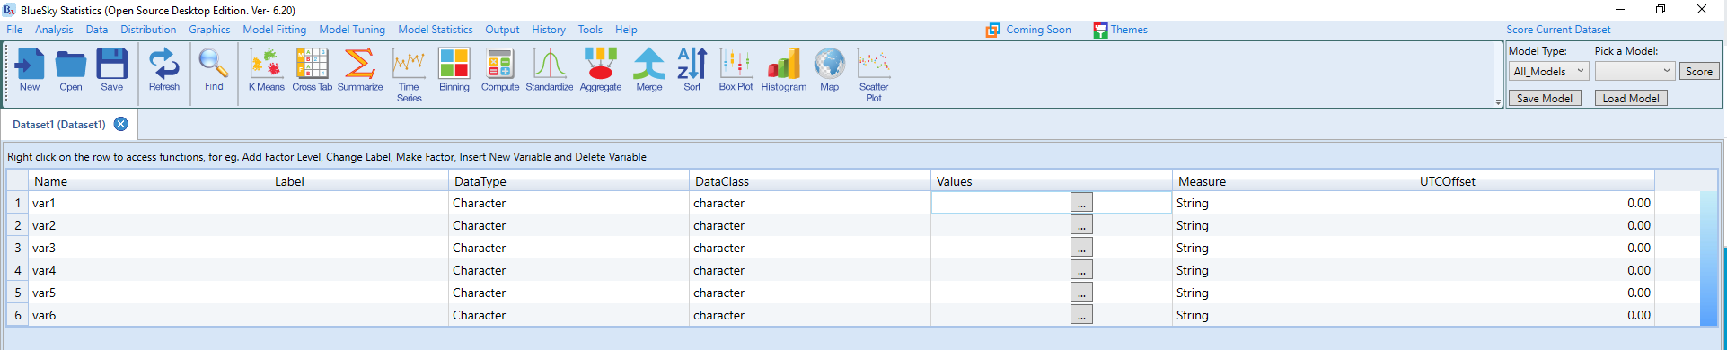
Where you define variables

Slide 5
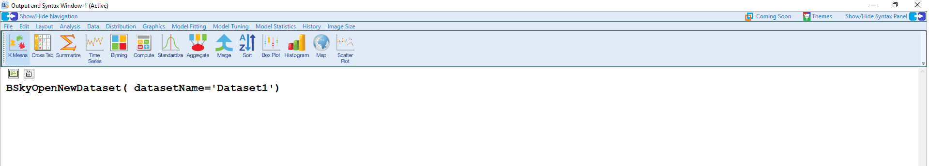
Click here to get script view
Where results are shown

Slide 6
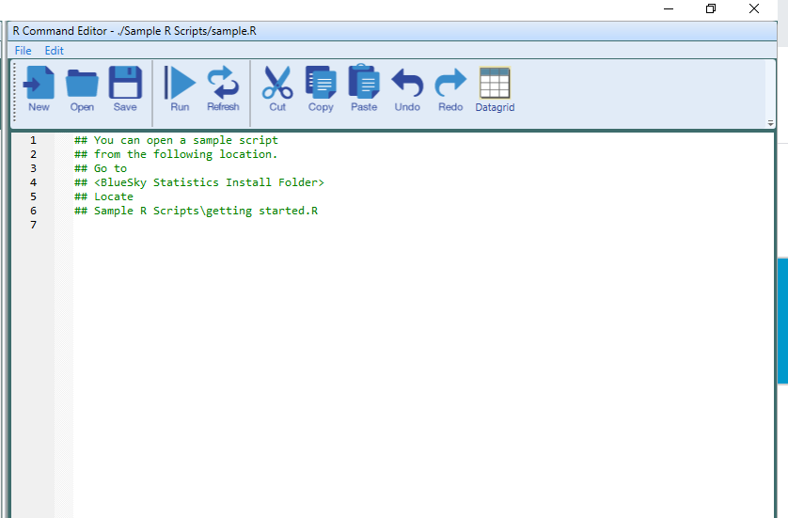
Where you type like a hacker

