Slide 1
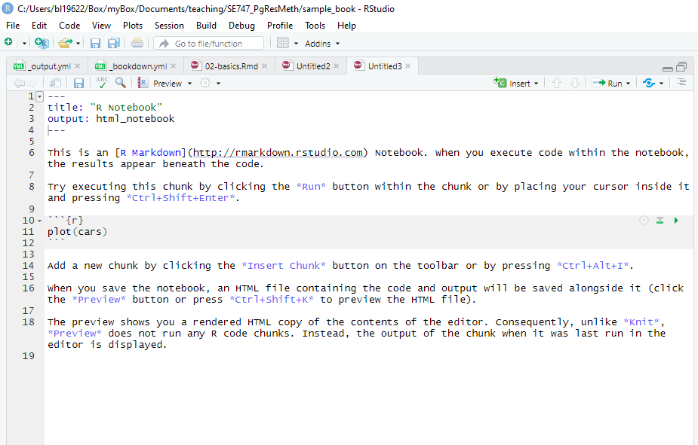
Leave this part. You can even give a title you like, e.g. “my se747 analysis”
You can delete this and add your own personal comments
Code chunk
Press play to run analysis,
Results will appear below

