Slide 1

Erlang in Production
“I wish I'd known that when I started”
Or
“This is nothing like the brochure :-(”

Slide 2
Who the Hell are you?
ShoreTel Sky
  http://shoretelsky.com
“Enterprise Grade” VoIP
Elevator Pitch

Slide 3
Our Systems
>9000 endpoints per server
>150 calls per minute per server (peak)
Real-time call control and reporting
People are used to their computer crashing, but not their phone - very low downtime tolerance

Slide 4
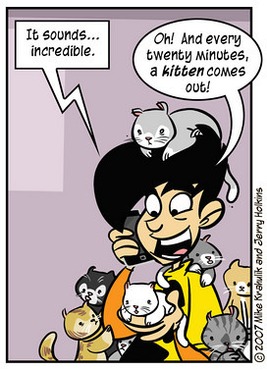
Erlang?
Simple, powerful syntax!
Highly concurrent!
Fault Tolerant!
Hot code loading!
We love it!
I want to help you love it

Slide 5
Syntax
-module(quicksort).
-export([qsort/1]).
qsort([]) -> [];
qsort([Pivot|Rest]) ->
qsort([ X || X <- Rest, X < Pivot])
++ [Pivot]
++ qsort([ Y || Y <- Rest, Y >= Pivot]).

Slide 6
Highly Concurrent
Tens of thousands of processes (threads) are no problem
Each only costs you 1236 bytes of memory
Primitives for send/receive:
NewPid = spawn(?MODULE, f, []),
NewPid ! {message, Message}
...
f() ->
receive
{message, M} -> io:fwrite(“~p”, [M])
end.

Slide 7
Fault Tolerant
Crashes are localised
Built in restart/recovery system
Compare with C/C++ :)

Slide 8
Hot Code Loading
Umm...I'll get to this later :)

Slide 9
Our Erlang Journey
“Discovered” it at LCA 2007
Hacked together a dynamic TFTP server
Hacked together a soft-phone for automated testing
Now used as the backbone of our call tracking and billing system
We're rewriting entire core system using Erlang
And a new build system!

Slide 10
Overview - I wish we'd known that...
Dialyzer should be mandatory
The VM can crash
Message queues “just work”...except when they don't
The OTP is invaluable
Integration as a UNIX-style service is lacking
Hot code loading is...interesting
System monitoring is vital

Slide 11
Dialyzer
Bringing (some) static type-safety to a dynamically typed language
One run over your code will show you why you need it

Slide 12
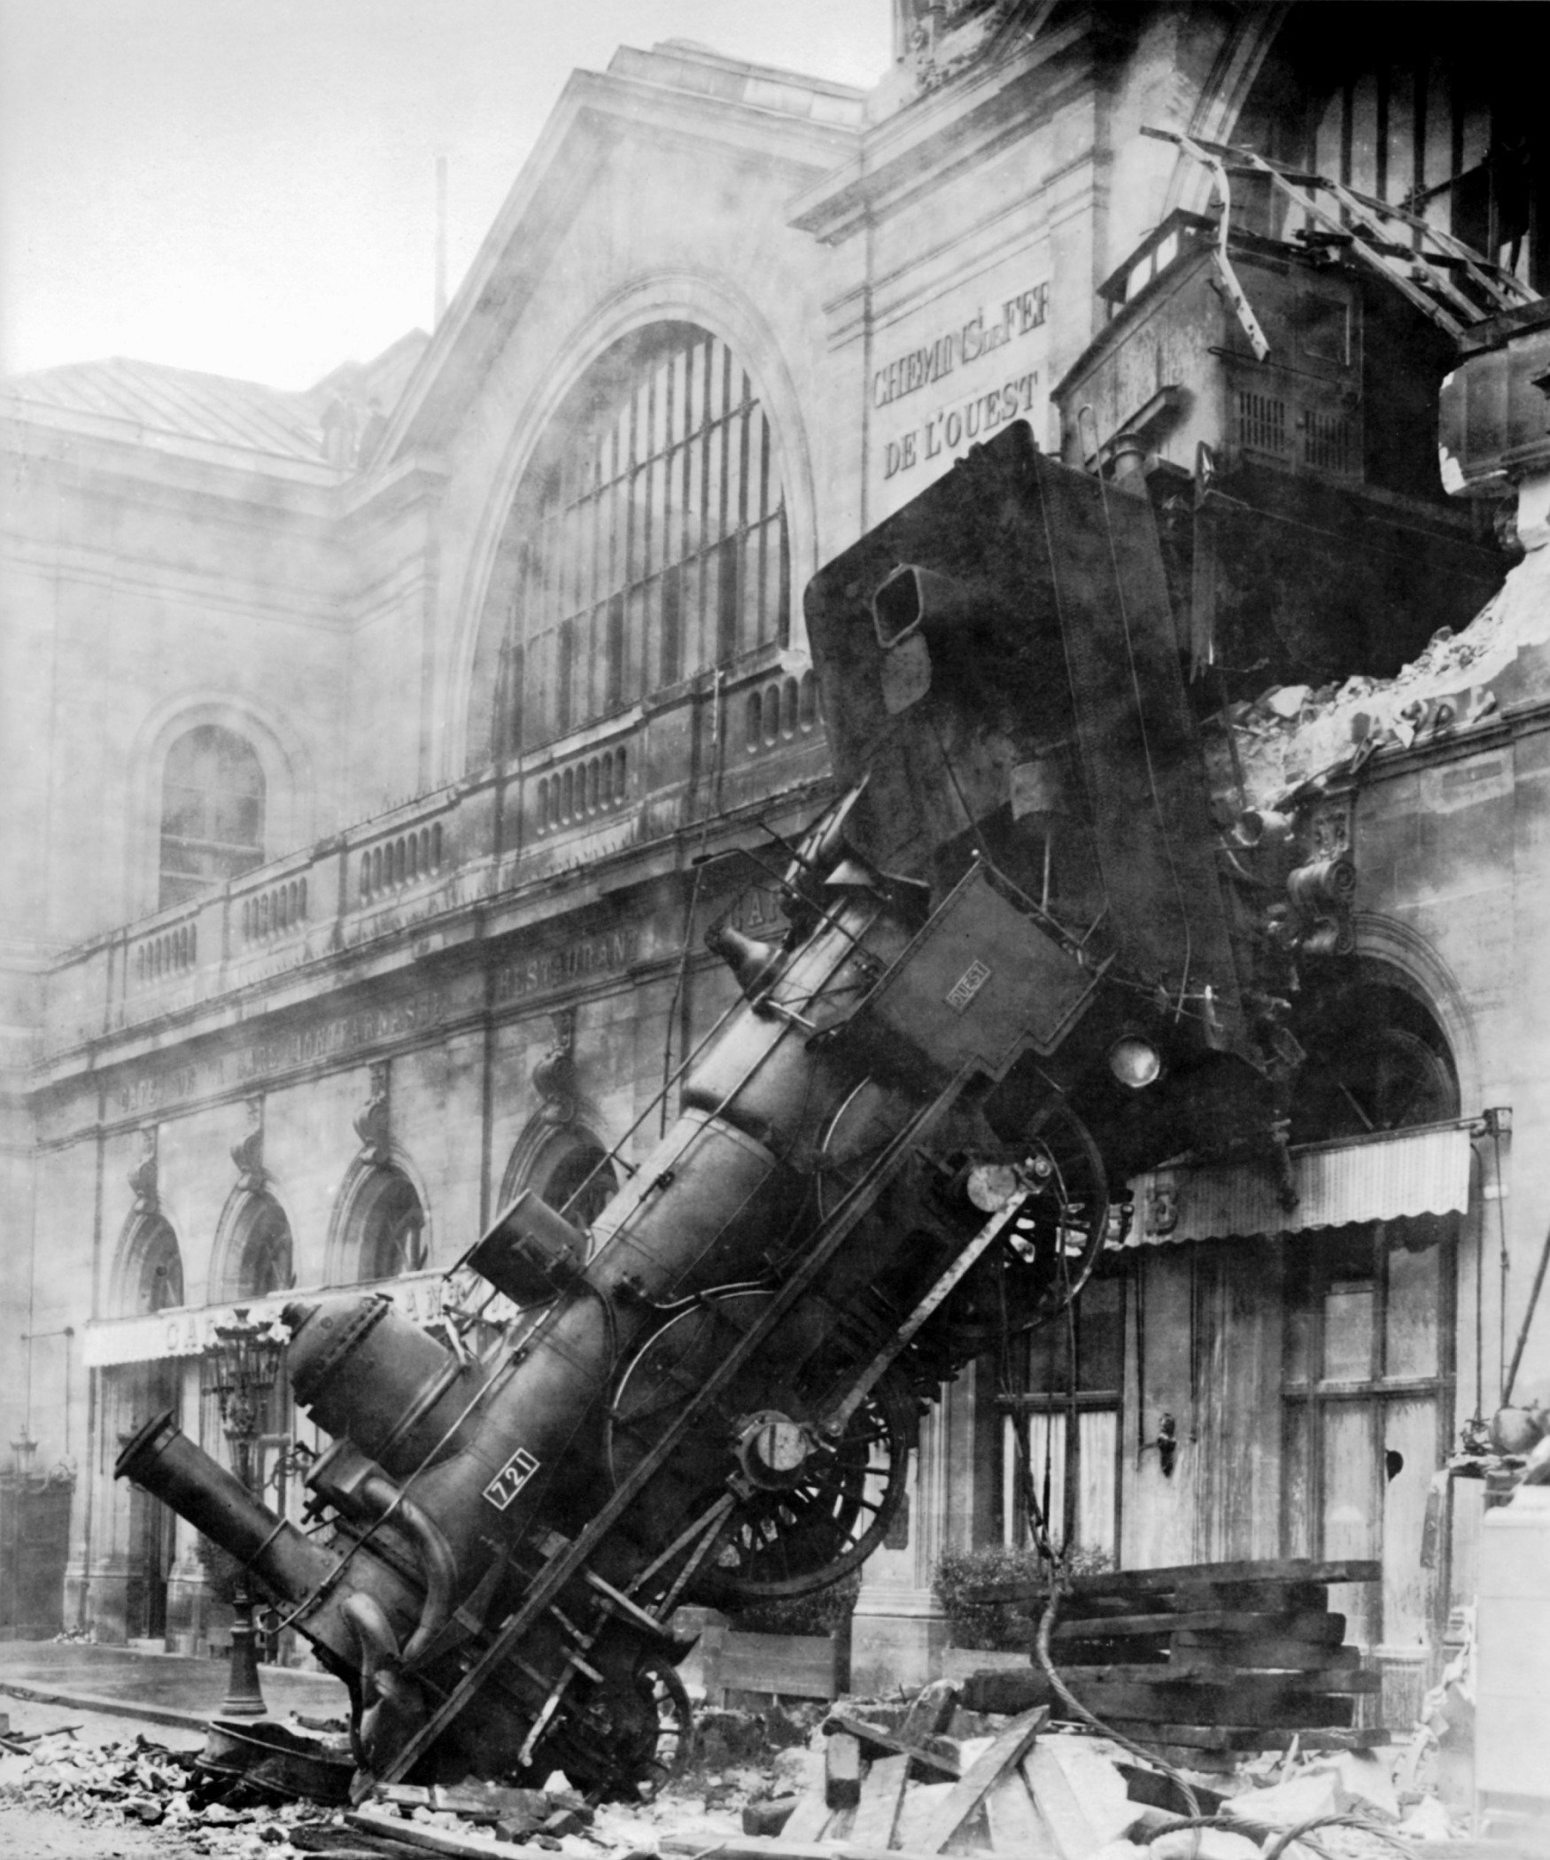
How to crash the VM
Out-Of-Memory
  Non tail-recursive loops
  Queue overflow
Linked-in Drivers or NIFs

Slide 13
Non Tail-Recursive Loops
Good:
main_loop() ->
do_something(),
wait_for_input(),
main_loop(). % Tail-call

Slide 14
Non Tail-Recursive Loops
Bad:
main_loop() ->
do_something(),
wait_for_input(),
main_loop(),
ok. % Oops

Slide 15
Non Tail-Recursive Loops
Also Bad:
loop() ->
A = do_something(),
case A of
done -> 1;
continue -> 1 + loop() % Also oops
end.

Slide 16
Non Tail-Recursive Loops
Bad(!):
foo(X) ->
try
case f(X) of
continue -> foo(A);
done -> ok
end
catch % try-catch must maintain the stack
_ -> doom()
end

Slide 17
Non Tail-Recursive Loops
Good:
foo(X) ->
try f(X) of
% Exceptions thrown here are not caught:
A -> foo(A); % So the stack is not kept
_ -> ok
catch
_ -> doom()
end.

Slide 18
Queue Overflow
Message queues are simple and powerful
...and can get you in very deep trouble
How do you do it?
  Outright overload
  Selective receive

Slide 19
Simple overload
% This is called by lots of threads...
log_msg(Msg) ->
logger ! {log, Msg}.
logger() ->
receive
{log, Msg} -> format_and_write(Msg);
_ -> ok
end,
logger().

Slide 20
Selective Receive
receiver() ->
% This is O(n):
receive
particular_message -> do_lots_of_work()
end,
% This is O(1):
receive
OtherStuff -> do_other_work(OtherStuff)
end,
receiver().

Slide 21
Selective Receive
May not be obvious in your code:
  mnesia:transaction/1
Can take hours or even days to cause problems (monitor your system!)
Somewhat mitigated as of R14 with new reference optimisation

Slide 22
New Reference Optimisation
R = make_ref(),
server ! {R, MyRequest},
receive
{R, Resp} -> process_response(Resp)
end

Slide 23
The Open Telephony Platform (OTP)
Architectural framework for writing robust long running applications
Forces you to consider process interaction, failure modes, crash behaviour etc
Possibly overkill for “small” projects
Definitely mandatory for anything else
Learn it (come to my workshop tomorrow)!

Slide 24
The OTP - Solving problems you didn't know you had
Making a “call” to another process.
First Try:
server_proc ! {request, ReqData},
receive
{response, RespData} -> RespData
end.

Slide 25
The OTP
But how can you be sure it's the right response?
Ref = make_ref(),
server_proc ! {request, Ref, ReqData},
receive
{response, Ref, RespData} -> RespData
end,

Slide 26
The OTP
But what if the server process doesn't exist?
case whereis(server_proc) of
undefined -> {error, noproc};
Pid ->
Ref = make_ref(),
Pid ! {request, Ref, ReqData},
receive
{response, Ref, RespData} -> {ok, RespData}
end
end

Slide 27
The OTP
But what if the server process dies after the call?
case whereis(server_proc) of
undefined -> {error, noproc};
Pid ->
Ref = make_ref(),
Pid ! {request, Ref, ReqData},
receive
{response, Ref, RespData} -> {ok, RespData}
after 5000 -> {error, timeout}
end
end

Slide 28
The OTP
It'd be nice not to have to wait 5 seconds if the process crashed...
MRef = erlang:monitor(process, server_proc),
Ref = make_ref(),
server_proc ! {request, Ref, ReqData},
receive
{response, Ref, RespData} ->
erlang:demonitor(MRef),
{ok, RespData};
{'DOWN', MRef, _, _} -> {error, no_proc};
after 5000 ->
erlang:demoniotr(MRef),
{error, timeout}
end

Slide 29
The OTP
But What if the remote node doesn't support erlang:monitor? (C/Java nodes don't).
Enough! 12+ Lines of code for a simple “call” is already far too much.
gen_server:call(server_proc, {request, ReqData})

Slide 30
More OTP Stuff
Supervision Trees
Event Handlers (subscribe-notify)
FSMs

Slide 31
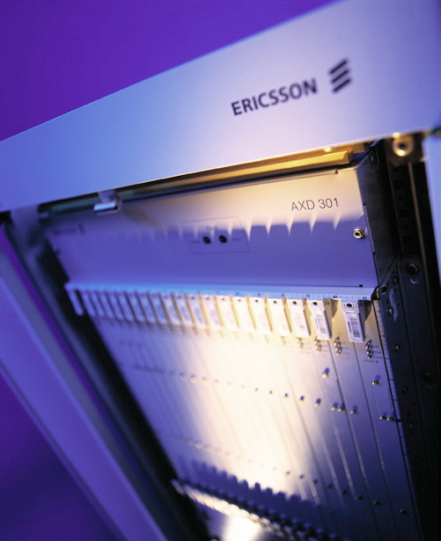
Erlang as a UNIX Service
Erlang has an embedded heritage
Turn on the device and walk away
But this can cause trouble in the UNIX world...

Slide 32
Erlang as a UNIX Service
Usual startup:
  erl -noshell -detached -boot myapp.boot
  Always returns 0 - success!
But...what if some part of startup fails?
Also, -detached means no console output
No feedback => Unhappy sysadmins

Slide 33
.pid Files
No .pid file - cannot easily find VM process on busy machines. Especially if it moves!
Naive solution: Just write it from your Erlang code...
But what if your code never runs?
That's when you might need the .pid file most of all!

Slide 34
heart to Manage VM Crashes
heart is a built in VM monitoring program
A nice idea, but can make shutdown of broken VMs difficult
  kill -stop is helpful
Great for embedded systems
Not so much for UNIX services

Slide 35
Log Rotation
Log rotation is...unusual?
No way to handle SIGHUP
All these quirks together make packaging (.deb, .rpm etc) challenging.

Slide 36
Our Solution: erld
Same basic principle as GNU screen
Wraps erl and holds its terminal
Programatically detaches from console
Logs console output
Intercepts SIGHUP for log rotation
Returns useful error codes
Manages crashes/restarts
Open source (GPL)!
https://github.com/ShoreTel-Inc/erld

Slide 37
Hot Code Loading
Great idea!
Ericsson use it to get insane (reported) uptimes on their AXD 301 switch
But no other big projects use it on more than a single module basis. Why not?

Slide 38
Hot Code Loading
It's really, really hard!
There's no good tools to help
The documentation is patchy (but improving)
There's no easy way to integrate with package management systems
It's hard to test

Slide 39
System monitoring
Erlang's VM has lots of great ways to monitor different parts of your system...
But that's only useful if you use them
And if you know what you're looking for

Slide 40
Key Monitoring points
Number of processes
  length(erlang:processes())
Queue length (esp. for busy processes)
  erlang:process_info(Pid, message_queue_len)
Total Memory Use
  erlang:memory/0,1

Slide 41
Take-Home Messages
Understand tail-calls
Keep your message queues short
Be careful of selective receives
You will need to work to get your Erlang project to behave as a UNIX service
Hot code loading is far harder than you think
Monitor your system
Use the OTP
Use Dialyzer

Slide 42
Questions?
bduggan@shoretel.com

Slide 43
Thanks!
The End.

