Slide 1
UML Components
Calebe de Paula Bianchini
calebe.bianchini@mackenzie.br

Slide 2
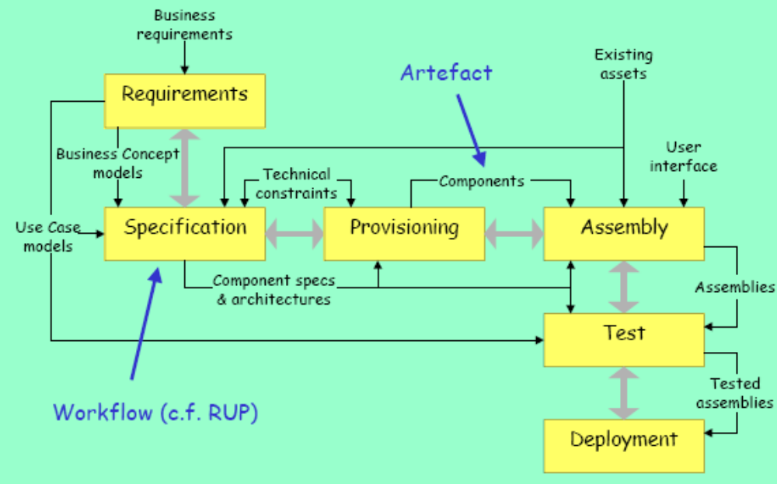
UML Components Process

Slide 3
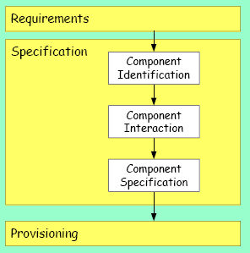
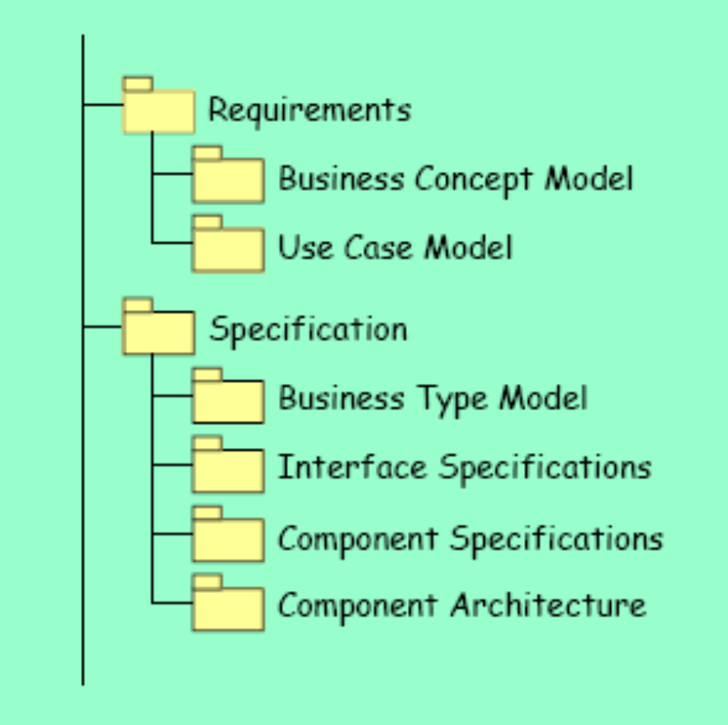
Basic Process & Artefacts

Slide 4
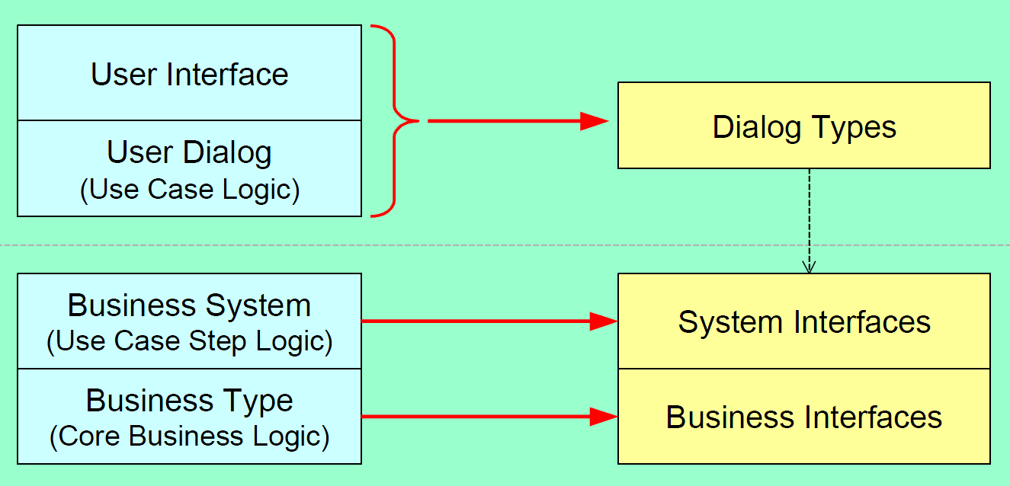
Layers/Architecture

Slide 5
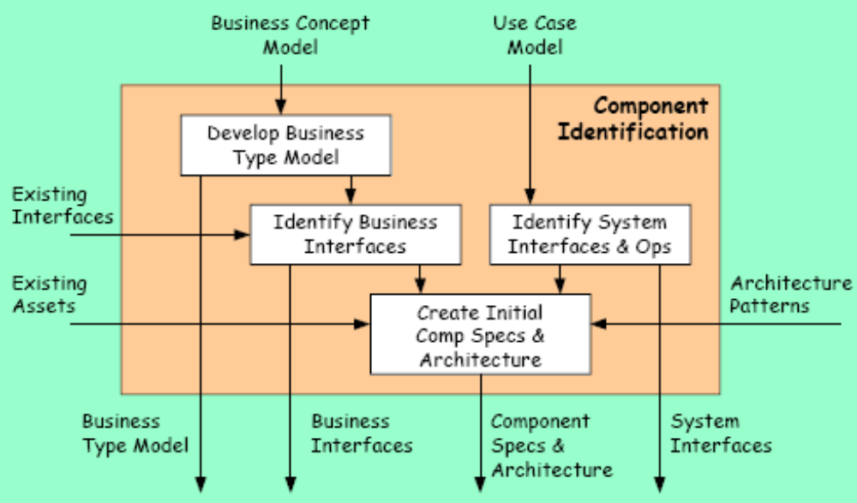
Component Identification

Slide 6
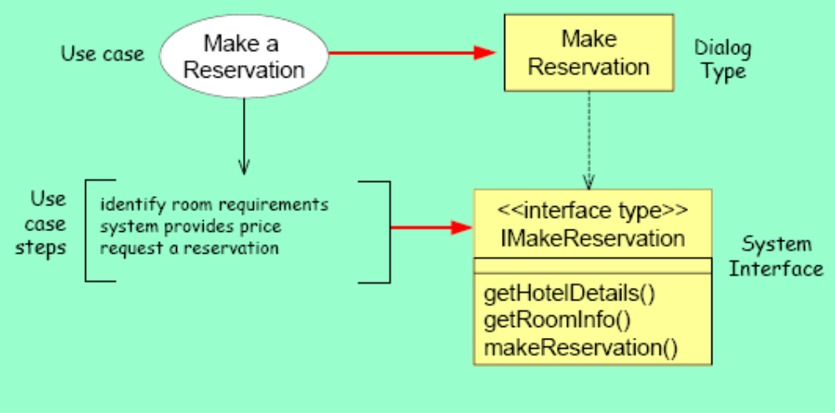
System Interfaces & Operation
One system interface per use case

Slide 7
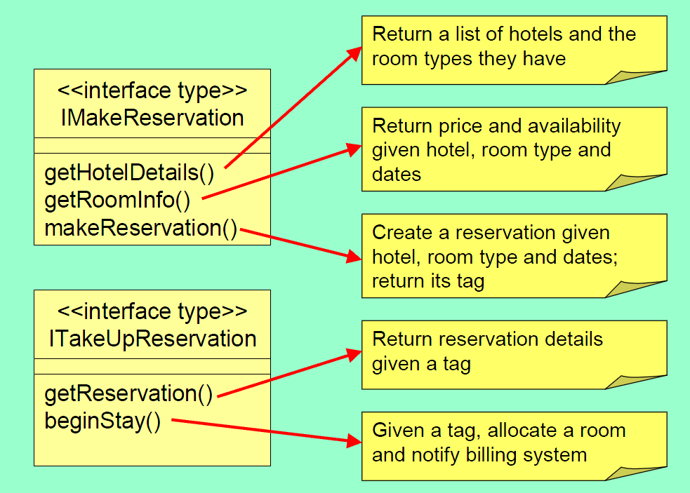
Some Interfaces

Slide 8
Business Interface
Copy the business concept model as the business type model
Refine and add any constraint
Indentify Core Business Types
Create business interfaces
Refine to indicate reponsabilities

Slide 9
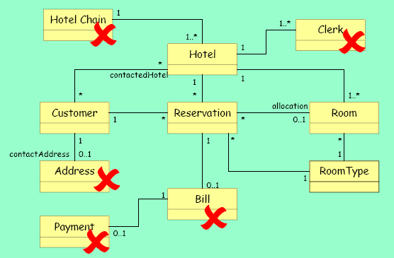
Business Type Model

Slide 10
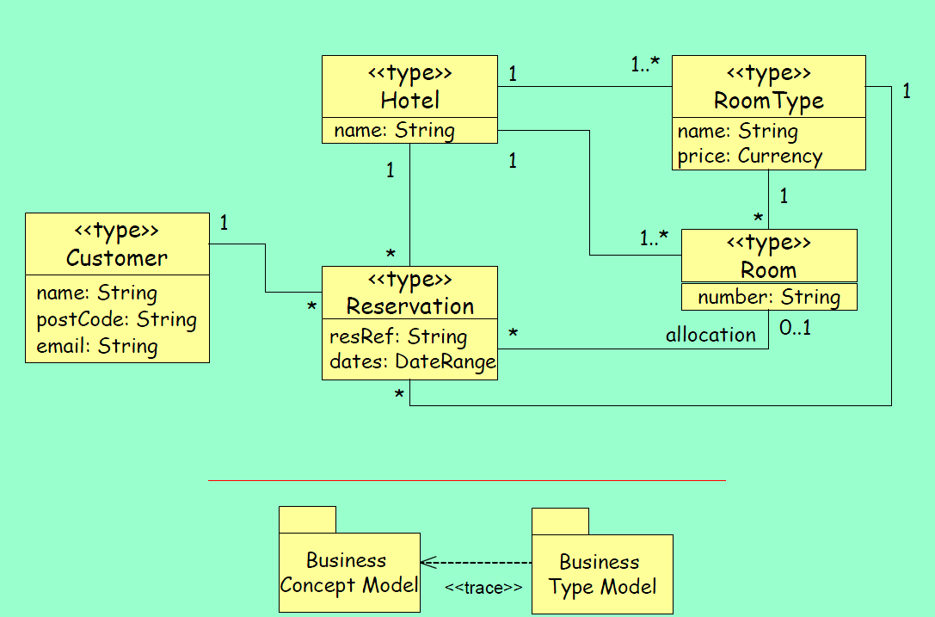
Business Type Model

Slide 11
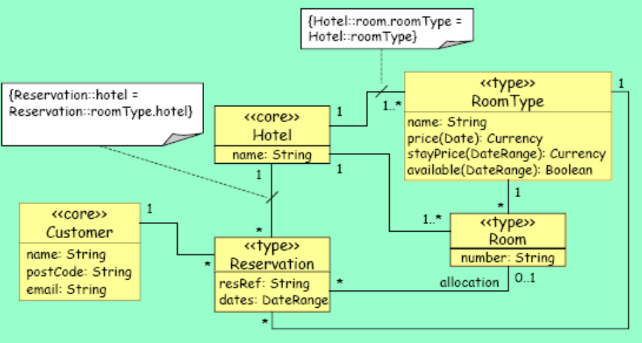
Core and Types

Slide 12
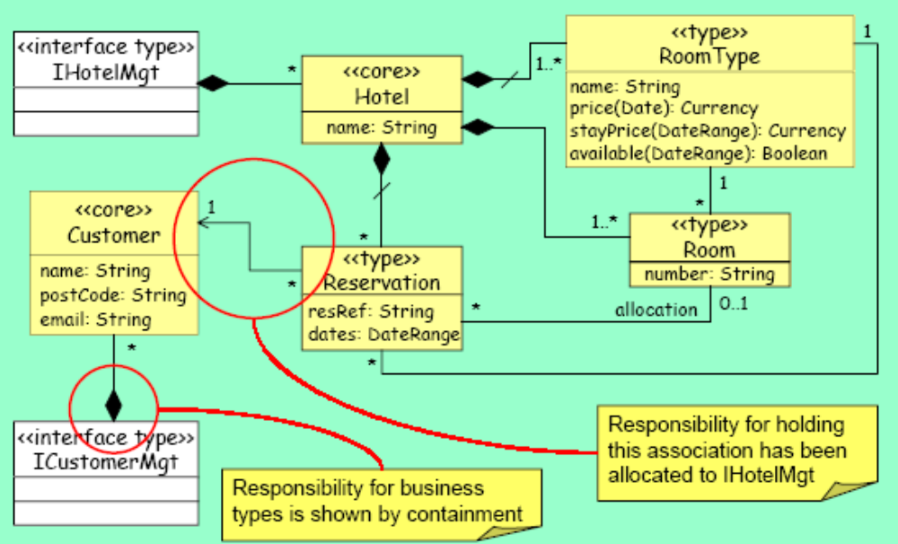
Interfaces for Core Types

Slide 13
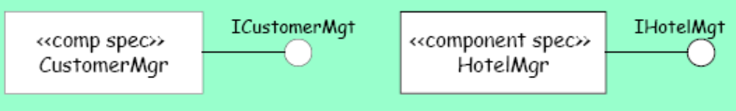
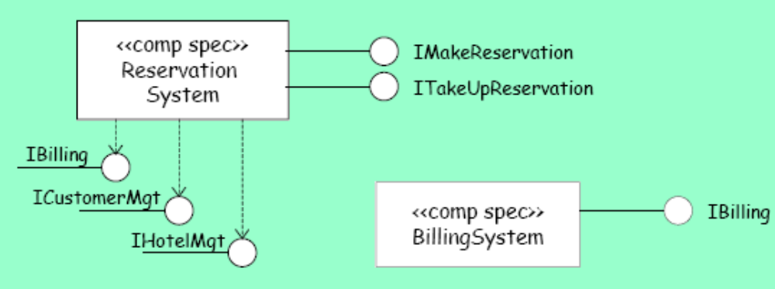
Architecture

Slide 14
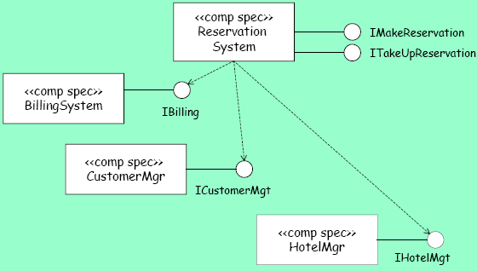
Initial Architecture

