Slide 1
UML Components
Calebe de Paula Bianchini
calebe.bianchini@mackenzie.br

Slide 2
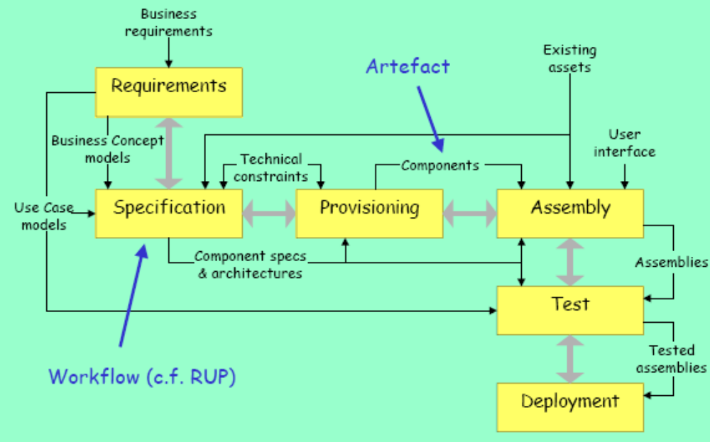
UML Components Process

Slide 3
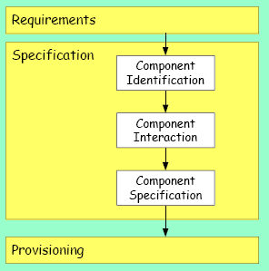
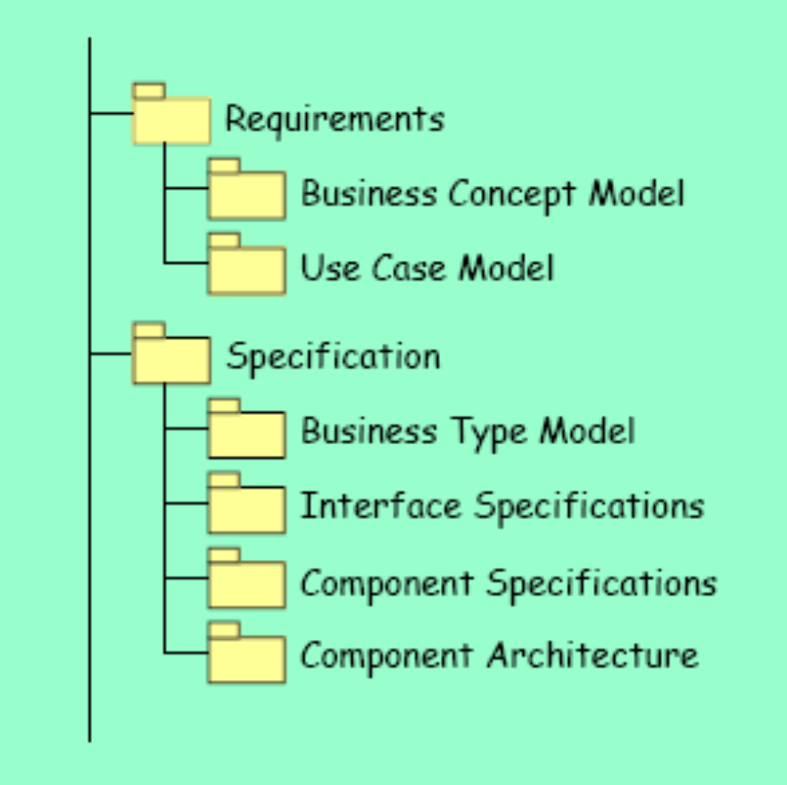
Basic Process & Artefacts

Slide 4
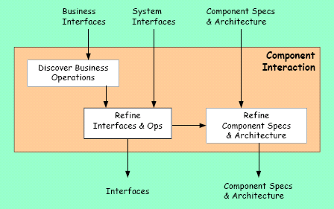
Component Interaction

Slide 5
Business Operations
Collaboration Diagrams
Operations on Business Interfaces
  Not all operations
  Only the most important
Use case steps
  Interaction of components
  One collaboration diagrams per operation (at least)
  Define signatures

Slide 6
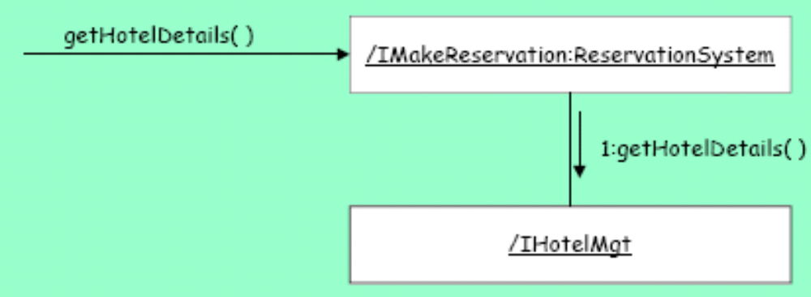
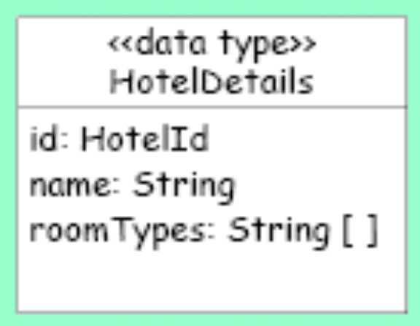
IMakeReservation:getHotelDetails

Slide 7
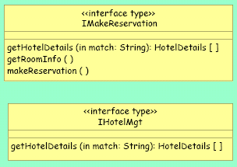
IMakeReservation:getHotelDetails

Slide 8
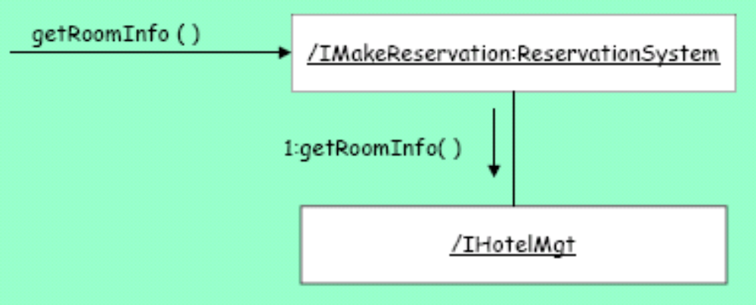
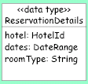
IMakeReservation:getRoomInfo

Slide 9
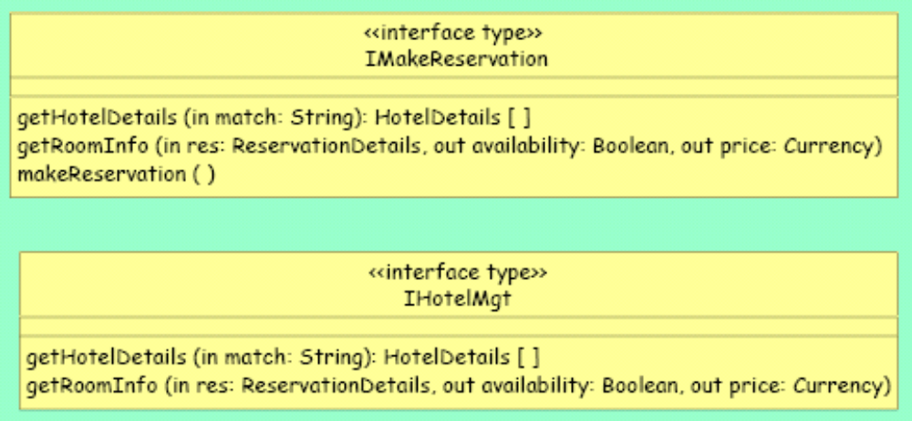
IMakeReservation:getRoomInfo

Slide 10
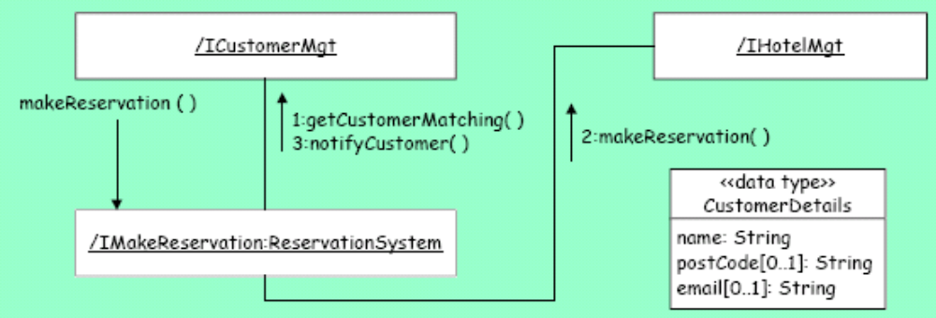
IMakeReservation:makeReservation

Slide 11
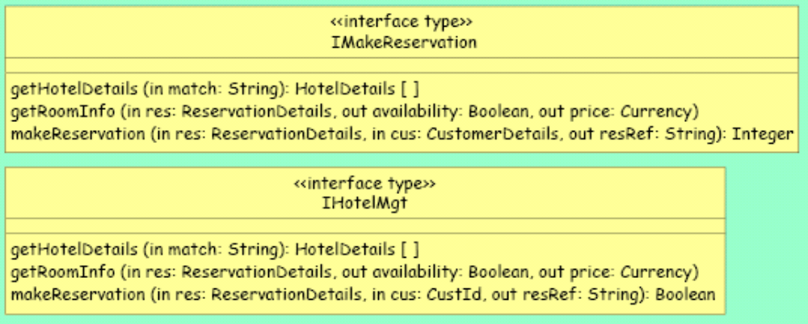
IMakeReservation:makeReservation

Slide 12
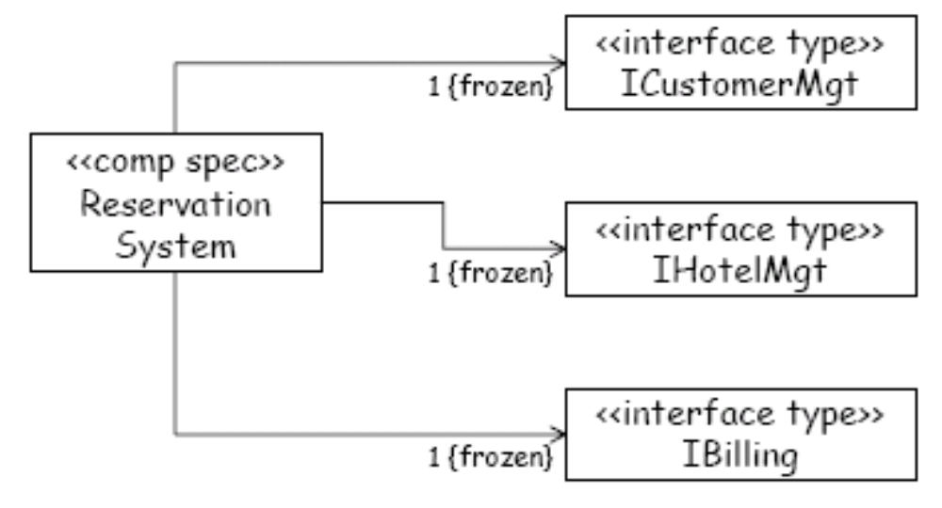
Integrity

Slide 13
Integrity
/ ICustomerMgt
1.1:getCustomerMatching(cd,cid)
1.3:deleteCustomer(cid)
/ IHouseKeeping:ReservationSystem
1:deleteCustomer(cd)
1.2:deleteReservationFor(cid)
/ IHotelMgt

Slide 14
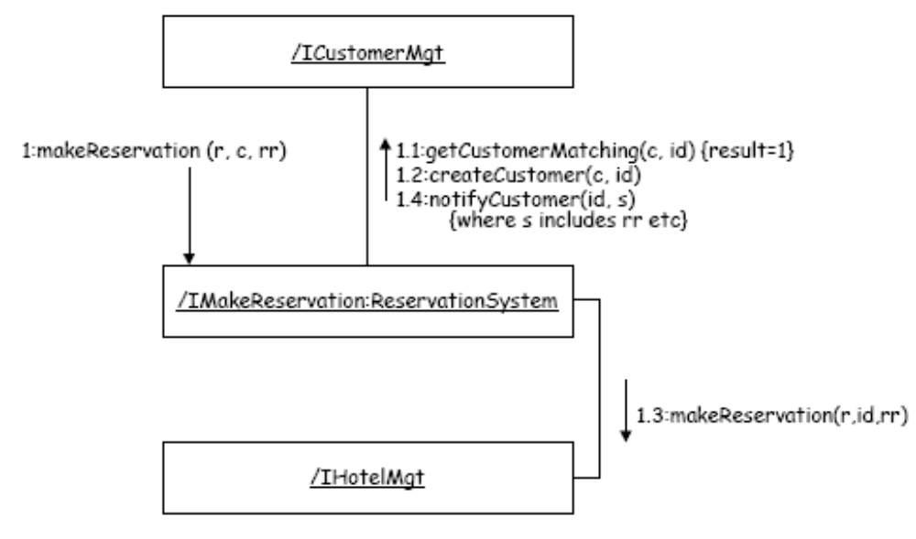
Refining...

Slide 15
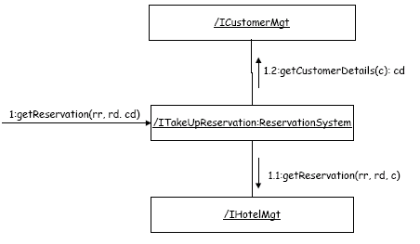
Refining...

Slide 16
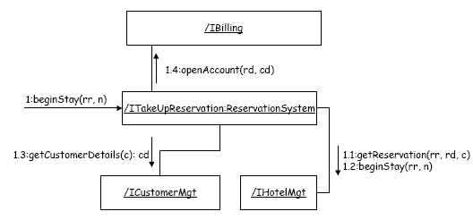
Refining...

Slide 17
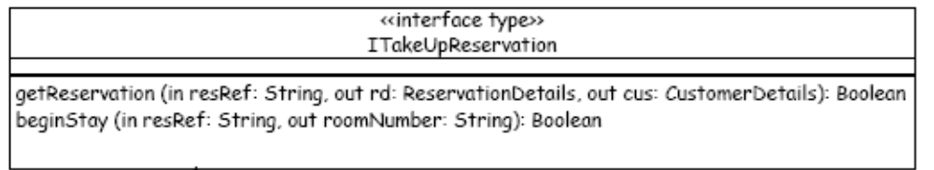
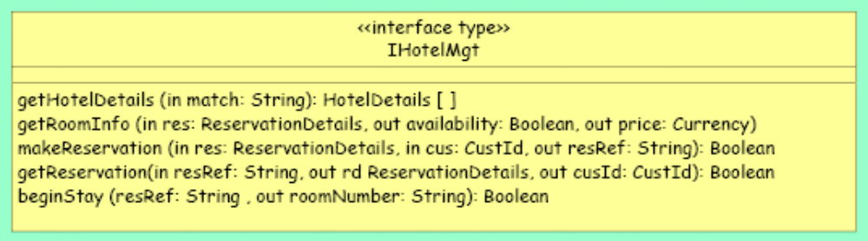
Refining...

Slide 18
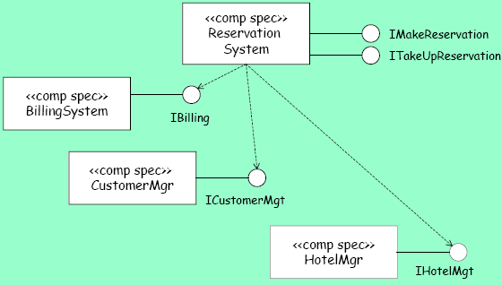
Architecture

