Slide 1
UML Components
Calebe de Paula Bianchini
calebe.bianchini@mackenzie.br

Slide 2
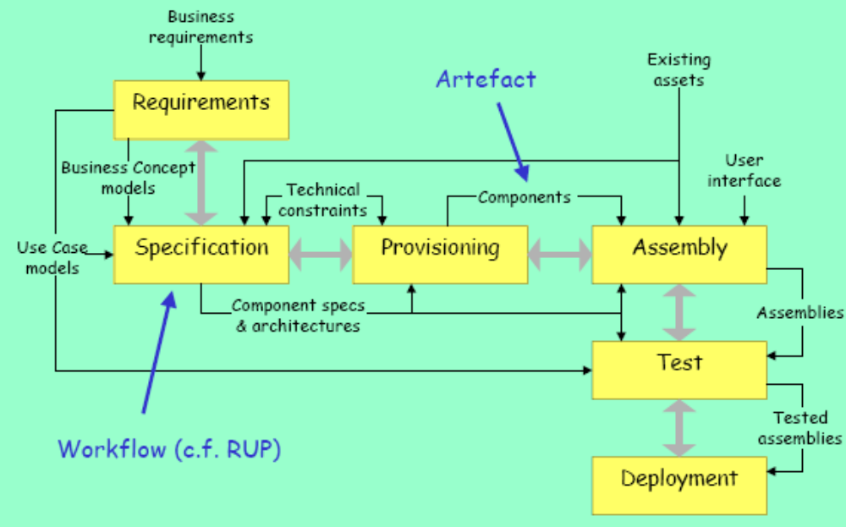
UML Components Process

Slide 3
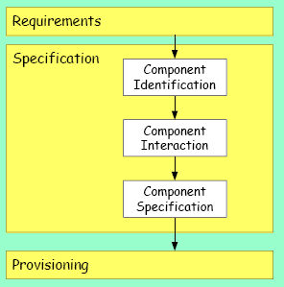
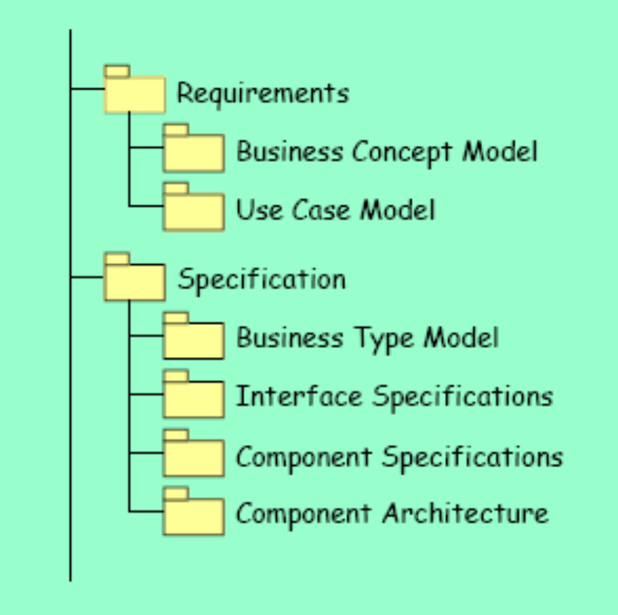
Basic Process & Artefacts

Slide 4
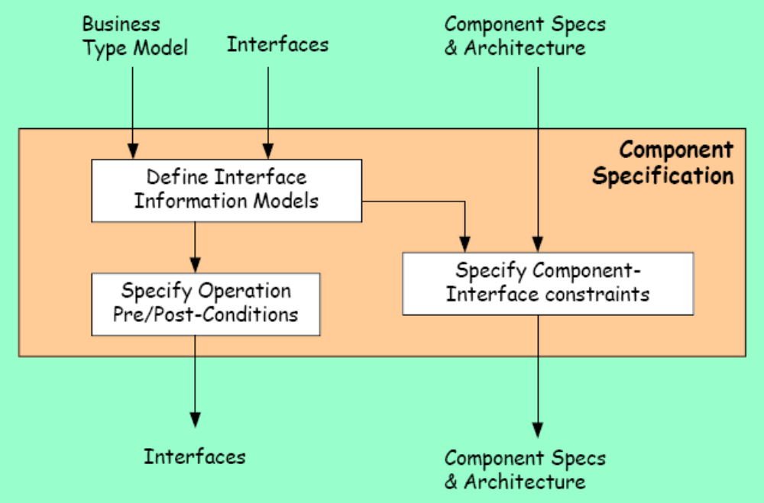
Component Specification

Slide 5
Interface Information Models
From Business Type Model
  To Interface Information Models
  When a type owned by one interface refers to a type owned by another, the referenced type appears in the interface informations models of both interfaces.
  But it won’t look the same!!!
Interface factoring
  Grouping operations
  Splitting interfaces

Slide 6
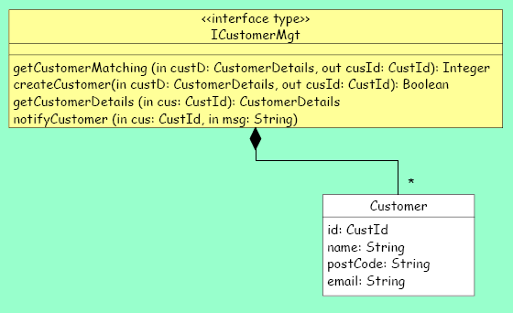
Interface Information Models

Slide 7
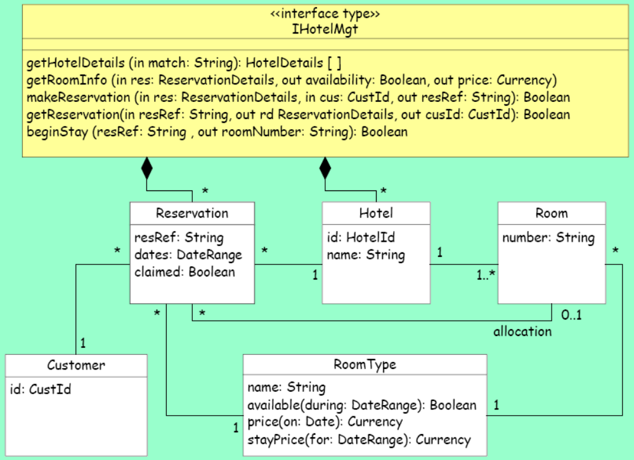
Interface Information Models

Slide 8
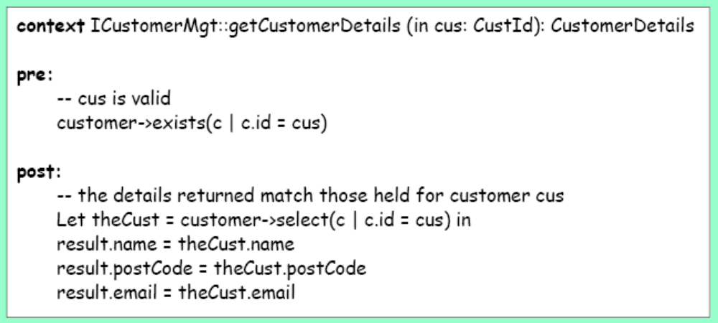
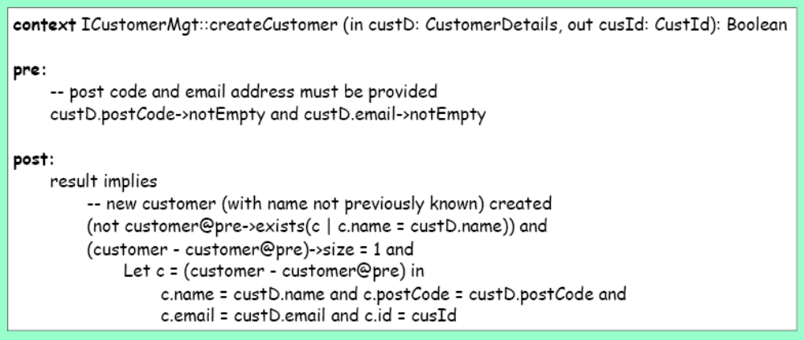
Pre- and Pos- conditions (OCL)

Slide 9
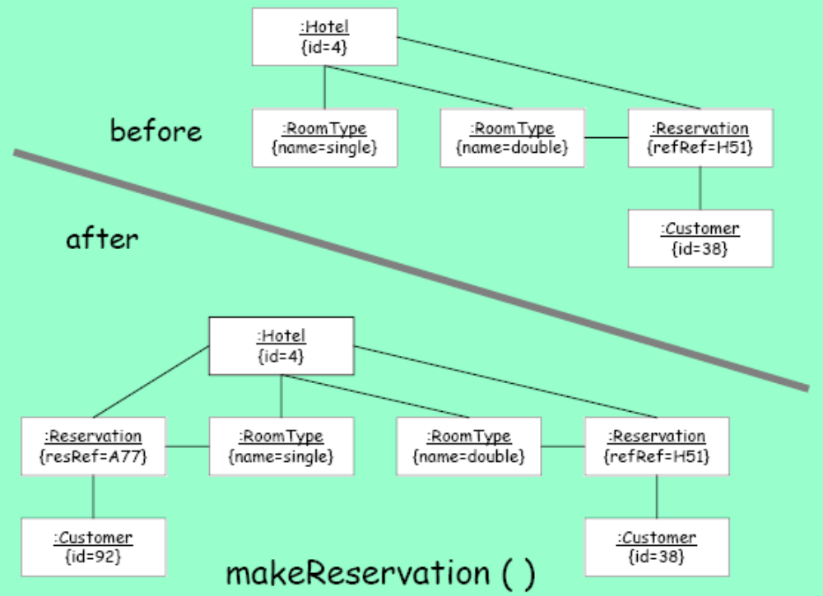
Snapshots (for pre- and pos-)

Slide 10
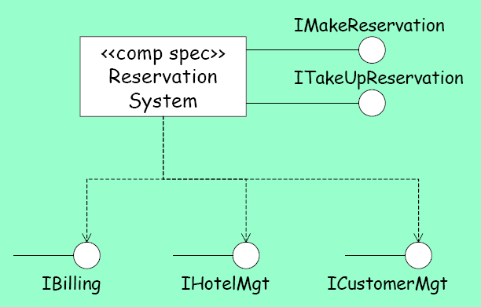
Interface Information Models

Slide 11
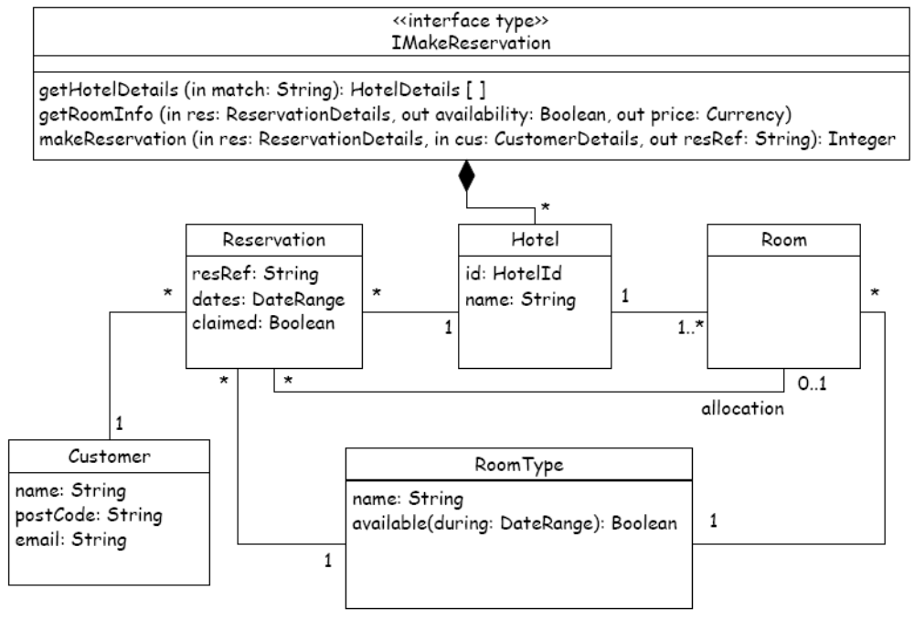
Interface Information Models

Slide 12
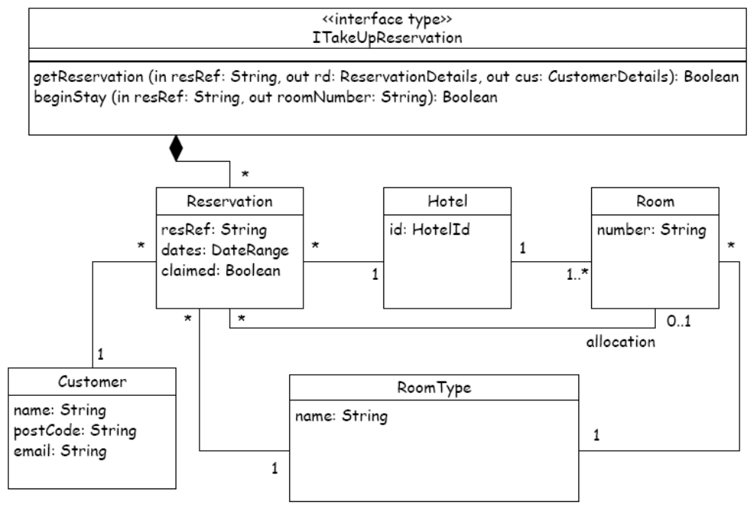
Interface Information Models

