Slide 1
SLIDE 1
Problem & why it matters
Team name: ‹Team name›
Problem statement (e.g. A2 — Ageing in place): C1 — FlatFair: HDB resale market intelligence & affordability forecasting
The problem in one sentence:
Young Singaporeans are making the biggest purchase of their lives in a market where HDB resale prices rose 56% since 2017 while household incomes rose 33%, with no transparent way to judge whether an asking price, or the repayment behind it, is reasonable.
Who is affected, and how badly (use a number from open data):
24,662 households bought a resale flat in the last 12 months; 1,847 of those flats sold for $1 million or more. A median 4-room flat now costs 4.4 years of the median household’s income, up from 3.8 in 2017.
Why it matters now:
After a 50% climb since 2020, prices have flattened (+1.3% year on year), so rising values no longer cover an overpayment. Since August 2024 an HDB loan needs a 25% downpayment instead of 20%, and the October 2024 Standard, Plus and Prime framework has reset expectations again.
Prices have outrun incomes
Index, 2017 = 100
Annual medians. Sources: HDB resale flat prices (data.gov.sg); SingStat M810361 median monthly household employment income.
FlatFair · DAISI Challenge Singapore 2026 · Round 1 · Problem C1 · Live prototype: flatfair-nine.vercel.app

Slide 2
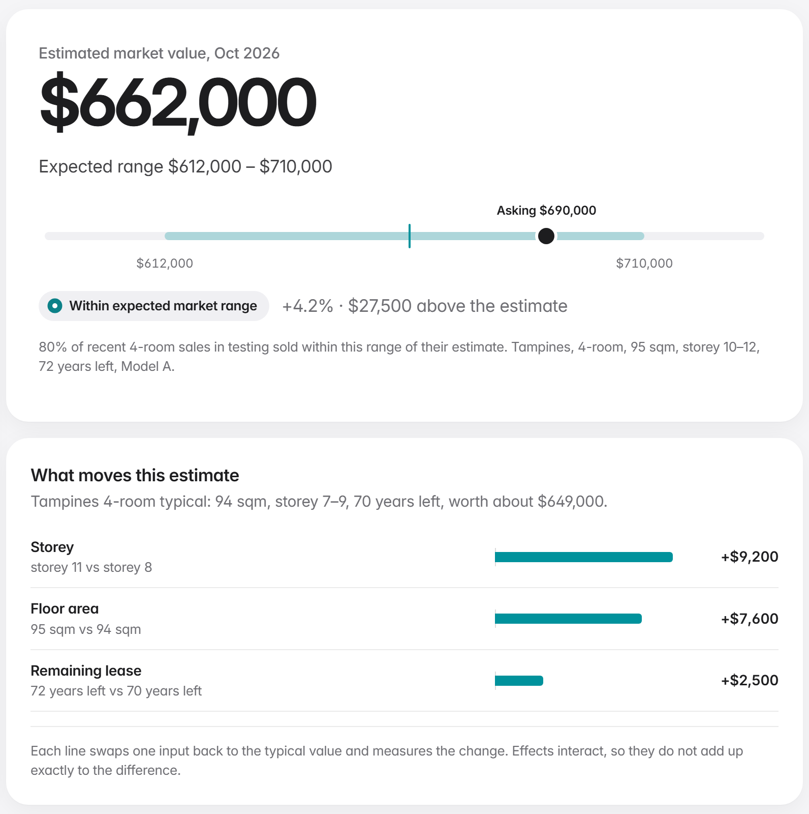
SLIDE 2
Solution & data
Your solution in one sentence:
FlatFair turns HDB’s resale records into a five-step decision tool that takes a buyer from “what is the market doing?” to “is this flat, at this price, sensible for us?”
Who uses it, and what decision it changes:
First-time resale buyers, and the counsellors and planners who advise them. It changes where they look (towns ranked by what the household can repay), what they offer (asking price vs estimated value and the 5 closest sales) and when they buy (a tested six-month outlook).
Datasets you will use (name + source, e.g. data.gov.sg):
1. HDB Resale Flat Prices, Jan 2017 to present — data.gov.sg d_8b84c4ee…6abc, 241,822 sales
2. Household Employment Income, key indicators (M810361) — SingStat Table Builder
3. HDB Annual Report 2025 · Population by Planning Area — HDB, SingStat (supply and demand context)
What makes your approach different from a generic dashboard:
It values a specific flat, not just the market: an 80% price range tested on 13,589 sales it never saw (median error 3.9% vs 9.5% for the $/sqm rule of thumb), plus repayment against the 30% MSR cap. Every model must beat a simple baseline: when a 3-month average out-forecast our ML model, we published the average.
Working prototype: a Tampines 4-room asking $690,000 sits within the expected $612k–$710k range. flatfair-nine.vercel.app
FlatFair · DAISI Challenge Singapore 2026 · Round 1 · Problem C1 · Live prototype: flatfair-nine.vercel.app

Slide 3
SLIDE 3
Databricks architecture & impact
Pipeline: source → ingestion → transform → model / analytics → output
1 Source
data.gov.sg API
SingStat Table Builder API
2 Ingestion
Lakeflow Job runs notebooks
retries · schema check → Bronze Delta
3 Transform
Silver & Gold Delta in Unity Catalog
9 quality checks · flags, not deletes
4 Model / analytics
MLflow: forecast backtest, fair value
model → UC registry · SQL / Genie
5 Output
Databricks App (FastAPI + JS)
public mirror on Vercel
(Name the Databricks components) Lakeflow Jobs · Delta Lake · Unity Catalog (lineage, tags, model registry) · MLflow · Databricks SQL / AI-BI · Genie · Databricks Apps
The user-facing output you will demo:
The FlatFair app: market explorer, six-month forecast with its range, affordability with “Where can I afford?”, fair value with comparable sales, and town comparison. Already working end to end.
Measurable impact if it worked:
On a typical $630k flat the pricing blind spot narrows from ~$60k to ~$25k (rule-of-thumb vs model median error). Every buyer sees repayment against the 30% MSR cap before committing, refreshed monthly from open data.
What you can realistically finish in the two-week sprint:
Pipeline, both models, the app and 66 tests are built. Sprint: run it as a Lakeflow Job in the final workspace, deploy on Databricks Apps, add a Genie space and dashboard, test with five first-time buyers.
FlatFair · DAISI Challenge Singapore 2026 · Round 1 · Problem C1 · Live prototype: flatfair-nine.vercel.app

