Slide 1
Detecting boroughs in the county of Gustavo A. Madero with a low density of parmacies
Exploration and prediction

Slide 2
Stackholders
Detecting boroughs with a low pharmacy density is valuable for future pharmacy owners
A good location ensures a constant stream of clients and adecuate supply routes

Slide 3
Data aquisition
Socioeconomic data from Mexico City government open data repositories
Venues data from Fourthsquare api

Slide 4
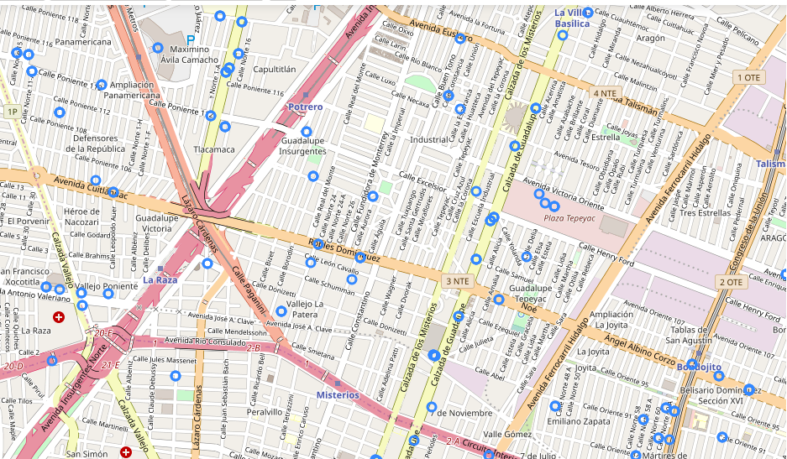
Prefered pharmacy locations
Prefered phamacy locations are along medium sized avenues or smal streets near a medium size avenue

Slide 5
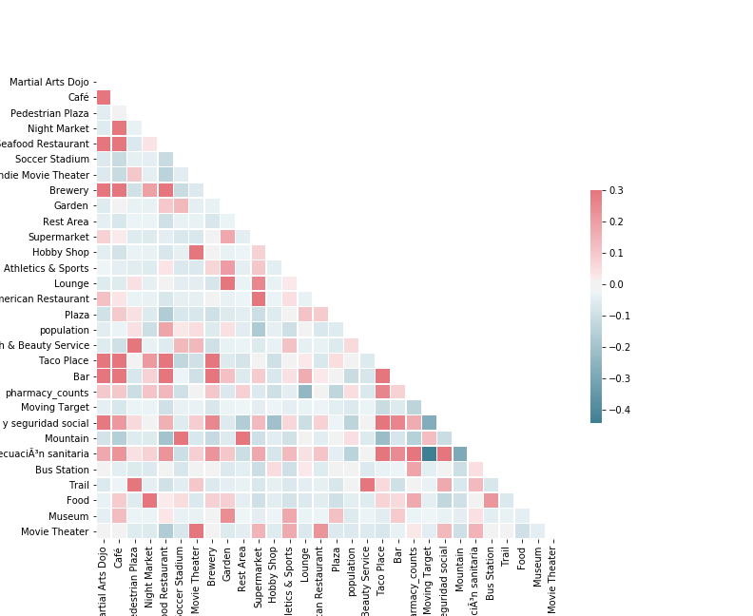
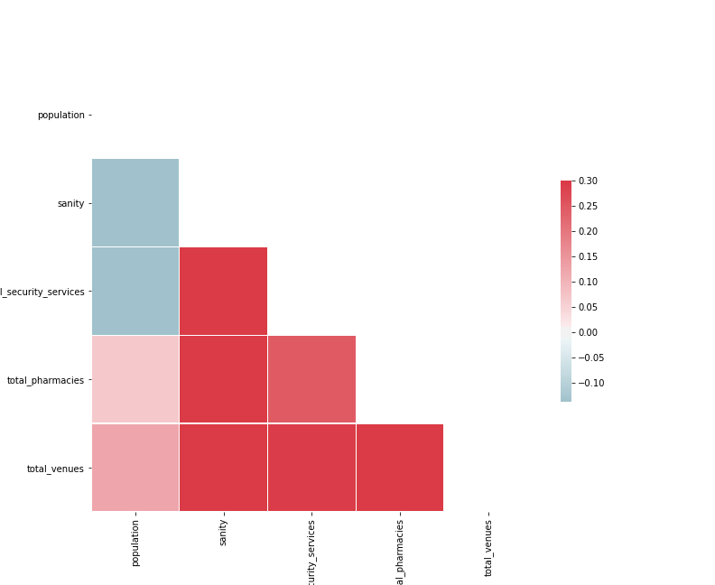
Selected variables for model

Slide 6
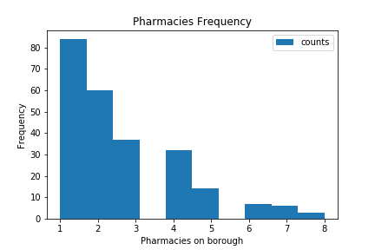
Target variable
Total boroughs were divided between those having one pharmacy and those having more than one pharmacy thus creating a target variable with two classes.
One pharmacy: 0
More than one pharmacies: 1

Slide 7
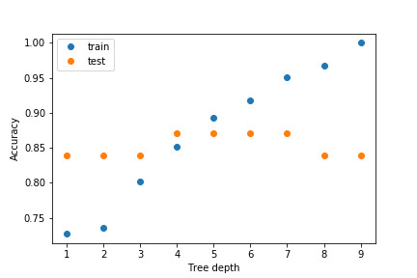
Random forest classifier training
Actual 0 | 26 | 12
Actual 1 | 0 | 114
 | Predicted 0 | Predicted 1

Slide 8
Low pharmacy density boroughs
There are some points which belong the class 0 but where classified on the class 1 which means this boroughs can host more than one pharmacies. Thus it is recommended to select a location within this boroughs and along a medium sized avenue or near one. The name of the boroughs are:
Ampliación progreso nacional
Benito Juárez
Guadalupe Insurgentes
La joyita
San José de la escalera
San Pedro el chico
Triunfo de la república
Valle de madero
Zona escolar oriente
Ex-ejido San Juán de Aragón sector 32
Pradera
Pueblo Santiago Atzacoalco

