Slide 1
Revisiting Classifier Two sample-test
Project for Statistics for Data Science Course
Bernardo D’Agostino, Yijiang Fan, Filippo Michelis

Slide 2
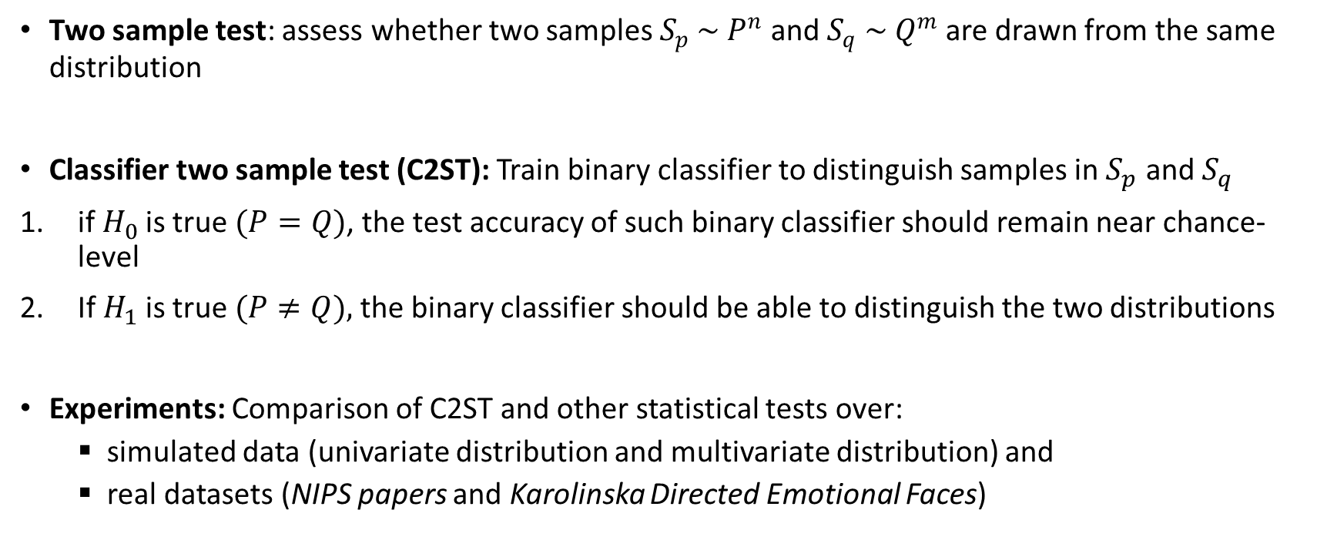
Introduction
Two sample test: assess whether two samples $S_{p} \sim P^{n}$ and $S_{q} \sim Q^{m}$are drawn from the same distribution
Classifier two sample test (C2ST): Train binary classifier to distinguish samples in $S_{p}$ and $S_{q}$
if $H_{0}$is true $(P=Q)$, the test accuracy of such binary classifier should remain near chance-level
If $H_{1}$is true$(P≠Q),$ the binary classifier should be able to distinguish the two distributions
Experiments: Comparison of C2ST and other statistical tests over:
simulated data (univariate distribution and multivariate distribution) and
real datasets (NIPS papers and Karolinska Directed Emotional Faces)

Slide 3
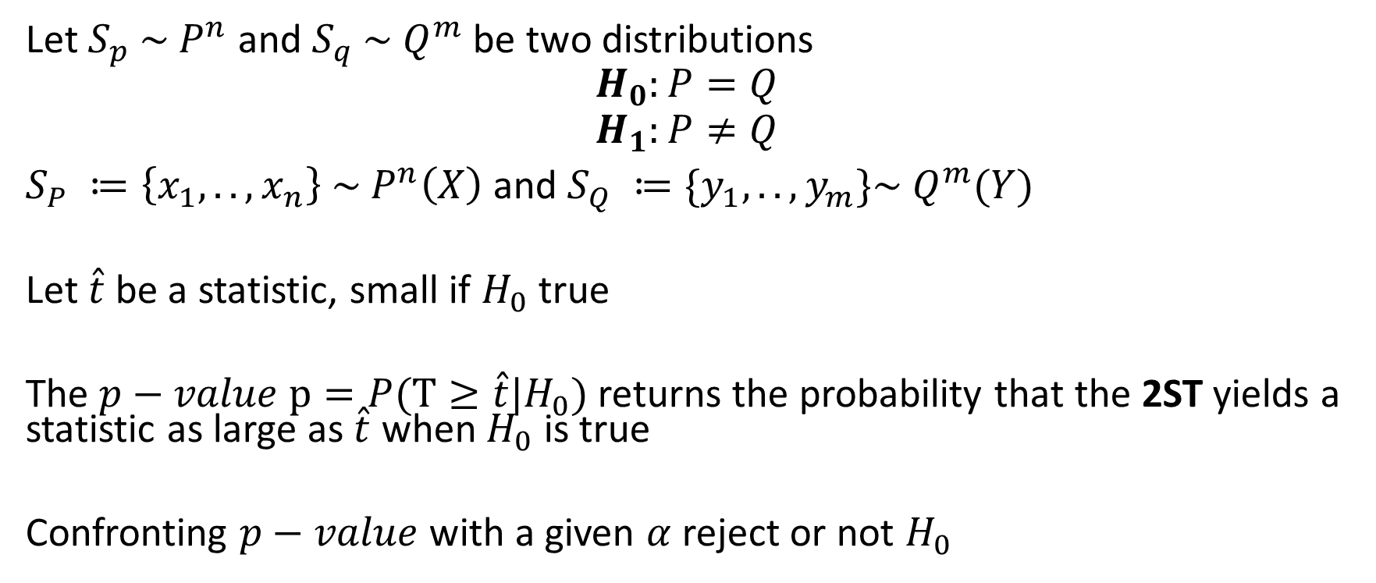
Two Sample Test: general framework
Let $S_{p} \sim P^{n}$ and $S_{q} \sim Q^{m}$ be two distributions
$$H_{0}:P=Q$$
$$H_{1}:P≠Q$$
$S_{P} ≔\left\{x_{1},..,x_{n}\right\} \sim P^{n}\left(X\right)$ and $S_{Q} ≔\{y_{1},..,y_{m}\}\sim Q^{m}(Y)$
Let $\hat{t}$ be a statistic, small if $H_{0}$ true
The $p−value$ $p=P(T≥\hat{t}|H_{0})$ returns the probability that the 2ST yields a statistic as large as $\hat{t}$ when $H_{0}$ is true
Confronting $p−value$ with a given $α$ reject or not $H_{0}$

Slide 4
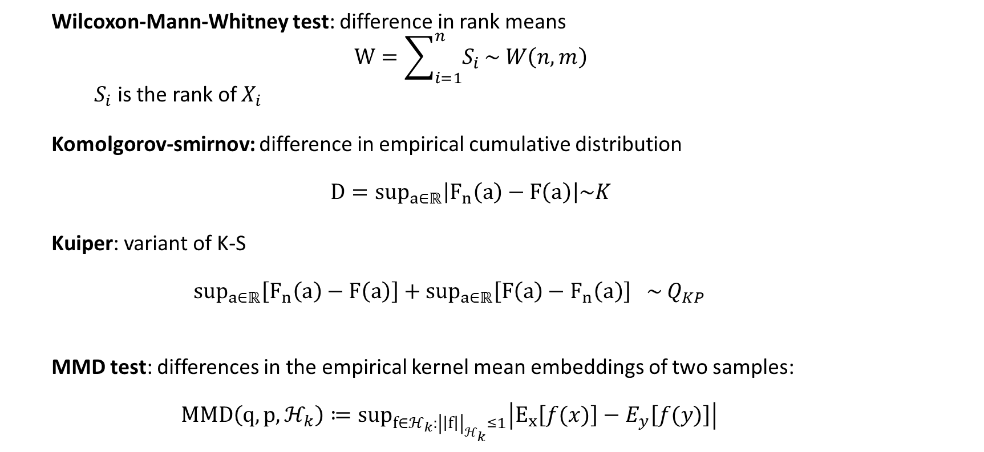
Two sample test: benchmarks
Wilcoxon-Mann-Whitney test: difference in rank means
$$W=\sum_{i=1}^{n}{S_{i}}\sim W\left(n,m\right)$$
$S_{i}$ is the rank of $X_{i}$
Komolgorov-smirnov: difference in empirical cumulative distribution
$$D=sup_{a∈ℝ}\left|F_{n}\left(a\right)−F\left(a\right)\right|\sim K$$
Kuiper: variant of K-S
$$sup_{a∈ℝ}\left[F_{n}\left(a\right)−F\left(a\right)\right]+sup_{a∈ℝ}\left[F\left(a\right)−F_{n}\left(a\right)\right] \sim { Q}_{KP}$$
MMD test: differences in the empirical kernel mean embeddings of two samples:
$$MMD\left(q,p,ℋ_{k}\right)≔sup_{f∈ℋ_{k}:{\left|\left|f\right|\right|}_{ℋ_{k}}≤1}\left|E_{x}\left[f(x)\right]−E_{y}\left[f(y)\right]\right|$$

Slide 5
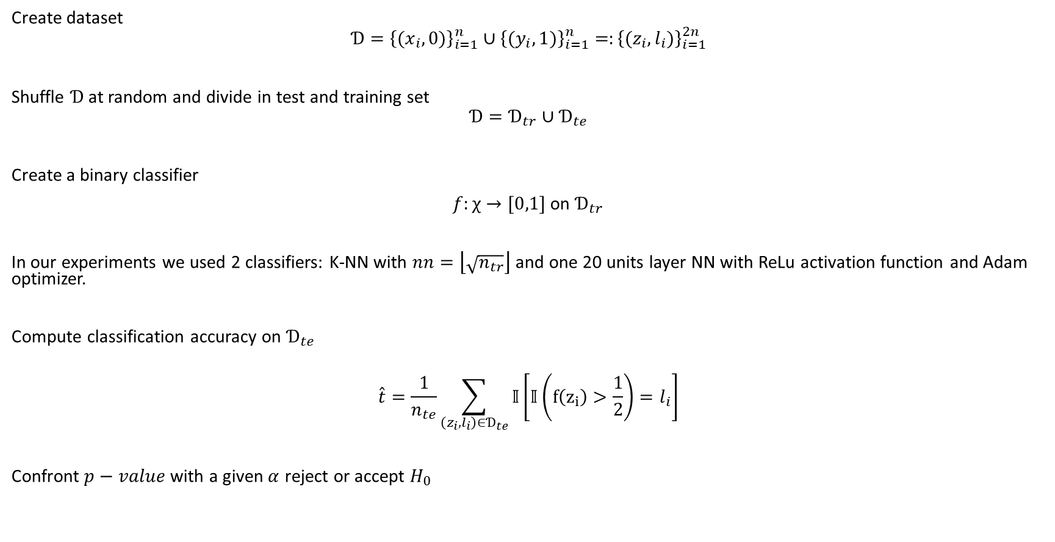
Classifier Two Sample Test (C2ST)
Create dataset
$$Ɗ={\left\{{(x}_{i},0)\right\}}_{i=1}^{n}∪{\left\{{(y}_{i},1)\right\}}_{i=1}^{n}=:{\left\{{(z}_{i},l_{i})\right\}}_{i=1}^{2n}$$
Shuffle $Ɗ$ at random and divide in test and training set
$$Ɗ=Ɗ_{tr}∪Ɗ_{te}$$
Create a binary classifier
$f:χ→[0,1]$ on $Ɗ_{tr}$
In our experiments we used 2 classifiers: K-NN with $nn=\left\lfloor \sqrt{n_{tr}}\right\rfloor$ and one 20 units layer NN with ReLu activation function and Adam optimizer.
Compute classification accuracy on $Ɗ_{te}$
$$\hat{t}=\frac{1}{n_{te}}\sum_{\left(z_{i}, l_{i}\right)∈Ɗ_{te}}{𝕀}\left[𝕀\left(f\left(z_{i}\right)>\frac{1}{2}\right)=l_{i}\right]$$
Confront $p−value$ with a given $α$ reject or accept $H_{0}$

Slide 6
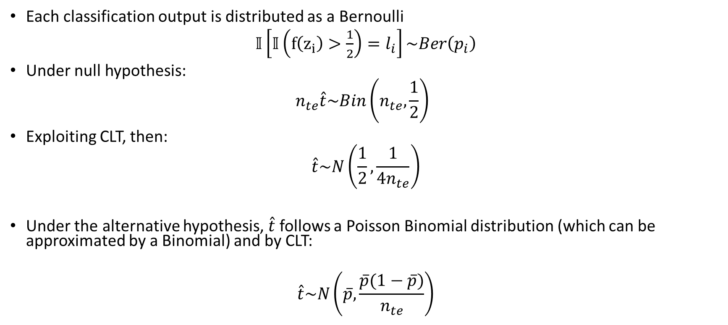
Null and alternative distribution
Each classification output is distributed as a Bernoulli
$𝕀\left[𝕀\left(f\left(z_{i}\right)>\frac{1}{2}\right)=l_{i}\right]\sim Ber\left(p_{i}\right)$
Under null hypothesis:
$$n_{te}\hat{t}\sim Bin\left(n_{te},\frac{1}{2}\right)$$
Exploiting CLT, then:
$$\hat{t}\sim N\left(\frac{1}{2},\frac{1}{4n_{te}}\right)$$
Under the alternative hypothesis, $\hat{t}$follows a Poisson Binomial distribution (which can be approximated by a Binomial) and by CLT:
$$\hat{t}\sim N\left(\overline{p},\frac{\overline{p}(1−\overline{p})}{n_{te}}\right)$$

Slide 7
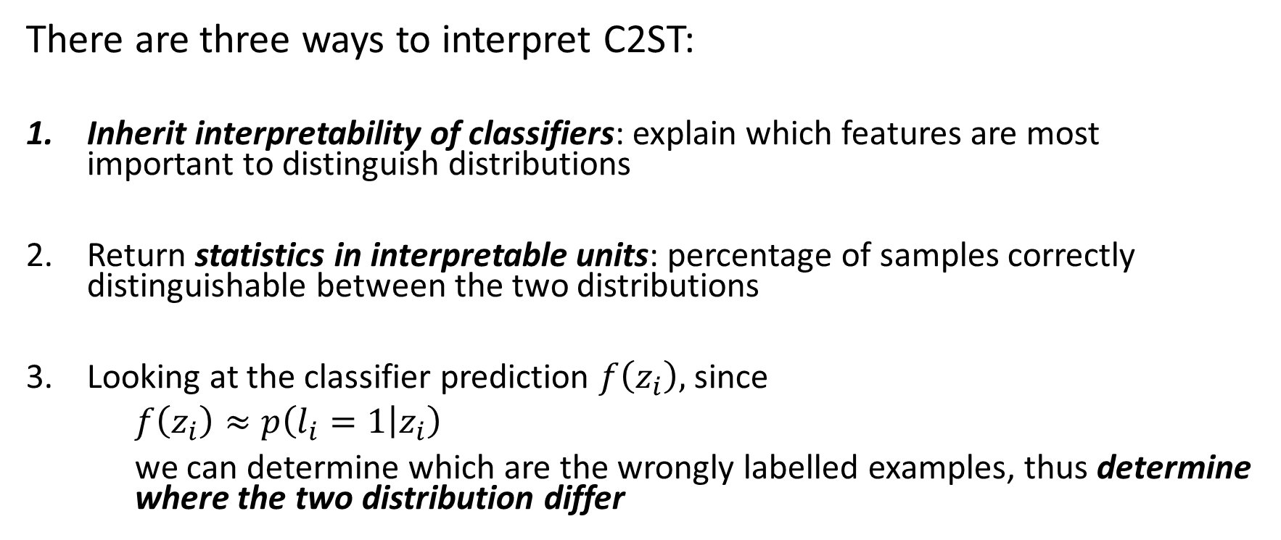
Interpretability of C2ST
There are three ways to interpret C2ST:
Inherit interpretability of classifiers: explain which features are most important to distinguish distributions
Return statistics in interpretable units: percentage of samples correctly distinguishable between the two distributions
Looking at the classifier prediction $f\left(z_{i}\right),$ since
$f\left(z_{i}\right)≈p\left(l_{i}=1 | z_{i}\right)$
we can determine which are the wrongly labelled examples, thus determine where the two distribution differ

Slide 8
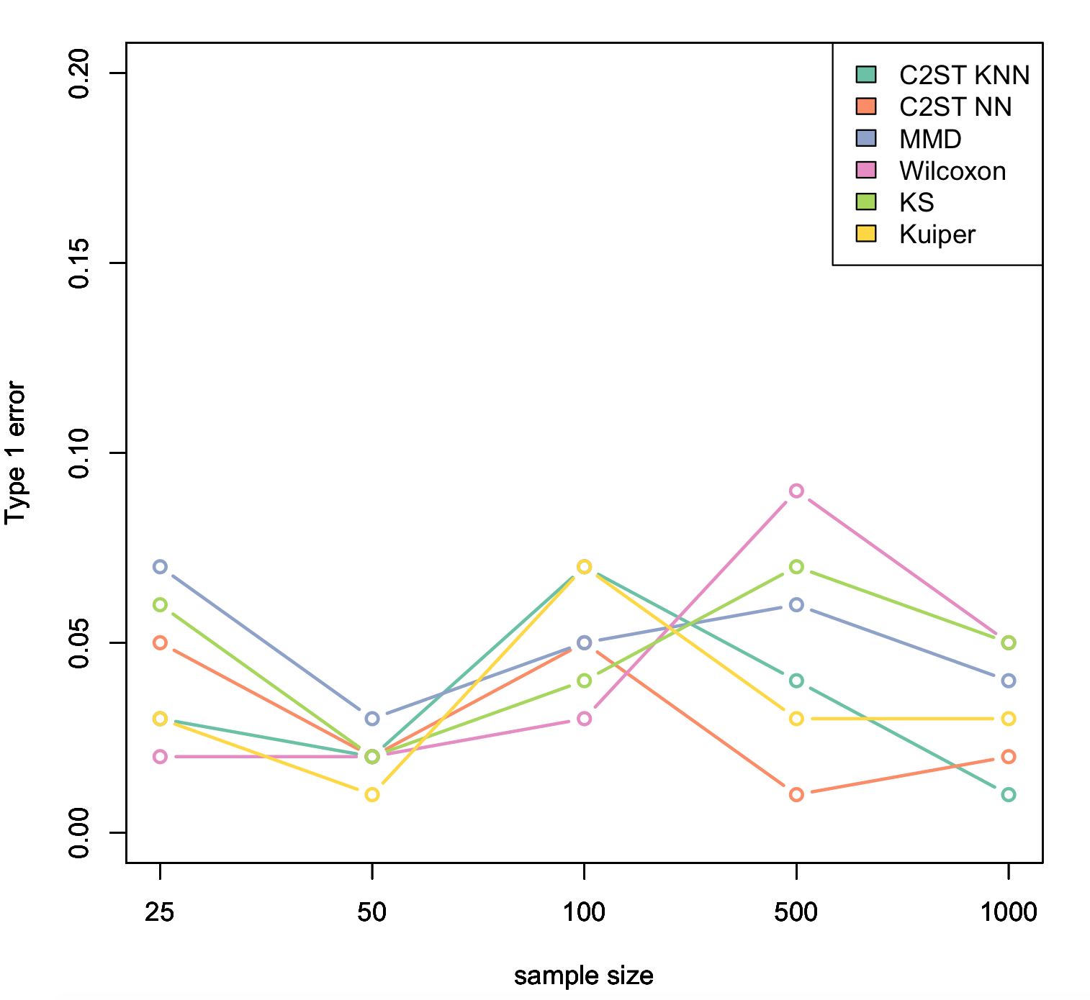
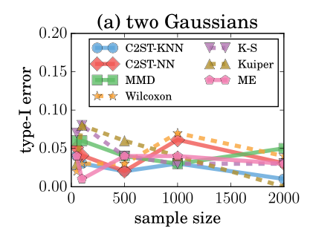
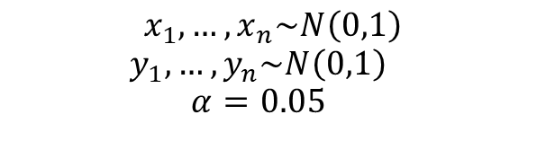
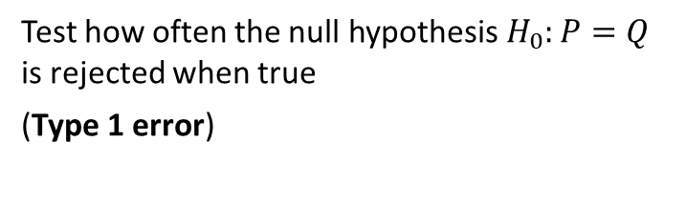
Experiments on synthetic data: Gaussian versus Gaussian
$$x_{1},…,x_{n}\sim N\left(0,1\right)$$
$$y_{1},…,y_{n}\sim N\left(0,1\right)$$
$$α=0.05$$
Test how often the null hypothesis $H_{0}:P=Q$ is rejected when true
(Type 1 error)

Slide 9
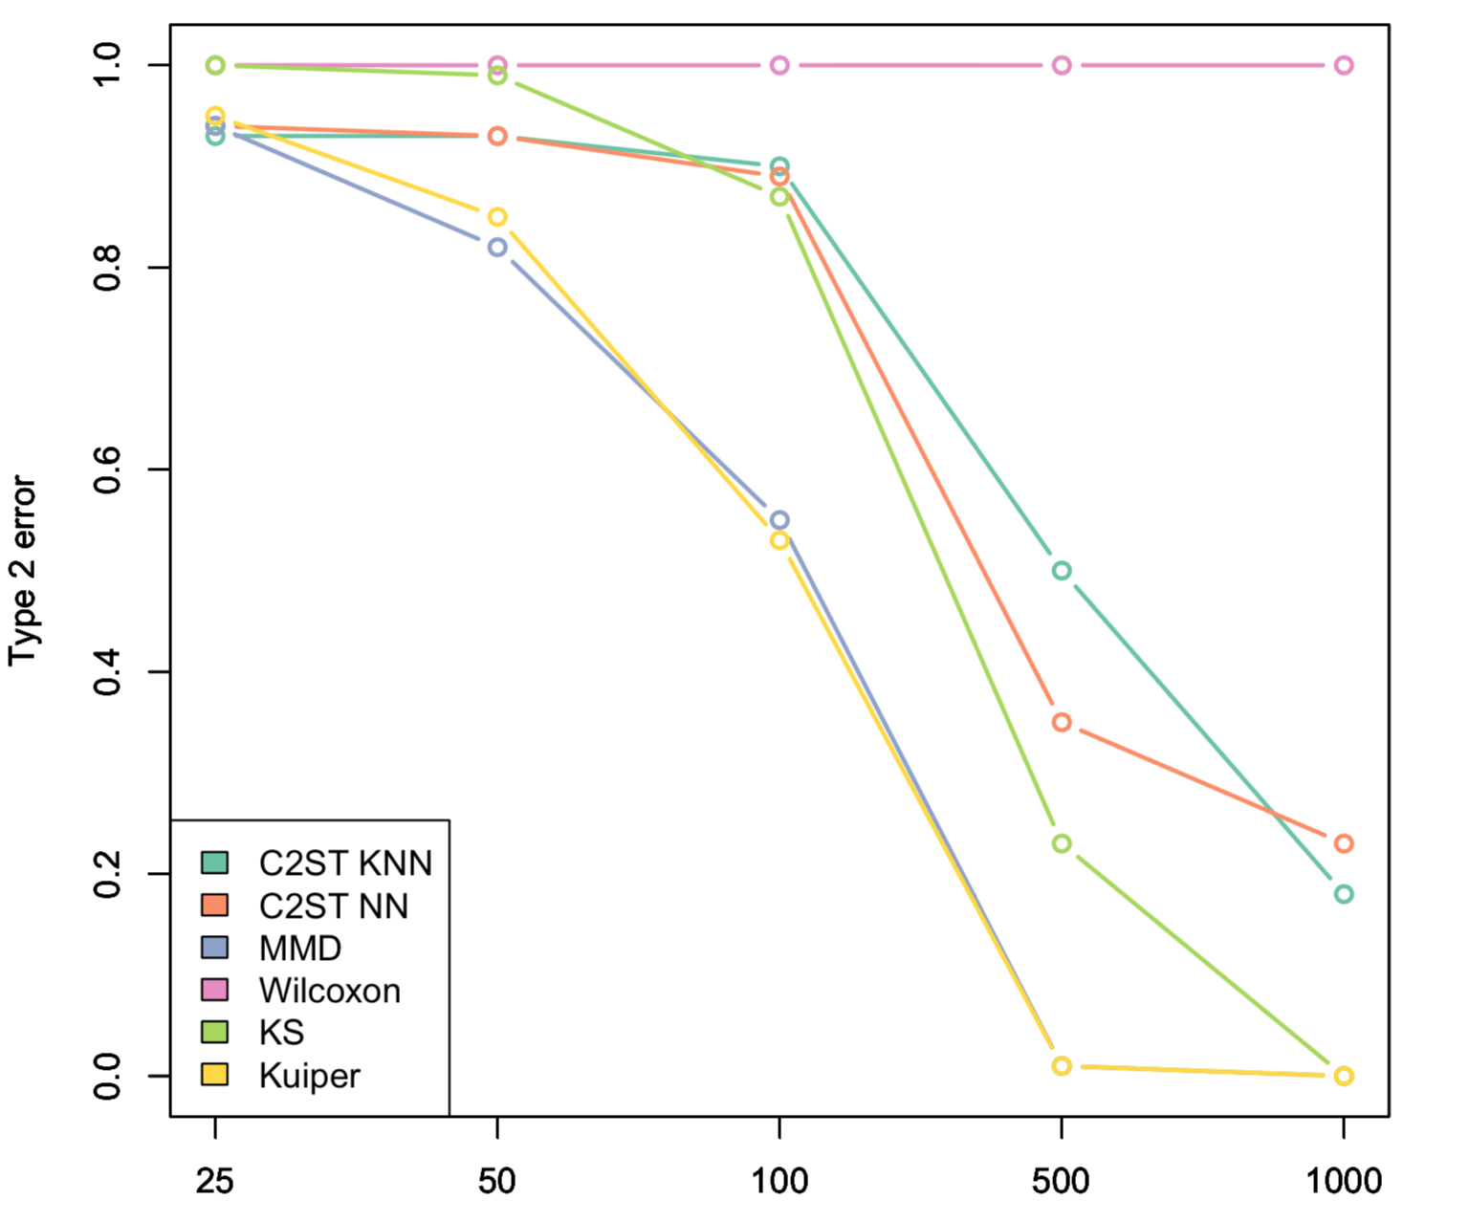
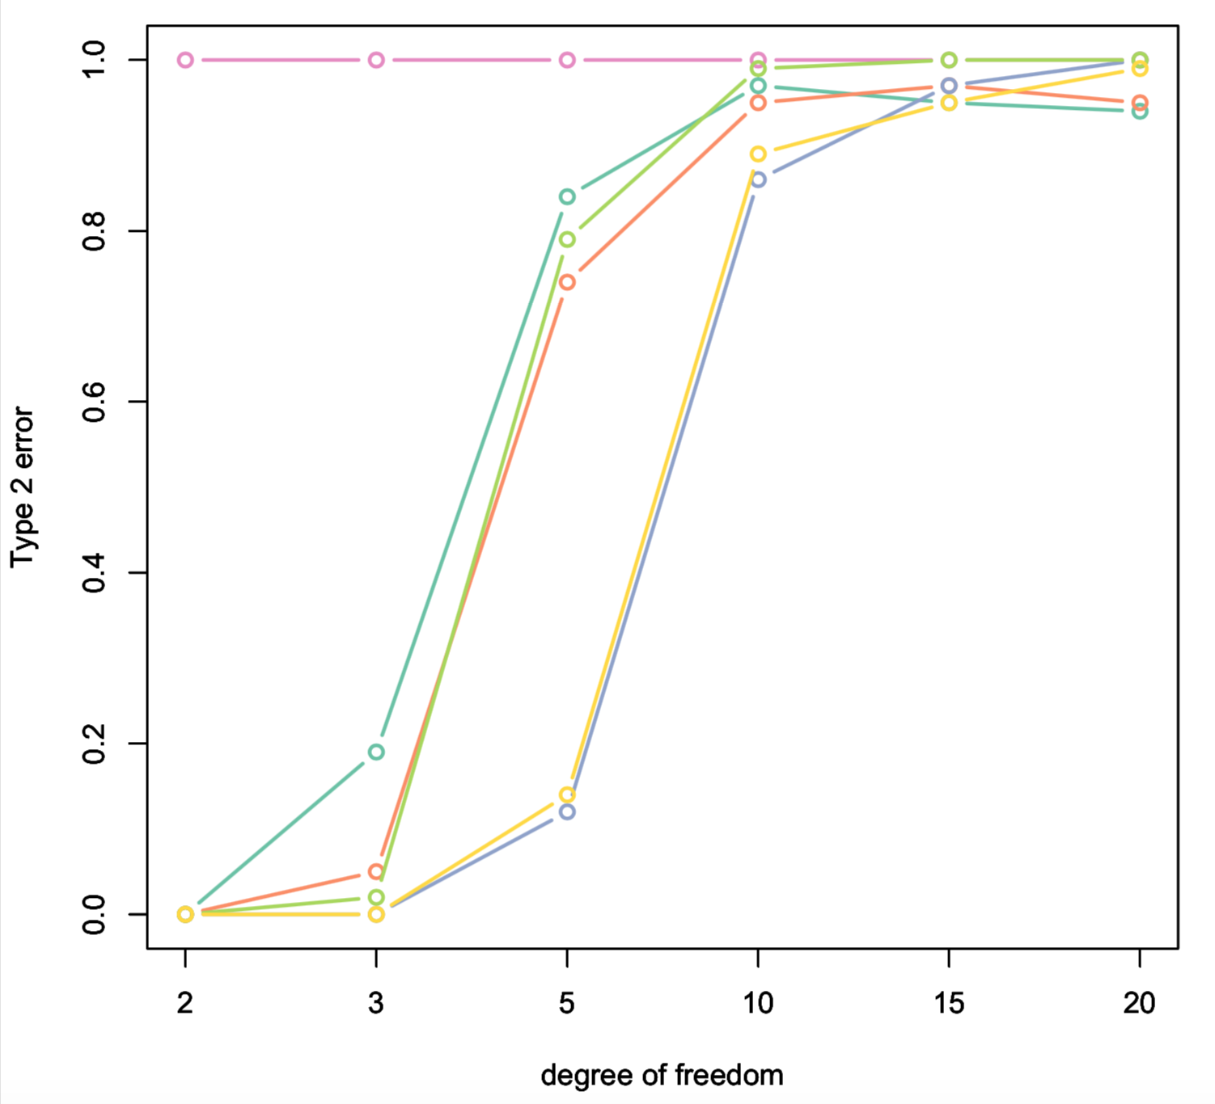
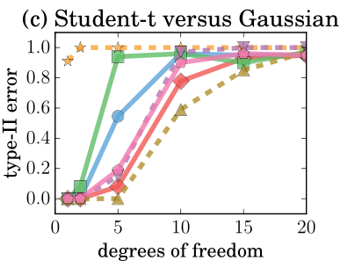
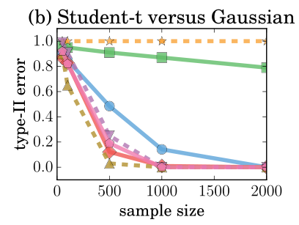
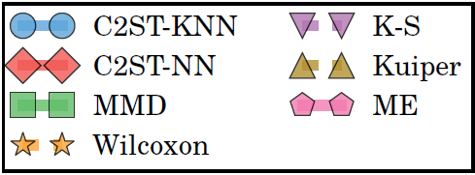
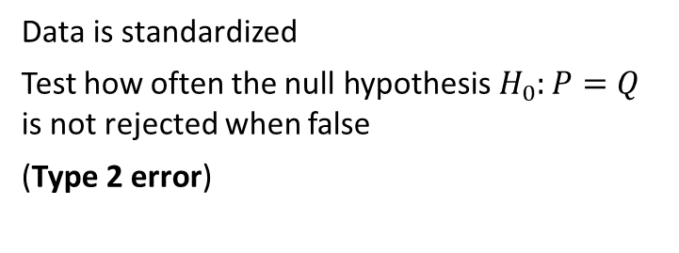

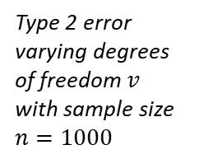
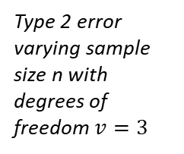
Experiments on synthetic data: Gaussian versus Student
Type 2 error varying sample size n with degrees of freedom $v=3$
$$x_{1},…,x_{n}\sim N\left(0,1\right)$$
$$y_{1},…,y_{n}\sim t\left(v\right)$$
$$α=0.05$$
Data is standardized
Test how often the null hypothesis $H_{0}:P=Q$ is not rejected when false
(Type 2 error)
Type 2 error varying degrees of freedom $v$ with sample size $n=1000$

Slide 10
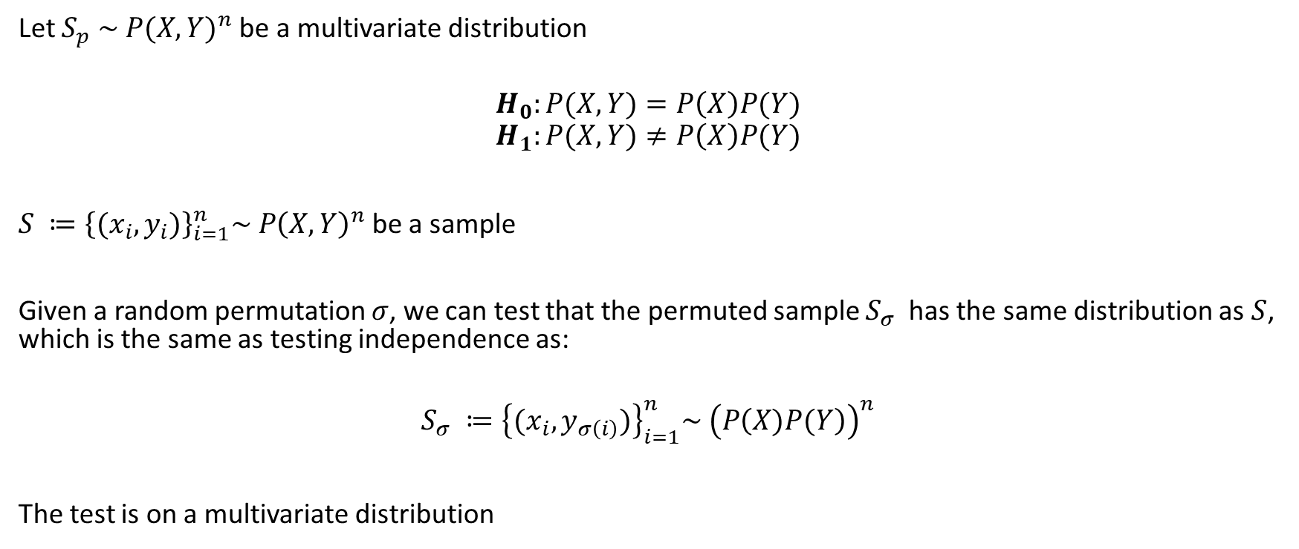
Two sample test for statistical independence
Let $S_{p} \sim {P(X,Y)}^{n}$ be a multivariate distribution
$$H_{0}:P(X,Y)=P\left(X\right)P(Y)$$
$$H_{1}:P(X,Y)≠P\left(X\right)P(Y)$$
$S ≔{\left\{{(x}_{i},y_{i})\right\}}_{i=1}^{n}\sim {P\left(X,Y\right)}^{n}$ be a sample
Given a random permutation $σ$, we can test that the permuted sample $S_{σ}$ has the same distribution as $S$, which is the same as testing independence as:
$$S_{σ} ≔{\left\{{(x}_{i},y_{σ\left(i\right)})\right\}}_{i=1}^{n}\sim {\left(P\left(X)P(Y\right)\right)}^{n}$$
The test is on a multivariate distribution

Slide 11
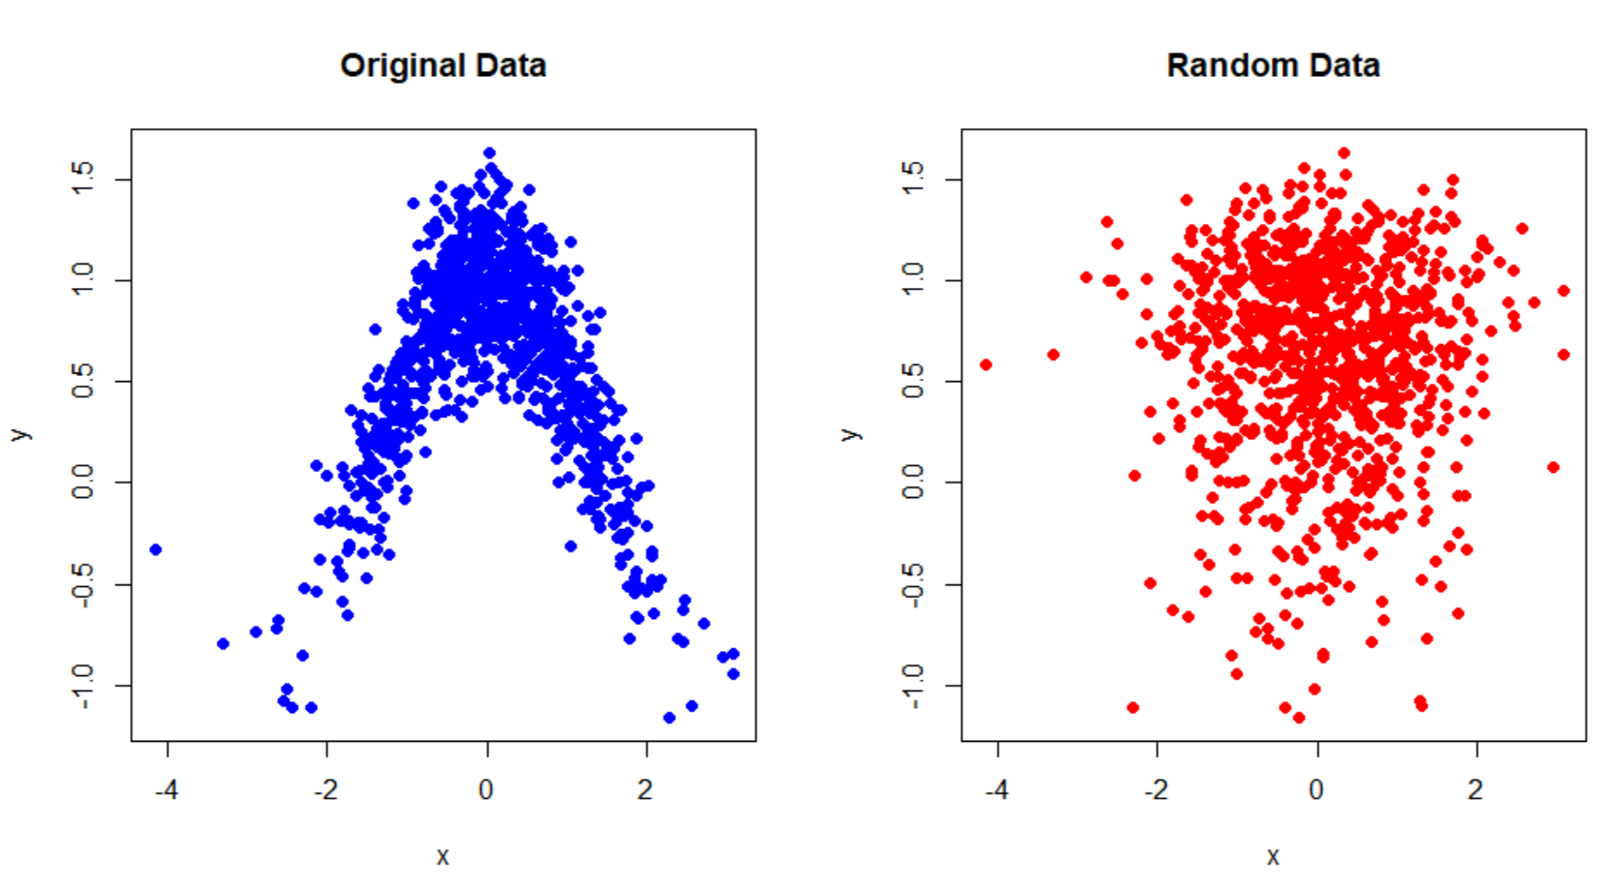
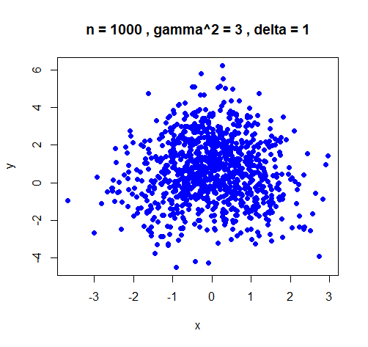
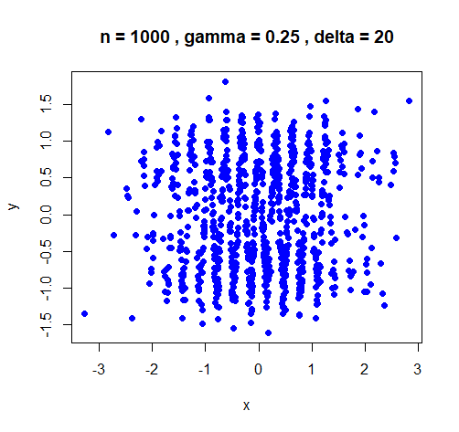


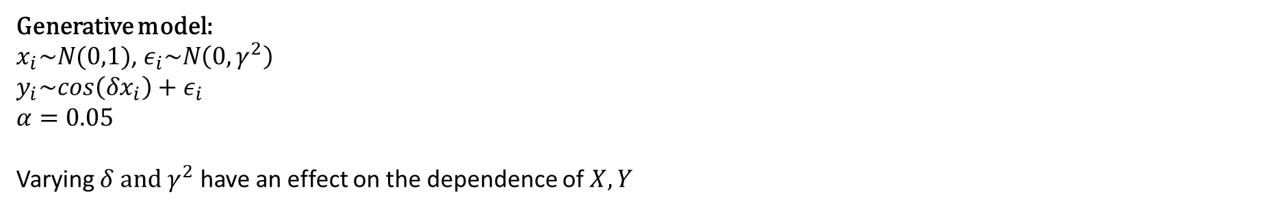

Experiments on synthetic data: Sinusoidal data
Generative model:
$x_{i}\sim N(0,1)$, $ε_{i}\sim N\left(0,γ^{2}\right)$
$y_{i}\sim cos\left(δx_{i}\right)+ε_{i}$
$$α=0.05$$
Varying $δ and γ^{2}$ have an effect on the dependence of $X,Y$
Distribution standard values
$γ=0.25, δ=1, n=1000$
Distribution with high $γ$
Distribution with high $δ$

Slide 12
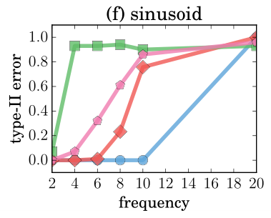
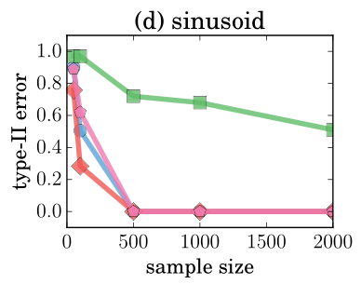
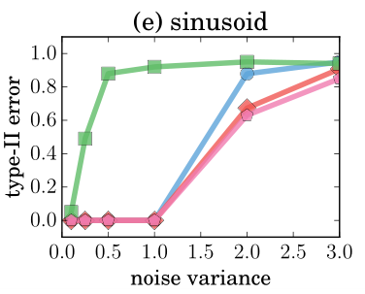
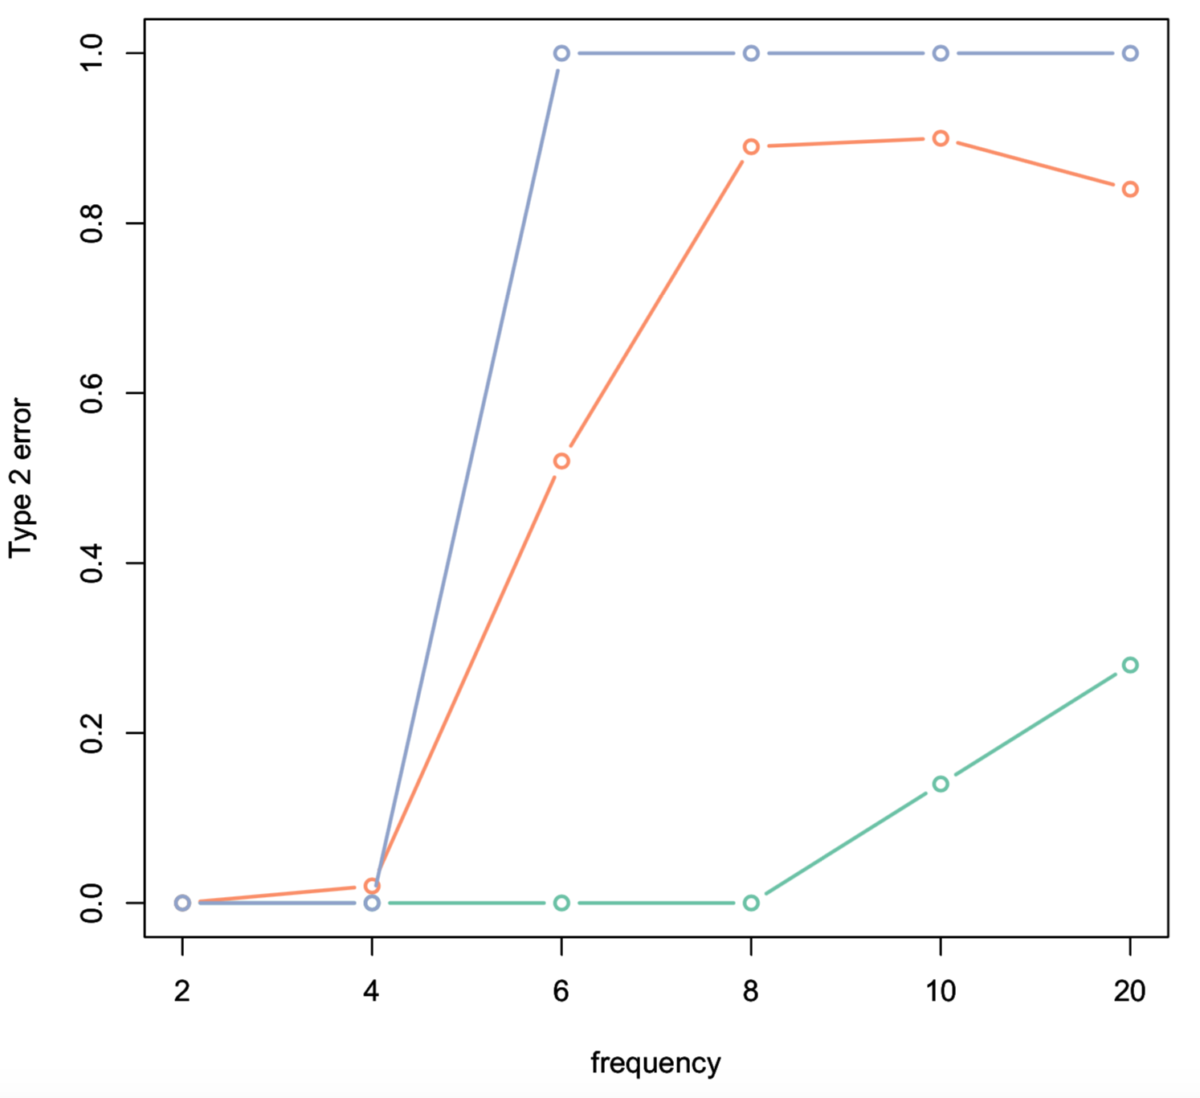
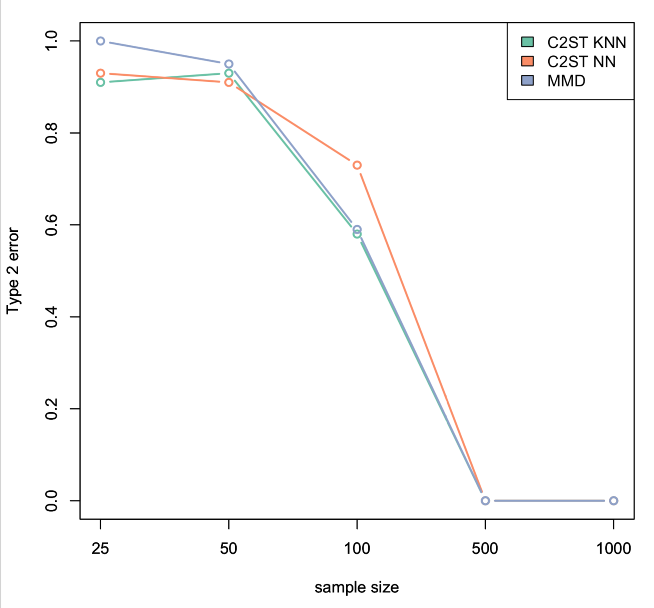
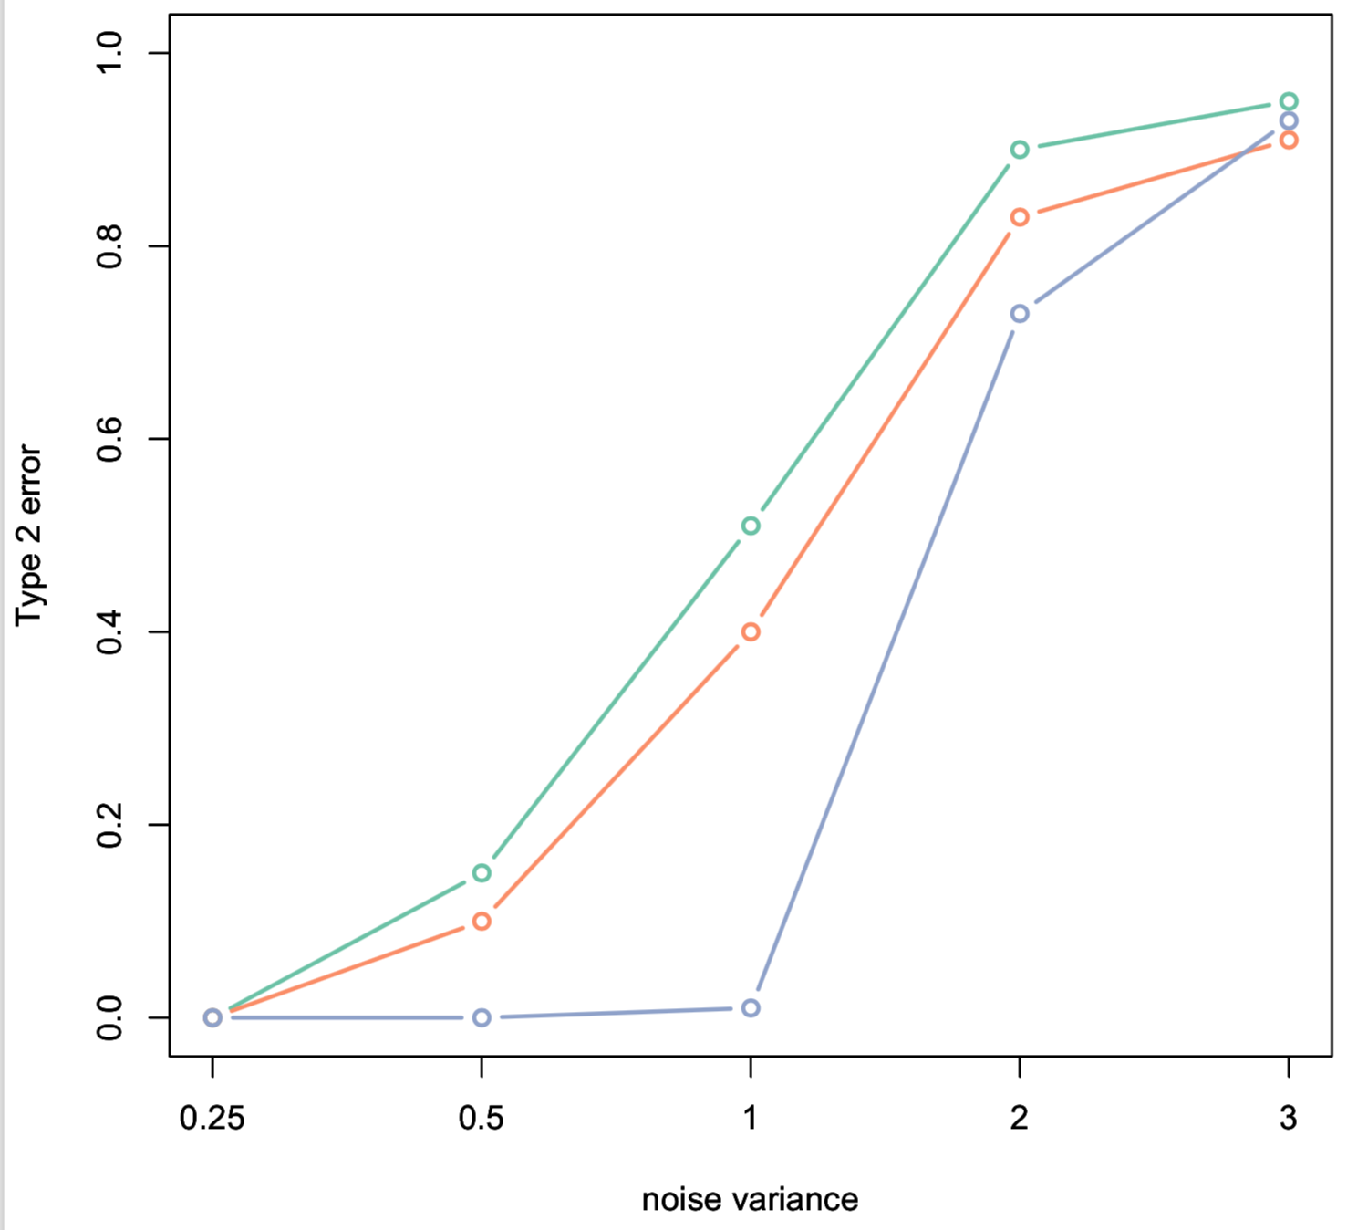

Slide 13
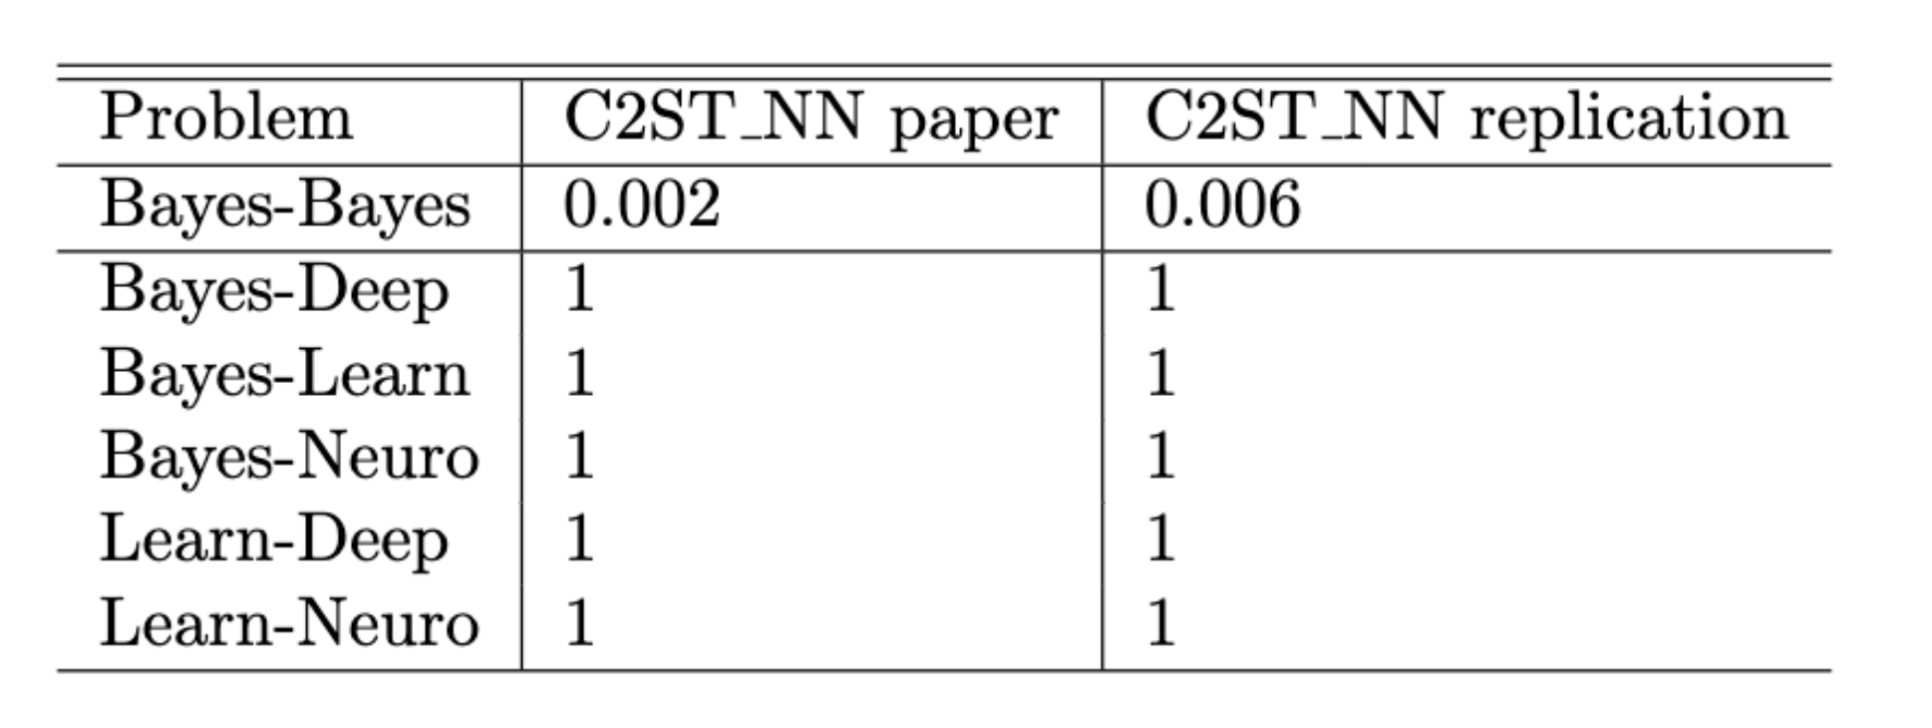
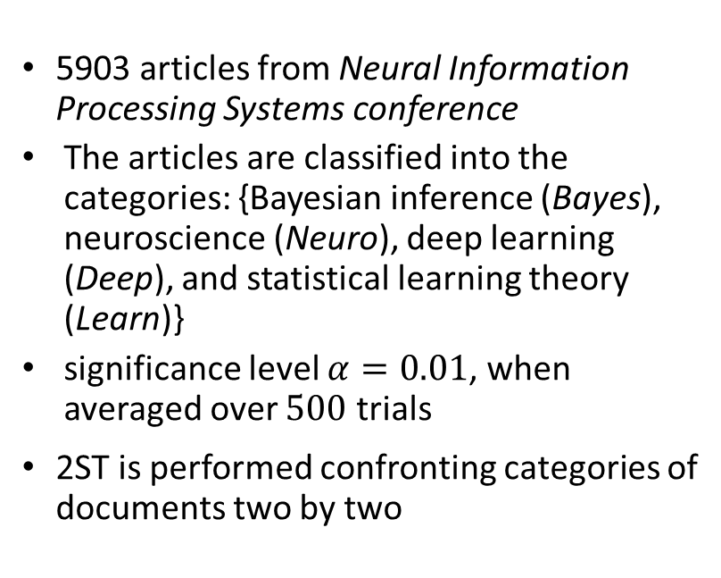
NIPS experiments
5903 articles from Neural Information Processing Systems conference
The articles are classified into the categories: {Bayesian inference (Bayes), neuroscience (Neuro), deep learning (Deep), and statistical learning theory (Learn)}
significance level $α=0.01$, when averaged over $500$ trials
2ST is performed confronting categories of documents two by two
Results of the C2ST as presented in the original paper. In the first row, Type 1 error of the test with Neural Network classifier. In the following rows, Type 2 errors.

Slide 14


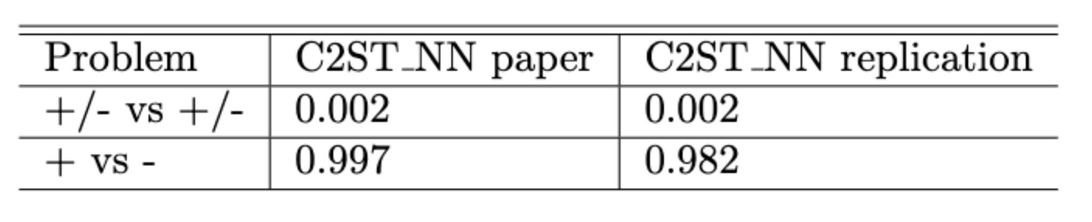
The Karolinska Directed Emotional Faces
Distinguish two classes of emotions:
Positive: {happy, neutral, surprised}
Negative: {afraid, angry, disgusted}
Preprocessing
Type 1 error
Type 2 error

Slide 15
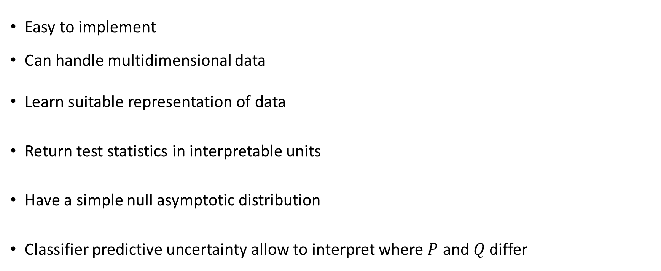
Conclusions
Easy to implement
Can handle multidimensional data
Learn suitable representation of data
Return test statistics in interpretable units
Have a simple null asymptotic distribution
Classifier predictive uncertainty allow to interpret where $P$ and $Q$ differ

