Slide 1
DSE 1002 Final Project Presentation
Bernardo Santos
12/15/2021

Slide 2
Overview
Motivation
Executive Summary
Data and Approach
Detailed Findings
Conclusions

Slide 3

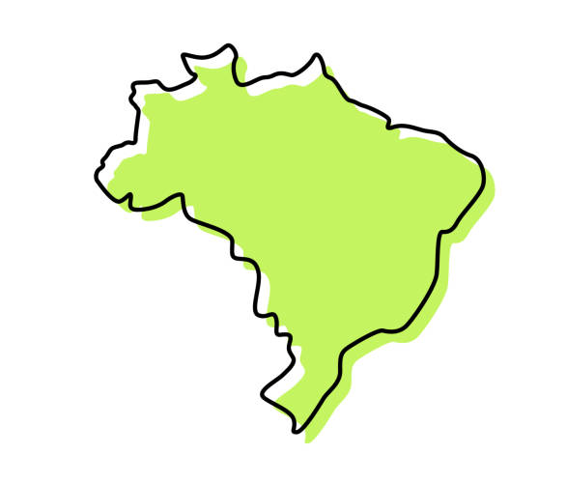

Motivation
I was motivated by my previous work experience in BTG Pactual, the largest investment bank in Latin America. At the bank I worked as an automation intern and had close contact with Machine Learning models used by the bank.
I intended to create models that would be similar to the ones I could use at the bank, where we could use internal data as inputs for the model and generate a trustworthy prediction.
Therefore I used a data set that contained information regarding investment funds (more on the data later).

Slide 4
Executive Summary
Quantitative Response Variable: The Question
Results
What makes an investment fund get high returns over a period of 10 years?
Model | MSE | Accuracy
Random Forest | 0.0005 | 96.44%
Neural Network | 5.08 | 79.05%
Linear Regression | 6.12 | 71.57%
Regression Tree | 19.01 | 78.20%
Null Model | 21.86 | 56.18%
Is it one single factor? Is it a combination of factors? Is it the way they allocate their resources? Is it the size of the fund?
As a matter of fact, I found out it takes a few factors to make a reliable prediction on the returns of a fund in 10 years, and the Random Forest was the model that understood the data pattern the better.
The Random Forest was by far the most accurate model, with 96.44% of accuracy and 0.0005 for the MSE.

Slide 5
Executive Summary
Qualitative Response Variable: The Question
Results
What makes an investment fund get returns higher than the inflation rate in a 10-year period of time (above 12.37%)?
Model | Accuracy
Random Forest | 97.97%
KNN | 95.69%
Classification Tree | 94.89%
Multiple Logistic Regression | 94.10%
Naive Bayes | 91.03%
Null Model | 87.05%
Since the question is similar to the quantitative response one, the same factors that help explain the previous one will explain this one too!
Not coincidentally, the Random Forest was the model that described the data the better as well.
The Random Forest was the most accurate model, with 97.97% of accuracy.

Slide 6






Data and Approach: Part I
Data Set Overview
But What Is An Investment Fund?
Composed of data regarding investment funds, which were retrieved from Yahoo Finance and stored in Kaggle comprising the years between 2012-2020. There are 24,281 rows and 173 columns.
Contains general information of the funds, such as name, size, total net assets, etc.
Contains portfolio indicators such as percentage of assets allocated in cash, stocks, or bonds; percentage allocated in specific sectors, etc.
Contains financial ratios, such as price-to-earnings, price-to-book, Treynor and Sharpe ratios, etc.
A supply of capital belonging to numerous investors used to collectively purchase securities while each investor retains ownership and control of his own shares.
Broader selection of investment opportunities, greater management expertise, and lower investment fees than investors might be able to obtain on their own.

Slide 7
Data and Approach: Part II
Missing Data
A data frame was created containing the percentage of missing data for each column, and the columns with 40% or more of missing data were removed from the data set. This resulted in a removal of 24 columns, with an additional removal of 33 columns that were related to these ones and would not make sense keeping such.
Categorical and Free Text Variables
Columns that contained free text were also removed, since they hold no value to our models and cannot be converted to numbers in such a way that would make sense. This resulted in a removal of 8 columns.
Normalization and Vectorization of the Data
Numerical values were scaled from 0 to 1 (normalization) and categorical values were encoded (vectorization) as an attempt to make the models get a better understanding of the data and therefore generate better results.

Slide 8
Data and Approach: Part III
The most important question of the whole project is yet to be answered: which variables are the most important ones to explain the results of an investment fund after 10 years?
To answer this question, a table of correlations was created, and the most correlated variables (except the ones that were too correlated to the response variable) were put on trial multiple times as I attempted to understand which variables put together would generate meaningful results.
These were the ones mainly used:
return_rating, price_earnings_ratio, price_book_ratio, price_cashflow_ratio, price_sales_ratio, asset_cash, asset_stocks, asset_bonds, sector_basic_materials, sector_basic_utilities, sector_communication_services, sector_technology, fund_return_ytd, fund_return_1year, category_return_1year, median_market_cap, quarters_up, quartes_down, size_type, investment_type, net_asset_value and rating.

Slide 9
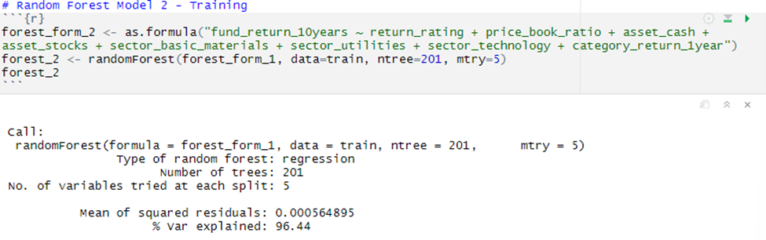
Detailed Findings: Quantitative Variable
Model | MSE | Accuracy
Random Forest | 0.0005 | 96.44%
Neural Network | 5.08 | 79.05%
Linear Regression | 6.12 | 71.57%
Regression Tree | 19.01 | 78.20%
Null Model | 21.86 | 56.18%
With a null model yielding 56.18% of accuracy, the bar was not set very high, and every model managed to beat it with a fair advantage.
The Random Forest was the only one that generated outstanding results, with 96.44% of accuracy and 0.0005 MSE.
Random Forest model was built with ntree=201 and mtry=5.
3 different variables that describe sectors allocations were used in this model.

Slide 10
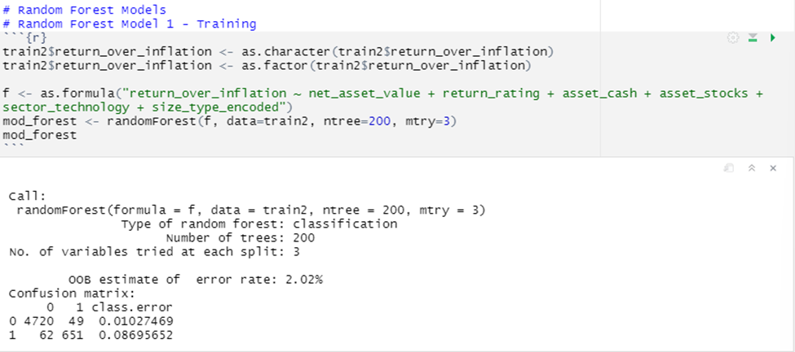
Detailed Findings: Qualitative Variable
Model | Accuracy
Random Forest | 97.97%
KNN | 95.69%
Classification Tree | 94.89%
Multiple Logistic Regression | 94.10%
Naive Bayes | 91.03%
Null Model | 87.05%
Differently from the previous part, this time the null model set the bar high with accuracy of 87.05%.
Even so, all the models built managed to beat the null model by at least 4%.
Again, the Random Forest model stood out with an accuracy of 97.97%, while the rest of the models stayed between 91% and 95%.
Random Forest model was built with ntree=200 and mtry=3.
Only 1 variable that described the sectors allocation.

Slide 11

Conclusions
What conclusions can we draw from the results we have encountered?

Slide 12
Conclusions
Clearly, the Random Forest model is our best ally when trying to predict the returns of a fund after 10 years or if we are predicting if it is higher than a specific threshold.
The best predictors to the return of a fund after 10 years are:
return_rating, net_asset_value, size_type, asset_cash, asset_stocks, price_book_ratio, sector_utilities, sector_technology, and sector_basic_materials.
All in all, I must say I am happy with the results I have obtained. What I intended to achieve was to find a model (or a group of models) that I could use to predict a fund’s return after 10 years based on a few variables.
I thought I could use this kind of model at my work, which is an investment bank where we have data about thousands of different investment funds, and we would benefit a lot from correct predictions of these funds’ success (or lack thereof).

Slide 13
References
The dataset can be found here:
https://www.kaggle.com/stefanoleone992/mutual-funds-and-etfs?select=MutualFunds.csv
On investment funds:
https://www.investopedia.com/terms/i/investment-fund.asp

