Slide 1

Supervised Learning Diabetes report
Bernard Adeboye

Slide 2
Project Goals
Use supervised learning techniques to build a machine learning model that can predict whether a patient has diabetes or not, based on certain diagnostic measurements.
Perform exploratory data analysis,
preprocessing and feature engineering, and
training a machine learning model.

Slide 3
Process
Step 1: Import libraries and load dataset
Step 2: Explorative Data Analysis to understand the dataset.
Step 3: Check for missing information in the dataset.
Step 4: Clean dataset by identifying and treating outliers, and filling missing values.
Step 5: Apply various machine learning algorithms
Step 6: Validate the ML algorithms to ascertain the best.
Step 7: Interpret and summary findings

Slide 4
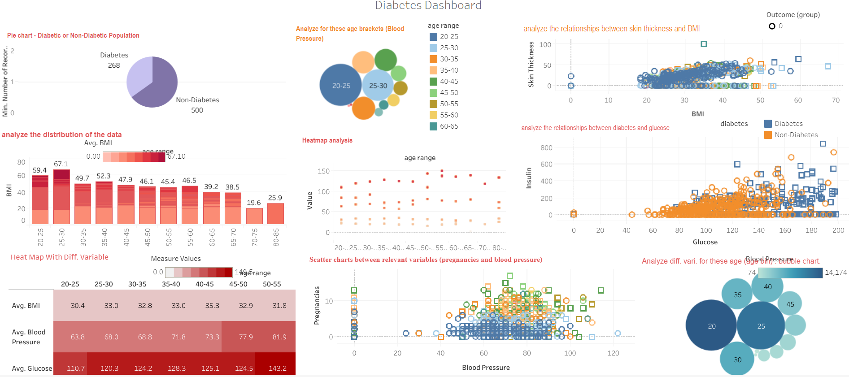
Data visualization dashboard

Slide 5
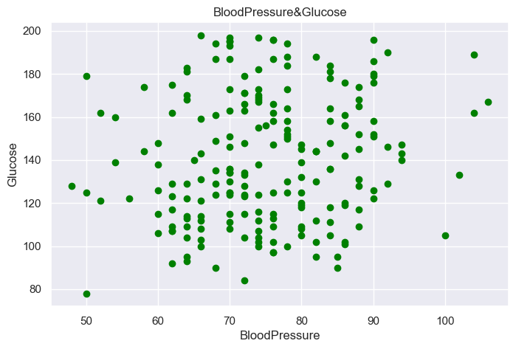

Slide 6
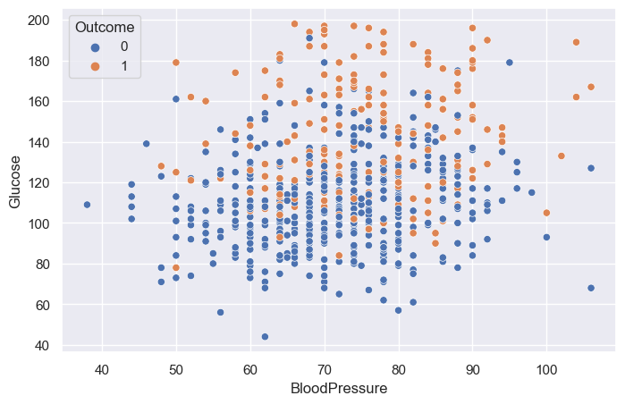
Blood Pressure and glucose

Slide 7
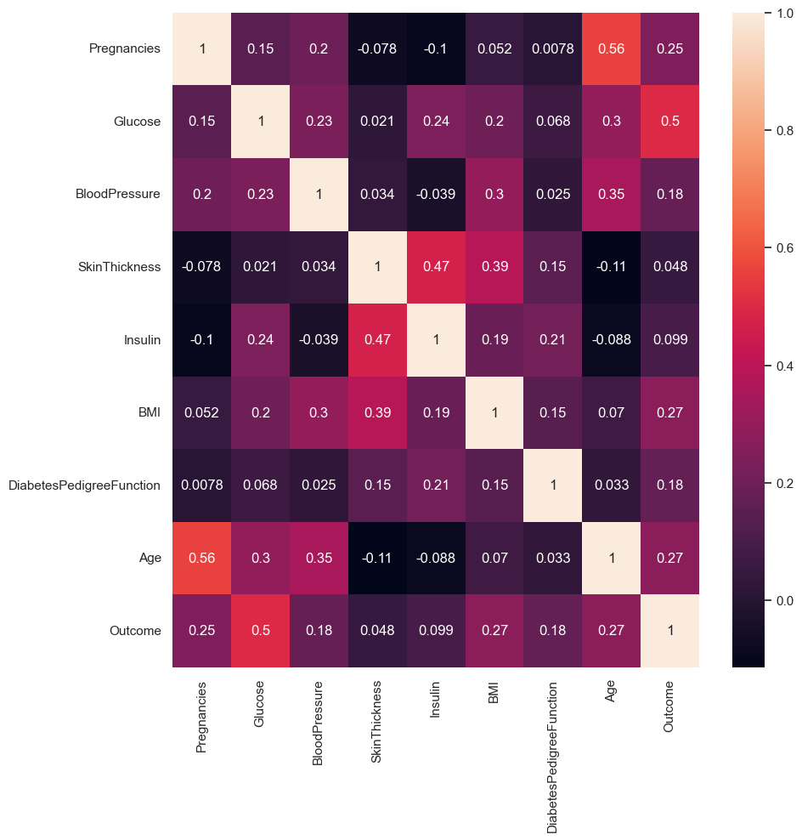
Correlation Matrix

Slide 8
Dataset findings
After analyzing the histogram we can identify that there are some outliers in some columns.
For Example:-
Blood Pressure - A living person cannot have a diastolic blood pressure of zero.
Plasma glucose levels - Zero is invalid number as fasting glucose level would never be as low as zero.
Skin Fold Thickness - For normal people, skin fold thickness can’t be less than 10 mm better yet zero.
BMI: Should not be 0 or close to zero unless the person is really underweight which could be life-threatening.
Insulin: In a rare situation a person can have zero insulin but by observing

Slide 9
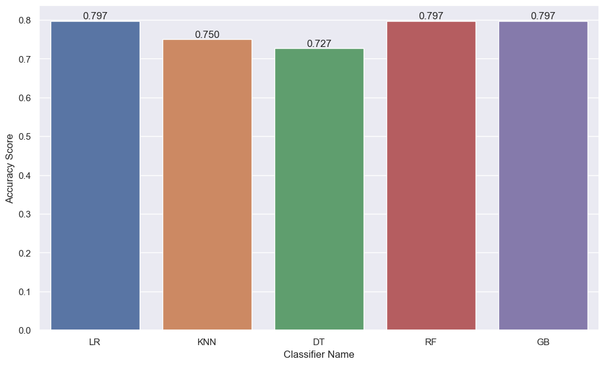
Models performance-Accuracy score metrics

Slide 10
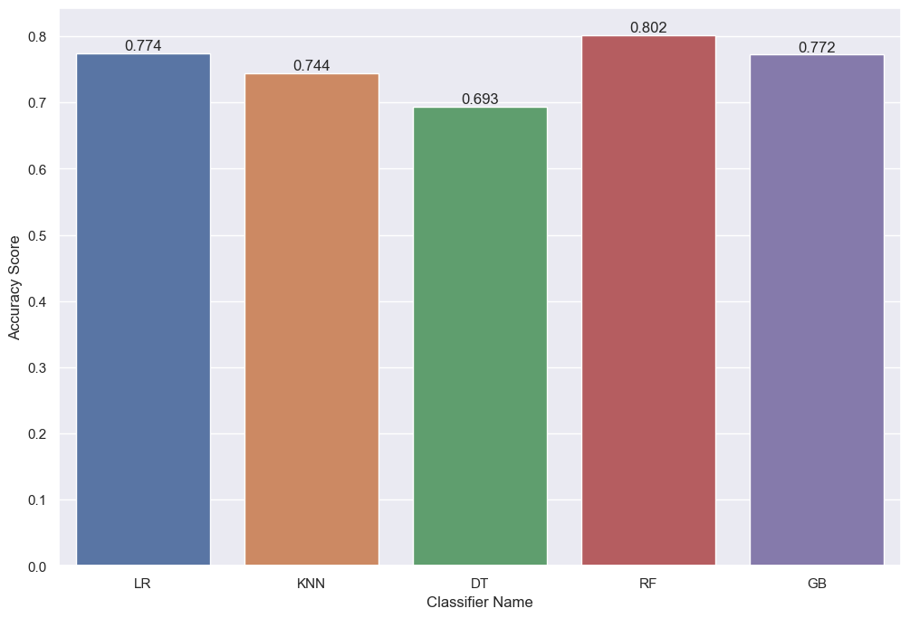
Model performance – Kfold Cross validation

Slide 11
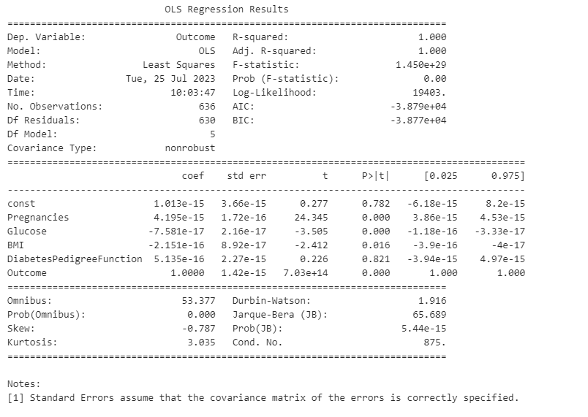
Model summary – Logistic Regression

Slide 12
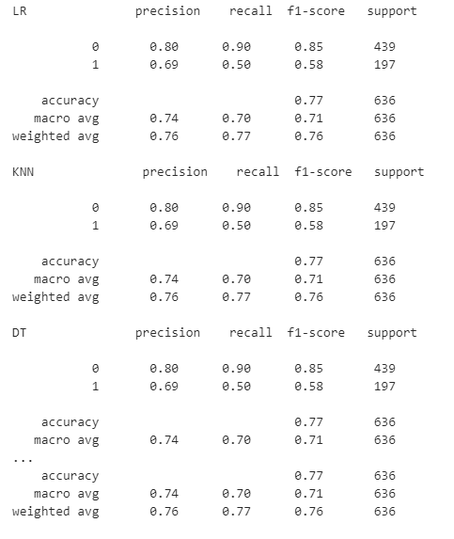
Model classification report-recall, precision, f1-score

Slide 13
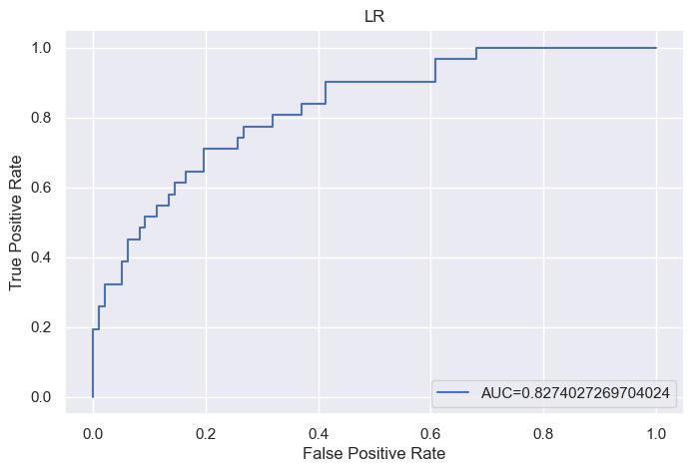
Roc-AUC curve for Logistic regression

Slide 14
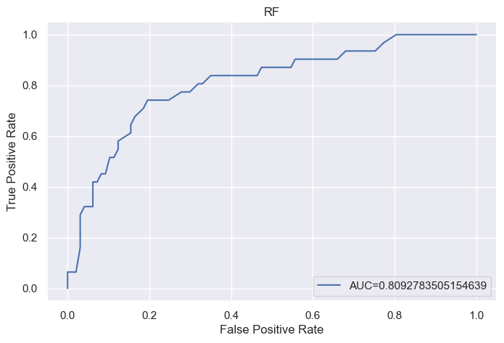
Roc-AUC curve for Random Forest

Slide 15
Conclusion
We can see the Logistic Regression, Random Forest and Gradient Boosting have performed better than the rest.
Diabetic and non-diabetic groups shows similar distribution pattern.
Most variables shows relative positive relationship between themselves.
Skin thickness and Insulin show alot of outliers due to the numbers of zeros.

