Slide 3
Dead End
Left Turn
Right Turn
“T” Intersection
Goal
Staright/left Intersection
Staright/Right Intersection
Cross Intersection

Slide 10
8
11
GOAL
9
10
7
12
5
4
3
13
14
2
6
1
START

Slide 11
IR Detector
IR LED
IR Detector
IR LED

Slide 12
Obstacle
Ultrasonic Sensor

Slide 13
Threshhold

Slide 14
TILT!
LEAN!
Forward!

Slide 16



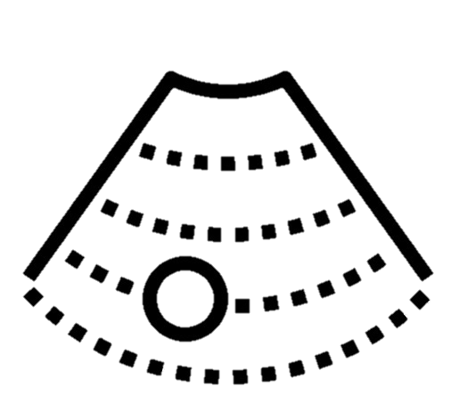



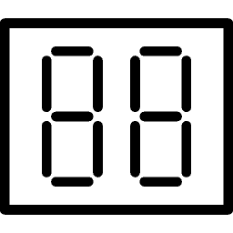
SENSORS
CONTROLLER
INTERFACE
Light sensor
Bluetooth
Ultrasound sensor
Arduino
Buttons
ACTUATORS
Buzzer
Motor 1
Motor 2
Display

