Slide 3
Dead End
Left Turn
Right Turn
“T” Intersection
Goal
Staright/left Intersection
Staright/Right Intersection
Cross Intersection

Slide 7
Branch not recognized

Slide 8
Branch recognized

Slide 9
8
11
GOAL
9
10
7
12
5
4
3
13
14
2
6
1
START

Slide 10
IR Detector
IR LED
IR Detector
IR LED

Slide 11
Obstacle
Ultrasonic Sensor

Slide 12
Threshhold

Slide 13
TILT!
LEAN!
Forward!

Slide 15







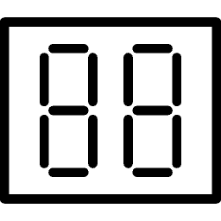
SENSORS
CONTROLLER
INTERFACE
Light sensor
Bluetooth
Ultrasound sensor
Arduino
Buttons
ACTUATORS
Buzzer
Motor 1
Motor 2
Display

