Slide 1
Harry Oh
Meet the Experts Widget @ MySears and MyKmart Communities
Notes:
Use a topic title slide each time a new person is presenting or a new topic is presented.

Slide 2
Overview
MySears and MyKmart Communities
Meet the Experts Widget
Questions

Slide 3
MySears and MyKmart Communities
Question and Answer (Q&A)
Social E-Commerce
Customers -> Users
Customer Service Representatives -> Experts

Slide 4
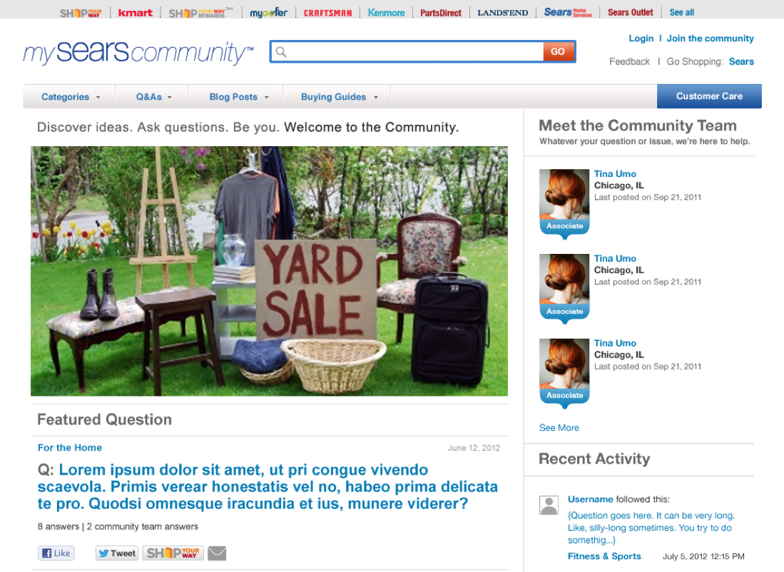
MySears and MyKmart Communities

Slide 5
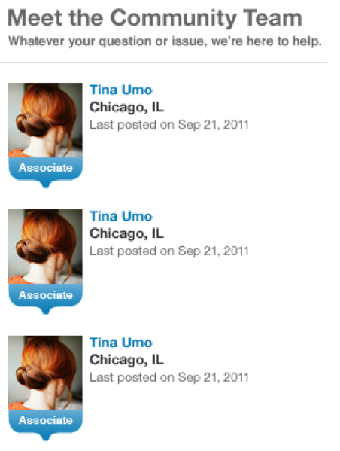
Meet the Experts Widget
Connect with Customer Service
Direct Assistance

Slide 6
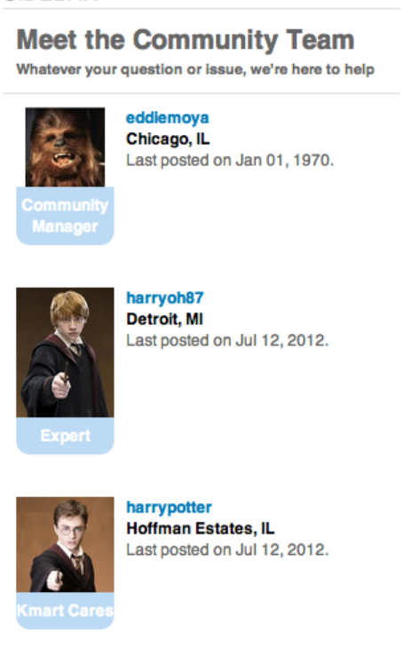
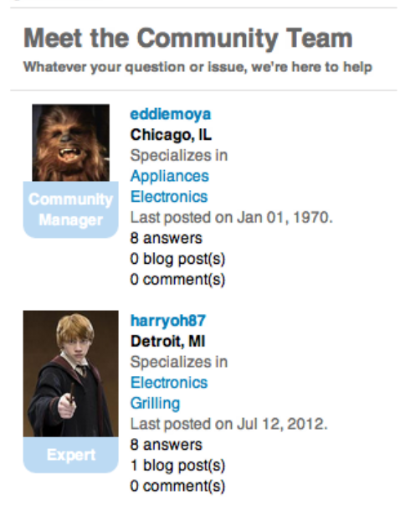
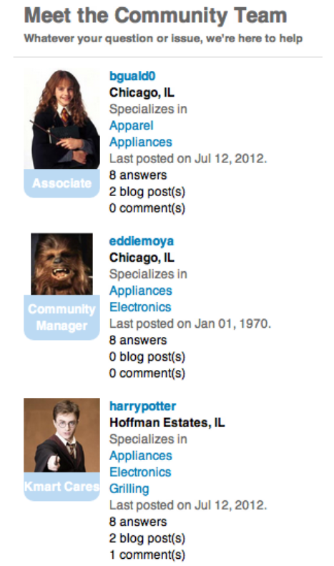
Meet the Experts Widget

Slide 7
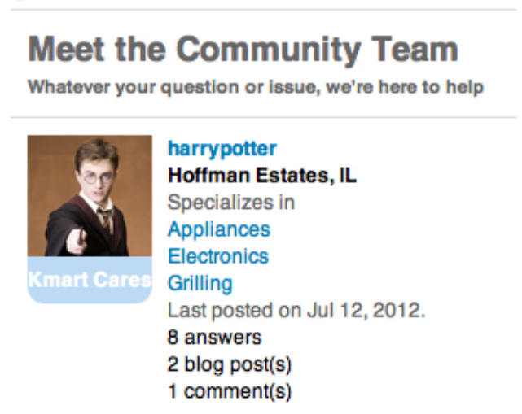
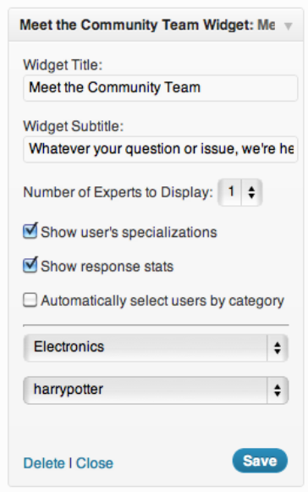
Meet the Experts Widget

Slide 8
Questions?

