Slide 1

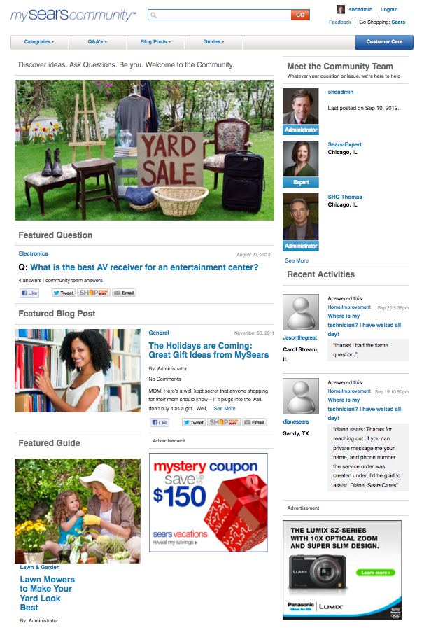

Communities
By: Hamid Shariff

Slide 2
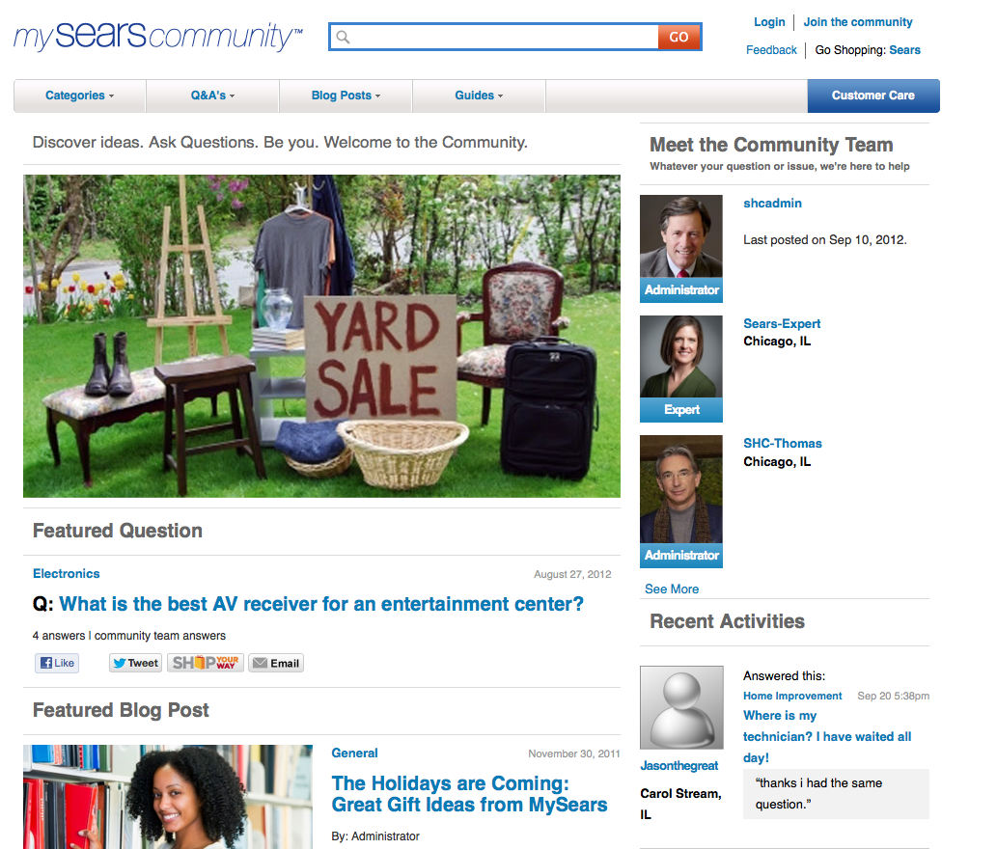
Login
✓
1
Go to Sears.com/community or kmart.com/community
2
Click on Login
3
Once modal opens up, enter your credentials
3
Click ’Sign In’

Slide 3
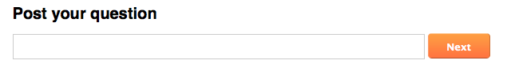
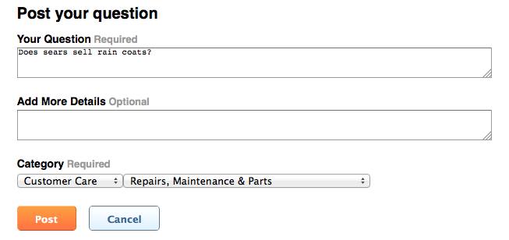
How to post a question?
✓
1
Click ’Q&As’ or ’Customer Care’ tab on the Homepage
2
Under ’Post your question’ area, type a question and then click ’Next’ (must be signed in)
3
Refine question if needed or add more detail.
4
Select a Category
5
If Sub-Category is available, select one
6
Click ’post’

Slide 4
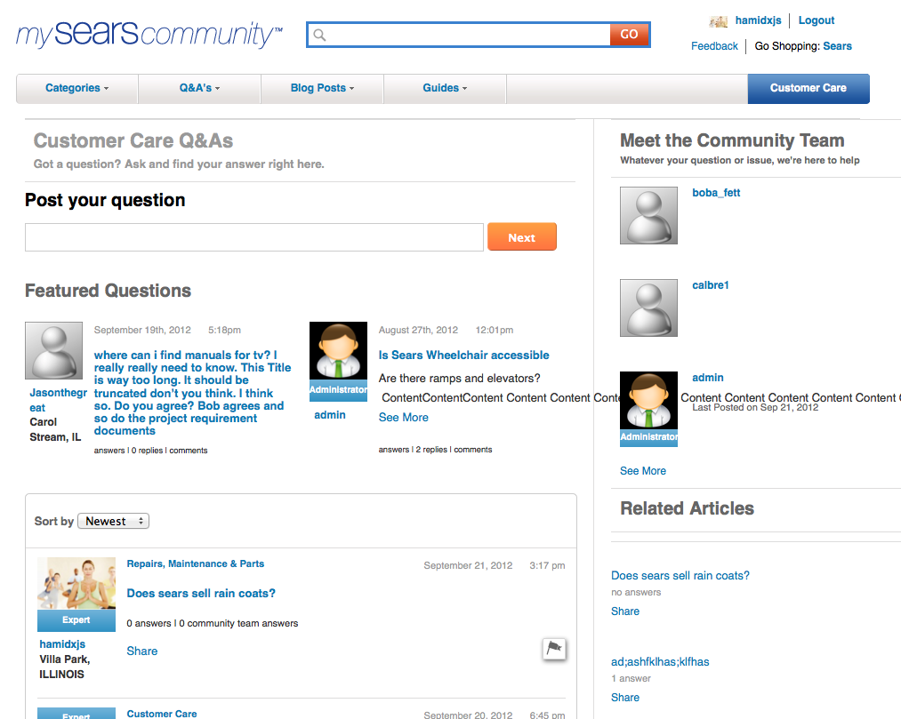
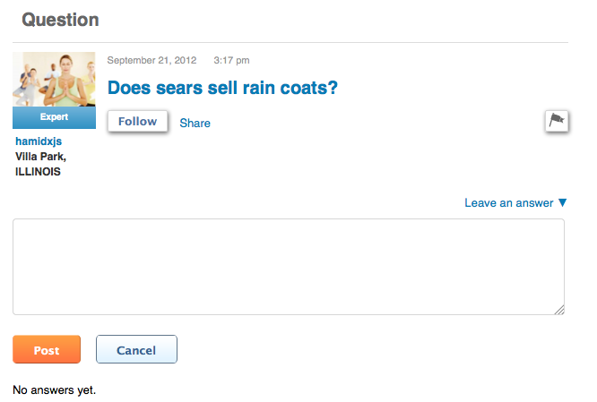
How to respond to a post?
1
Hover over ’Q&As’ tab on the Homepage
2
Click on ’Customer Care’ Link
3
Use filter to sort out ’Newest/Oldest’
4
Click on a question
✓
5
On question landing page, click on ’Leave an answer’
6
After it opens up content field, click ’Post’

Slide 5
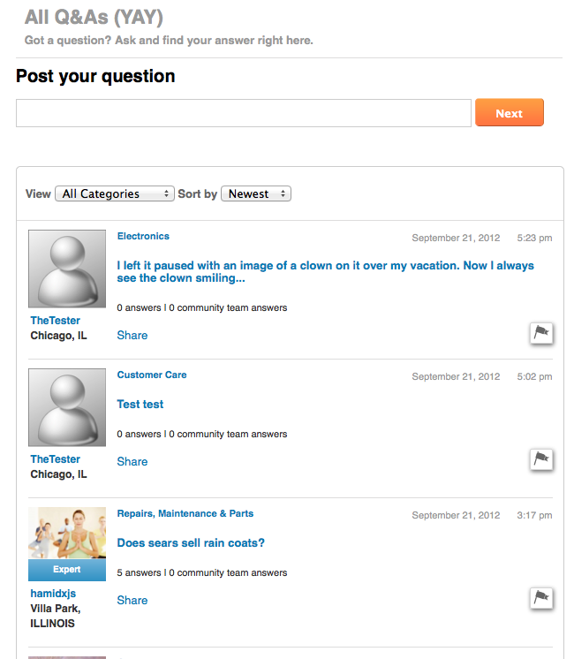
How to View/Sort by
Q&A?
1
Click on ’Q&As’ tab on the hompepage
✓
2
Use ’View/Sort by’ to filter through the questions by Category and Newest/Oldest

Slide 6
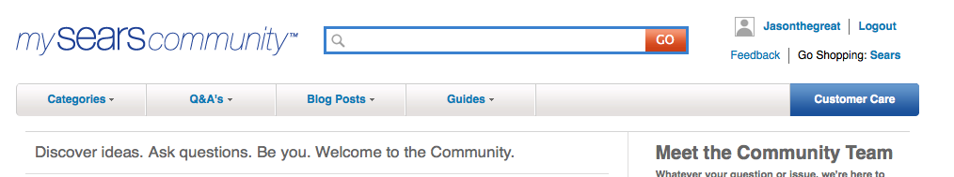
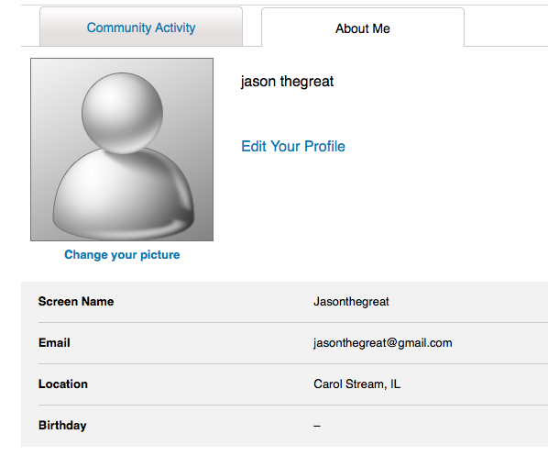
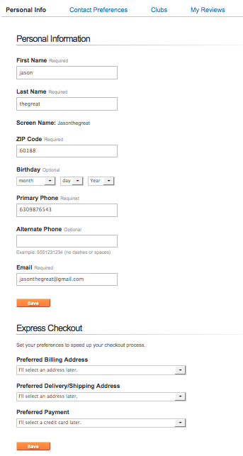
How to edit profile?
✓
1
Click on username on the top right of the header
5
2
Click on ’About Me’ tab
3
To change your picture, click on ’Change your picture’ and upload image that you want
4
To change your profile info, click on ’Edit your profile’(you might need to login once again)
5
Once logged in, change any information you see fit and click ’Save’
6
To navigate back to Communities, click ’Back’ until you get to ’Edit your profile’ page

Slide 7
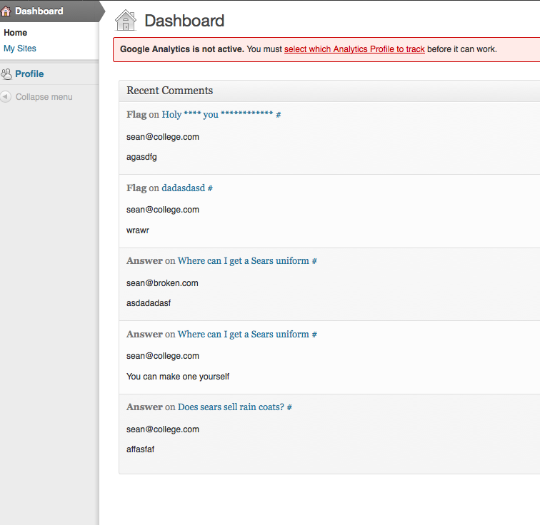
How to view a user’s
email address for
private emailing (CCN)?
1
Go to sears.com/community or kmart.com/community
2
Login with your credentials
3
Once longged in, go to the url add wp-admin after community (ex.sears.com/community/wp-admin)
4
User will be directed to the backend Dashboard where they can view user email under ’Recent Comments’ (the question must be commented on before its viewable on the backend)
✓

Slide 8

THANK YOU!

