Slide 1
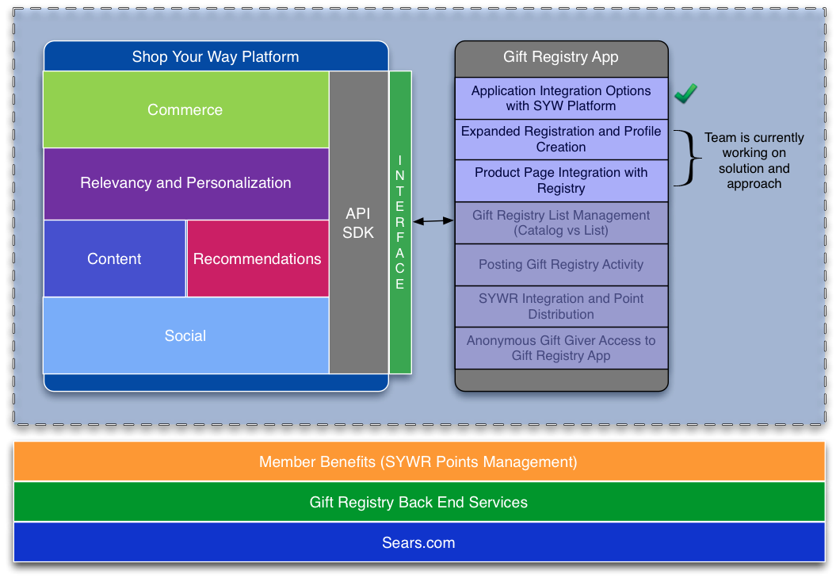
Architecture - Building on the Shop Your Way Platform

