Slide 1
Space BATTLE Modifications
F.U.N. Team //Insert SpongeBob reference here
CE810-2

Slide 2
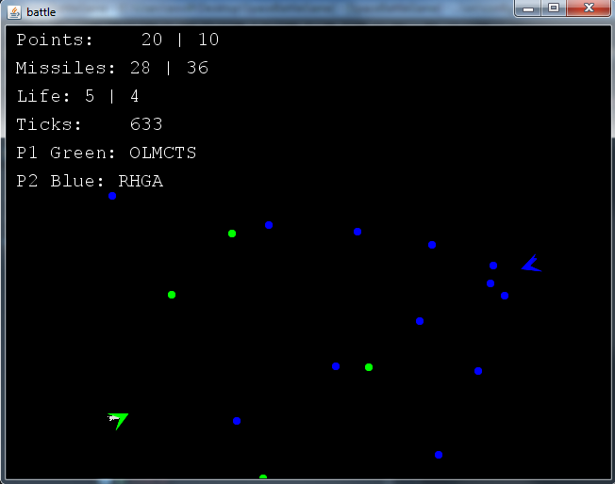
Triple shooting!
Everyone knows that shooting forward is too mainstream.
Added 2 new missiles! They are shot 45 and -45 degrees from the front.

Slide 3
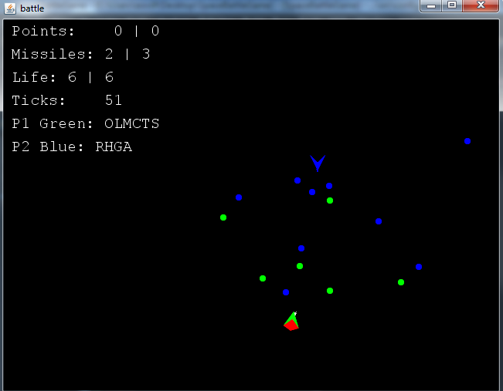
Losing points when shooting?
Not anymore!
Is a battle game! Fight with all your might! Do not fold your fire!

Slide 4
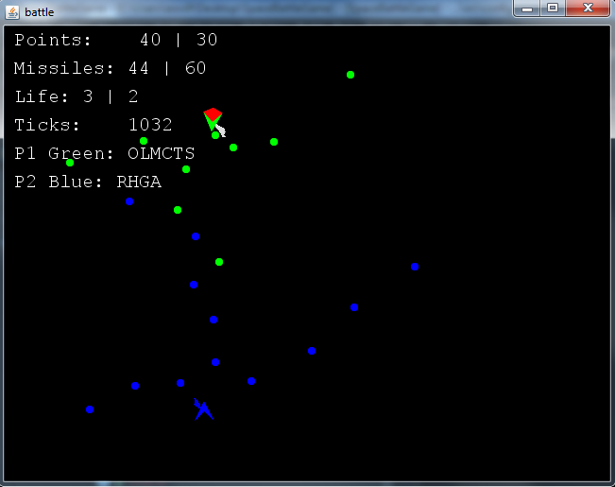
Flexible movement!
Because we know that moving forward is not enough. Spaceships move backwards too!

Slide 5
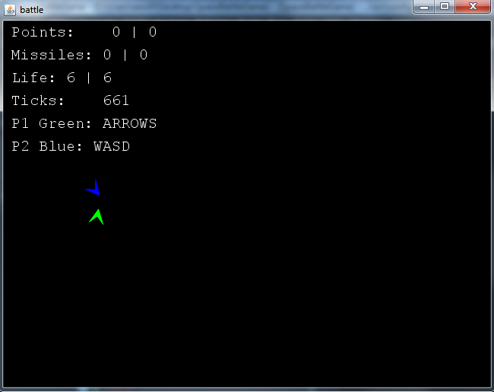
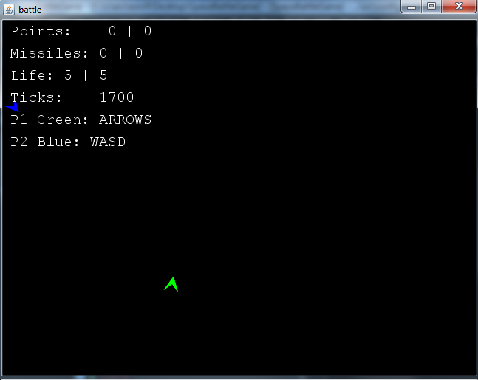
Spaceships colliding?
In the original version nothing interesting happened.
Now the spaceships are pushed backwards with a big force simulating an explosion.
Be careful!!! YOU WILL LOSE A LIFE!

Slide 6
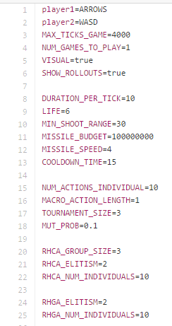
New properties
Maximum ticks = 4000
Missile budget = … a lot!
Cooldown time = 15
Lives = 6

Slide 7
