Slide 1

Music Trends Over 6 Year Period

Slide 2
Our Theory
We decided to track music trends over a 6-year period to see how music listening habits have changed
Our 2 main reasons to believe habits have changed are:
Did COVID have a long-term impact on music trends and listening habits
Did Tik-Toks rise in popularity change music

Slide 3
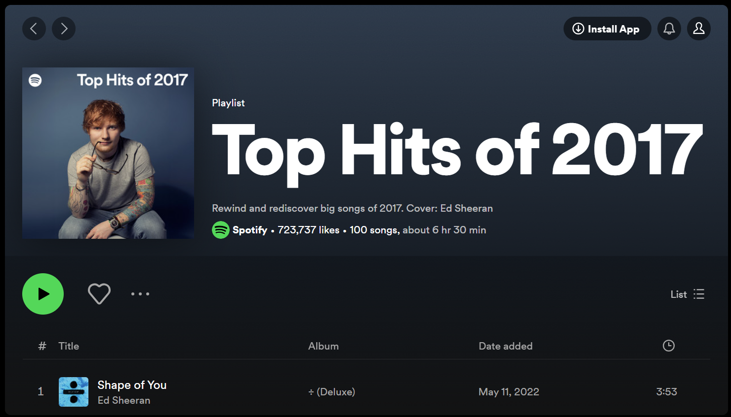
How we obtained our data
Spotify every year posts a playlist of their top 100 most streamed songs, and we have used these playlists as our data sets for our testing
Then using the Spotipy API we found details of all the songs within the playlists we further analyse
These details were:
Track Features (Danceability, Energy etc)
Artist Name
Genre
Track Name
Track Popularity

Slide 4
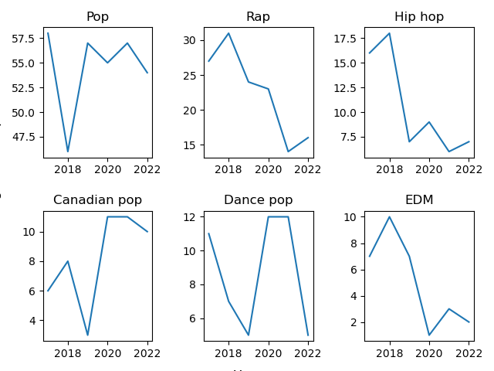
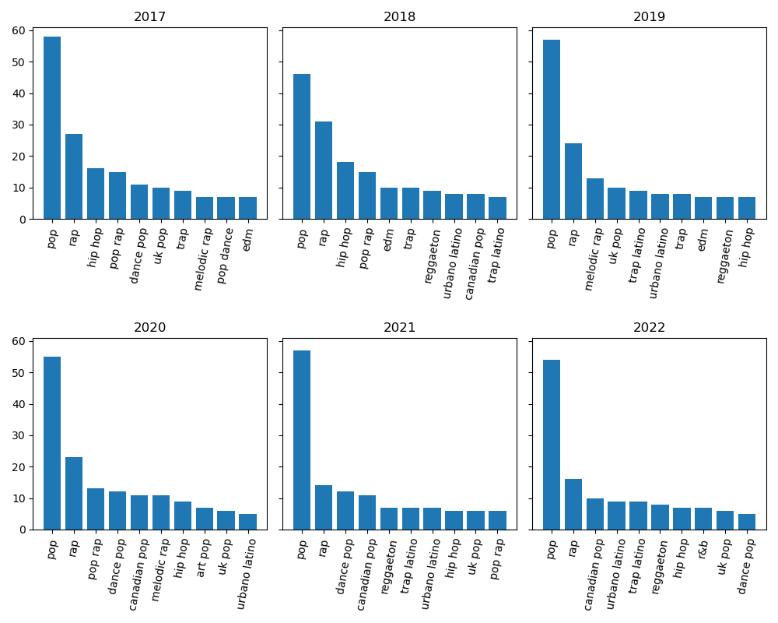
Have Genres Changed?

Slide 5

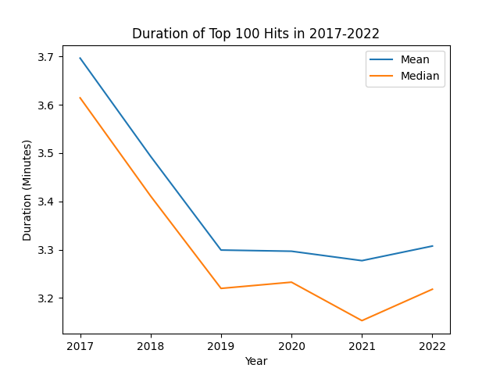
Has Song Duration Decreased?

Slide 6
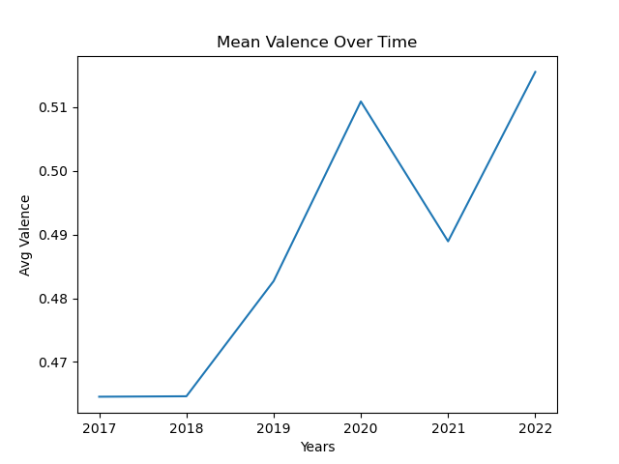
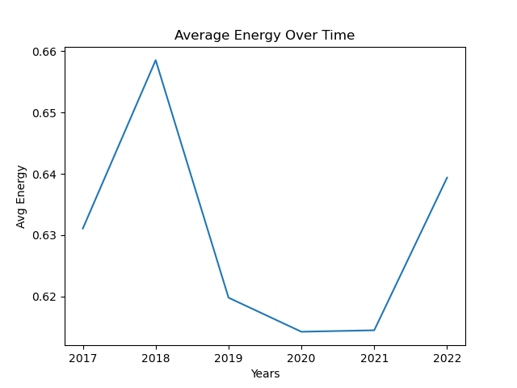
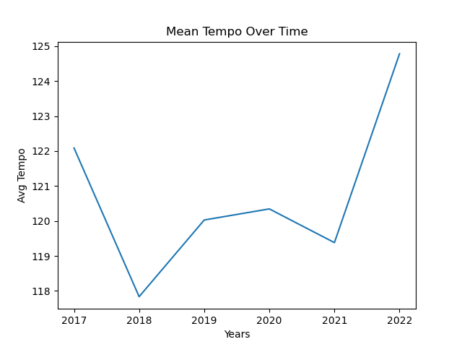
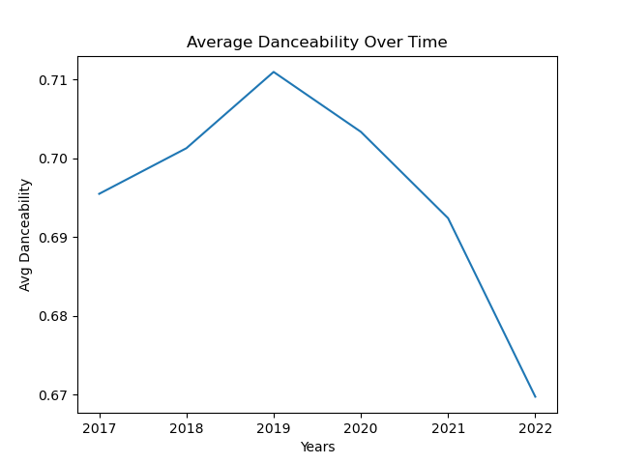
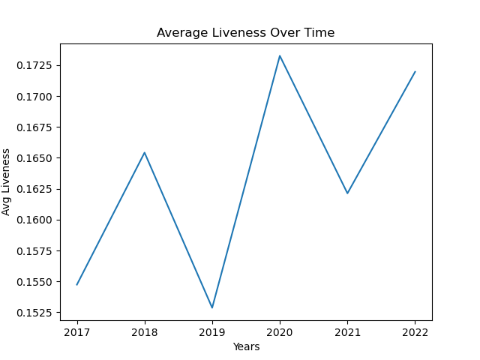
Have Track Features Changed?

Slide 7
Artists

Slide 8
Conclusions

