Slide 1
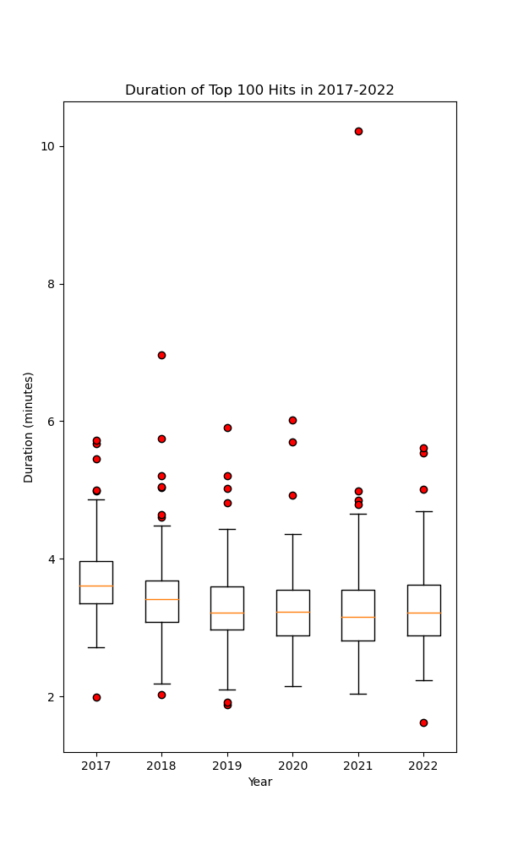
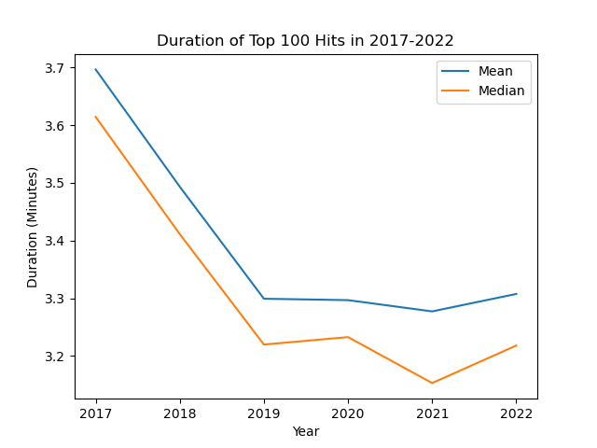
Has Song Duration Decreased?
Short answer: YES!
How?
Line plot & Boxplot
BOTH mean duration and median duration decreased
There are songs with a variety of durations,
but this does not affect the overall results

Slide 2
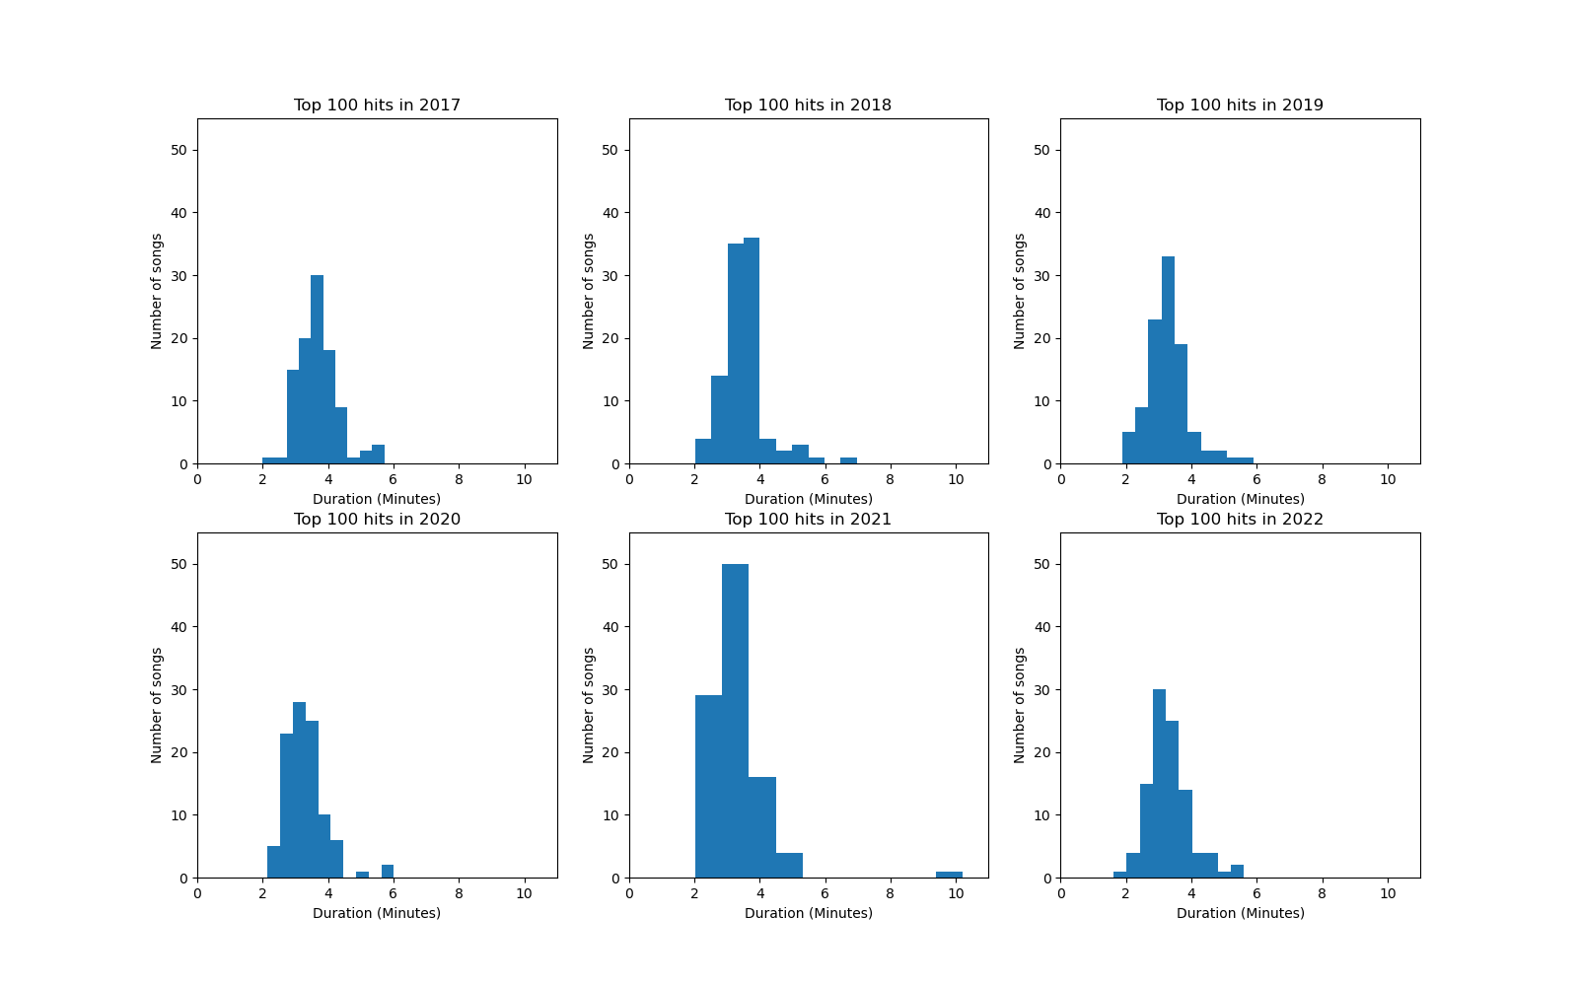
Song Duration Has Decreased
How?
Histogram
Shifted left over the years
More shorter songs in 2022 than in 2017

Slide 3
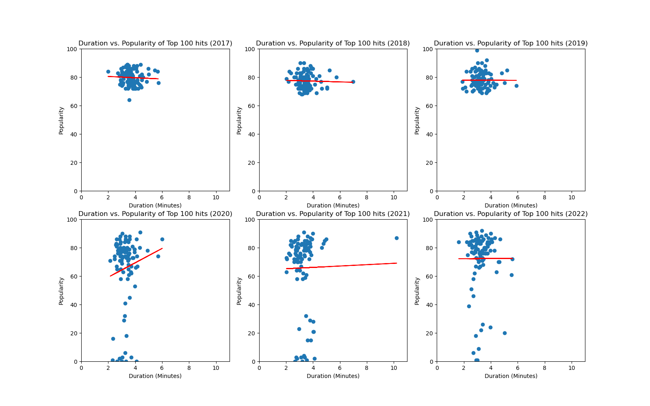
A few more questions to ask
Are shorter songs more popular?
Scatter plot - Duration Vs. Popularity
-0.06 < r-value < 0.15

Slide 4
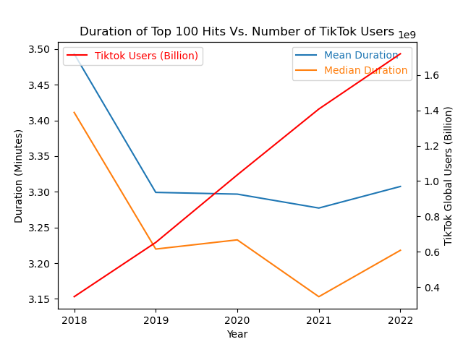
A few more questions to ask
Did the rise of TikTok or other short video social media websites contribute to the change in music duration?
Duration Vs. TikTok users
r-value ~ - 0.7
Was the COVID-19 pandemic a major factor underlying this trend?
No conclusions can be drawn based on the analysed data

