Slide 1

Music Trends Over 6 Year Period

Slide 2
Our Theory
We decided to track music trends over a 6-year period to see how music listening habits have changed
Our 2 main reasons to believe habits have changed are:
Did COVID have a long-term impact on music trends and listening habits
Did Tik-Toks rise in popularity change music

Slide 3
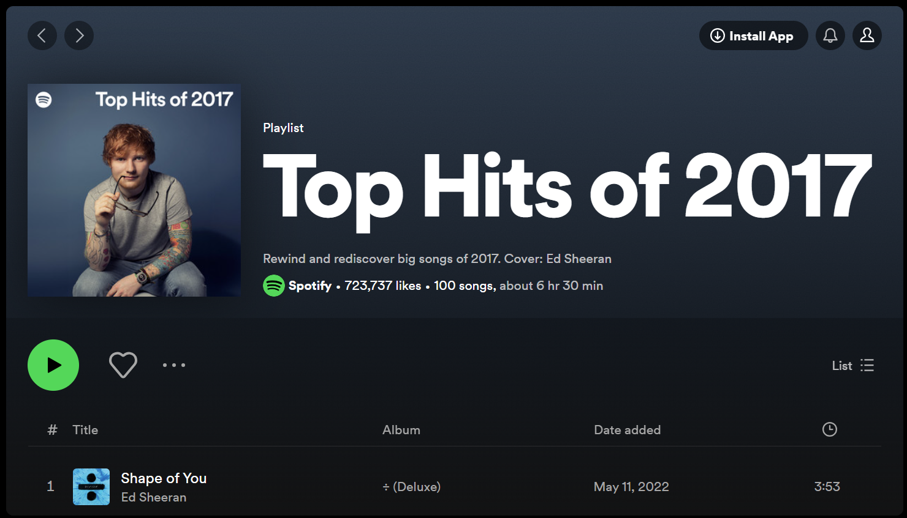
How we obtained our data
Spotify every year posts a playlist of their top 100 most streamed songs, and we have used these playlists as our data sets for our testing
Then using the Spotipy API we found details of all the songs within the playlists we further analyse
These details were:
Track Features (Danceability, Energy etc)
Artist Name
Genre
Track Name
Track Popularity

Slide 4
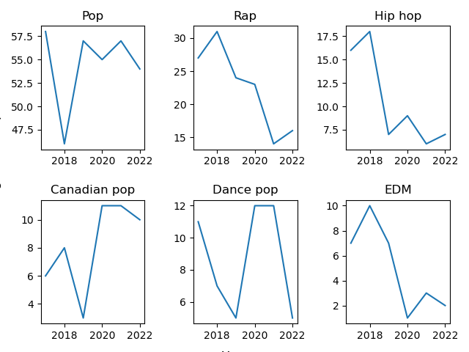
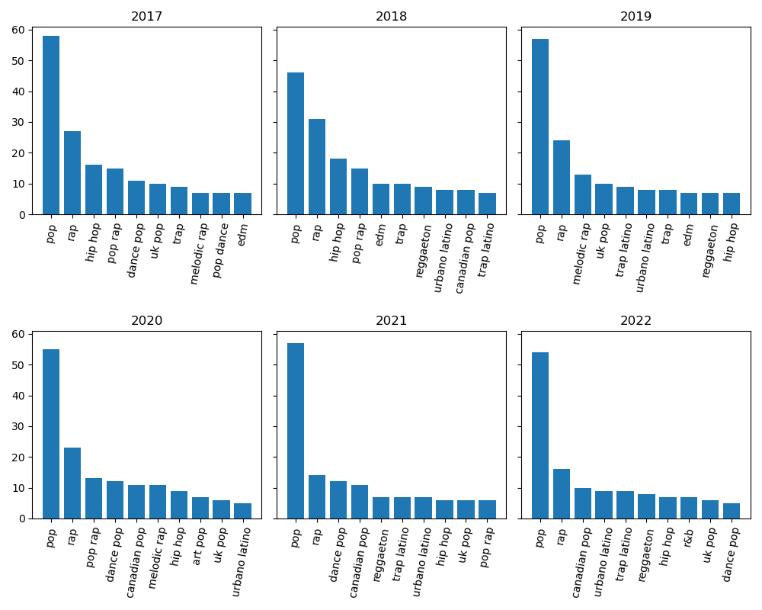
Have Genres Changed?

Slide 5
Artist Behaviour
Are there Artists that have managed to be in the top 100 multiple times?
Are there any artists that have been in the top 100 throughout the sampled years?
What could be a factor to their consistency to produce hits?

Slide 6
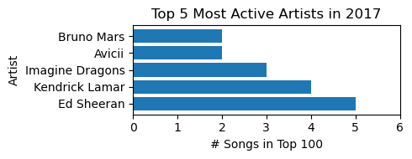
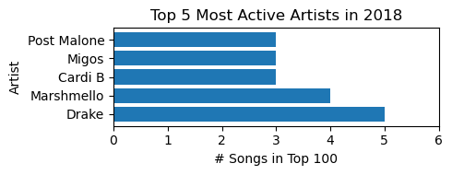
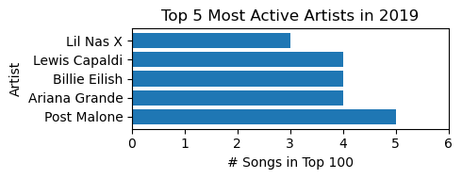
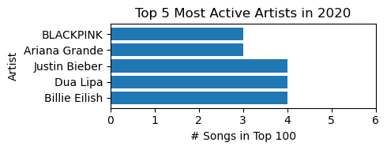
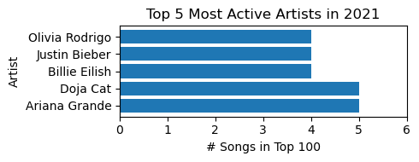
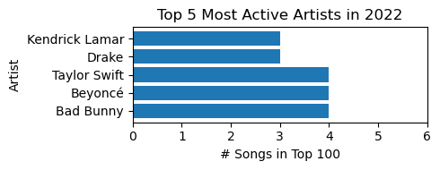
Multiple Hits
How Many Songs per artist on Average
Sample of 5 Artists with the Most Songs for each Year
Year | Average Song Count
2017 | 1.3
2018 | 1.3
2019 | 1.4
2020 | 1.4
2021 | 1.6
2022 | 1.5

Slide 7
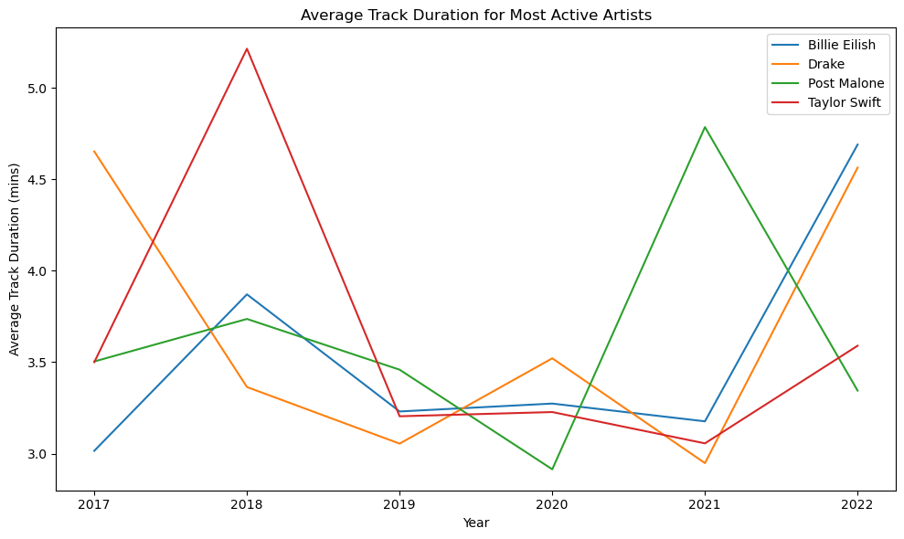
Who were the consistent artists with multiple hits
Only 5 Artists had a song in the top 100 in every year.
One of the artists didn’t appear in the top 5 with more than one top 100 song in a single year in this sampled period (Shawn Mendes)
There is a noticeable dip in all artists average song duration in 2019

Slide 8
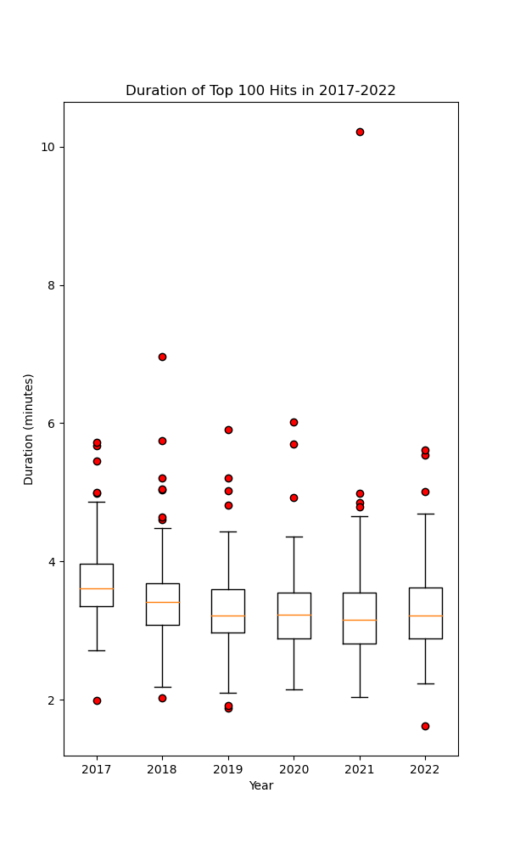
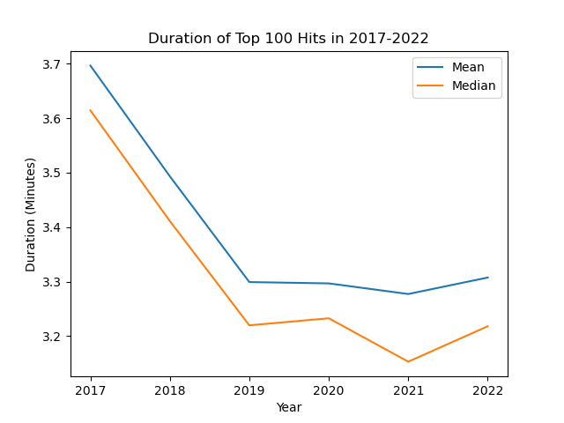
Has Song Duration Decreased?
Short answer: YES!
How?
Line plot & Boxplot
BOTH mean duration and median duration decreased
There are songs with a variety of durations,
but this does not affect the overall results

Slide 9
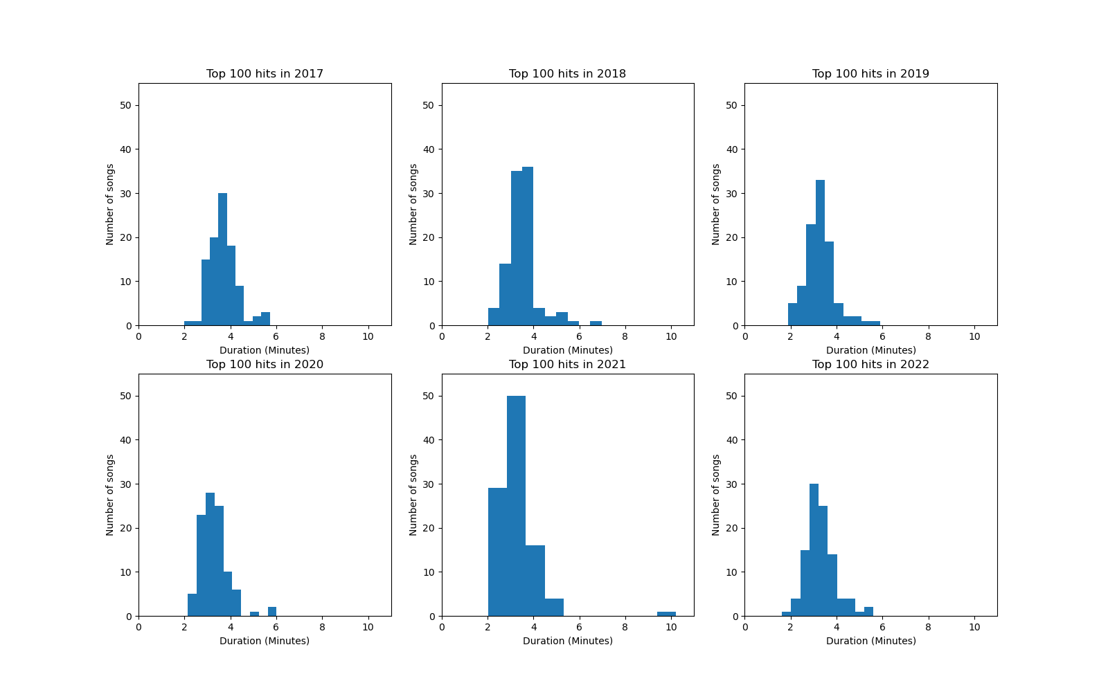
Song Duration Has Decreased
How?
Histogram
Shifted left over the years
More shorter songs in 2022 than in 2017

Slide 10
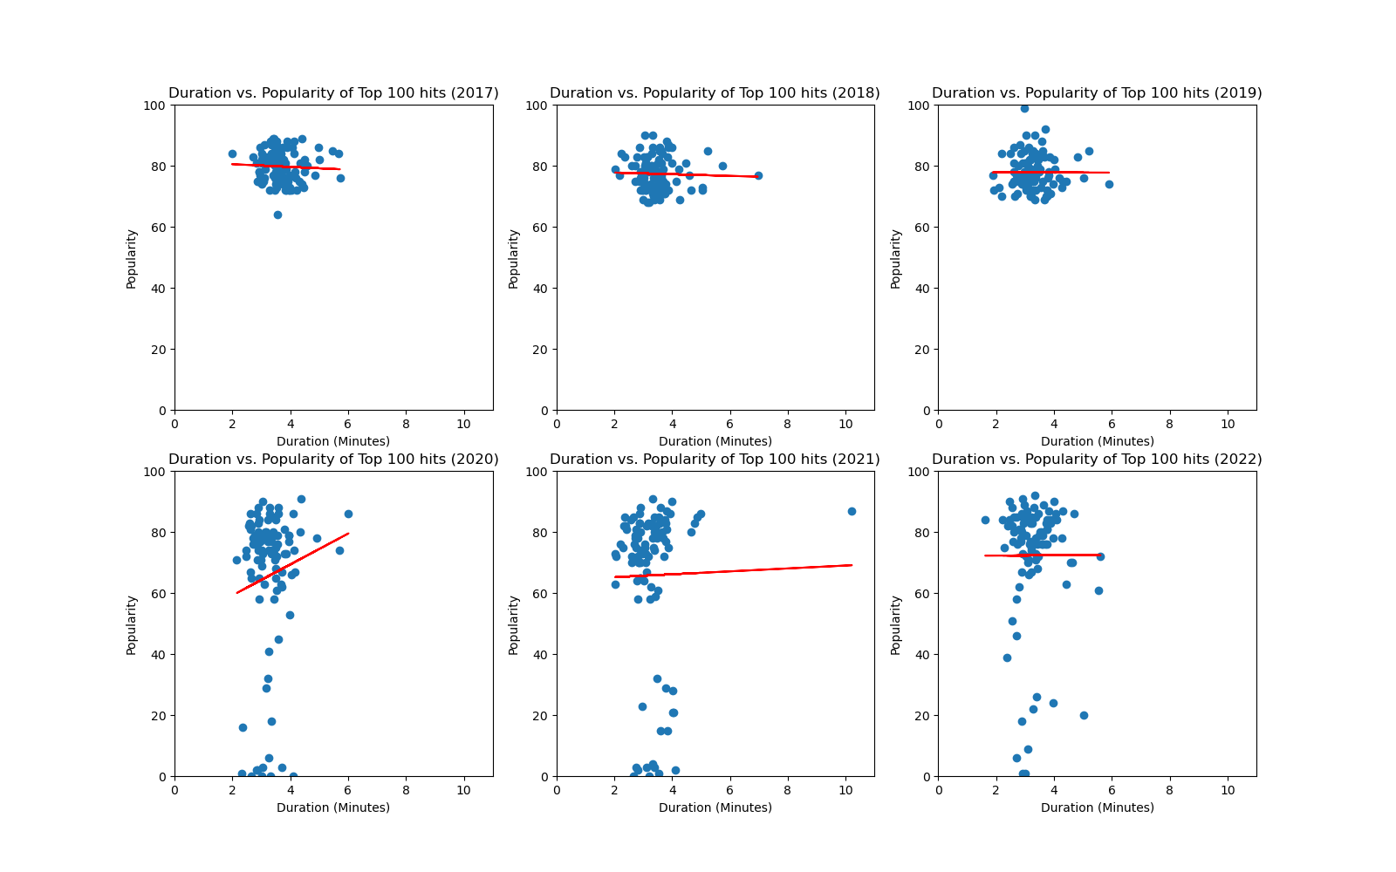
A few more questions to ask
Are shorter songs more popular?
Scatter plot - Duration Vs. Popularity
-0.06 < r-value < 0.15

Slide 11
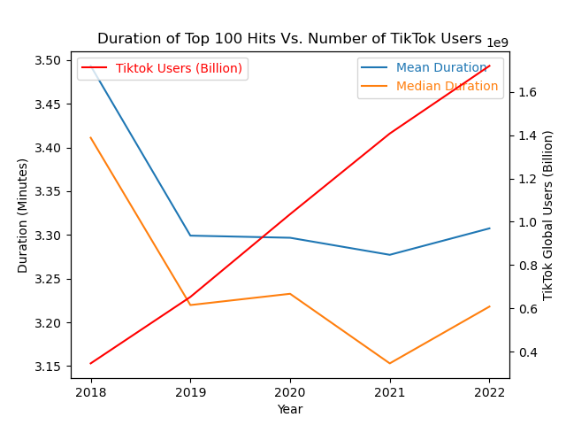
A few more questions to ask
Did the rise of TikTok or other short video social media websites contribute to the change in music duration?
Duration Vs. TikTok users
r-value ~ - 0.7
Was the COVID-19 pandemic a major factor underlying this trend?
No conclusions can be drawn based on the analysed data

Slide 12
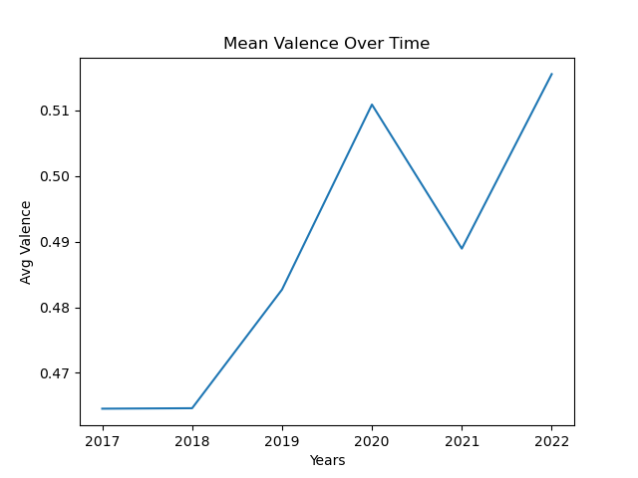
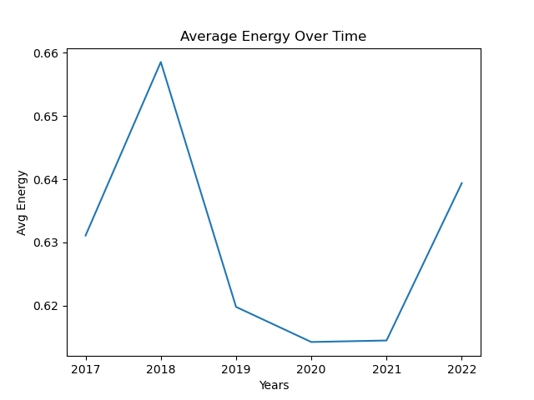
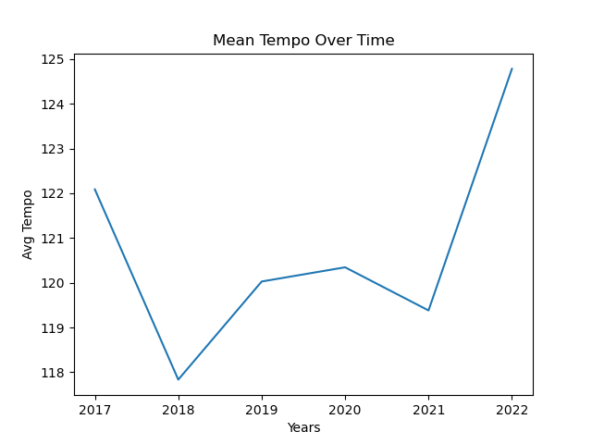
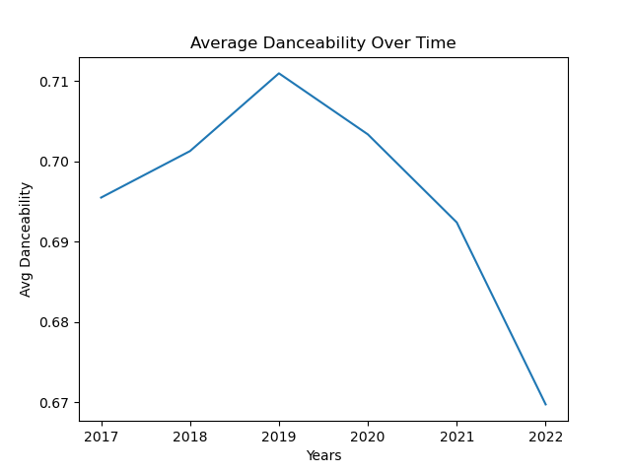
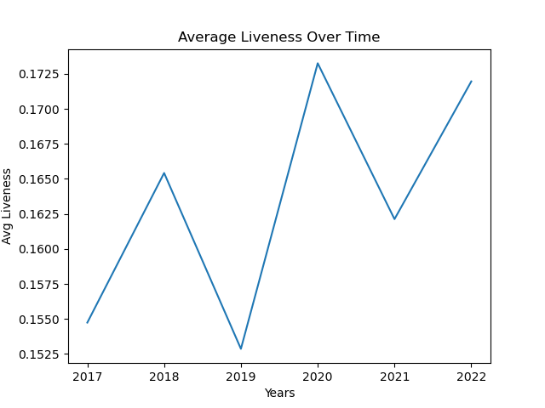
Have Track Features Changed?

Slide 13
Conclusions

