Slide 1

Music Trends Over 6 Year Period

Slide 2
Our Theory
We decided to track music trends over a 6-year period to see how music listening habits have changed
Our 2 main reasons to believe habits have changed are:
Did COVID have a long-term impact on music trends and listening habits
Did Tik-Toks rise in popularity change music

Slide 3
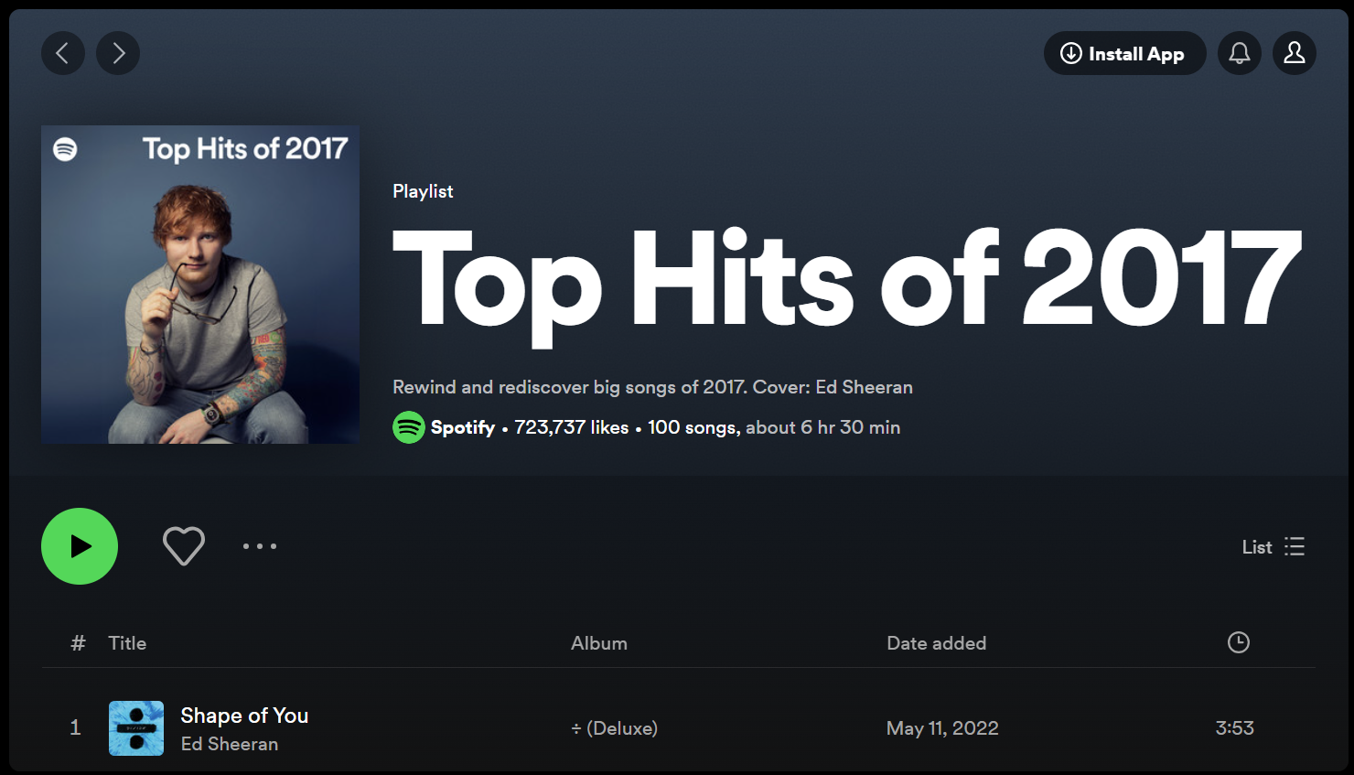
How we obtained our data
Spotify every year posts a playlist of their top 100 most streamed songs, and we have used these playlists as our data sets for our testing
Then using the Spotipy API we found details of all the songs within the playlists we further analyse
These details were:
Track Features (Danceability, Energy etc)
Artist Name
Genre
Track Name
Track Popularity

Slide 4
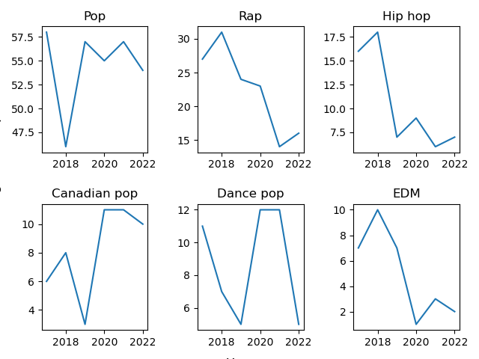
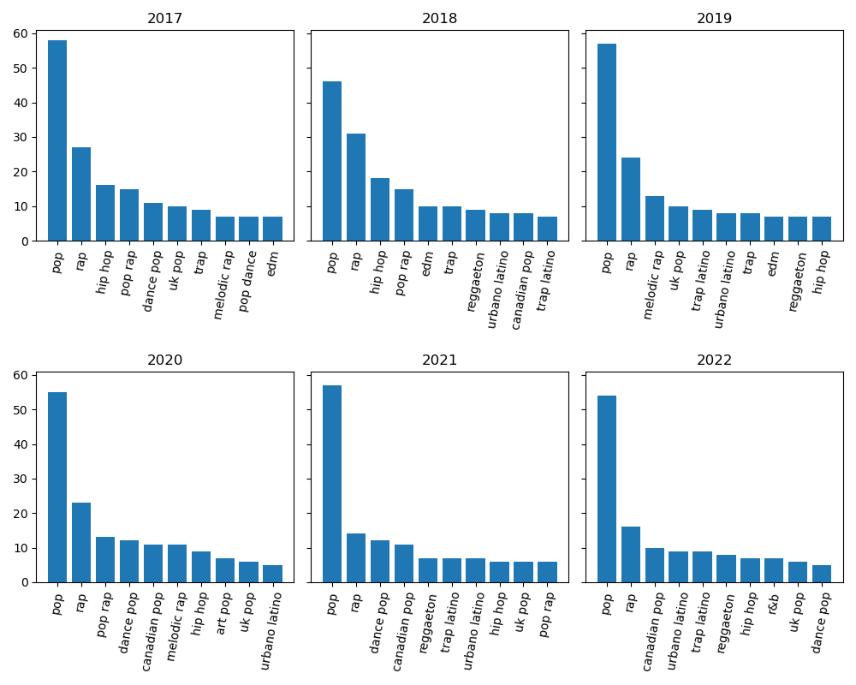
Have Genres Changed?

Slide 5
Artists

Slide 6
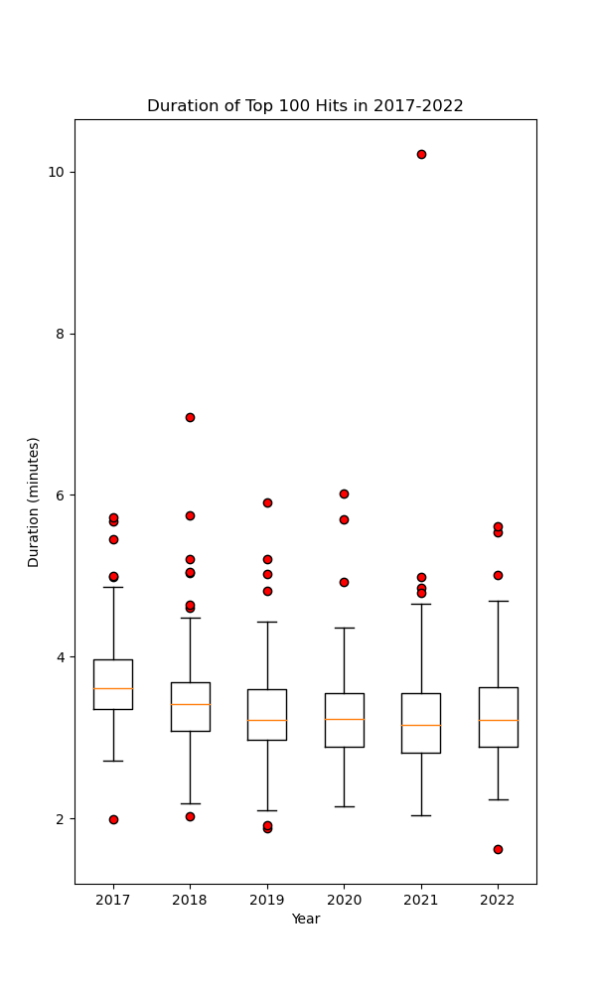
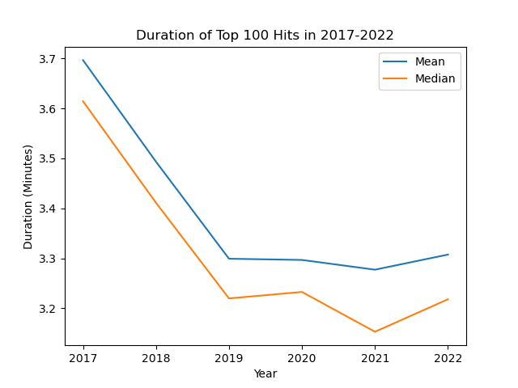
Has Song Duration Decreased?
Short answer: YES!
How?
Line plot & Boxplot
BOTH mean duration and median duration decreased
There are songs with a variety of durations,
but this does not affect the overall results

Slide 7
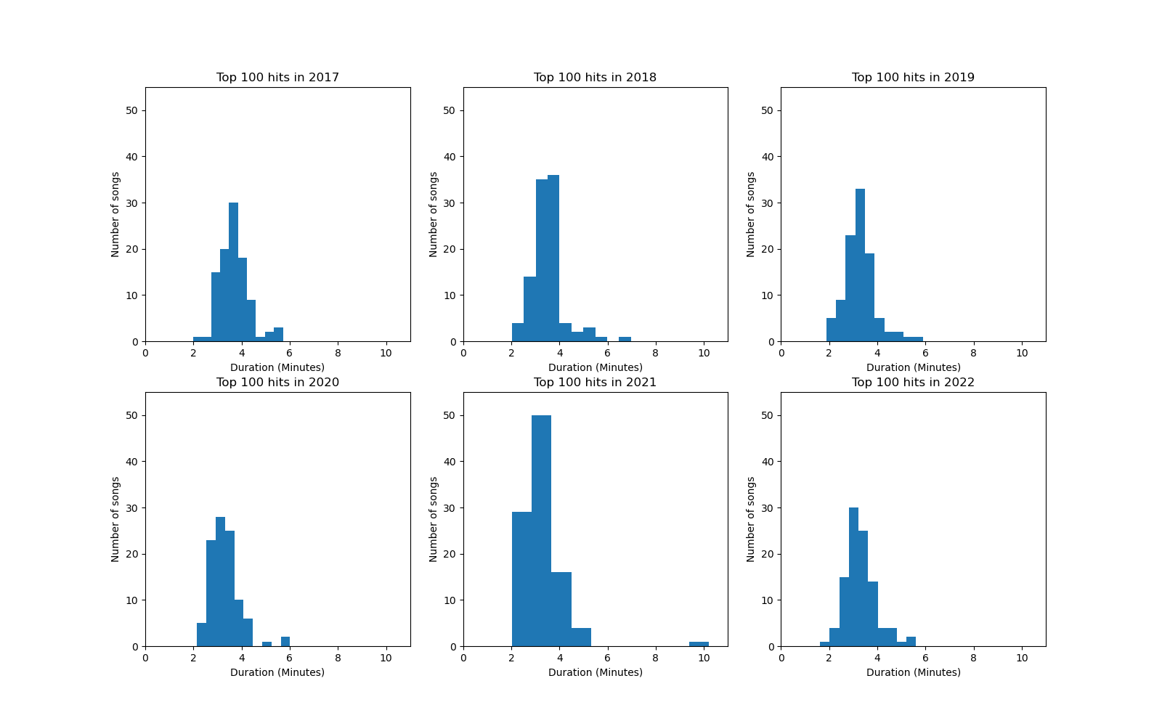
Song Duration Has Decreased
How?
Histogram
Shifted left over the years
More shorter songs in 2022 than in 2017

Slide 8
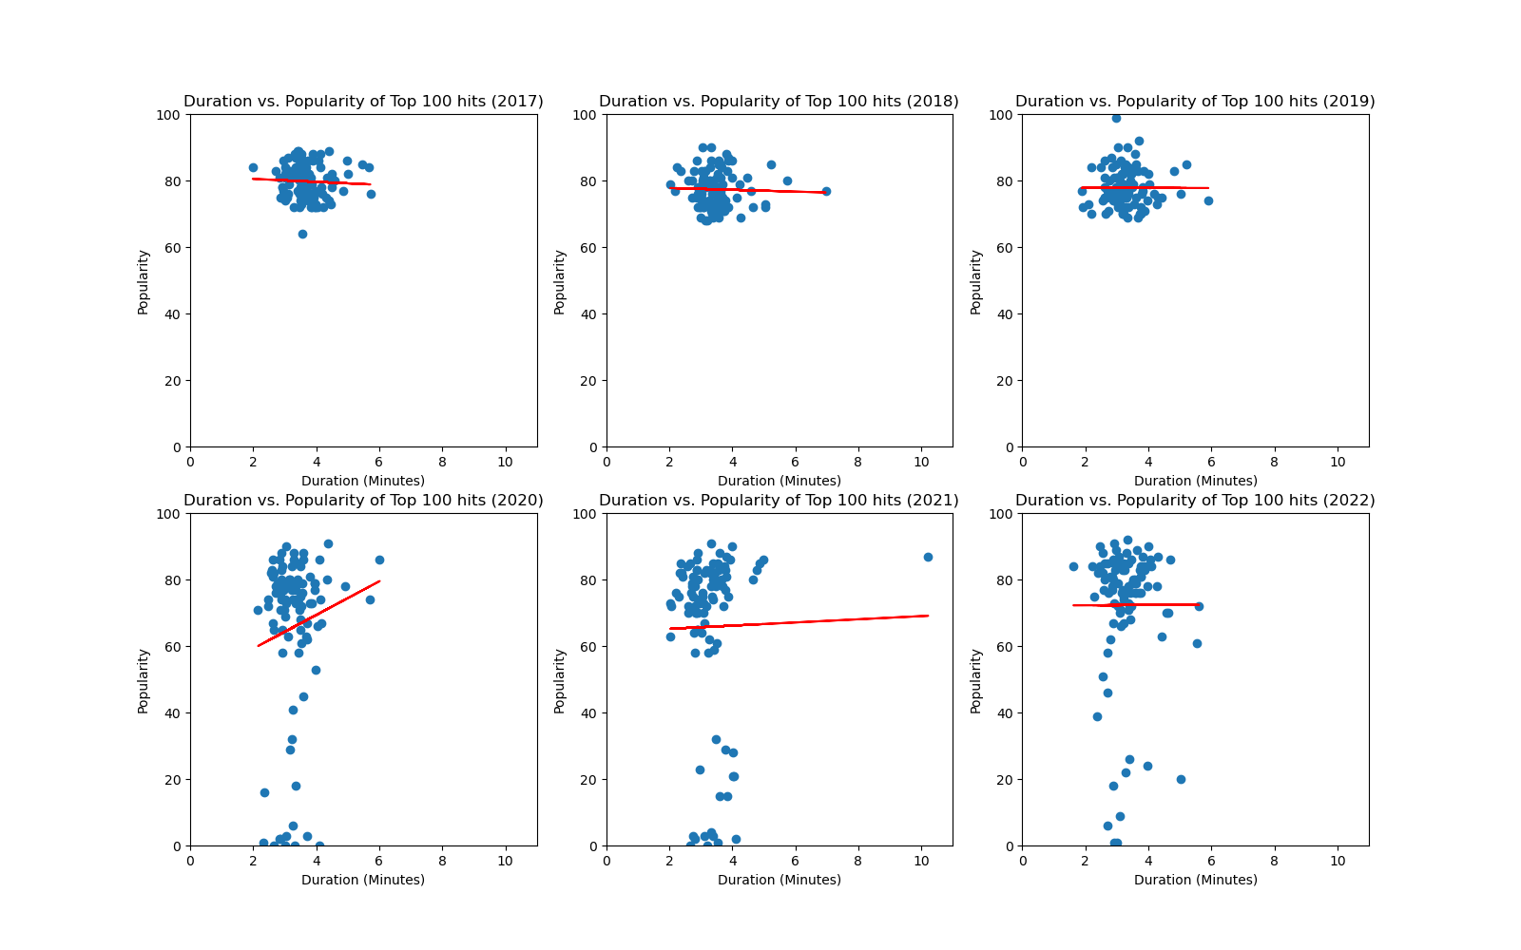
A few more questions to ask
Are shorter songs more popular?
Scatter plot - Duration Vs. Popularity
-0.06 < r-value < 0.15

Slide 9
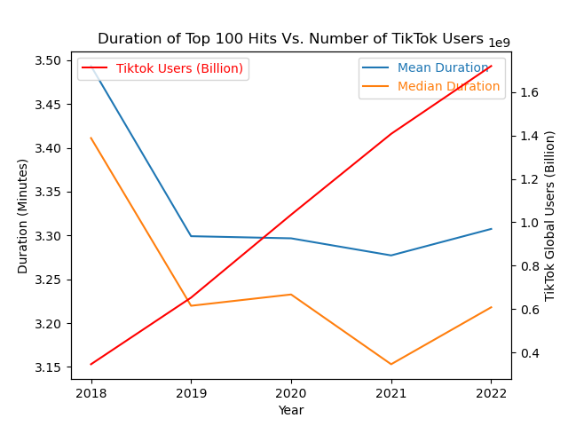
A few more questions to ask
Did the rise of TikTok or other short video social media websites contribute to the change in music duration?
Duration Vs. TikTok users
r-value ~ - 0.7
Was the COVID-19 pandemic a major factor underlying this trend?
No conclusions can be drawn based on the analysed data

Slide 10
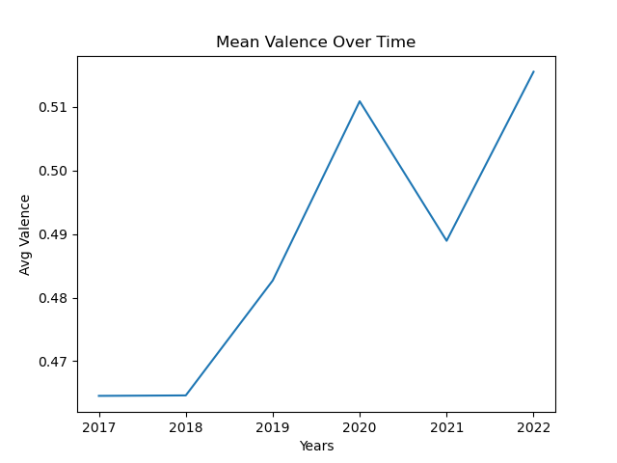
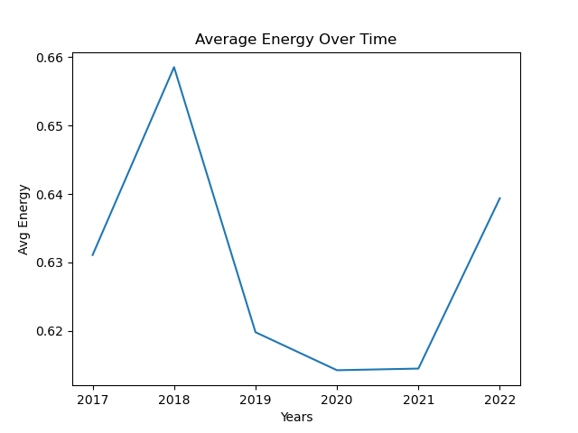
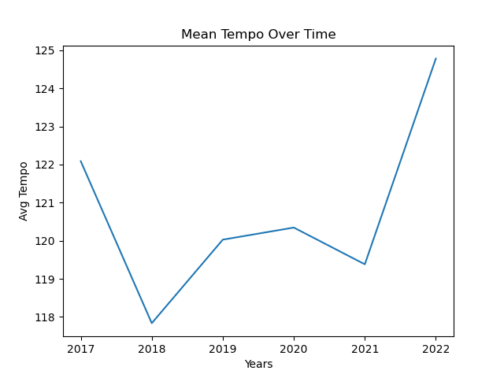
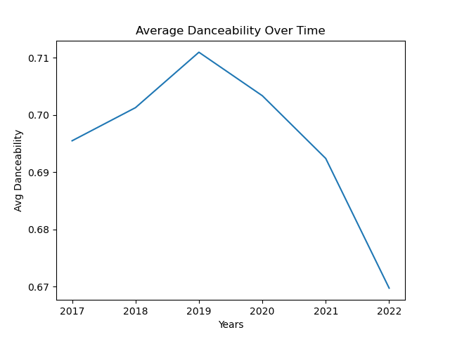
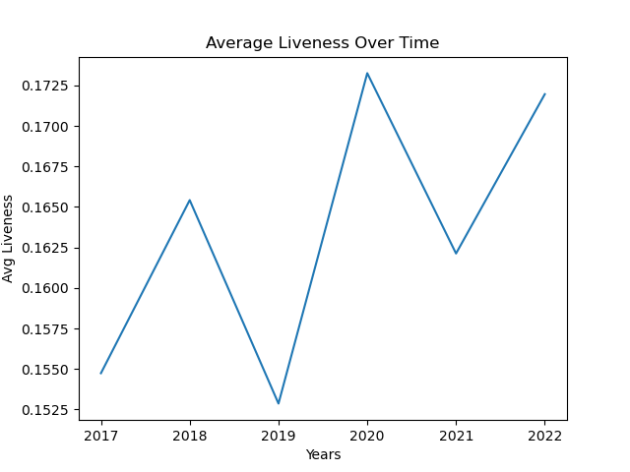
Have Track Features Changed?

Slide 11
Conclusions

