Slide 1

Few Shot Object Detection
Jean-Bernard Uwineza FirstName LastName FirstName LastName
FirstName LastName FirstName LastName
EE260: Intro to Deep Learning

Slide 2
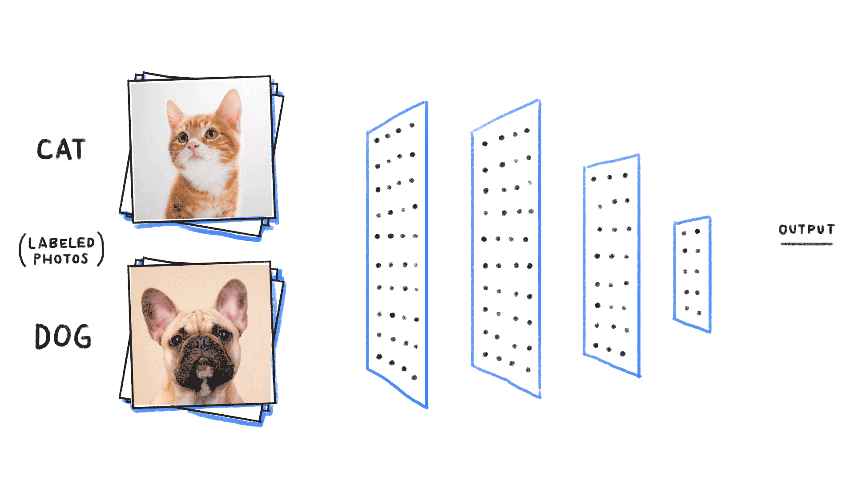
What is Object Recognition?
Object Classification (or recognition) involves recognizing specific pre-specified objects or object classes.
Usually done in image classification where each image is assigned one label from a set of categories.
Few Shot Object Detection

Slide 3
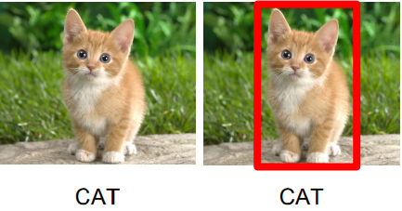
What is Object Localization?
Object Localization involves specifying locations of recognized objects.
Usually, just putting bounding boxes around recognized objects.
Few Shot Object Detection

Slide 4
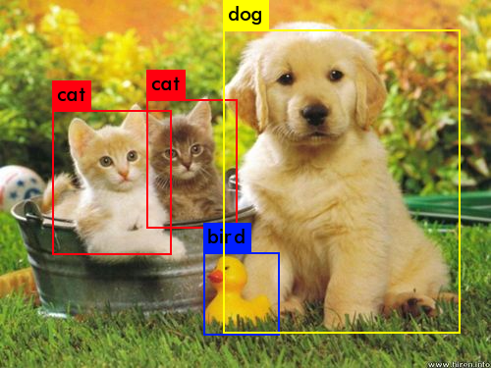
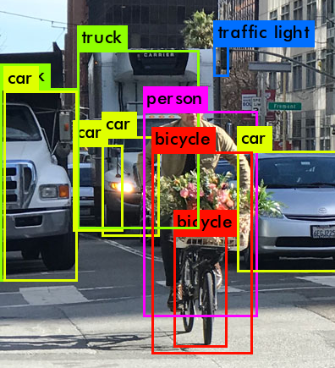
Object Detection
Object Detection combines classification and localization.
Each recognized object is given a location and a class label.
Few Shot Object Detection

Slide 5
Few Shot Detection
Training detector requires many training examples per class.
If we want to introduce new classes, we need many examples to fine-tune the model.
Few Shot Detection attempts to use as few training examples for new classes of objects.
There are two prominent approaches:
Meta-learning & Few-shot finetuning
Few Shot Object Detection

Slide 6
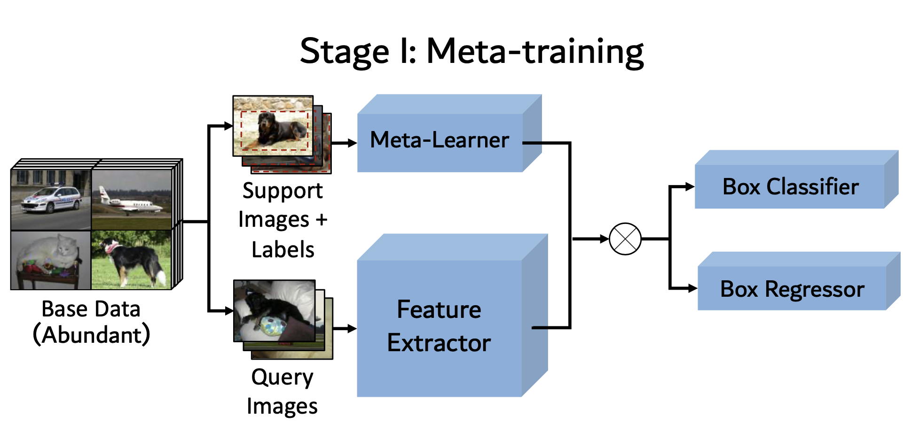
Meta-Learning
Few Shot Object Detection

Slide 7
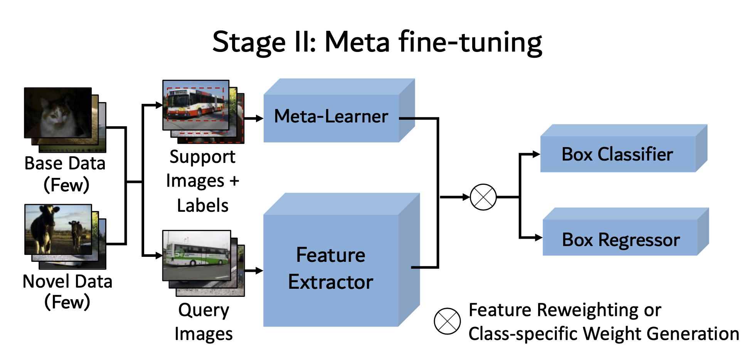
Meta-Learning
Few Shot Object Detection

Slide 8
Introduction
To add other slides, just duplicate or copy this slide.
Only change the tile and the body.
DO NOT change the Footer area.
Few Shot Object Detection

Slide 9
Thank you!

