Slide 1
Internet Programming
Bayu Priyambadha, S.Kom
Achmad Arwan, s.kom
Widhy h, s.kom

Slide 2
Course Objectives
Students are able to understand the concept of website application, especially server-side application
Students are able to understand and apply how to design a dynamic website

Slide 3
Course Scoring
40% Final Project
35% Assignment
25% Mid-Exam

Slide 4
Road Map (1)
Introduction
PHP, HTML, and State
Decisions, Loops, and Arrays
Files and Directories
Retrieving Data From MySQL using PHP
Using PHP to Manipulate Data in MySql
PHP5 and E-Mail
UTS

Slide 5
Road Map (2)
OOP With PHP
MVC Concept
CodeIgniter (1)
CodeIgniter (2)
How to Create PHP Framework
How to Create PHP Framework
Presentation Final Project
Presentation Final Project

Slide 6
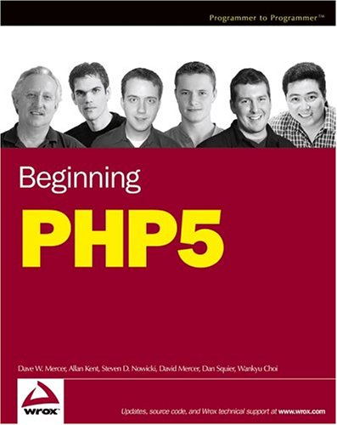
Referensi
Mercer, Dave. 2004. Baginning PHP 5. Wrox Press. Indianapolis, Indiana.

Slide 7
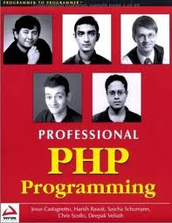
Referensi
Castagnetto, Jesus et al. 1999. Professional PHP Programming. Wrox

Slide 8

Referensi
Upton, David. 2007. CodeIgniter for Rapid PHP Applicarion Development. PACKT. Birmingham, UK

Slide 9
Thanks

