Slide 1
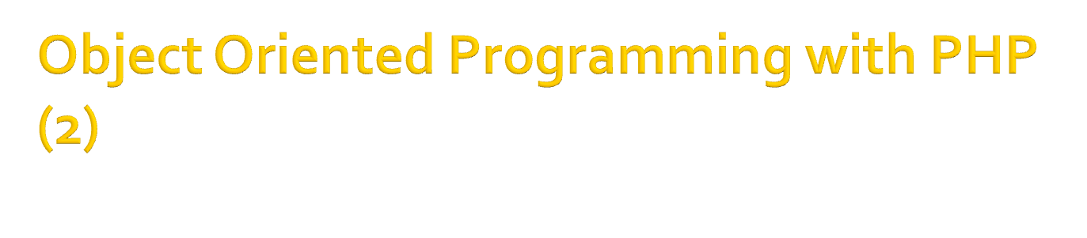
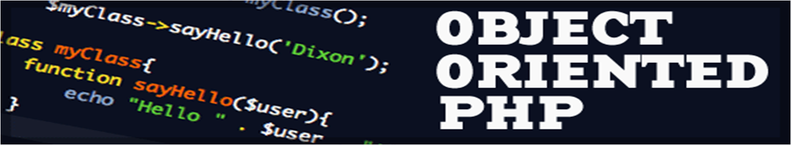
Bayu Priyambadha, S.Kom

Slide 2

Final Keyword
Class Abstraction
Object Interfaces

Slide 3

PHP introduces “Final” keyword, that prevent overriding of sub-class method
“Final” can be implement at method and class
Final class means that class cannot be extended

Slide 4

<?php
class BaseClass {
public function test() {
echo "BaseClass::test() called\n";
}
final public function moreTesting() {
echo "BaseClass::moreTesting() called\n";
}
}
class ChildClass extends BaseClass {
public function moreTesting() {
echo "ChildClass::moreTesting() called\n";
}
}
// Results in Fatal error: Cannot override final method BaseClass::moreTesting()
?>

Slide 5
<?php
final class BaseClass {
public function test() {
echo "BaseClass::test() called\n";
}
// Here it doesn't matter if you specify the function as final or not
final public function moreTesting() {
echo "BaseClass::moreTesting() called\n";
}
}
class ChildClass extends BaseClass {
}
// Results in Fatal error: Class ChildClass may not inherit from final class (BaseClass)
?>

Slide 6

Class that is defined as an abstract cannot be instantiated
Class that consist of one abstract method, must be declared as abstract class

Slide 7

abstract class AbstractClass
{
// Force Extending class to define this method
abstract protected function getValue();
abstract protected function prefixValue($prefix);
// Common method
public function printOut() {
print $this->getValue() . "\n";
}
}
class ConcreteClass1 extends AbstractClass
{
protected function getValue() {
return "ConcreteClass1";
}
public function prefixValue($prefix) {
return "{$prefix}ConcreteClass1";
}
}

Slide 8

Object Interfaces allow us to define method without detail
Methods of Interfaces must be define with public modifier
Using “implement” keyword to use object interfaces

Slide 9

Class cannot implement more than one class that consist of the same method
Interface can be inherited as same as usual class using “extend” keyword
Class that implement the interfaces must be use all methods it owned, with the same specification

Slide 10
<?php
interface a
{
public function foo();
}
interface b extends a
{
public function baz(Baz $baz);
}
// This will work
class c implements b
{
public function foo()
{
}
public function baz(Baz $baz)
{
}
}
?>

Slide 11

Monyet merupakan salah satu dari jenis Hewan, Monyet mempunyai kemampuan untuk Berjalan, Makan dan Bersuara, tapi suatu saat Monyet apabila dilatih akan bisa Berkendara seperti naik sepeda yang tidak dipunyai oleh hewan lainnya.

Slide 12
<?php
echo “Terima Kasih....!!!”
?>

