Slide 1


Slide 2

Understanding about How to Working with Server Side Scripting using PHP Framework (CodeIgniter)

Slide 3

Introduction to CodeIgniter (CI)
The Structures of CI Website
Using CI to Simplify Databases

Slide 4


Slide 5

CI is a powerful PHP framework with a very small footprint, built for PHP coders who need a simple and elegant toolkit to create full-featured web applications

Slide 6

Model-View-Controller Based System
PHP 4 Compatible
Extremely Light Weight
Full Featured database classes with support for several platforms.
Active Record Database Support
Form and Data Validation
Security and XSS Filtering
Session Management

Slide 7
Email Sending Class. Supports Attachments, HTML/Text email, multiple protocols (sendmail, SMTP, and Mail) and more.
Image Manipulation Library (cropping, resizing, rotating, etc.). Supports GD, ImageMagick, and NetPBM
File Uploading Class
FTP Class
Localization
Pagination

Slide 8
Data Encryption
Benchmarking
Full Page Caching
Error Logging
Application Profiling
Scaffolding
Calendaring Class
User Agent Class

Slide 9
Zip Encoding Class
Template Engine Class
Trackback Class
XML-RPC Library
Unit Testing Class
Search-engine Friendly URLs
Flexible URI Routing
Support for Hooks, Class Extensions, and Plugins
Large library of "helper" functions

Slide 10


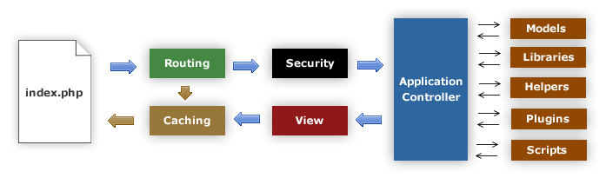

Slide 11
The Flow
  The index.php serves as the front controller, initializing the base resources needed to run CodeIgniter.
  The Router examines the HTTP request to determine what should be done with it.
  If a cache file exists, it is sent directly to the browser, bypassing the normal system execution.
  Security. Before the application controller is loaded, the HTTP request and any user submitted data is filtered for security.
  The Controller loads the model, core libraries, plugins, helpers, and any other resources needed to process the specific request.
  The finalized View is rendered then sent to the web browser to be seen. If caching is enabled, the view is cached first so that on subsequent requests it can be served.

Slide 12

CI is based on the Model-View-Controller development pattern
  Model
    represents data structures, typically will contain functions to retrieve, insert, and update information in a database.
  View
    the information that is being presented to a user, normally a web page, but can also be a page fragment like a header or footer, RSS page, or any other type of "page"
  Controller
    serves as an intermediary between the Model, the View, and any other resources needed to process the HTTP request and generate a web page

Slide 13
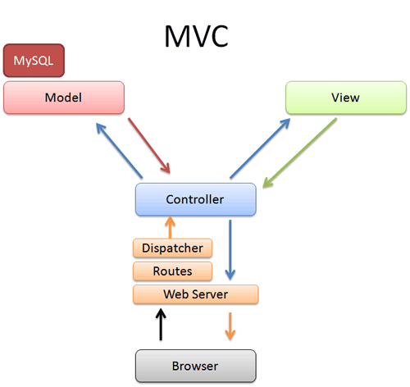

Slide 14

CI goal is maximum performance, capability, and flexibility in the smallest, lightest possible package
  Dynamic Instantiation
    components are loaded and routines executed only when requested, rather than globally
  Loose Coupling
    the less components depend on each other the more reusable and flexible the system becomes
  Component Singularity
    each class and its functions are highly autonomous in order to allow maximum usefulness

Slide 15


Slide 16

Controller is simply a class file that is named in a way that can be associated with a URI
  localhost/index.php/hello/
<?php
class Hello extends Controller {
function index()
{
echo 'Hello World!';
}
}
?>

Slide 17
Function
  function can be add to the controller and called by the URI segment
    localhost/index.php/hello/index

Slide 18

View is simply a web page, or a page fragment, like a header, footer, sidebar, etc.
  views can flexibly be embedded within other views (within other views, etc., etc.)
  views are never called directly, they must be loaded by a controller

Slide 19
Loading a View
  $this->load->view('name');
    name is the name of your view file
      the .php file extension does not need to be specified unless you use something other than .php.

Slide 20
Adding Dynamic Data to the View
  data is passed from the controller to the view by way of an array or an object in the second parameter of the view loading function
<html>
<head>
<title><?php echo $title;?></title>
</head>
<body>
<h1><?php echo $heading;?></h1>
<p><?php echo $message;?></p>
</body>
</html>
$data = array(
'title' => 'My Title',
'heading' => 'My Heading',
'message' => 'My Message'
);
$this->load->view('blogview', $data);

Slide 21

Models are PHP classes that are designed to work with information in a database
  $this->load->model('Model_name');
class Model_name extends Model {
function Model_name()
{
parent::Model();
}
}

Slide 22

Helpers help us with tasks
  each helper file is simply a collection of functions in a particular category
    URL Helpers, that assist in creating links,
    Form Helpers that help to create form elements,
    Text Helpers perform various text formatting routines,
    Cookie Helpers set and read cookies,
    File Helpers help to deal with files
    etc

Slide 23
Loading a Helper
  $this->load->helper('name');
  $this->load->helper( array('helper1', 'helper2', 'helper3') );

Slide 24

Plugins work almost identically to Helpers
  the main difference is that a plugin usually provides a single function, whereas a Helper is usually a collection of functions
  Helpers are also considered a part of the core system; plugins are intended to be created and shared by the community

Slide 25
Loading Plugins
  $this->load->plugin('name');
  $this->load->plugin( array('plugin1', 'plugin2', 'plugin3') );

Slide 26


Slide 27

CodeIgniter has a config file that lets to store database connection values (username, password, database name, etc.)
  application/config/database.php

Slide 28
Active Record
  the Active Record Class is globally enabled or disabled by setting the $active_record variable in the database configuration file to TRUE/FALSE (boolean)
    if the active record class not used, setting it to FALSE will utilize fewer resources when the database classes are initialized

Slide 29

There are two ways to connect to a database
  Automatically Connecting
    the "auto connect" feature will load and instantiate the database class with every page load
    to enable "auto connecting", add the word database to the library array, as indicated in the following file application/config/autoload.php

Slide 30
There are two ways to connect to a database
  Manually Connecting
    if only some of the pages require database connectivity it can be manually connect to the database by adding this line of code in any function where it is needed, or in the class constructor to make the database available globally in that class
      $this->load->database();

Slide 31

To submit a query, use the following function
  $this->db->query('YOUR QUERY HERE');
    the query() function returns a database result object when "read" type queries are run
  $this->db->simple_query();
    a simplified version of the $this->db->query() function
    it ONLY returns TRUE/FALSE on success or failure

Slide 32
Query Bindings
  bindings enable to simplify query syntax by letting the system put the queries together
$sql = "SELECT * FROM some_table WHERE id = ? AND status = ? AND author = ?";
$this->db->query($sql, array(3, 'live', 'Rick'));

Slide 33

result()
  this function returns the query result as an array of objects, or an empty array on failure
$query = $this->db->query("YOUR QUERY");
foreach ($query->result() as $row)
{
echo $row->title;
echo $row->name;
echo $row->body;
}

Slide 34
result_array()
  this function returns the query result as a pure array, or an empty array when no result is produced
$query = $this->db->query("YOUR QUERY");
foreach ($query->result_array() as $row)
{
echo $row['title'];
echo $row['name'];
echo $row['body'];
}

Slide 35
row()
  this function returns a single result row
    if the query has more than one row, it returns only the first row (the result is returned as an object)
$query = $this->db->query("YOUR QUERY");
if ($query->num_rows() > 0)
{
$row = $query->row();
echo $row->title;
echo $row->name;
echo $row->body;
}

Slide 36
row_array()
  identical to the above row() function, except it returns an array
$query = $this->db->query("YOUR QUERY");
if ($query->num_rows() > 0)
{
$row = $query->row_array();
echo $row['title'];
echo $row['name'];
echo $row['body'];
}

Slide 37

CodeIgniter uses a modified version of the Active Record Database Pattern
  this pattern allows information to be retrieved, inserted, and updated in your database with minimal scripting
  CodeIgniter does not require that each database table be its own class file

Slide 38
Selecting Data
  $this->db->get();
    runs the selection query and returns the result.
$query = $this->db->get('mytable');
// Produces: SELECT * FROM mytable
$query = $this->db->get('mytable', 10, 20);
// Produces: SELECT * FROM mytable LIMIT 20, 10
// (in MySQL. Other databases have slightly different syntax)

Slide 39
Selecting Data
  $this->db->get_where();
    identical to the get() function except that it permits you to add a "where" clause in the second parameter, instead of using the db->where() function
$query = $this->db->get_where('mytable', array('id' => $id), $limit, $offset);

Slide 40
Selecting Data
  $this->db->select();
    permits to write the SELECT portion of query
$this->db->select('title, content, date');
$query = $this->db->get('mytable');
// Produces: SELECT title, content, date FROM mytable

Slide 41
Inserting Data
  $this->db->insert();
    generates an insert string based on the data you supply, and runs the query
$data = array(
'title' => 'My title' ,
'name' => 'My Name' ,
'date' => 'My date'
);
$this->db->insert('mytable', $data);
// Produces: INSERT INTO mytable (title, name, date) VALUES ('My title', 'My name', 'My date')

Slide 42
Inserting Data
  $this->db->set();
    this function enables you to set values for inserts or updates
$this->db->set('name', $name);
$this->db->insert('mytable');
// Produces: INSERT INTO mytable (name) VALUES ('{$name}')

Slide 43
Updating Data
  $this->db->update();
    Generates an update string and runs the query based on the data you supply
$data = array(
'title' => $title,
'name' => $name,
'date' => $date
);
$this->db->where('id', $id);
$this->db->update('mytable', $data);
// Produces:
// UPDATE mytable // SET title = '{$title}', name = '{$name}', date = '{$date}'
// WHERE id = $id

Slide 44
Deleting Data
  $this->db->delete();
    generates a delete SQL string and runs the query
$this->db->delete('mytable', array('id' => $id));
// Produces:
// DELETE FROM mytable
// WHERE id = $id

Slide 45
Deleting Data
  $this->db->empty_table();
    generates a delete SQL string and runs the query
$this->db->empty_table('mytable');
// Produces
// DELETE FROM mytable

Slide 46
Method Chaining
  allows you to simplify your syntax by connecting multiple functions (PHP5)
$this->db->select('title')->from('mytable')->where('id', $id)->limit(10, 20);
$query = $this->db->get();

Slide 47

CodeIgniter User Guide

Slide 48


@#!$%&&*(((!#

