Slide 1
Chapter 4
Working with Files and Directories
PHP Programming

Slide 2
Objectives
Open and close files
Write data to files
Read data from files
Manage files and directories
Upload Files

Slide 3
Opening and Closing File Streams
A stream is a channel used for accessing a resource that you can read from and write to
The input stream reads data from a resource (such as a file)
The output stream writes data to a resource
  1. Open the file stream with the fopen() function
  2. Write data to or read data from the file stream
  3. Close the file stream with the fclose() function
Name of Book

Slide 4
Opening a File Stream
A handle is a special type of variable that PHP uses to represent a resource such as a file
The fopen() function opens a handle to a file stream
The syntax for the fopen() function is:
open_file = fopen(“text file”, “mode”);
A file pointer is a special type of variable that refers to the currently selected line or character in a file
Name of Book

Slide 5
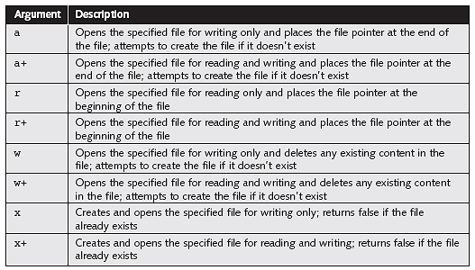
Opening a File Stream (continued)
Table 6-1 Mode arguments of the fopen() function
Name of Book

Slide 6

Opening a File Stream (continued)
$BowlersFile = fopen(“bowlers.txt”, “r+”);
Figure 6-1 Location of the file pointer when the fopen() function uses a mode argument of “r+”
Name of Book

Slide 7

Opening a File Stream (continued)
$BowlersFile = fopen(“bowlers.txt”, “a+”);
Figure 6-2 Location of the file pointer when the fopen() function uses a mode argument of “a+”
Name of Book

Slide 8
Closing a File Stream
Use the fclose function when finished working with a file stream to save space in memory
  $BowlersFile = fopen(“bowlers.txt”, “a”);
  $NewBowler = “Gosselin, Don\n”;
  fwrite($BowlersFile, $NewBowler);
  fclose($BowlersFile);
Name of Book

Slide 9
Writing Data to Files
PHP supports two basic functions for writing data to text files:
  file_put_contents() function writes or appends a text string to a file
  fwrite() function incrementally writes data to a text file
Name of Book

Slide 10
Writing Data to Files (continued)
Escape sequences used to identify the end of a line:
  UNIX/Linux platforms use the \n carriage return
  Macintosh platforms use \r carriage return
  Windows uses both the \r carriage return escape sequence and the \n newline escape sequence
Name of Book

Slide 11
Writing an Entire File
The file_put_contents() function writes or appends a text string to a file
The syntax for the file_put_contents() function is:
file_put_contents (filename, string[, options])
Name of Book

Slide 12
file_put_contents() Function
$TournamentBowlers = “Blair, Dennis\n”;
$TournamentBowlers .= “Hernandez, Louis\n”;
$TournamentBowlers .= “Miller, Erica\n”;
$TournamentBowlers .= “Morinaga, Scott\n”;
$TournamentBowlers .= “Picard, Raymond\n”;
$BowlersFile = “bowlers.txt”;
file_put_contents($BowlersFile, $TournamentBowlers);
Name of Book

Slide 13
file_put_contents() Function (continued)
If no data was written to the file, the function returns a value of 0
Use the return value to determine whether data was successfully written to the file
if (file_put_contents($BowlersFile, $TournamentBowlers) > 0)
echo “<p>Data was successfully written to the
$BowlersFile file.</p>”;
else
echo “<p>No data was written to the $BowlersFile file.</p>”;
Name of Book

Slide 14
Writing an Entire File (continued)
The FILE_USE_INCLUDE_PATH constant searches for the specified filename in the path that is assigned to the include_path directive in your php.ini configuration file
The FILE_APPEND constant appends data to any existing contents in the specified filename instead of overwriting it
Name of Book

Slide 15
Writing an Entire File (continued)
<h1>Coast City Bowling Tournament</h1>
<?php
if (isset($_GET['first_name']) && isset($_GET['last_name'])) {
$BowlerFirst = $_GET['first_name'];
$BowlerLast = $_GET['last_name'];
$NewBowler = $BowlerLast . “, “ . “$BowlerFirst” . “\n”;
$BowlersFile = “bowlers.txt”;
if (file_put_contents($BowlersFile, $NewBowler, FILE_APPEND) > 0)
echo “<p>{$_GET['first_name']} {$_GET['last_name']} has
been registered for the bowling tournament!</p>”;
else
echo “<p>Registration error!</p>”;
}
else
echo “<p>To sign up for the bowling tournament, enter your first
and last name and click the Register button.</p>”;
?>
<form action=”BowlingTournament.php” method=”get”
enctype=”application/x-www-form-urlencoded”>
<p>First Name: <input type=”text” name=”first_name” size=”30” /></p>
<p>Last Name: <input type=”text” name=”last_name” size=”30” /></p>
<p><input type=”submit” value=”Register” /></p>
</form>
Name of Book

Slide 16
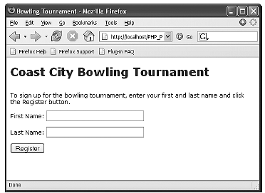
Writing an Entire File (continued)
Figure 6-6 Bowling registration form
Name of Book

Slide 17
Handling Magic Quotes
Magic quotes automatically adds a backslash (\) to any:
  Single quote (')
  Double quote (”)
  NULL character contained in data that a user submits to a PHP script
  My best friend's nickname is “Bubba”
  My best friend\'s nickname is \”Bubba\”
Name of Book

Slide 18
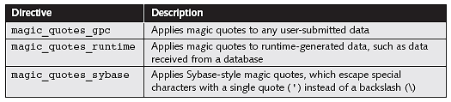
Handling Magic Quotes (continued)
Table 6-2 Magic quote directives
Disable magic quotes in your php.ini configuration file and instead manually escape the strings with the addslashes() function
Name of Book

Slide 19
addslashes() Function
Accepts a single argument representing the text string you want to escape and returns a string containing the escaped string
$Nickname = addslashes($_GET['nickname']);
echo $Nickname; // My best friend\'s nickname is \”Bubba\”.
With magic quotes enabled:
My best friend\\\'s nickname is \\\”Bubba\\\”
Name of Book

Slide 20
stripslashes() Function
Removes slashes that were added with the addslashes() function
To prevent the display of escaped characters, use the stripslashes() function with the text you want to print
if (file_put_contents($BowlersFile, $NewBowler, FILE_APPEND) > 0)
echo “<p>” . stripslashes($_GET['first_name']) . “ “
. stripslashes($_GET['last_name'])
. “ has been registered for the bowling tournament!</p>”;
else
echo “<p>Registration error!</p>”;
Name of Book

Slide 21
stripslashes() Function (continued)
if (isset($_GET['first_name']) && isset($_GET['last_name'])) {
$BowlerFirst = addslashes($_GET['first_name']);
$BowlerLast = addslashes($_GET['last_name']);
$NewBowler = $BowlerLast . “, “ . “$BowlerFirst” . “\n”;
$BowlersFile = “bowlers.txt”;
if (file_put_contents($BowlersFile, $NewBowler, FILE_APPEND) > 0)
echo “<p>{$_GET['first_name']}{$_GET['last_name']}
has been registered for the bowling tournament!</p>”;
else
echo “<p>Registration error!</p>”;
}
else
echo “<p>To sign up for the bowling tournament, enter your first
and last name and click the Register button.</p>”;
Name of Book

Slide 22
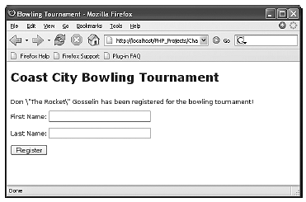
stripslashes() Function (continued)
Figure 6-7 Output of text with escaped characters
Name of Book

Slide 23
Writing Data Incrementally
Use the fwrite() function to incrementally write data to a text file
The syntax for the fwrite() function is:
fwrite($handle, data[, length]);
The fwrite() function returns the number of bytes that were written to the file
If no data was written to the file, the function returns a value of 0
Name of Book

Slide 24
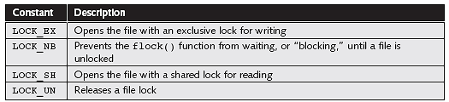
Locking Files
To prevent multiple users from modifying a file simultaneously use the flock() function
The syntax for the flock() function is:
flock($handle, operation)
Table 6-3 Operational constants of the flock() function
Name of Book

Slide 25
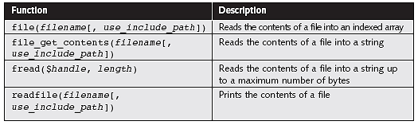
Reading an Entire File
Table 6-4 PHP functions that read the entire contents of a text file
Name of Book

Slide 26
file_get_contents() Function
Reads the entire contents of a file into a string
$DailyForecast = “<p><strong>San Francisco daily weather
forecast</strong>: Today: Partly cloudy. Highs from the 60s to
mid 70s. West winds 5 to 15 mph. Tonight: Increasing clouds. Lows
in the mid 40s to lower 50s. West winds 5 to 10 mph.</p>”;
file_put_contents(“sfweather.txt”, $DailyForecast);
$SFWeather = file_get_contents(“sfweather.txt”);
echo $SFWeather;
Name of Book

Slide 27
readfile() Function
Prints the contents of a text file along with the file size to a Web browser
readfile(“sfweather.txt”);
Name of Book

Slide 28
file() Function
Reads the entire contents of a file into an indexed array
Automatically recognizes whether the lines in a text file end in \n, \r, or \r\n
  $January = “48, 42, 68\n”;
  $January .= “48, 42, 69\n”;
  $January .= “49, 42, 69\n”;
  $January .= “49, 42, 61\n”;
  $January .= “49, 42, 65\n”;
  $January .= “49, 42, 62\n”;
  $January .= “49, 42, 62\n”;
  file_put_contents(“sfjanaverages.txt”, $January);
Name of Book

Slide 29
file() Function (continued)
$JanuaryTemps = file(“sfjanaverages.txt”);
for ($i=0; $i<count($JanuaryTemps); ++$i) {
$CurDay = explode(“, “, $JanuaryTemps[$i]);
echo “<p><strong>Day “ . ($i + 1) . “</strong><br />”;
echo “High: {$CurDay[0]}<br />”;
echo “Low: {$CurDay[1]}<br />”;
echo “Mean: {$CurDay[2]}</p>”;
}
Name of Book

Slide 30
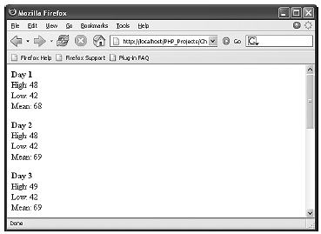
file() Function (continued)
Figure 6-8 Output of individual lines in a text file
Name of Book

Slide 31
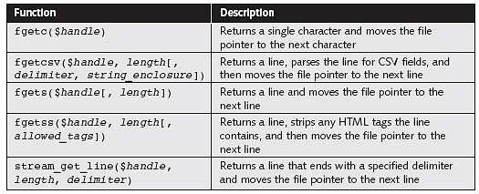
Reading Data Incrementally
Table 6-5 PHP functions that iterate through a text file
The fgets() function uses the file pointer to iterate through a text file
Name of Book

Slide 32
Reading Data Incrementally (continued)
You must use fopen() and fclose() with the functions listed in Table 6-5
Each time you call any of the functions in Table 6-5, the file pointer automatically moves to the next line in the text file (except for fgetc())
Each time you call the fgetc() function, the file pointer moves to the next character in the file
Name of Book

Slide 33
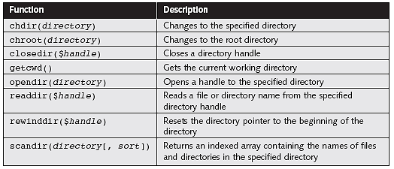
Reading Directories
Table 6-6 PHP directory functions
Name of Book

Slide 34
Reading Directories (continued)
To iterate through the entries in a directory, open a handle to the directory with the opendir() function
Use the readdir() function to return the file and directory names from the open directory
Use the closedir() function to close a directory handle
Name of Book

Slide 35
Reading Directories (continued)
  $Dir = “C:\\PHP”;
  $DirOpen = opendir($Dir);
  while ($CurFile = readdir($DirOpen)) {
  echo $CurFile . “<br />”;
  }
  closedir($DirOpen);
Name of Book

Slide 36
scandir() Function
Returns an indexed array containing the names of files and directories in the specified directory
    $Dir = “C:\\PHP”;
    $DirEntries = scandir($Dir);
    foreach ($DirEntries as $Entry) {
    echo $Entry . “<br />”;
    }
Name of Book

Slide 37
Creating Directories
The mkdir() function creates a new directory
To create a new directory within the current directory:
  Pass just the name of the directory you want to create to the mkdir() function
  mkdir(“bowlers”);
Name of Book

Slide 38
Creating Directories (continued)
To create a new directory in a location other than the current directory:
  Use a relative or an absolute path
    mkdir(“..\\tournament”);
    mkdir(“C:\\PHP\\utilities”);
Name of Book

Slide 39
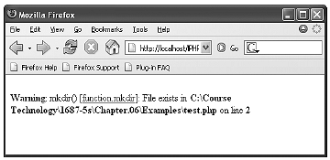
Creating Directories (continued)
  Figure 6-9 Warning that appears if a directory already exists
Name of Book

Slide 40
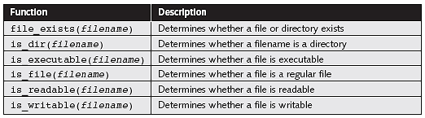
Obtaining File and Directory Information
Table 6-7 PHP file and directory status functions
Name of Book

Slide 41
Obtaining File and Directory Information (continued)
$DailyForecast = “<p><strong>San Francisco daily weather
forecast</strong>: Today: Partly cloudy. Highs from the 60s to
mid 70s. West winds 5 to 15 mph. Tonight: Increasing clouds. Lows
in the mid 40s to lower 50s. West winds 5 to 10 mph.</p>”;
$WeatherFile = “sfweather.txt”;
if (is_writable($WeatherFile)) {
file_put_contents($WeatherFile, $DailyForecast);
echo “<p>The forecast information has been saved to
the $WeatherFile file.</p>”;
}
else
echo “<p>The forecast information cannot be saved to
the $WeatherFile file.</p>”;
Name of Book

Slide 42
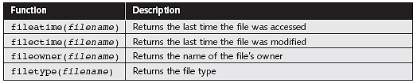
Obtaining File and Directory Information (continued)
Table 6-8 Common file and directory information functions
Name of Book

Slide 43
Obtaining File and Directory Information (continued)
$Dir = “C:\\PHP”;
if(is_dir($Dir)) {
echo “<table border='1‘ width='100%'>”;
echo “<tr><th>Filename</th><th>File Size</th>
<th>File Type</th></tr>”;
$DirEntries = scandir($Dir);
foreach ($DirEntries as $Entry) {
echo “<tr><td>$Entry</td><td>” . filesize($Dir . “\\”
. $Entry) . “</td><td>” . filetype($Dir . “\\”
. $Entry) . “</td></tr>”;
}
echo “</table>”;
}
else
echo “<p>The directory does not exist.</p>”;
Name of Book

Slide 44
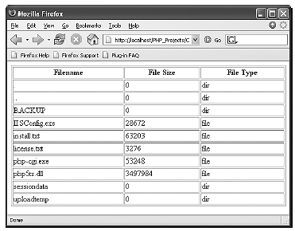
Obtaining File and Directory Information (continued)
Figure 6-10 Output of script with file and directory information functions
Name of Book

Slide 45
Copying and Moving Files
Use the copy() function to copy a file with PHP
The function returns a value of true if it is successful or false if it is not
The syntax for the copy() function is:
  copy(source, destination)
For the source and destination arguments:
  Include just the name of a file to make a copy in the current directory, or
  Specify the entire path for each argument
Name of Book

Slide 46
Copying and Moving Files (continued)
if (file_exists(“sfweather.txt”)) {
if(is_dir(“history”)) {
if (copy(“sfweather.txt”,
“history\\sfweather01-27-2006.txt”))
echo “<p>File copied successfully.</p>”;
else
echo “<p>Unable to copy the file!</p>”;
}
else
echo (“<p>The directory does not exist!</p>”);
}
else
echo (“<p>The file does not exist!</p>”);
Name of Book

Slide 47
Renaming Files and Directories
Use the rename() function to rename a file or directory with PHP
The rename() function returns a value of true if it is successful or false if it is not
The syntax for the rename() function is: rename(old_name, new_name)
Name of Book

Slide 48
Removing Files and Directories
Use the unlink() function to delete files and the rmdir() function to delete directories
Pass the name of a file to the unlink() function and the name of a directory to the rmdir() function
Both functions return a value of true if successful or false if not
Use the file_exists() function to determine whether a file or directory name exists before you attempt to delete it
Name of Book

Slide 49
Upload Files Form
(Upload.html)
<html>
<body>
<form action="upload_file.php" method="post"
enctype="multipart/form-data"><!– use when form require binary data-->
<label for="file">Filename:</label>
<input type="file" name="file" id="file" /> <!-- input type file -->
<br />
<input type="submit" name="submit" value="Submit" />
</form>
</body>
</html>
Internet programming

Slide 50
Upload Files Action (Upload_files.php)
<?php
if ((($_FILES["file"]["type"] == "image/gif") || ($_FILES["file"]["type"] == "image/jpeg“)) && ($_FILES["file"]["size"] < 20000))
{
if ($_FILES["file"]["error"] > 0) {
echo "Return Code: " . $_FILES["file"]["error"] . "<br />"; }
else
{
echo "Upload: " . $_FILES["file"]["name"] . "<br />";
echo "Type: " . $_FILES["file"]["type"] . "<br />";
echo "Size: " . ($_FILES["file"]["size"] / 1024) . " Kb<br />";
echo "Temp file: " . $_FILES["file"]["tmp_name"] . "<br />";
if (file_exists("upload/" . $_FILES["file"]["name"])) {
echo $_FILES["file"]["name"] . " already exists. "; }
else
{
move_uploaded_file($_FILES["file"]["tmp_name"],
"upload/" . $_FILES["file"]["name"]);
echo "Stored in: " . "upload/" . $_FILES["file"]["name"];
}
}
}
else
{
echo "Invalid file";
}
?>

Slide 51
$_FILES
By using the global PHP $_FILES array you can upload files from a client computer to the remote server.
The first parameter is the form's input name and the second index can be either "name", "type", "size", "tmp_name" or "error". Like this:
$_FILES["file"]["name"] - the name of the uploaded file
$_FILES["file"]["type"] - the type of the uploaded file
$_FILES["file"]["size"] - the size in bytes of the uploaded file
$_FILES["file"]["tmp_name"] - the name of the temporary copy of the file stored on the server
$_FILES["file"]["error"] - the error code resulting from the file upload
Internet programming

Slide 52
Summary
The stream is used for accessing a resource, such as a file, that you can read from and write to
A handle is a special type of variable that PHP uses to represent a resource such as a file
The fopen() function opens a stream to a text file
A file pointer is a special type of variable that refers to the currently selected line or character in a file
Name of Book

Slide 53
Summary (continued)
Use the fclose() function to ensure that the file doesn’t keep taking up space in your computer’s memory
PHP supports two basic methods for writing data to text files: file_put_contents() and the fwrite() function
Magic quotes automatically add backslashes to any single quote, double quote, or NULL character contained in data that a user submits to a PHP script
Name of Book

Slide 54
Summary (continued)
PHP includes various functions, such as the fgets() function, that allow you to use the file pointer to iterate through a text file
To iterate through the entries in a directory, you open a handle to the directory with the opendir() function
PHP includes various file and directory status functions, such as the file_exists() function, which determines whether a file or directory exists
Name of Book

Slide 55
Summary (continued)
The enctype attribute of the <form> tag specifies which content-type to use when submitting the form. "multipart/form-data" is used when a form requires binary data, like the contents of a file, to be uploaded
The type="file" attribute of the <input> tag specifies that the input should be processed as a file. For example, when viewed in a browser, there will be a browse-button next to the input field
By using the global PHP $_FILES array you can upload files from a client computer to the remote server.
The first parameter is the form's input name and the second index can be either "name", "type", "size", "tmp_name" or "error".
Name of Book

