Slide 1
Building an online bidding application using PHP/MySQL
Widhy Hayuhardhika NP, S.Kom

Slide 2
Outline Topic #1 MySQL Connection

Slide 3
MySQL Database Connection
Overview of database structure
Connecting to MySQL database
Selecting the database to use
Using the require_once statement

Slide 4
Overview of Database connection
Database: auction
Tables
tblaccount
tblbiditems
tblbidhistory

Slide 5
Table tblaccount
This will hold the account info of bidders/ auctioneers
Table structure
Column accountid: integer, primary key, auto-increment
Column username: string 50 chars
Column password: string 50 chars

Slide 6
Table tblbiditems
This will hold the items auctioned for bidding
Table structure
Column biditemid: integer , primary key, auto-increment
Column accountid: string 50 chars
This identifies the auctioneer
Column biditem: string 50 chars
Column biddesc: tiny text

Slide 7
Table tblbidhistory
This will hold the bid info for each item being auctioned
Table structure
Column bidhistoryid: integer , primary key, auto-increment
Column accountid: integer
Column biditemid: integer
Column bidprice: double
Column dtesubmitted: datetime

Slide 8
Connecting to databases:
Function mysql_connect:
Creates a connection to MySQL
Syntax: mysql_connect($hostname, $username,$password)
Ex: $conn=mysql_connect(“localhost”, “root”,”password”)
Function mysql_select_db
Specifies the database in MySQL for use
Syntax: mysql_select_db($database, $connection)
Ex: mysql_select_db(“auction”, $conn)
Function die
Terminates execution of PHP script

Slide 9

Connecting to MySQL and selecting auction database
Create file dbconnect.inc
For code reuse, a separate file can be created to connect to the database
PHP pages can call dbconnect.inc to connect yo the auction database

Slide 10

Reusing the database connection
Function require_once()
Loads a file into a PHP script

Slide 11
Outline Topic #2 Creation of Accounts

Slide 12
Creation of accounts
HTML form handling
MySQL commands
Function mysql_query()
Function mysql_error()
Adding records
SQL insert statement

Slide 13
HTML form handling
Create:
File index.html
File addaccount.html
File addaccountprocess.php
$_POST array

Slide 14
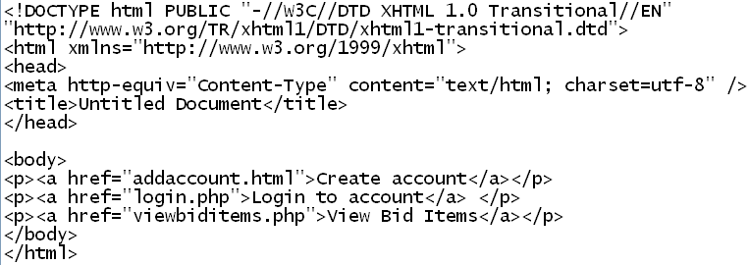
File index.html
First page that displays
Provide the user with the option to create accounts

Slide 15
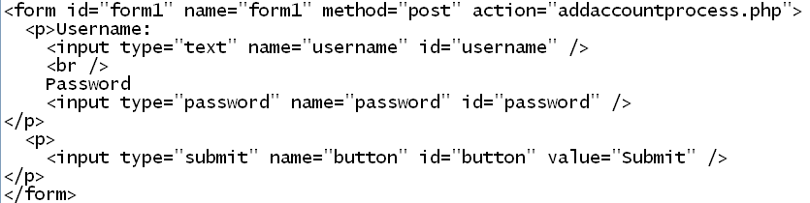

File addaccount.html
Displays a form for accepting new account info

Slide 16
File addaccountprocess.php
$_POST array
Special arrays that hold all form variables
Function mysql_query()
Executes an SQL statement on the database
Function mysql_error()
Displays error encountered when executing an SQL statement
SQL Insert
Adds a record on a database table

Slide 17
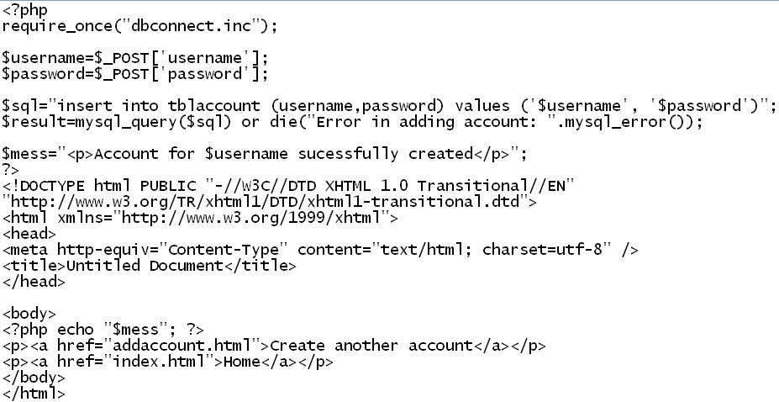
File addaccountprocess.php script

Slide 18
Create accounts:
Username: auctioneer1
This account will place items for bidding
Usernames: bidder1, bidder2
These account will bid for item auctioned off

Slide 19
Outline Topic #3 Managing Logins

Slide 20
Managing logins
SQL select statement
Function mysql_num_rows
Function isset()
Session
URL rewriting
Querystring
$_GET array
Create:
File login.php
File loginverify.php
File checkstatus.inc
File menu.php

Slide 21
SQL select statement
Example 1: select * from tblaccount
Selects all columns/ rows from table tblaccount
Example 2: select username, password from tblaccount
Selects columns username and password for all rows in table tblaccount
Example 3: select * from tblaccount where username=‘jundolor’
Selects all columns from table tblaccount for all rows whose column username contains ‘jundolor’
Example 4: select accountid from tblaccount where username=‘media’
Selects column accountid from tblaccount for all rows whose column username contains ‘media’

Slide 22
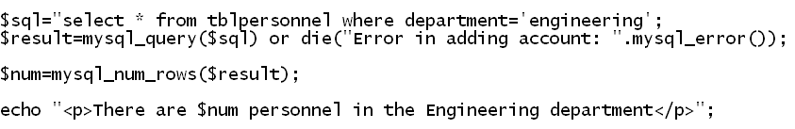
Function mysql_num_rows
Retrieves the number of rows from a result set
Can only be used for SQL select statements

Slide 23
Function isset()
Checks if a variable exist
Example: isset($name)
This check if the variable $name exist

Slide 24
Sessions
Special variables stored in web servers
Allows passing of information between web pages
Call the function session_start() at the start of scripts that will use sessions

Slide 25

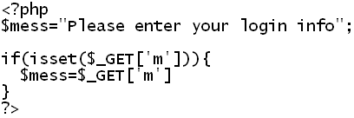
URL Rewriting
Querystring
Information can be passed on by appending variable/value to the URL
$_GET array
Special array that holds all querystring values

Slide 26
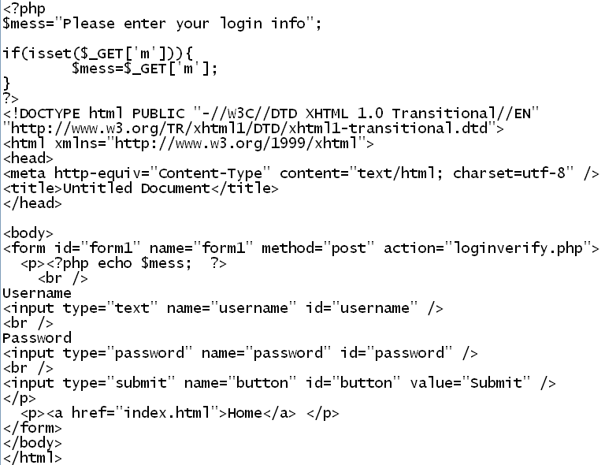
File login.php code

Slide 27
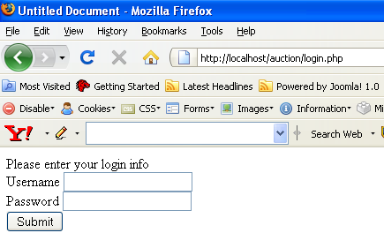
File login.php browser shot

Slide 28
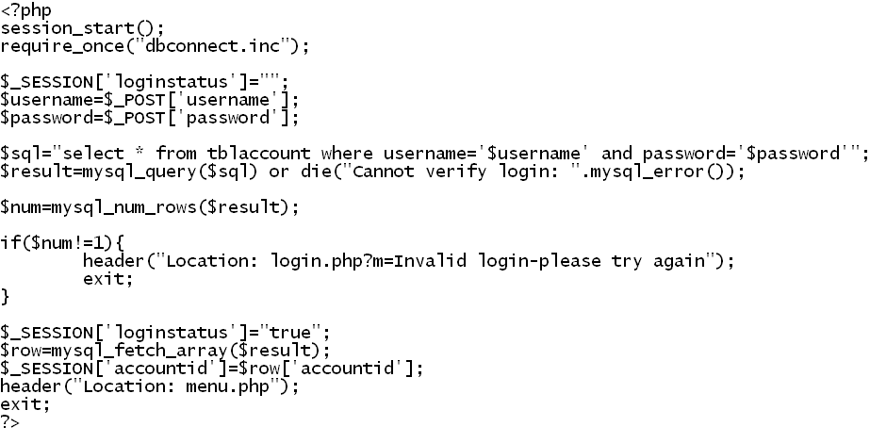
File loginverify.php code

Slide 29
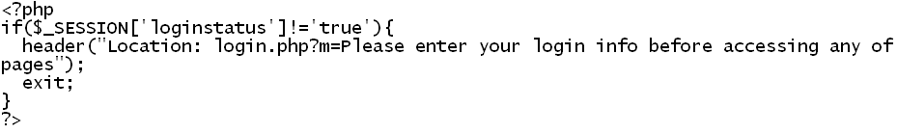
File checkstatus.inc code

Slide 30
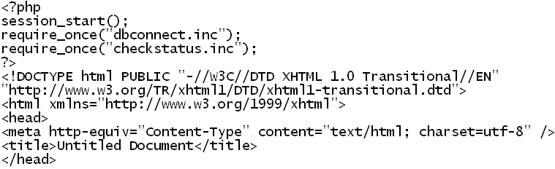
File menu.php

Slide 31
Outline Topic #4 Adding Items to Auction

Slide 32
Adding items to auction
File menu.php
Create:
File addauctionitem.php
File addauctionitemprocess.php

Slide 33
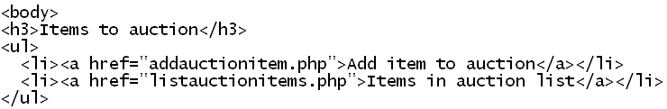
File menu.php

Slide 34
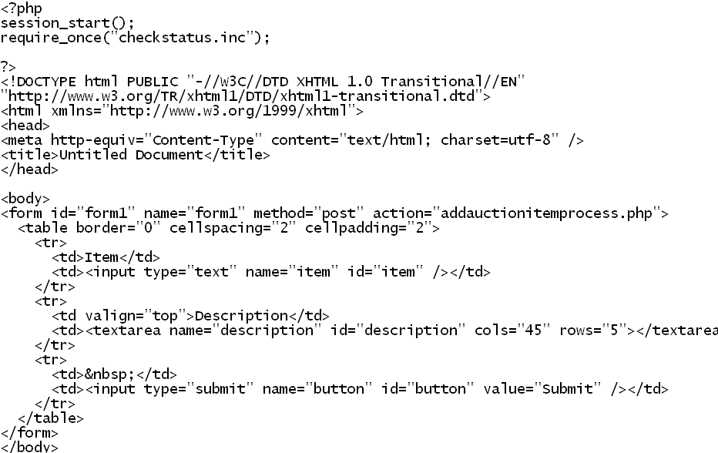
File addauctionitem.php code

Slide 35
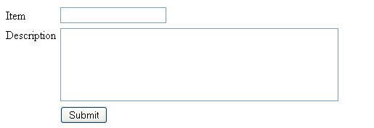
File addauctionitem.php screen shot

Slide 36
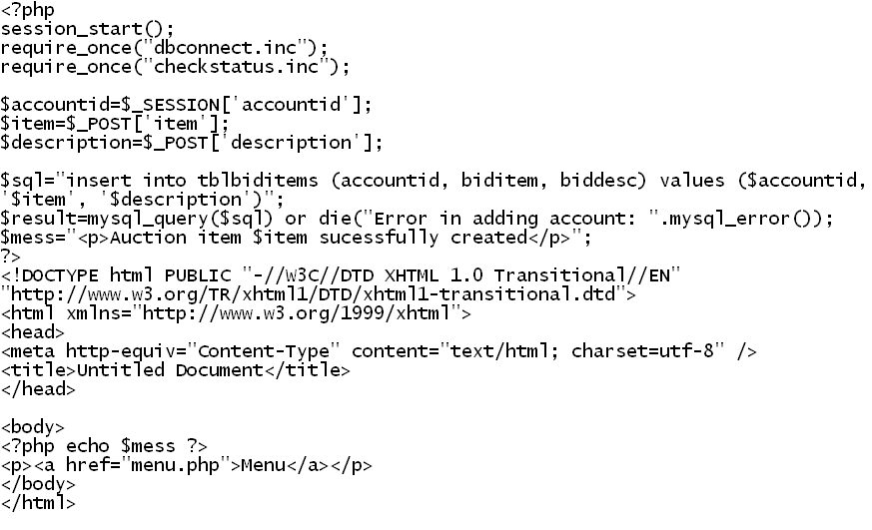
File addauctionprocess.php

Slide 37
Outline Topic #5 Deleting Bid Items

Slide 38
Deleting Bid Items
Function mysql_fetch_array()
Writing querystring URL to identify records to delete
SQL delete statement
Create:
File listauctionitems.php
File: deletebiditem.php

Slide 39
Function mysql_fetch_array()
Fetches a row as an associative from a select query result set

Slide 40
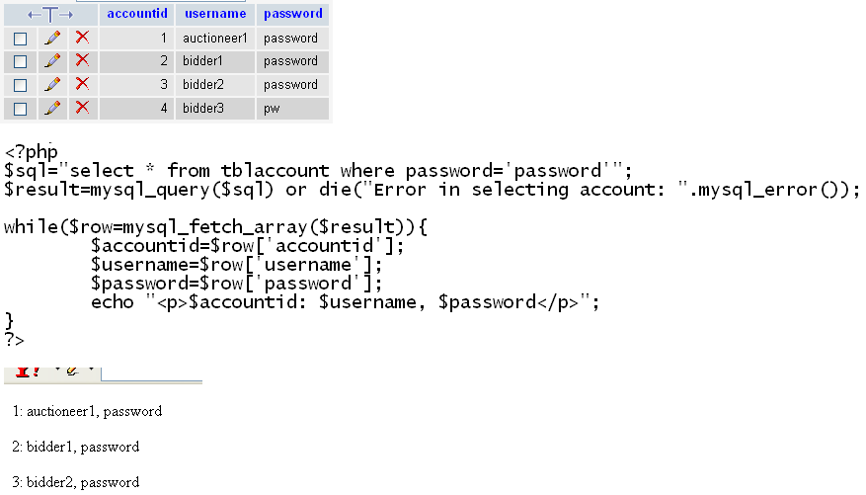
Sample mysql_fetch_array() code

Slide 41
Writing querystring URLto identify records to delete
Auction items belonging to current account will be selected
A loop will be created to go through each row
Each row will hyperlink to a PHP based page for deletion
To identify the row, a querystring variable will be appended to the URL

Slide 42
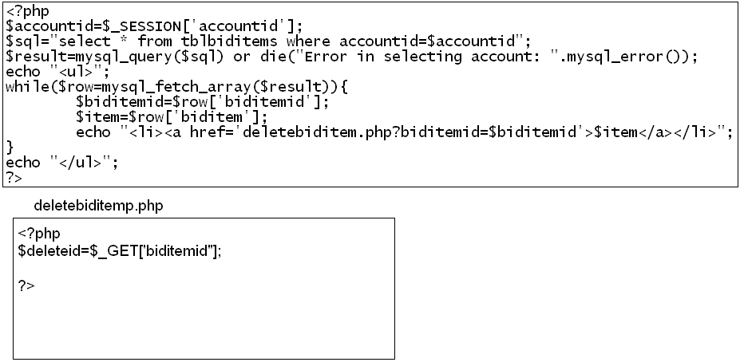
Writing querystring URLto identify records to delete- code

Slide 43
SQL delete statement
Example 1: delete from tblaccount
Deletes all rows on table tblaccount
Example 2: delete from tblaccount where accountid=1
Deletes only rows matching the condition

Slide 44

File menu.php

Slide 45
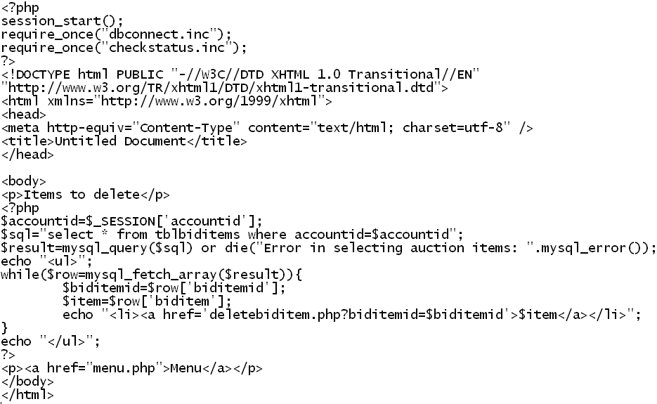
File listauctionitems.php

Slide 46
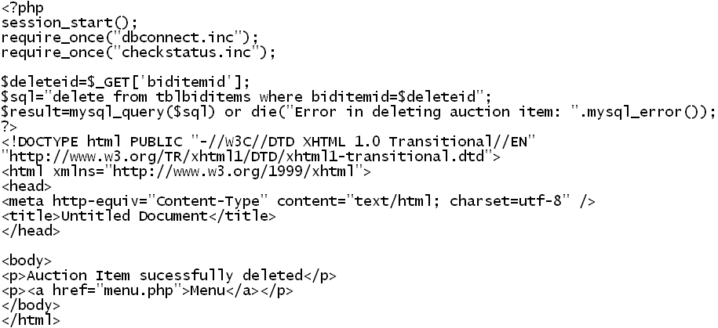
File deletebiditem.php

Slide 47
Outline Topic #6 Logging Out

Slide 48
Loggin out
Function session_destroy()
Create:
File logout.php

Slide 49
Function session_destroy()
Terminates all session variables stored in server memory

Slide 50

File menu.php

Slide 51
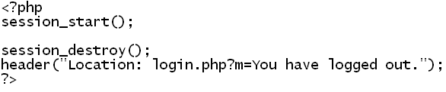
File logout.php
Once logout.php is called, all session variable will be dropped from server memory
Browser will not be able to access any page calling checkverify.php (ex: menu.php)

Slide 52
Outline Topic #7 Viewing Bid Items

Slide 53
Viewing bid items
Establishing relations between tables
SQL natural join clause
Create:
File listbiditems.php

Slide 54
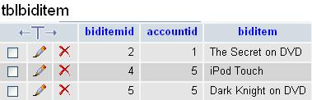
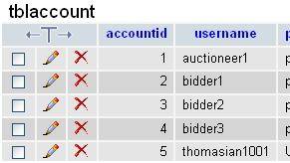
Establishing relations
Table tblbiditem
Holds the items being auctioned off
Column accountid identifies the owner if the auctioned item
Table tblaccount
Holds account information of the owner of the item being auctioned
Column accountid
Links the owner of the account to the auction item

Slide 55
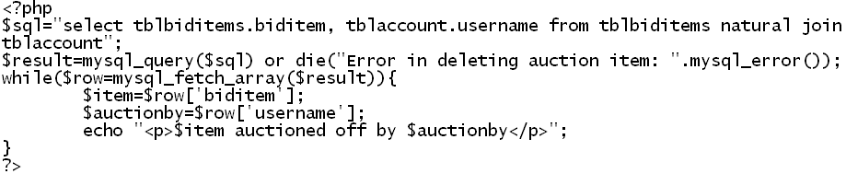
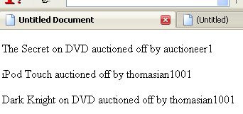
SQL natural join clause
Used with SQL select statement
Connects rows between different tables via their common column

Slide 56
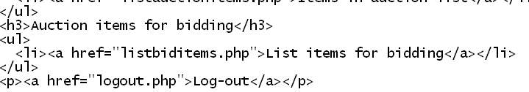
File menu.php

Slide 57
File listbiditems.php
All items with their respective owners being auction are listed
Each item will hyperlink to a PHP page for accepting bids
Accepting bids will be covered in the next topic section
Each hyperlink will append a querystring variable to identify it in the PHP page for accepting bids

Slide 58
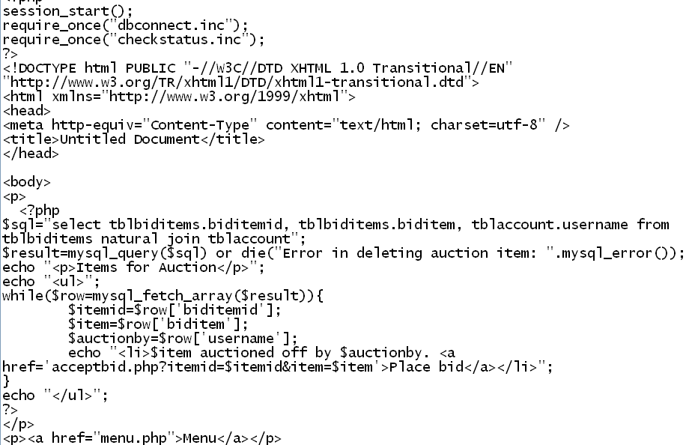
File listbiditems.php code

Slide 59
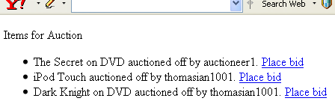
File listbiditems.php screen shot

Slide 60
Outline Topic #7 Accepting Bids

Slide 61
Accepting bids
Using hidden fields to store ID numbers
MySQL now() function
Create:
File acceptbid.php
File acceptbidprocess.php

Slide 62
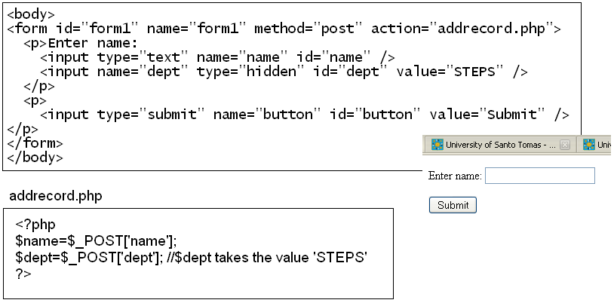
Hidden fields
Not displayed to the browser
Used to pass constant values

Slide 63
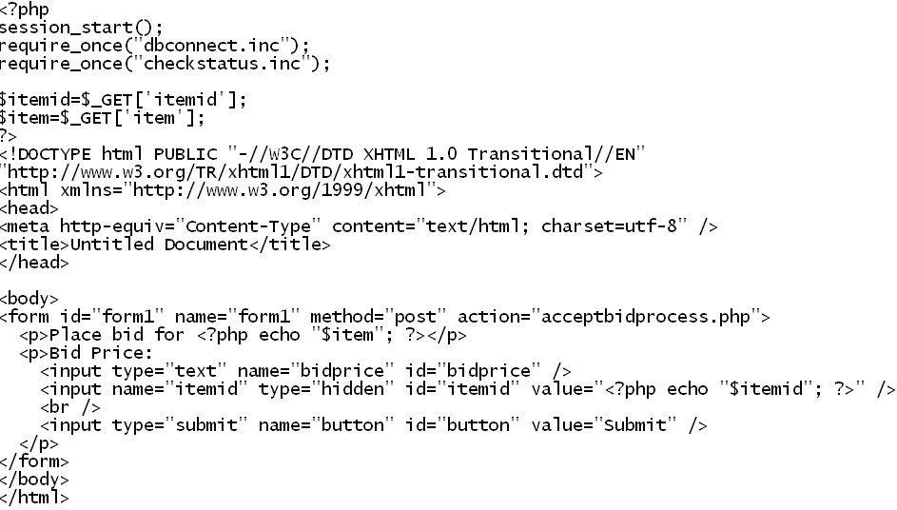
File acceptbid.php
Place the id of the auction item in a hidden field

Slide 64
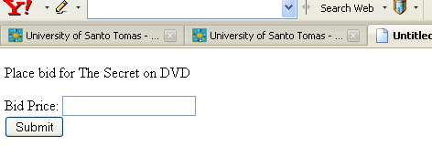
File acceptbid.php screen shot

Slide 65
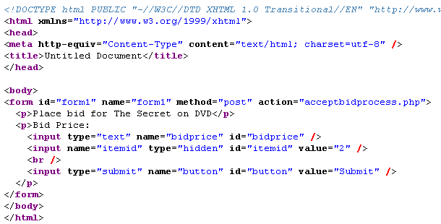
File acceptbid.php HTML generated code

Slide 66
MySQL now() function
Returns the current date and time as a value in 'YYYY-MM-DD HH:MM:SS' or YYYYMMDDHHMMSS.uuuuuu format
depending on whether the function is used in a string or numeric context
The value is expressed in the current time zone.

Slide 67
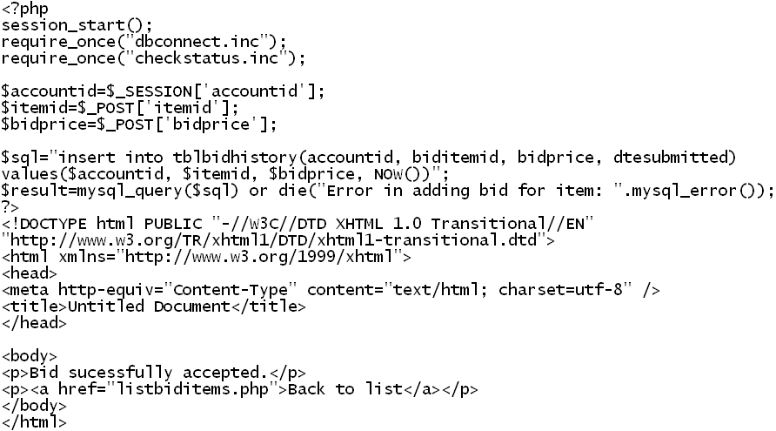
File acceptbidprocess.php

Slide 68
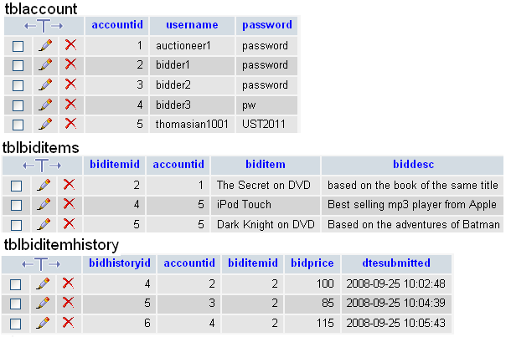
Resulting records

Slide 69
Outline Topic #9 Listing Bids For Each Bid Item

Slide 70
Listing bids for each bid item
MySQL date_format() function
Relating information from two or more tables
SQL order by clause

Slide 71
MySQL date_format() function
Formats a string based on a specified format
The following are some of the specifies of the format string:
%D: Day of month with English suffix
%d: Numeric day of month (01…31)
%M: Month name (January…December)
%m: Month numeric (01…12)
%Y: Year (4 digits)
%y: Year (2 digits)

Slide 72
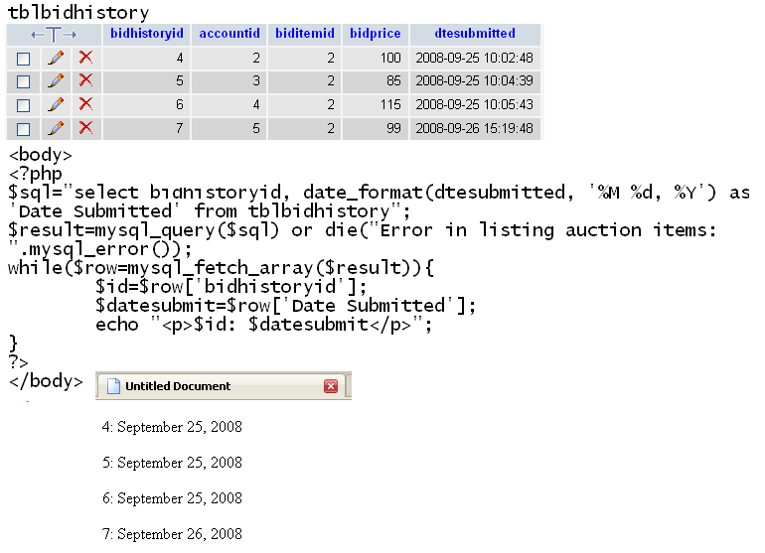
MySQL date_format() sample

