Slide 1
Introduction to MVC Web Framework with CodeIgniter
By @KnightBaron

Slide 2
What Is Framework?

Slide 3
What Is Framework?
Provide general structure of the application
Therefore, you must learn its structure to be able to use it
Handle common tasks
What is a difference between framework and library?
Your code use library
Your code is used by framework
Notes:
A set of code that…

Slide 4
What Is MVC?

Slide 5
What Is MVC?
A Design Pattern
Stands for Model, View and Controller
Separate Business Logic from Presentation Logic
Notes:
เช่น Cookbook Bussiness Logic ก็จะเป็นการติดต่อ DB เอาตำราตาม Criteria มาโชว์ ส่วนจะโชว์ยังไงก็ Presentation Logic

Slide 6
Model-View-Controller
Model
View
Controller
Notes:
ไม่ใช่การแยก Layer แต่เป็น 3 Module ที่แยกออกจากกัน

Slide 7
Model
Represents data
Hold data structure
Usually (but not always) backed by database
Contains data related logic
i.e. determine whether today is user birthday or not

Slide 8
Controller
Holds business logic
Handling Input/Output
Notify model(s) of user action
Use view(s) for presentation

Slide 9
View
How data will be displayed to user
Holds presentation logic
i.e. looping through a set of data to be displayed

Slide 10
MVC And The Web

Slide 11
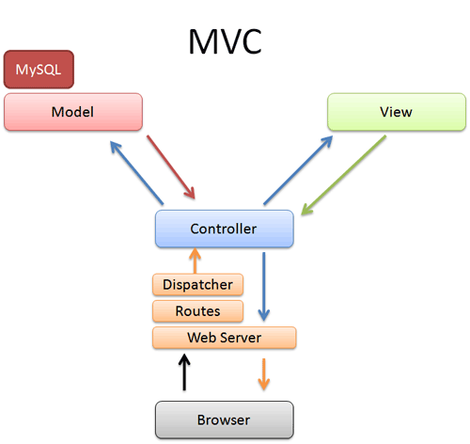
MVC For Web

Slide 12
MVC Web Framework
Ruby
Ruby on Rails
Python
Django
PHP
CodeIgniter
CakePHP
Zend Framework
Pylons
TurboGears
Etc.
Etc.
Merb
Etc.

Slide 13
Introduction to CodeIgniter
Notes:
CodeIgniter มันก็คือ MVC Web Framework ตัวนึงนั่นแหละ แต่ทำไมวันนี้เราถึงเลือก CodeIgniter?

Slide 14
Why CodeIgniter?
Pros
Cons
Easy to learn and adopt
Easy to deploy
Lightweight
Extensive Thai user base
Thai document is available
http://codeigniter.in.th by @Dominixz
It’s PHP :-(
Not very object-oriented in some part
Incompetence cache and view framework
Though you can plug another toolset of your choice instead

Slide 15

Want A Better Experience?
Notes:
อ่อ! เดี๋ยวที่ Lab Theory จะมี Workshop Django ด้วยนะ วันที่ 26-30 ใครสนใจลงชื่อได้

Slide 16
A Standard Blog Example

Slide 17
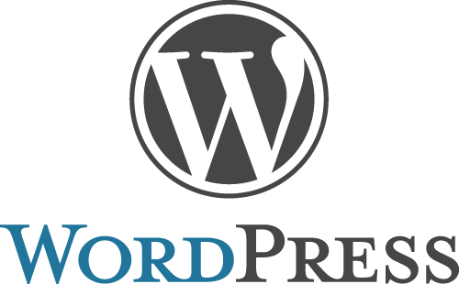
What Do We Need For A Blog?
Notes:
แต่ในวันนี้ เราจะใช้ CodeIgniter เขียน Blog ง่ายๆ ของเราเองขึ้นมา

Slide 18
Components Of A Blog
Post (Entry)
(Static) Page
Category
Comment
Theme
Tag
User
Navigation
Etc.

Slide 19
A (Stupidly) Simple Blog
Post
Comment
Front Page
Post Page
Create New Post Page

Slide 20
A (Stupidly) Simple Blog Broken Into MVC
Model
Post
Comment
Controller
Blog
View
Front View
Post View
Create New Post View

Slide 21
Workshop: Creating A Blog With CodeIgniter

Slide 22
Conclusion

Slide 23
Conclusion
What is a framework?
What is MVC?
Model – Represents data
Controller – Holds business logic
View – Holds presentation logic
MVC In Web Application
Implementing a blog with CodeIgniter

Slide 24
Any Question?

Slide 25
Thank You
Feel free to contact me for any help

Slide 26
References
http://en.wikipedia.org/wiki/Model%E2%80%93View%E2%80%93Controller
http://betterexplained.com/articles/intermediate-rails-understanding-models-views-and-controllers/
http://slash7.com/2005/02/22/mvc-the-most-vexing-conundrum/

Slide 27
Contact Me
Blog: http://aosekai.net
Email: knightbaron (at) gmail (dot) com
Twitter: @KnightBaron
Facebook: http://fb.me/knightbaron
IRC
#fanboi@irc.thai.com
#thai-fansubs@irc.thai.com

