Slide 1
Interface dan Package

Slide 2
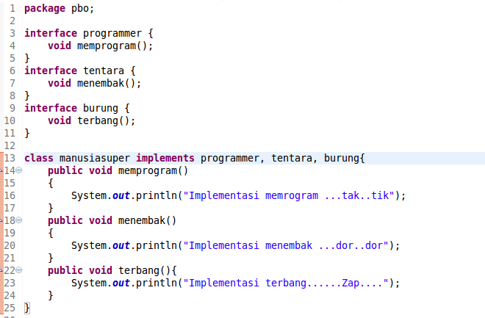
Interface: manusiasuper.java

Slide 3
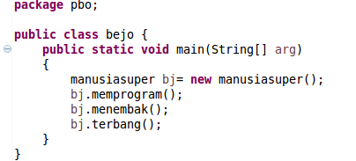
Implementasi Interface: bejo.java

Slide 4
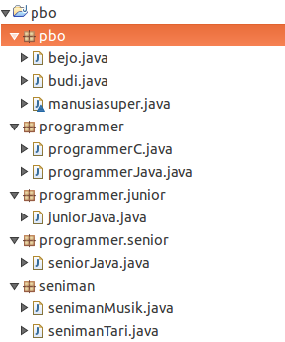
Package
Buat package:
Programmer
class: programmerC.java
programmerJava.java
Programmer.junior
class: juniorJava.java
Programmer.senior
class: seniorJava.java
Seniman
class: senimanMusik.java
senimanTari.java
Buat class budi.java di package pbo

Slide 5
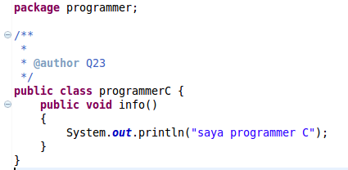
Package: programmer, class: programmerC.java

Slide 6
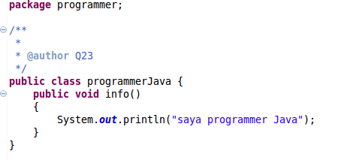
Package: programmer, class: programmerJava.java

Slide 7
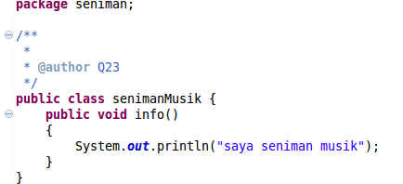
Package: seniman, class: senimanMusik.java

Slide 8
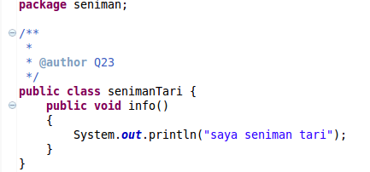
Package: seniman, class: senimanTari.java

Slide 9
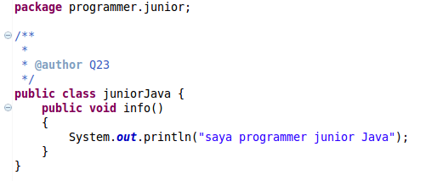
Package: programmer.junior, class: juniorJava.java

Slide 10
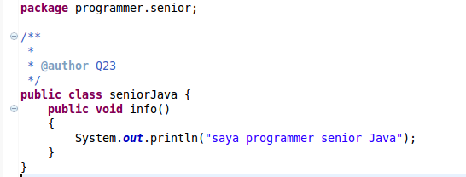
Package: programmer.senior, class: seniorJava.java

Slide 11
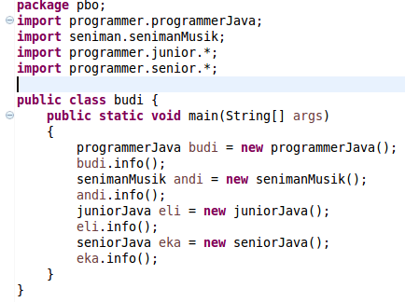
Implementasi package Package: pbo, class: budi.java

