Slide 1
JSON
Rekayasa Web

Slide 2

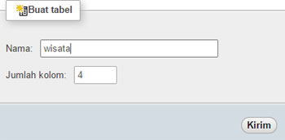
Membuat Database dan Tabel
http://localhost/phpmyadmin

Slide 3
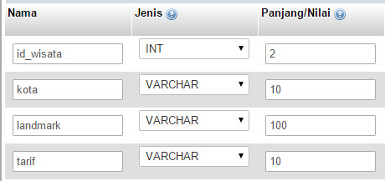
Tabel Wisata
Primary Key = id_wisata

Slide 4
Isi Datanya
ID_WISATA | KOTA | LANDMARK | TARIF
1 | SEMARANG | LAWANG SEWU | 20000
2 | YOGYAKARTA | PRAMBANAN | 35000
3 | MAGELANG | BOROBUDUR | 45000
4 | SURAKARTA | PGS | GRATIS
5 | PURWOKERTO | BATU RADEN | 25000

Slide 5
koneksi.php
<?
$server = "localhost";
$username = "root";
$password = “";
$database = “rekayasaweb";
// Koneksi dan memilih database di server
$koneksi = mysqli_connect($server, $username, $password, $database)
or die(mysqli_connect_error());
?>
Parameter MySQL

Slide 6
buatjson.php
<?php
include "koneksi.php";
$query = "select * from wisata";
$hasil = mysqli_query($koneksi, $query);
if($hasil){
$data = array();
if(mysqli_num_rows($hasil))
{
while($item = mysqli_fetch_assoc($hasil)) {
$data[] = $item;
}
}
echo json_encode(array('wisata'=>$data));
}
?>

Slide 7
bacajson.php
<?php
$json_url = 'http://localhost/json/buatjson.php';
$curl = curl_init($json_url);
$options = array(
CURLOPT_RETURNTRANSFER => true,
CURLOPT_HTTPHEADER => array('Content-type: application/json')
);
curl_setopt_array($curl, $options);
$hasil = curl_exec($curl);
$decode = json_decode($hasil, true);
foreach($decode['wisata'] as $data){
echo $data['id_wisata'] . "<br>";
echo $data['kota'] . "<br>";
echo $data['landmark'] . "<br>";
echo $data['tarif'] . "<br><hr>";
}
?>

