Slide 1
Praktikum 1 – API Documentation
OpenAPI Specification dengan Swagger

Slide 2
Link
OpenAPI Specification v3.1.0
(https://spec.openapis.org/oas/latest.html)
Swagger Editor
( https://editor.swagger.io/)

Slide 3
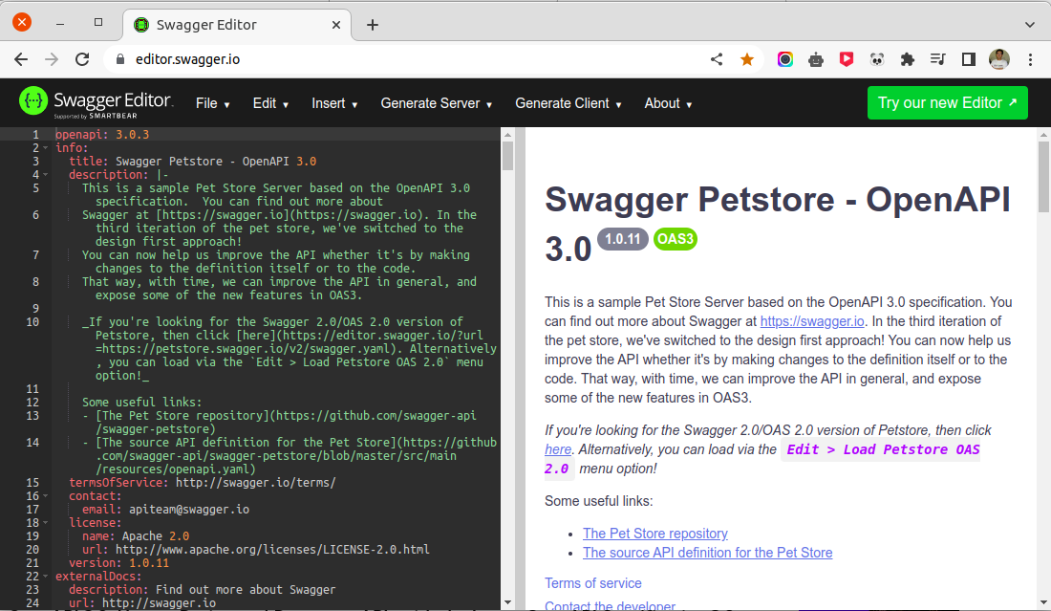

Slide 4
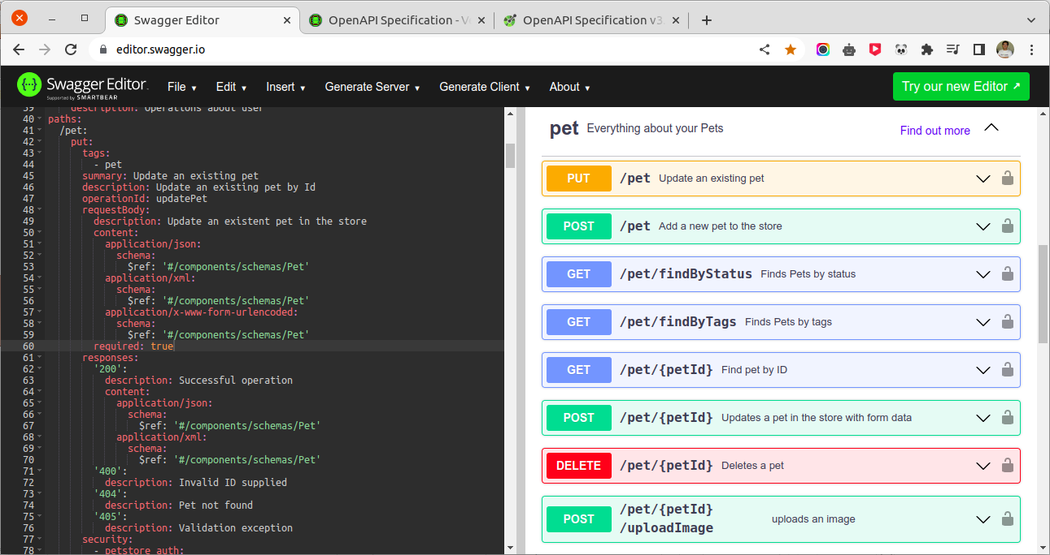

Slide 5
Planning
$router->get('wisata', ['uses' => 'WisataController@showAll']);
$router->get('wisata/{id}', ['uses' => 'WisataController@showOne']);
$router->post('wisata', ['uses' => 'WisataController@create']);
$router->delete('wisata/{id}', ['uses' => 'WisataController@delete']);
$router->put('wisata/{id}', ['uses' => 'WisataController@update']);

Slide 6
