Slide 1

Home Page
StratPlanner
Sign In/out
Please Login to Continue
Bringing people and strategy together…

Slide 2
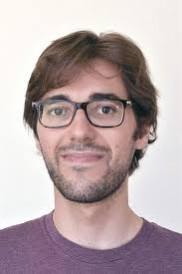
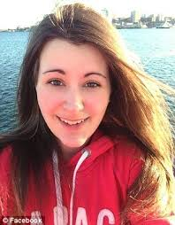
My Dashboard Page
StratPlanner
Sign In/out
My Dashboard
My Profile
My Team
Todays Todos
Recent Activity
Active Alerts
Task: Product Operations Plan Development
Due Date: 2017-08-19
Status: Not-Started
Action: Task Updated
Employee 1 Task Overdue
Complete Presentation
Employee 2 Task Delayed
TPS Report Coversheet
Task: Product Operations Plan Development
Due Date: 2017-08-19
Status: Not-Started
Action: Task Updated
Employee 3 Out Sick
Destroy Office Copier
Task: Product Operations Plan Development
Due Date: 2017-08-19
Status: Not-Started
Action: Task Updated
Task: Product Operations Plan Development
Due Date: 2017-08-19
Status: Not-Started
Action: Task Updated
Task: Product Operations Plan Development
Due Date: 2017-08-19
Status: Not-Started
Action: Task Updated

Slide 3
My Profile Page
StratPlanner
Sign In/out
Home
My Profile
My Team
My Contact Info
First Name:
Last Name:
Nick Name:
Email:
Cell Phone
My Work Info
Title:
Start Date:
Location:
Role:
Last Name:
Nick Name:
Apply
Cancel

Slide 4
My Team Page (Managers Only)
StratPlanner
Sign In/out
My Dashboard
My Profile
My Team
Team Dashboard
My Team
Selected Team Member Detail
Name: Ineeda Bigspliff
Hire Date: 2017-08-19
Title: Dev Lead
Email: Task Updated
Name: Nicholas DeJuanHitWunder
Hire Date: 2017-08-19
Title: Dev Lead
Email: Task Updated
Name: Nicholas DeJuanHitWunder
Hire Date: 2017-08-19
Title: Dev Lead
Email: Task Updated
Name: Nicholas DeJuanHitWunder
Hire Date: 2017-08-19
Title: Dev Lead
Email: Task Updated
Title:
Start Date:
Location:
Name: Ineeda Bigspliff
Hire Date: 2017-08-19
Title: Dev Lead
Email: Task Updated
Role:
Next Review:
Name: Nicholas DeJuanHitWunder
Hire Date: 2017-08-19
Title: Dev Lead
Email: Task Updated
Current Team:
Add Comment
Add Review
Update Profile

Slide 5
Team Admin Dashboard
StratPlanner
Sign In/out
My Dashboard
My Profile
My Team
Team Dashboard
Active Teams
Selected Team Detail
Team Name | Manager | Member Count | Goals
The Losers | Williams | 15 | 4
The Winners | Finney | 12 | 6
Hercules | Atkin | 22 | 4
Team Name:
Manager:
ID | Objective | Owner | Target Date
1 | Grow by 10% | BLW | Jul 7
2 | Shrink costs by 20% | JKR | Jul 9
3 | Reduce attrition | JCW | Dec 10
Add Comment
Add Objective
Update Team

