Slide 1

Publishing your research paper
February 28, 2024

Slide 2
Outline of the course
February 5
Introduction
Knowing me, knowing you
Scientific communication
WTC break
Selecting a journal
Submitting your paper
February 28
Processing feedback
After your paper is accepted
Writing in a team
WTC break
Authorship & contributorship
You, the reviewer

Slide 3
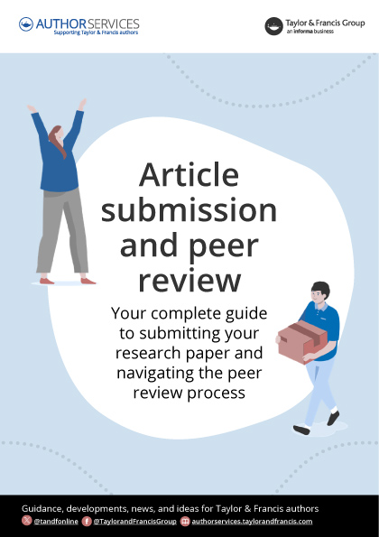
Suggested guide
https://authorservices.taylorandfrancis.com/resources/article-submission-and-peer-review-free-guide/

Slide 4

Possible decisions
Rejection
Desk rejection
Rejection after reviews
Revise and resubmit
Major revision
Minor revision
Conditional acceptance
Acceptance

Slide 5

Rejected
Desk rejection
Editor only
Triage function
None or few suggestions
Rejection after reviews
Includes reviewers’ comments
Evaluation (+ suggestions)

Slide 6

Reasons for desk rejection
Not fit for journal
topic
approach
discipline
type of research
Author instructions
length
formatting
anonymization
Rule violation
published elsewhere
text recycling or plagiarism
copyright
data sharing
ethics approval
Sloppy writing
focus
structure
style
grammar, spelling

Slide 7
What to do after desk rejection?
It is not the end of the world
Do not blame yourself
May ask for motivation if lacking
Do not appeal
Discuss with others, and consider
Your journal choice may not have been optimal
Your paper may need changes

Slide 8

Peer review

Slide 9

Anonymity of peer reviews
Double-anonymous (double-blind)
Reviewers do not know authors’ identities
Authors do not know authors’ identities
Single-anonymous (single-blind)
Reviewers know authors’ identities
Authors not reviewers’ identities
Open
Reviewers know authors’ identities
Authors know reviewers’ identities

Slide 10
Anonymity of peer reviews
Advantages
….
….
Disadvantages
….
….

Slide 11
How to anonymize your manuscript
No names on title pages
Avoid explicit self-citation (“In a previous study, we found that … (Bernasco et al. 2017)” and replace it with “Bernasco et al. (2017) found that …”
If really unavoidable, use “In a previous study, we found that … (Authors, 2017)”.
Exclude acknowledgements, grant numbers and titles and other identifying information
Do not refer to a preprint if you uploaded it to a repository
If you preregistered your study

Slide 12
Other forms of peer review
Review of preprint
Preregistered reports (study proposal is reviewed)
Review of published work

Slide 13

Who are your peer reviewers?
Scholars/researchers
Published (in same journal)
Know about your topic
Why do they review?
Sense of obligation
Flattered
Curiosity

Slide 14
Peer reviewers
Are not eligible if they have any conflict of interest
Should treat the manuscript strictly confidential
Should not disclose they are reviewing the manuscript
Should not try to identify (let alone contact) authors
Are expected to review within 3 / 4 / 8 weeks (varies)
(opiniated) Reviewers’ tasks:
protect readers against poor research and biased findings (ensure credibility and accuracy)
help authors improve their work

Slide 15

Editor’s verdict
Contents of decision letter
Thank you for submission
Description of procedure (how many reviewers)
Most important elements of assessment (editor and reviewers)
Decision: rejected, revise and resubmit, (conditionally) accepted
The verbatim reports of the reviewers (usually 2 or 3)

Slide 16
What do reviewers want?
Replication study? Motivate it explicitly
Innovation (new questions, theories, methods)
Study design and methods suitable and transparent
Discuss all relevant literature (including their own work ☺)
Clear presentation of results
Conclusions supported by research
Writing quality is sufficient

Slide 17

What do reviews look like?
Hand-out

Slide 18
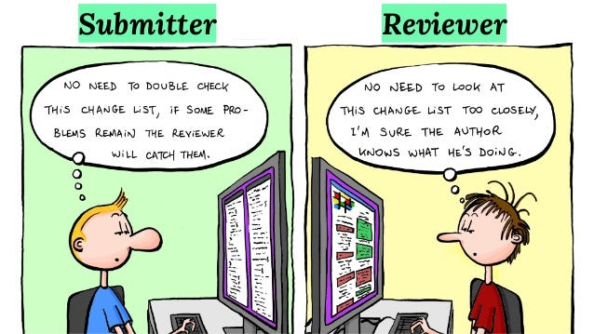
Revise and resubmit: tips and tricks
Do not take it personal!
Make a task list (is it feasible?)
Draft your revision note (‘response to reviewers’)
Revision note (hand-out)
Respond point-by-point
Do not skip or hide any issues
Be concise
Manuscript revision
Use track changes

Slide 19
What do revision notes look like?
Hand-out

Slide 20
Rejected after reviews
When can I resubmit to the same journal? (it is uncommon)
If you ask the Editor and have explicit confirmation
If you address most or all reviewer concerns
(you will usually get new reviewers)
Can I ignore the reviews?
No, you would waste potentially useful suggestions
No, you would waste reviewers’ efforts
No, your reviewer might be your reviewer for another journal
Thus: revise and resubmit elsewhere (but no revision memo required)

Slide 21

Accepted
Additional information
Acknowledgements
Author biographies
Author roles statement
Popular summary
Open access
Copyright agreement
Proofs
When asked: Your work is NOT part of employment relationship!

Slide 22

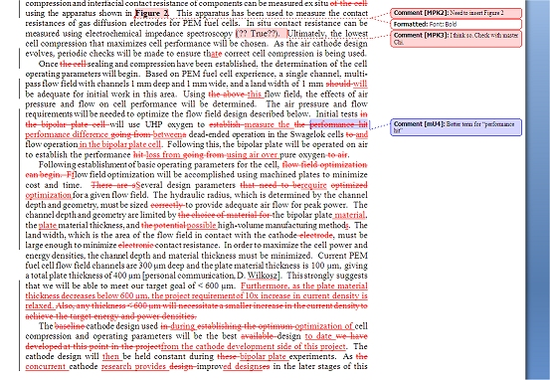
Writing together
You and your supervisors
Ask for written comments
Use track changes

Slide 23
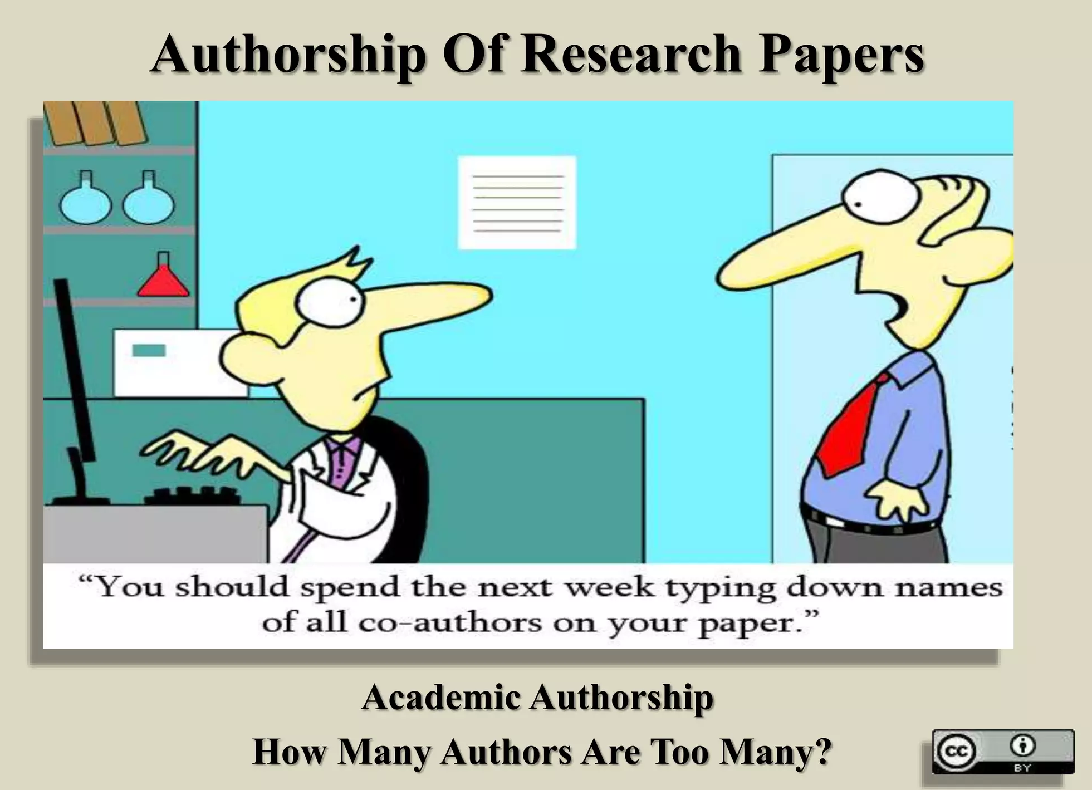
Co-authorship
Authorship and contributorship
Who should be co-authors?
Who decide on co-authorship, and when?
Author order

Slide 24
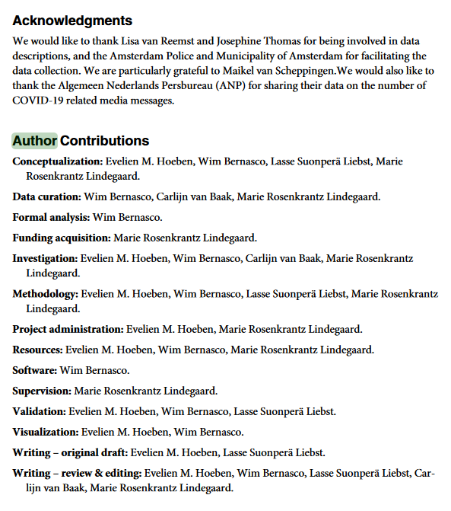
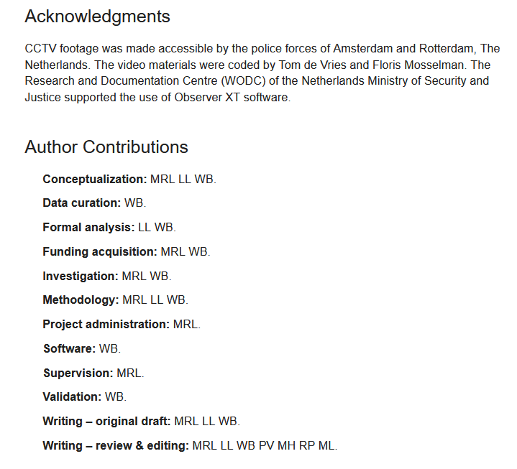
CRediT: Contributor Roles Taxonomy
Specify contributions explicitly
Self-initiated or required by journal
Roles (https://credit.niso.org/)
Conceptualization
Data curation
Formal Analysis
Funding acquisition
Investigation
Methodology
Project administration
Resources
Software
Supervision
Validation
Visualization
Writing – original draft
Writing – review & editing

Slide 25
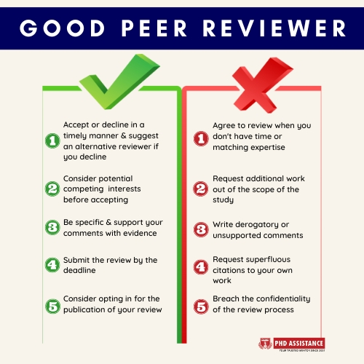
You as a peer reviewer
Authors are being asked as reviewers
Selection based on
Topic/method of your published work
Fields of interest in your MPS profile

Slide 26
You as peer reviewer: Q&A
Can I cancel an already accepted reviewing task? Yes, if you notify the editor
Will my work more easily be accepted if I agree to do reviews? No
Will my work more easily be accepted if I write positive reviews? No
Can I ask someone to help me do a review? Yes, but only with the Editor’s explicit consent
Can I cite from a paper I am reviewing? No
Can I cite from a published paper I reviewed? Yes
Can I use ideas I get from reading a review? I think so. I do not know how this could be prevented
How many reviews should I do, what is a fair share? About twice the number of submissions you do per year, divided by the average number of co-authors (e.g. 6 per year with 3 co-authors on average = 12/3 = 4 reviews
What do I do if I suspect scientific integrity issues in a paper I review (e.g. plagiarism). Do not submit your review but contact the Editor.

Slide 27
That is it for today
What’s next?
Tonight: Slides on https://github.com/bernasco/publishing_your_research_paper_2024
Tomorrow: your certificate of participation (e-mail)
Friday: invitation online (Google Forms) anonymous course evaluation survey

