Slide 1
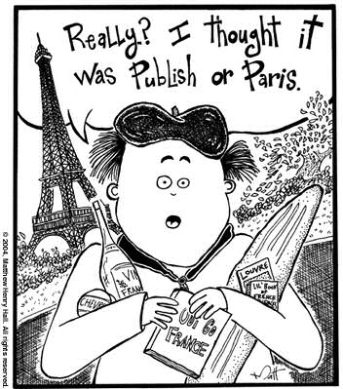
Publishing your research paper
Contents
Select potential outlets for your paper
Communicate with editors
Use manuscript processing systems
Read and respond to reviewer feedback
Revise your manuscript
Publish open access
Be a reviewer
Wim Bernasco
Two meetings at NSCR, February 2024
1 ECTS
wbernasco@nscr.nl

Slide 2
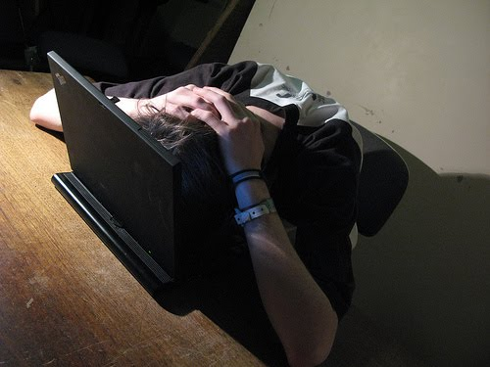
Publishing research papers

Slide 3

Publishing your research paper

Slide 4
Toilets and emergencies
Offices
corridor
corridor
screen
toilets
We are here
windows
corridor
Printer area

Slide 5


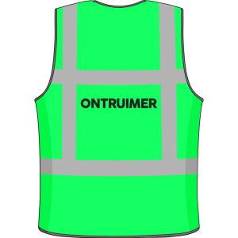

Toilets and emergencies
Offices
corridor
corridor
Follow instructions by
screen
toilets
We are here
windows
corridor
Printer area

Slide 6
Outline of the course
February 5
Introduction
Knowing me, knowing you
Scientific communication
WTC break
Selecting a journal
Submitting your paper
February 28
Processing feedback
After your paper is accepted
Writing in a team
WTC break
Authorship & contributorship
You, the reviewer

Slide 7
Introduction: Why this course
Little formal training in practise of publishing
Many PhDs want answers on practical questions
In which journal should I try to publish this work?
I haven’t heard back from the journal for 4 weeks. Should I e-mail the editor?
What does “major revision” mean, and “conditionally accepted”?
I am asked to review a paper. What do I do?
Is it fair that this person should be listed as a co-author?
Course not about writing, but about getting your work published

Slide 8

Disclaimer
As a PhD candidates, you have supervisors
They may have different experiences and opinions than I have
Involve them in your deliberations and decisions (they may be your co-authors)

Slide 9

Knowing me, knowing you
?
Your name
Your affiliation
Topic of your research
Any experience in publishing research
Motivation for this course (specific questions)

Slide 10
Scientific communication
Motivations
Scientific progress: communicate (present, discuss) to improve scientific knowledge
Individual recognition: please your superiors and advance your career
Scientific journals
Long ago scientists wrote each other letters (discoveries, comments)
Journals helped centralize communication
Separate roles: author, reviewer, editor, reader
Online revolution mainly speeds and globalizes the process

Slide 11

Criteria for selecting a journal
?

Slide 12
Selecting a journal: Impact factor
Impact factor: how often is the average paper in this journal cited
Last-5-year IF is more stable than last-year IF
You can find IFs at https://jcr.clarivate.com/jcr/ (pay wall!) under Social Sciences / Criminology and Penology
As a rule: IFs and rejection rates are correlated!
Discussion: Why do authors cite papers from high IF journals?
Discussion: Are citations a proper measure of impact?

Slide 13
Selecting a journal: Discipline, topic, approach
Generic (general interest) journals
Special topic journals (Journal of Interpersonal Violence, International Review of Victimology, Police Quarterly, Probation Journal, Trauma, Violence, & Abuse)
Special method journals (Journal of Quantitative Criminology, Journal of Experimental Criminology, Theoretical Criminology)

Slide 14
Selecting a journal: Society membership
?
European Journal of Criminology (European Society of Criminology)
British Journal of Criminology (British Society of Criminology)
Criminology & Criminal Justice (British Society of Criminology)
Criminology (American Society of Criminology)
Criminology and Public Policy (American Society of Criminology)
Justice Quarterly (Academy of Criminal Justice Sciences)
Tijdschrift voor Criminologie (Nederlandse Vereniging voor Criminologie)

Slide 15
Selecting a journal: Your favorite references
Frequency table of references
Which journals appear often?
Likely appropriate for your paper
Journal | Citations
Policing: An International Journal | 8
Crime and Delinquency | 6
Police Quarterly | 4
… | …

Slide 16
Selecting a journal: Practical issues
Maximum word count
Maximum number of tables / figures
Average duration of review procedure
Journal special issue
Find manuscript requirements under “submission guidelines” or “author instructions”

Slide 17


Selecting a journal: Open access
Three types
Limited access: Access is for paid subscribers only
Hybrid journals: Authors can pay for open access
Open access journals: all articles are open access
Advantages
Democratic values and ethics
Potentially more readers
Comply with research funders’ requirements
Disadvantages
Access is free for readers, but authors pay

Slide 18

Selecting a journal: Open access (costs)
Hybrid
Criminology (Wiley): € 2,830
Journal of Research in Crime and Delinquency (Sage) € 3,211
Justice Quarterly (Taylor & Francis) € 3,840
Open access
Crime science (Springer) € 3,840

Slide 19
Selecting a journal: Green open access
You publish your paper without open access (behind a pay-wall)
But you share a postprint = accepted author manuscripts, (AAM), pre-proof or author’s original version
Typically, the MS-Word version accepted by the Editor
Upload to public repository (e.g. Open Science Foundation https://osf.io )
Note that a preprint is something completely different (more later)
Advantage
Open access, but no costs involved for authors
Disadvantages
Not the final format (e.g. not same page numbering)
Possibly more difficult to find

Slide 20
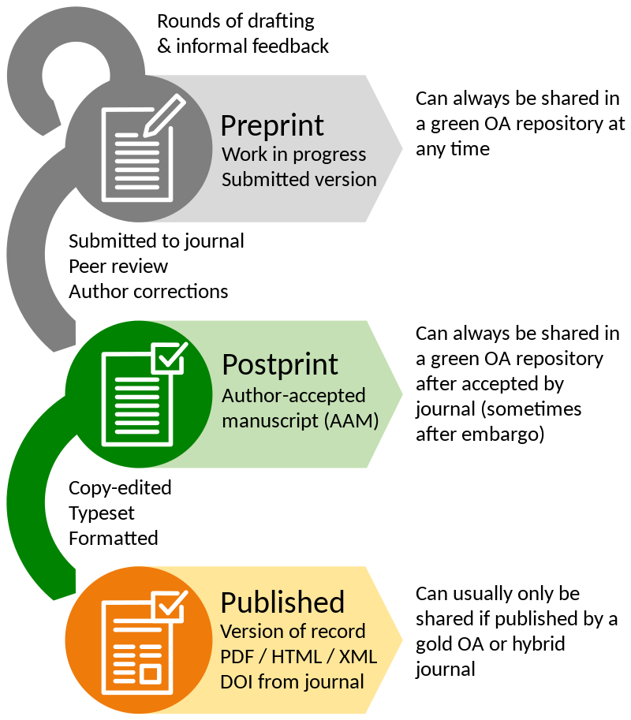
Preregistration, preprint, postprint
preregistration: published before you do the research
preprint: published after you do the research, before peer-review
Postprint: published after peer-review (accepted), not copy-edited
Published: published after peer-review (accepted), copy-edited

Slide 21
Where can I find and upload preprints?
List of preprint repositories
Multidisciplinary: OSF Preprints
Social Sciences: SocArXiv
Discipline specific: CrimRxiv, PsyArXiv
Institutional repositories (NSCR)
Personal websites
Depends on the publisher’s Copyright
Find out publisher Copyrights in Sherpa Romeo

Slide 22
What are the pros and cons about preprinting my work? (individual vs collective)
Pros | Cons
Priority of discovery (e.g., first to propose a theory) | More likely to be biased: preprints are not necessarily peer-reviewed
Speeds up the scientific process (e.g., COVID-19 research) | Undermines blind peer-review (e.g., reviewers might know who the authors are)
Invites scrutiny: anyone can review it before acceptance | My ideas may get scooped
Tears down paywalls (preprints are OA) | Some journals view preprints negatively
Gets more exposure | The contents might change
References
Jacques, S. (2020). Utility of Making Your Preprints Open Access. Criminology Open. https://doi.org/10.21428/b7013076.bece5ba5
Wheeler, A. P. (2019). Why I publish preprints. Andrew P. Wheeler blog. Retrieved from: https://andrewpwheeler.com/2019/05/30/why-i-publish-preprints/

Slide 23

Suggested guide
https://authorservices.taylorandfrancis.com/publishing-your-research/choosing-a-journal/

Slide 24

Submitting a paper
Wat does an Editor do?
Manuscript processing system (e.g. Editorial Manager, ScholarOne)
Cover letter
Requirements
Title
Abstract
References (Endnote, Zotero)
Acknowledgement
Biographic note
Waiting for a response

Slide 25
Submitting a paper: The Editor
Coordinates the processing of your paper
Triage: scans paper for suitability / quality
Reviews the paper (usually superficially)
Searches and invites reviewers and sends your paper out for review
Reads and synthesizes reviews
Makes a decision
(repeats steps 4-6 in case of revision)
The editor is usually assisted by an editorial assistant (a person) and a manuscript processing system (software)

Slide 26
Submitting: Manuscript processing systems
ScholarOne, Editorial Manager
What do they look like?
What do they want from you?
Title
Abstract and keywords
Manuscript
Cover letter
Figures and tables
Affiliations, e-mail addresses and ORCIDs of all authors
Word, tables and figure counts
Acknowledgement
Contact information corresponding author
Biographic notes all authors
Ethics statements
After acceptance: Open access fee or copyright transfer contract
British Journal of Criminology is an exception: just e-mail your manuscript to the editorial office

Slide 27
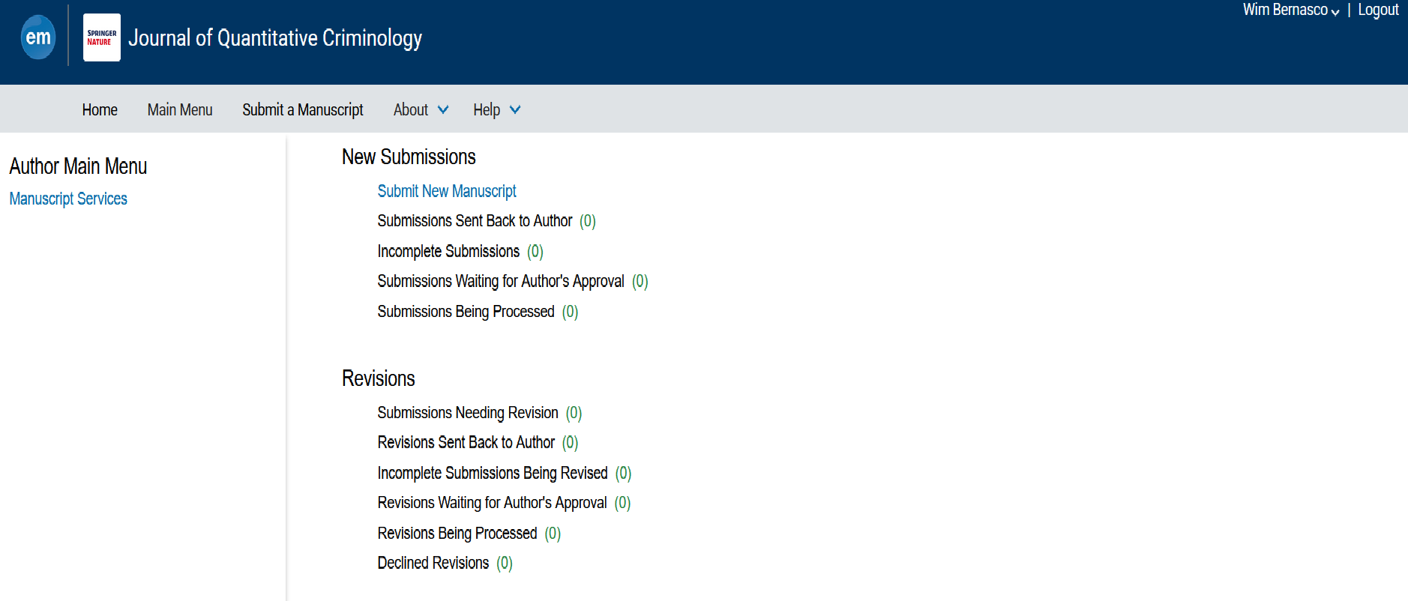

Slide 28



Submitting: Working with reference systems
Reference software
Endnote (paid)
Zotero (free, open)
Mendeley (free, owned by Elsevier)
Three functions
Database of literature (incl. PDF)
Ensure completeness in manuscripts
Adjustable reference formats
Continue using them throughout

Slide 29
What is an ORCID (and why would you want one)
Open Researcher and Contributor ID
16-digit number that uniquely identifies you as an author
Looks like 0000-0002-3385-0883 (this is my ORCID)
https://orcid.org/0000-0002-3385-0883 is a link to that person’s ORCID information
Advantages
No mistakes about who you are or if you change your name
People can find references to all your work in one place (and you do not have to do or pay anything for it)

Slide 30
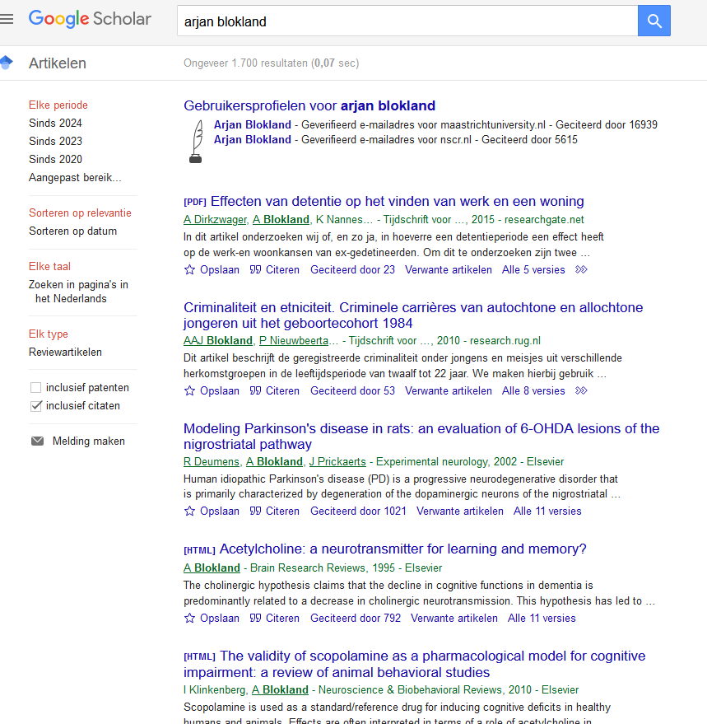

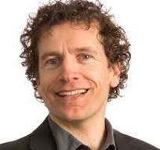
Prof. Arjan Blokland
Prof. Arjan Blokland

Slide 31

Possible decisions
Rejection
Revise and resubmit
Major revision
Minor revision
Conditional acceptance
Acceptance

Slide 32
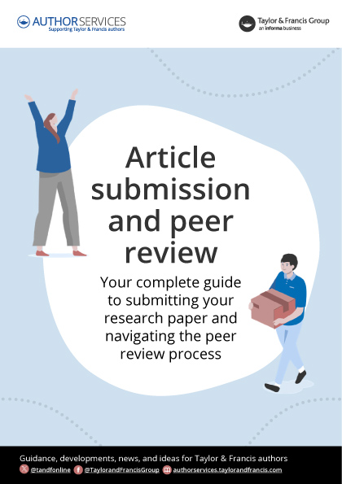
Suggested guide
https://authorservices.taylorandfrancis.com/resources/article-submission-and-peer-review-free-guide/

