Slide 1
Data Wrangling Project
United States National Occupational Employment and Wage Estimates (May 2015)
United States Crime Rate 2015 Data Source: Bureau Of Labor Statistics, Federal Bureau of Investigation
This PowerPoint document includes the screen shots of
various plots graphed under this project.
Jyoti Chaudhary (RUID: 168007813)

Slide 2
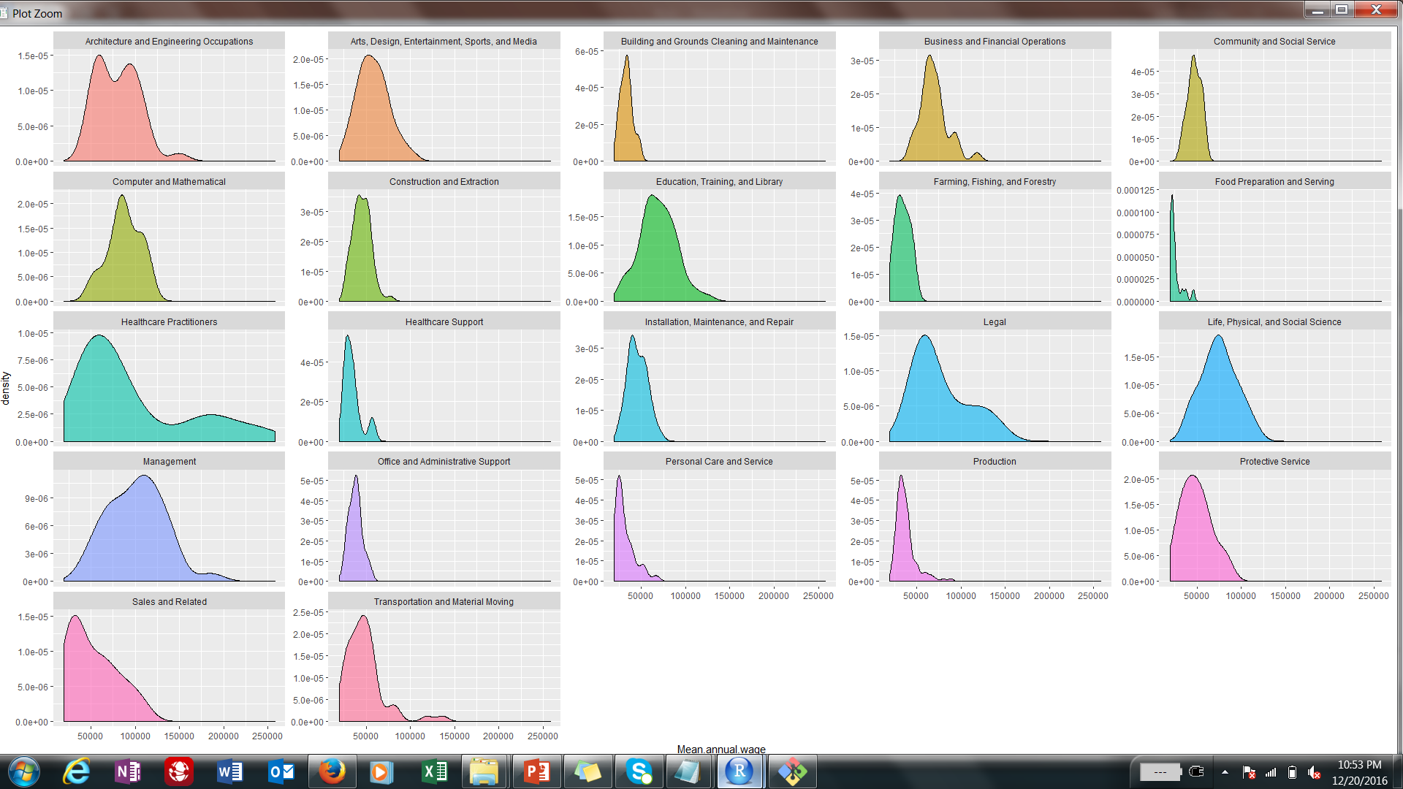

Slide 3
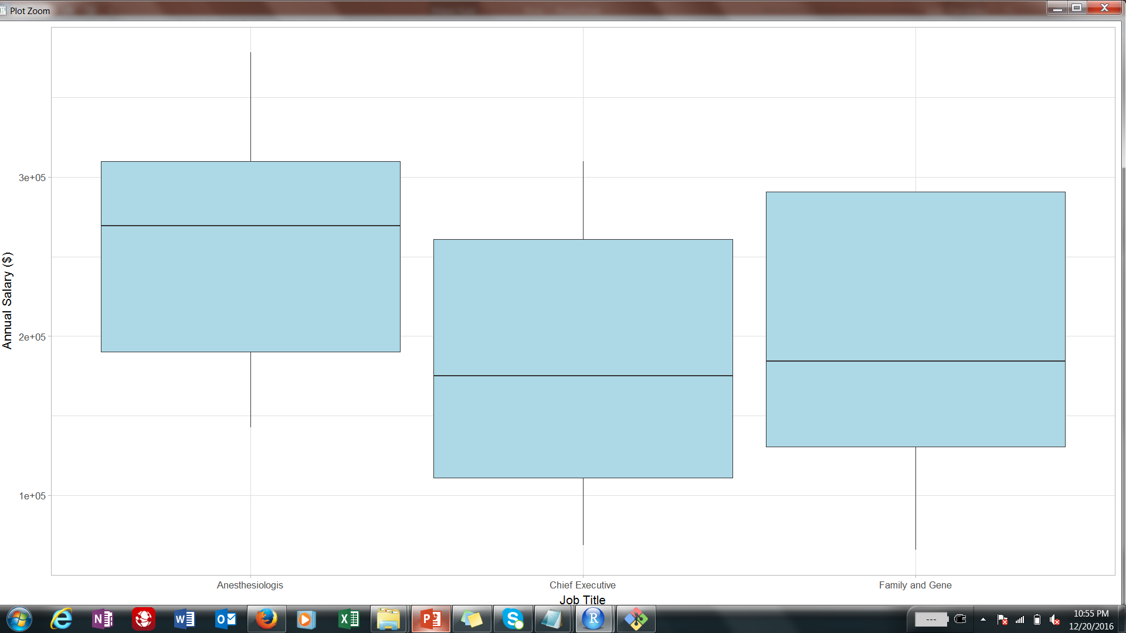

Slide 4
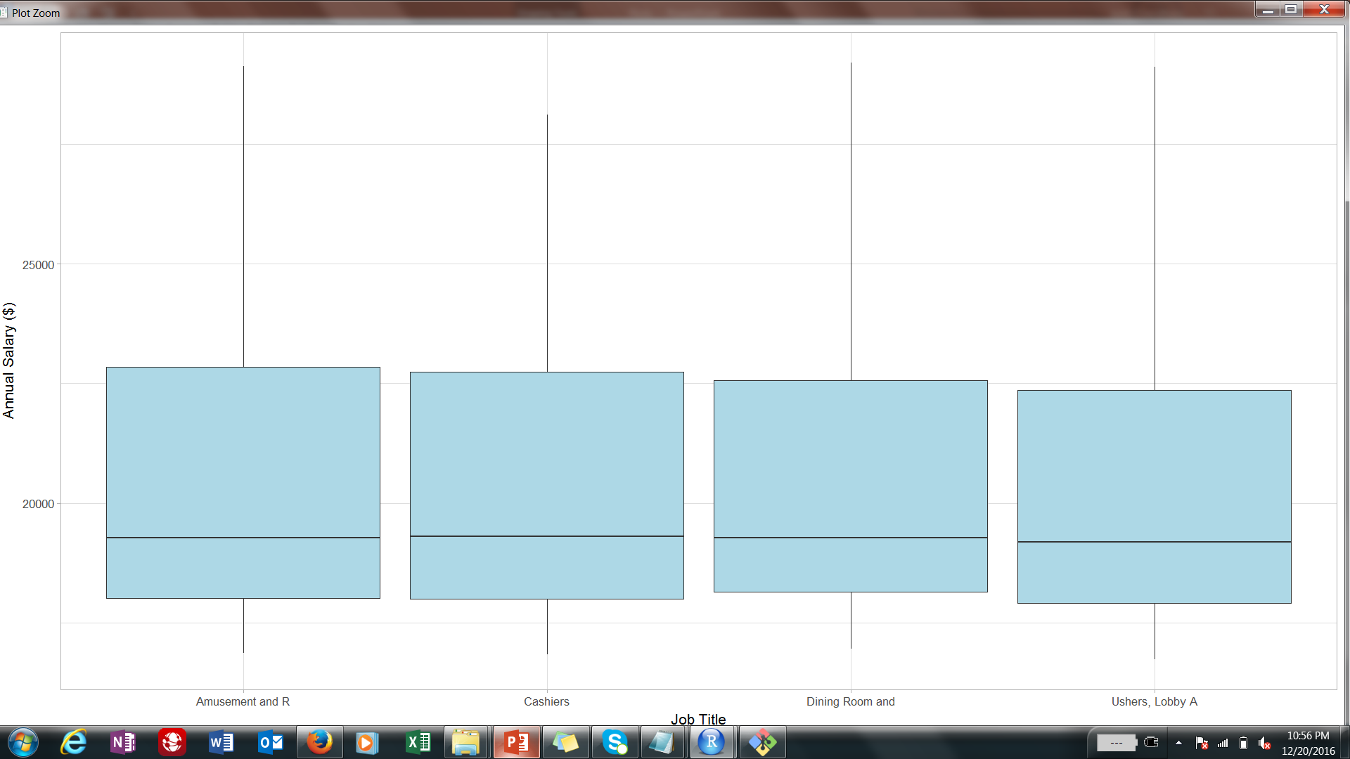

Slide 5
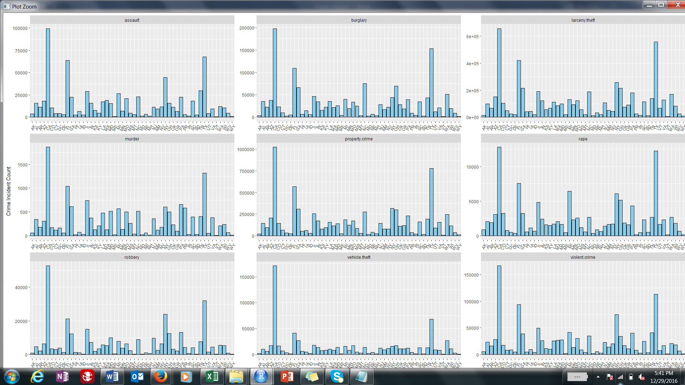

Slide 6
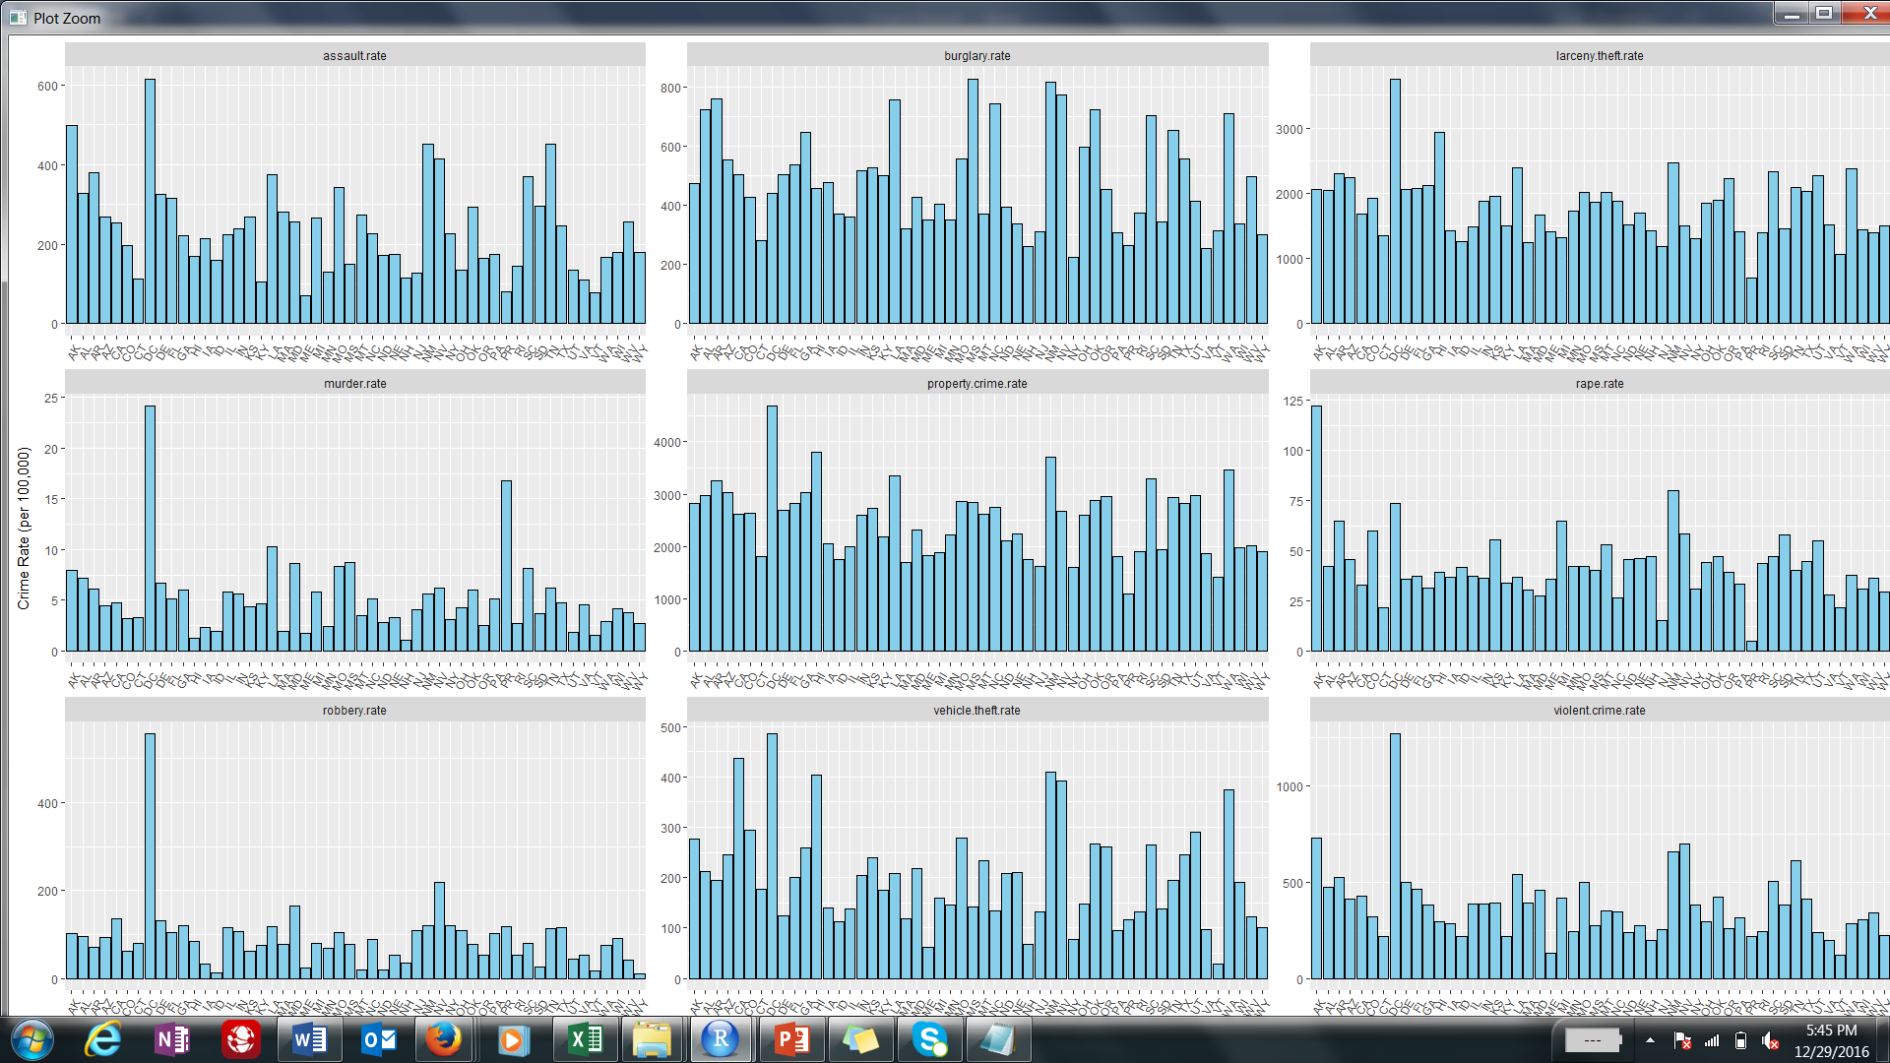

Slide 7
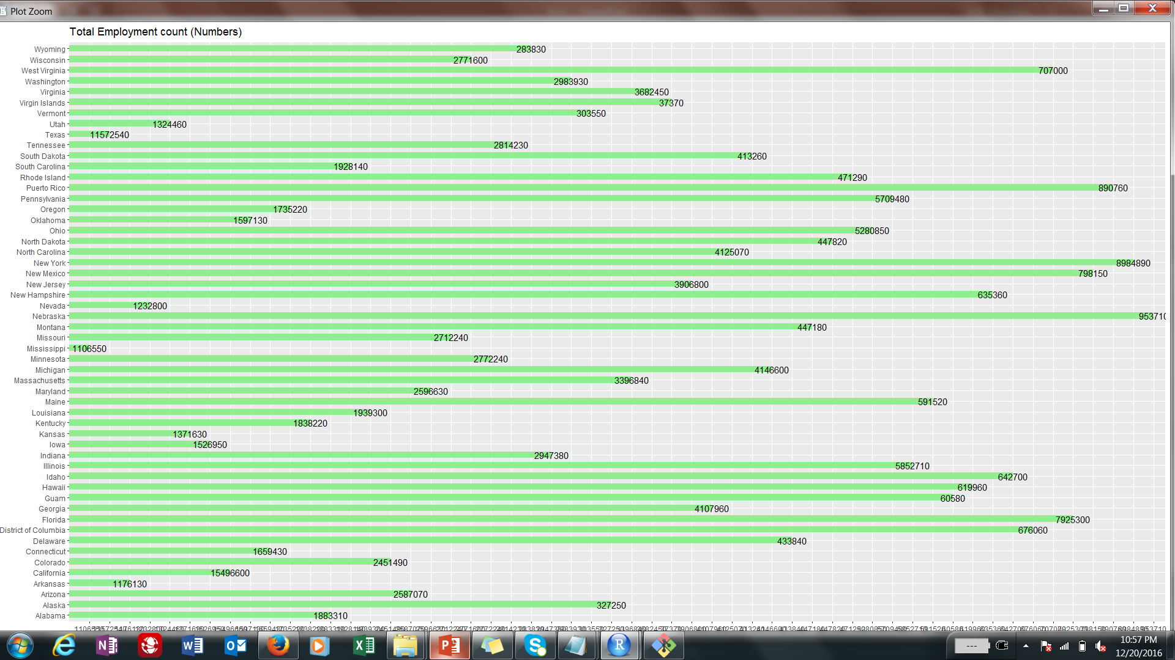

Slide 8
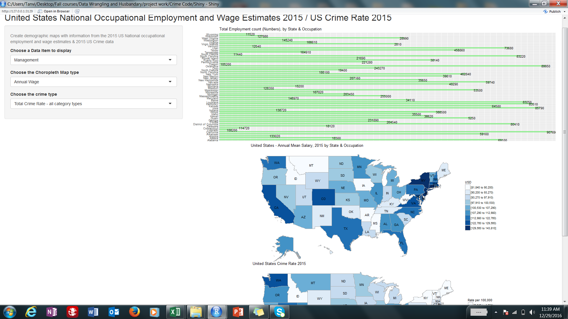

Slide 9
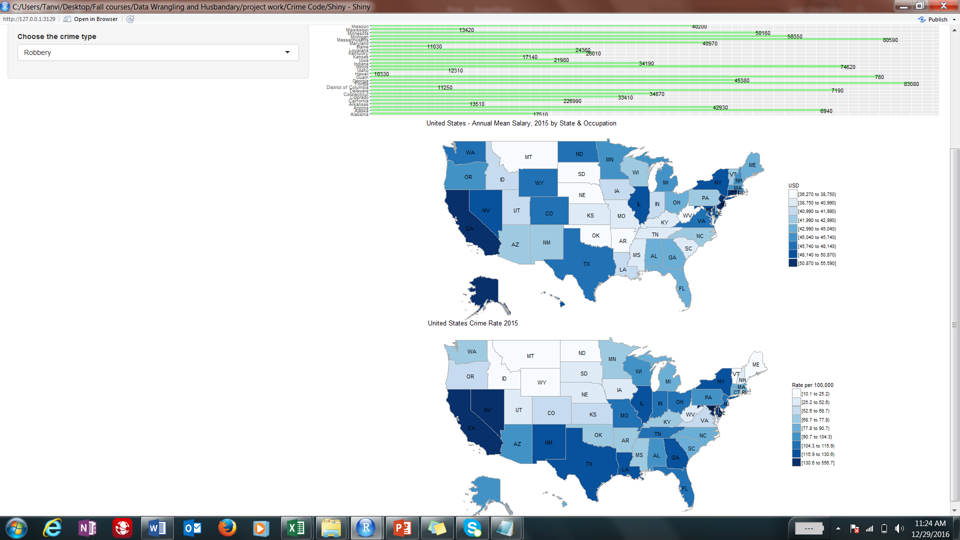

Slide 10
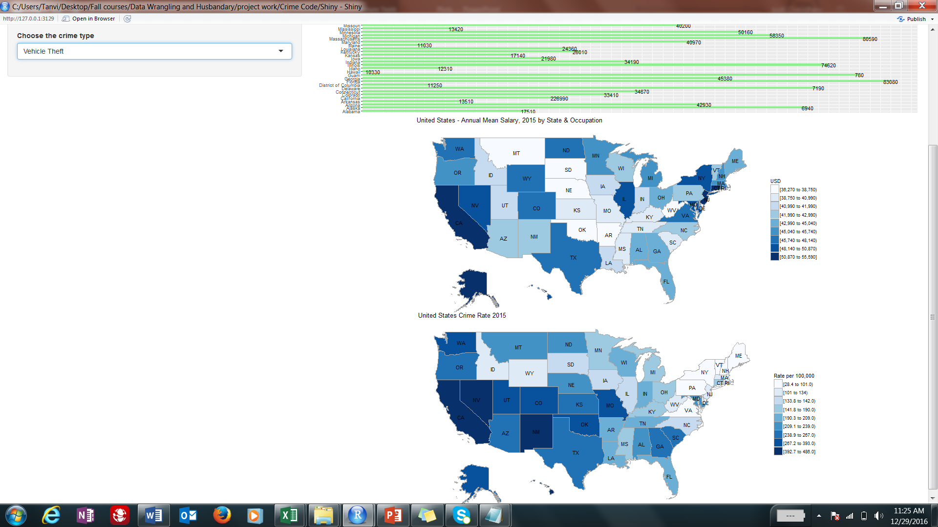

Slide 11
