Slide 1
Data Wrangling Project
United States National Occupational Employment and Wage Estimates (May 2015) Data Source: Bureau Of Labor Statistics
This PowerPoint document includes the screen shots of
various plots graphed under this project.
Jyoti Chaudhary (RUID: 168007813)

Slide 2
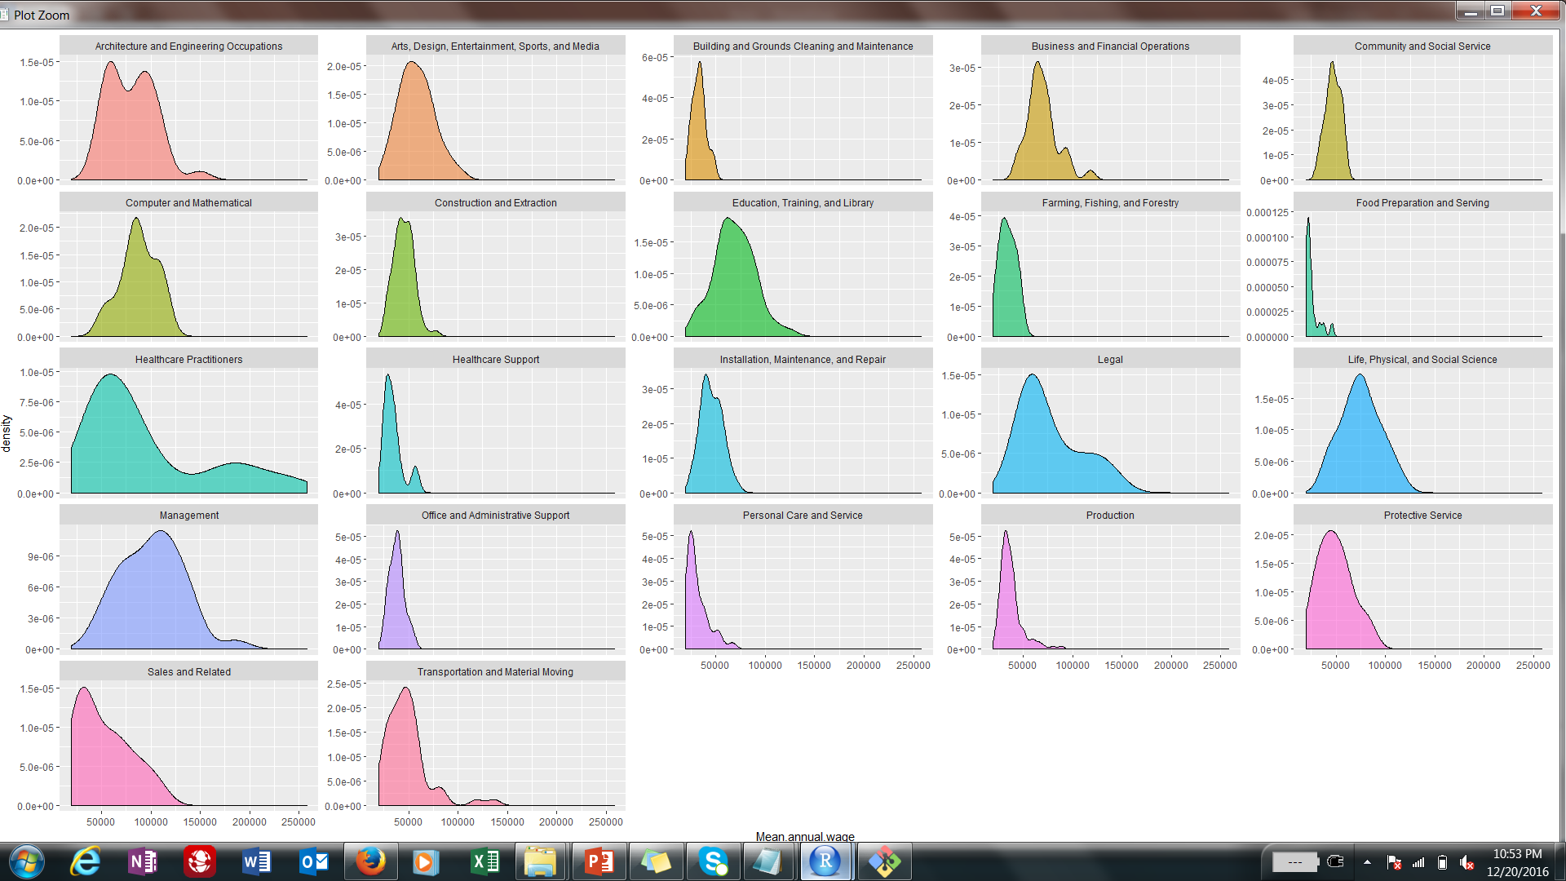

Slide 3
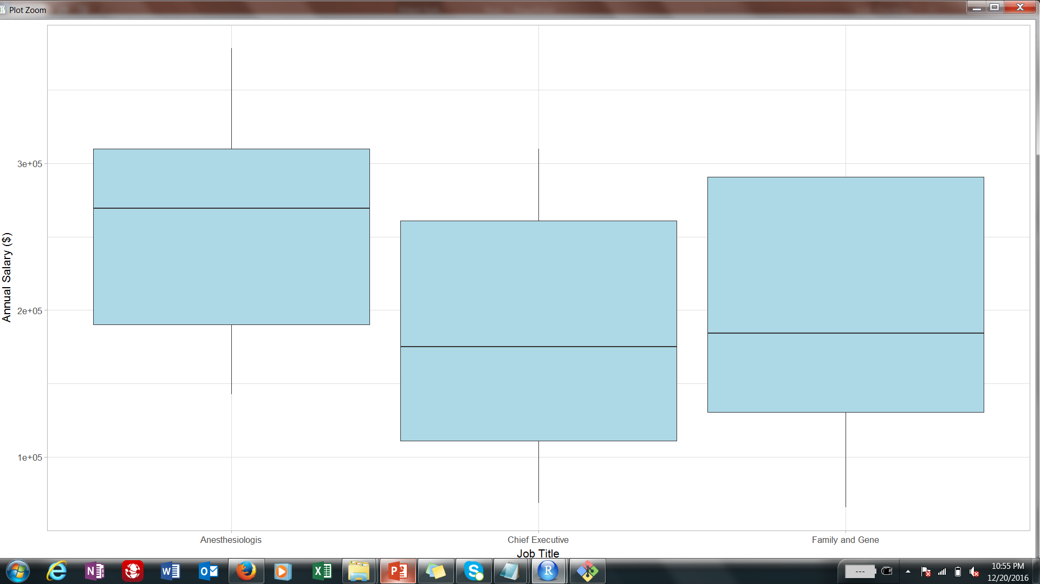

Slide 4
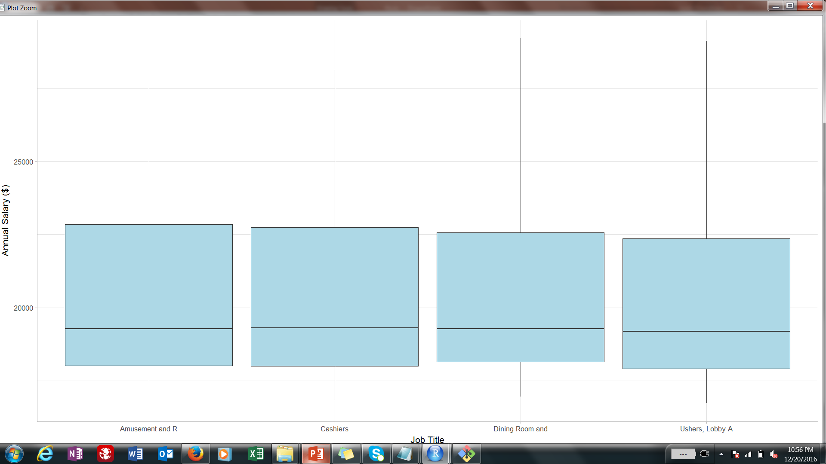

Slide 5
