Slide 1

Data Visualization

Slide 2
Who Am I?

Slide 3



Bernat Gel
Bioinformatician at the Hereditary Cancer Group, IGTP
https://github.com/bernatgel
@bernatgel
bgel@igtp.cat

Slide 4

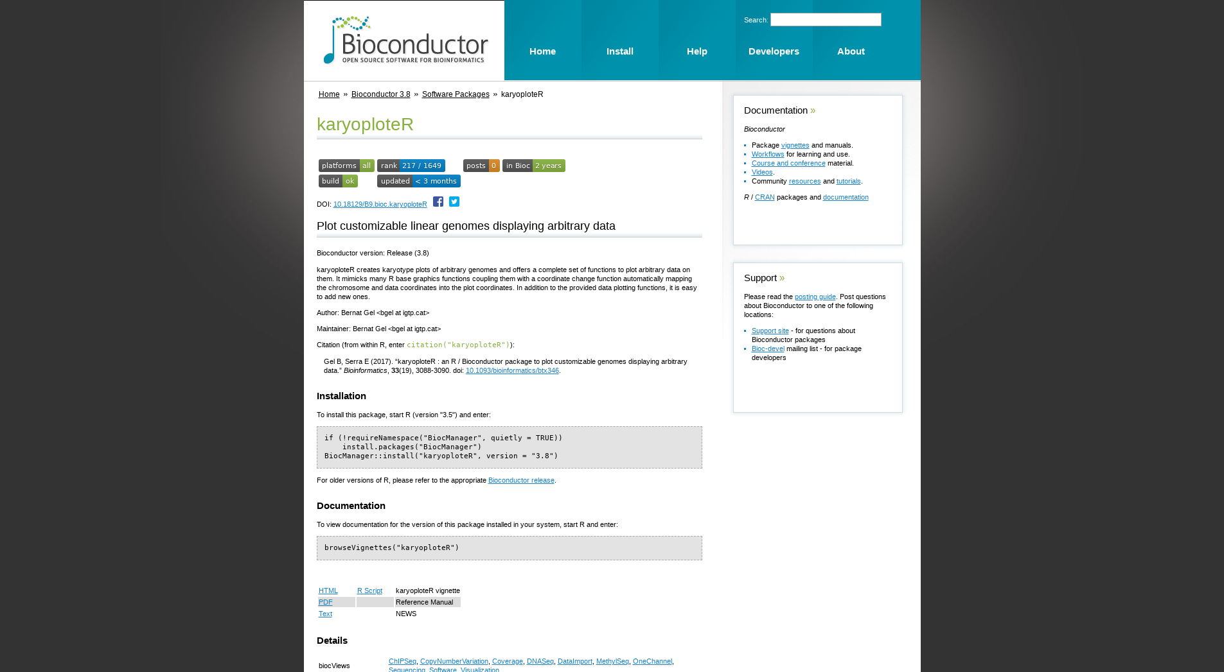
Author of karyoploteR

Slide 5
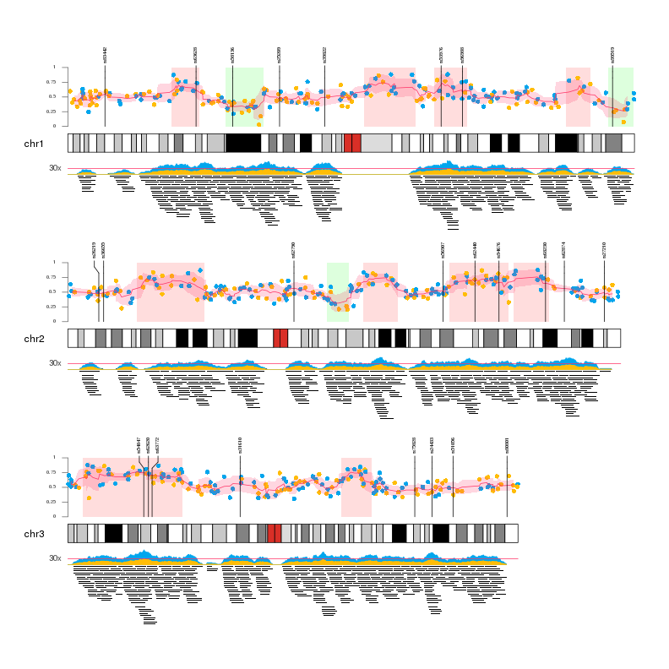

Slide 6
Let's start!

