Slide 1
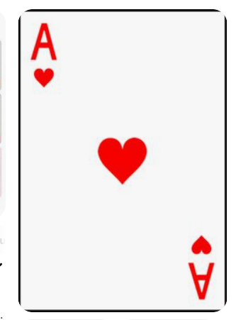
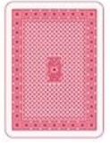
Control UICarta
front
UICartam
N
♠
Image
Carta (Carta)
BackFace (boolean)
back
N
♠

Slide 2
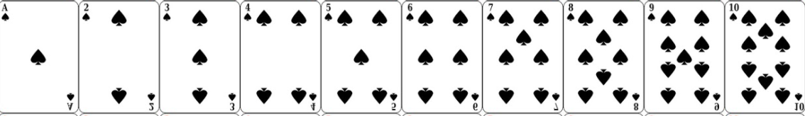
1 |  | 1
 | 1
2 |  | 2
1 |  | 1
 | 1
1 |  | 1
 | 2
2 |  | 2

Slide 3
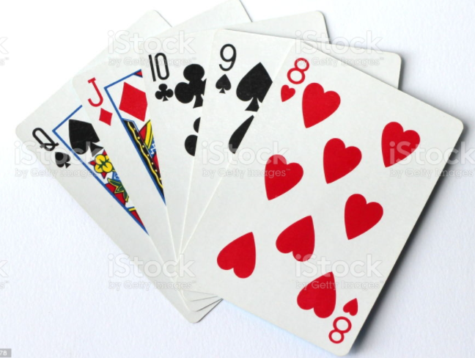
Control UIMa
UIMacv
UIMacv
Cartes (ObservableCollection<Carta>)

