Slide 1
Bidirectional RNN

Slide 2
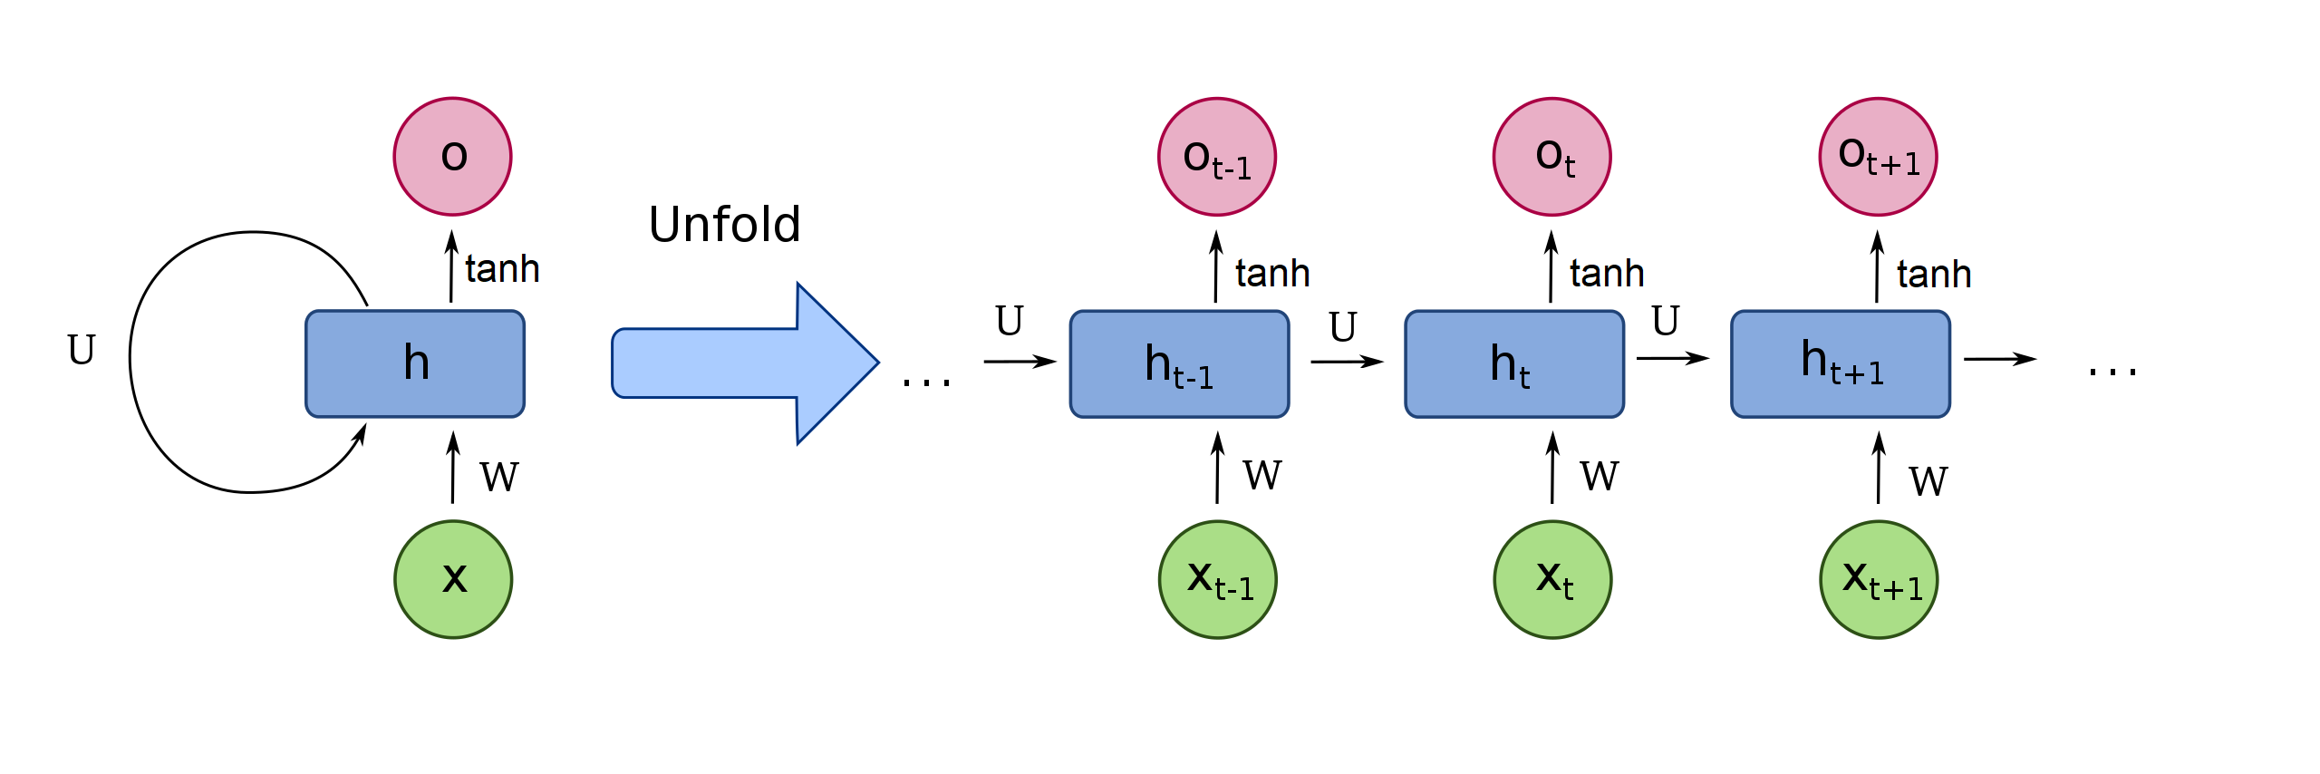
RECURRENT NEURAL NETWORKS
Quelle: https://en.wikipedia.org/wiki/Recurrent_neural_network

Slide 3
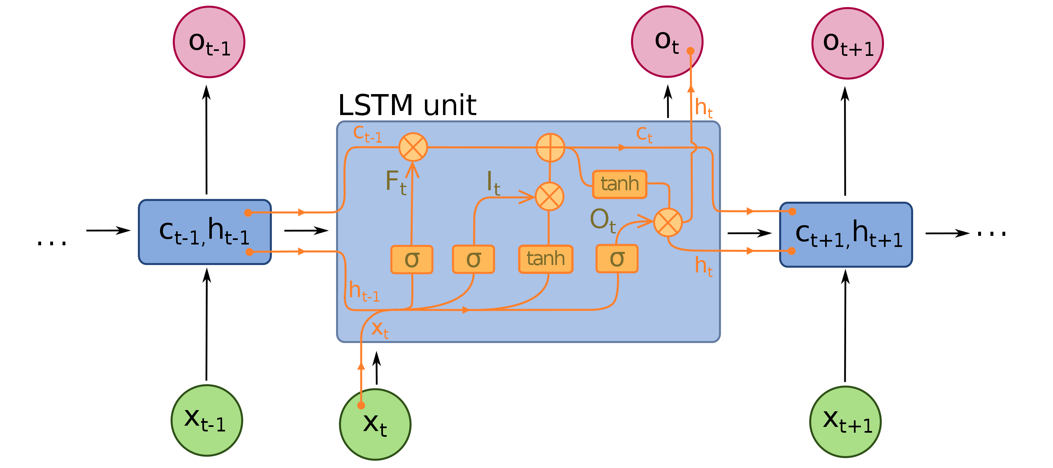
Long Short Term Memory
.
Quelle: https://en.wikipedia.org/wiki/Recurrent_neural_network

Slide 4
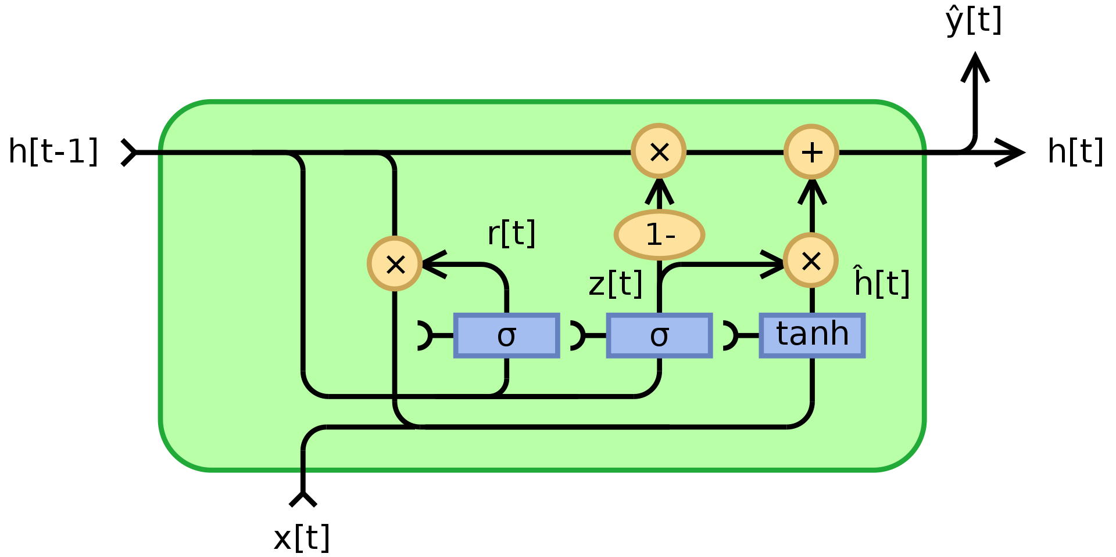
Gated Recurrent Unit
.
By Jeblad - Own work, CC BY-SA 4.0, https://commons.wikimedia.org/w/index.php?curid=66234712

Slide 5
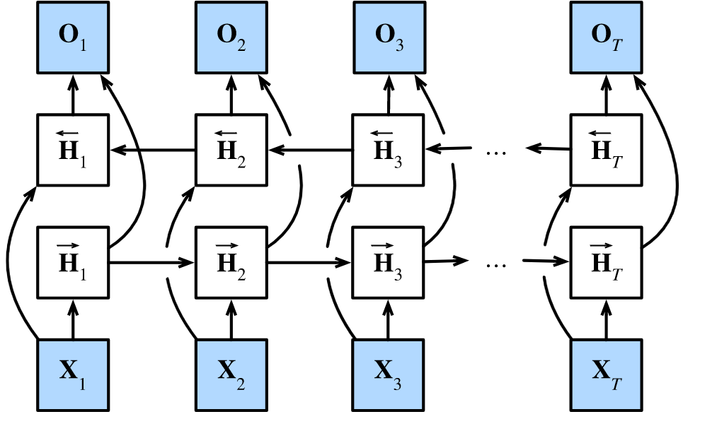
Bidirectional
Quelle: https://d2l.ai/chapter_recurrent-modern/bi-rnn.html

Slide 6
Bidirectional
In bidirectional RNNs, the hidden state for each time step is simultaneously determined by the data prior to and after the current time step.
Bidirectional RNNs bear a striking resemblance with the forward-backward algorithm in probabilistic graphical models.
Bidirectional RNNs are mostly useful for sequence encoding and the estimation of observations given bidirectional context.
Bidirectional RNNs are very costly to train due to long gradient chains.
Quelle: https://d2l.ai/chapter_recurrent-modern/bi-rnn.html

