Slide 1
Gated Recurrent Unit

Slide 2
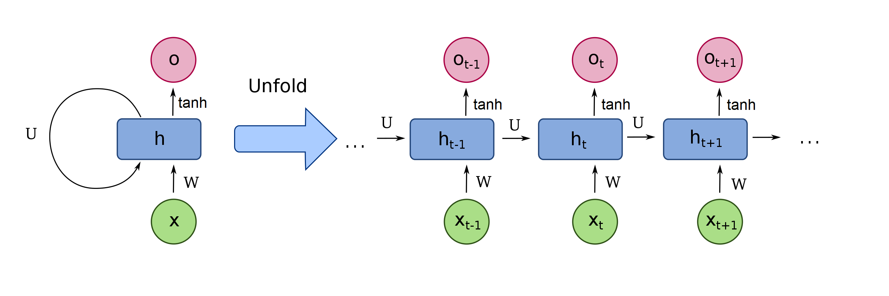
RECURRENT NEURAL NETWORKS
Quelle: https://en.wikipedia.org/wiki/Recurrent_neural_network

Slide 3
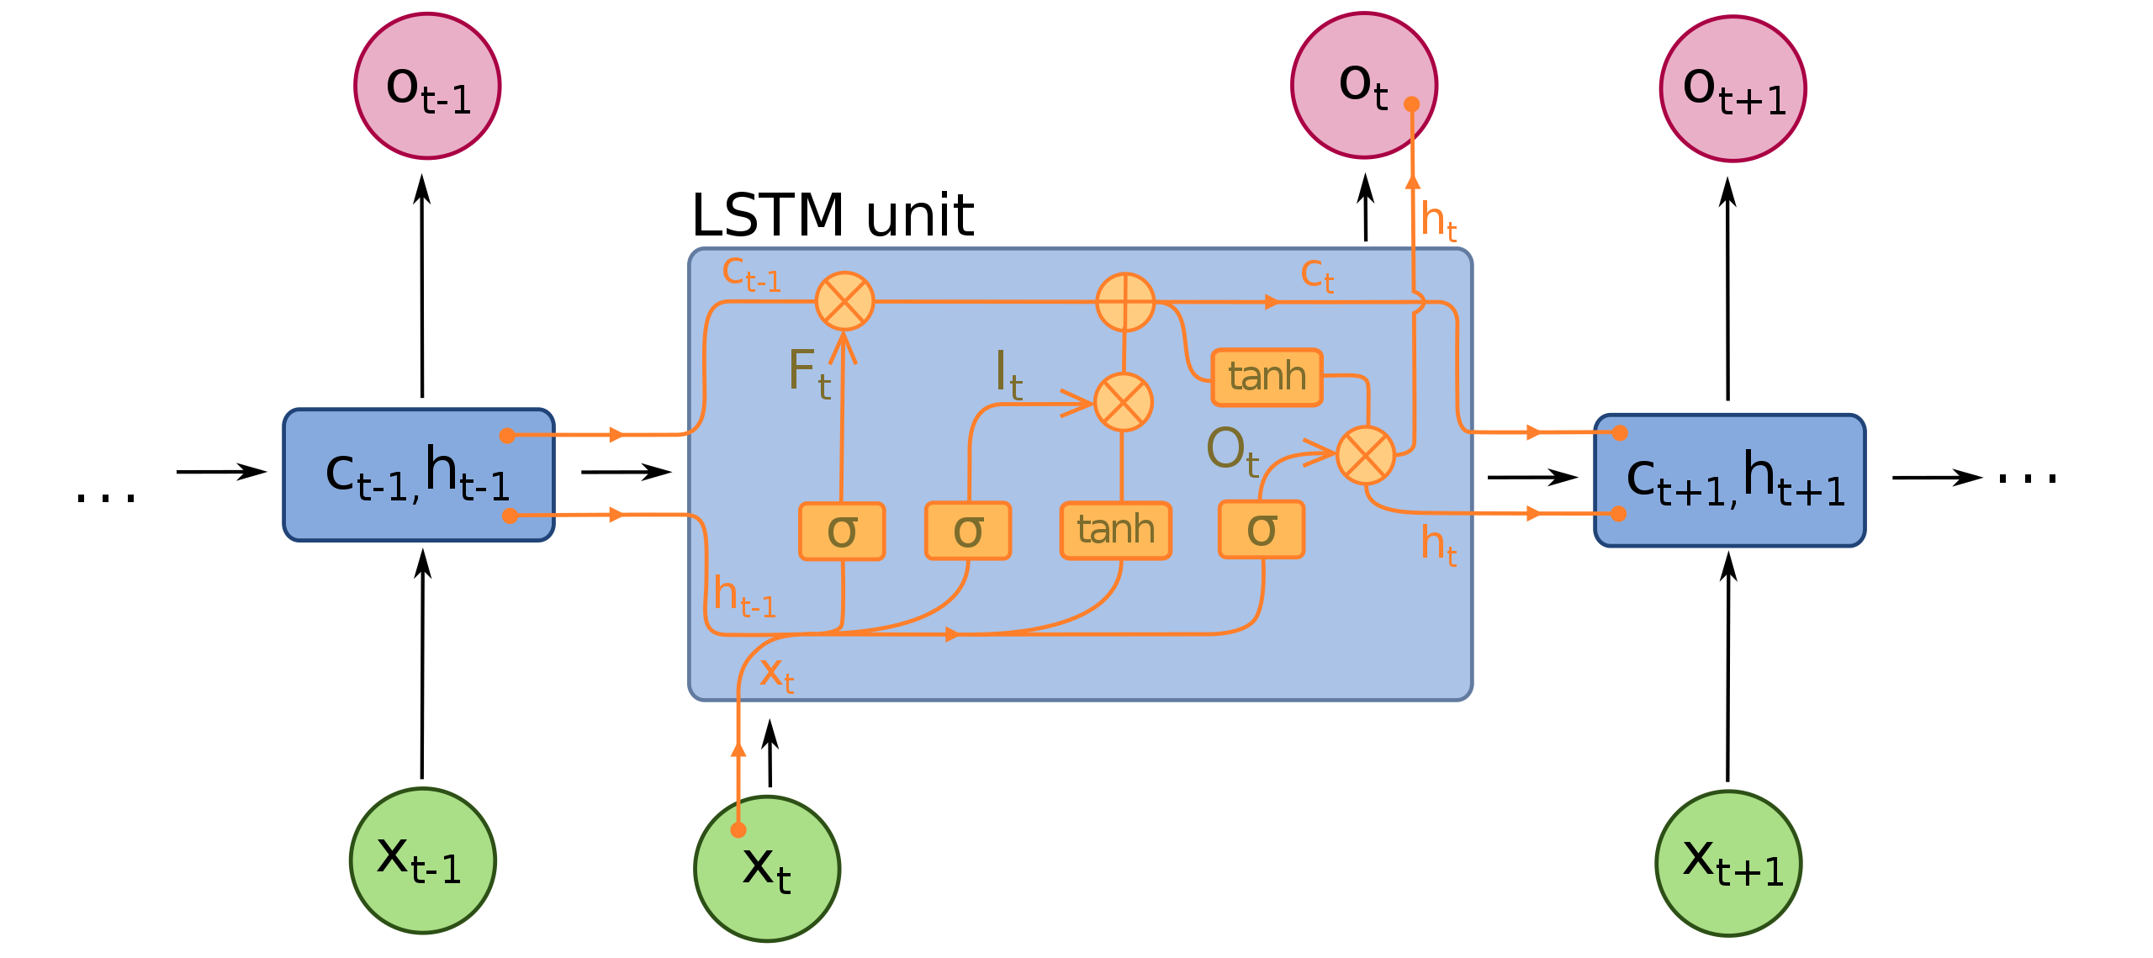
Long Short Term Memory
.
Quelle: https://en.wikipedia.org/wiki/Recurrent_neural_network

Slide 4
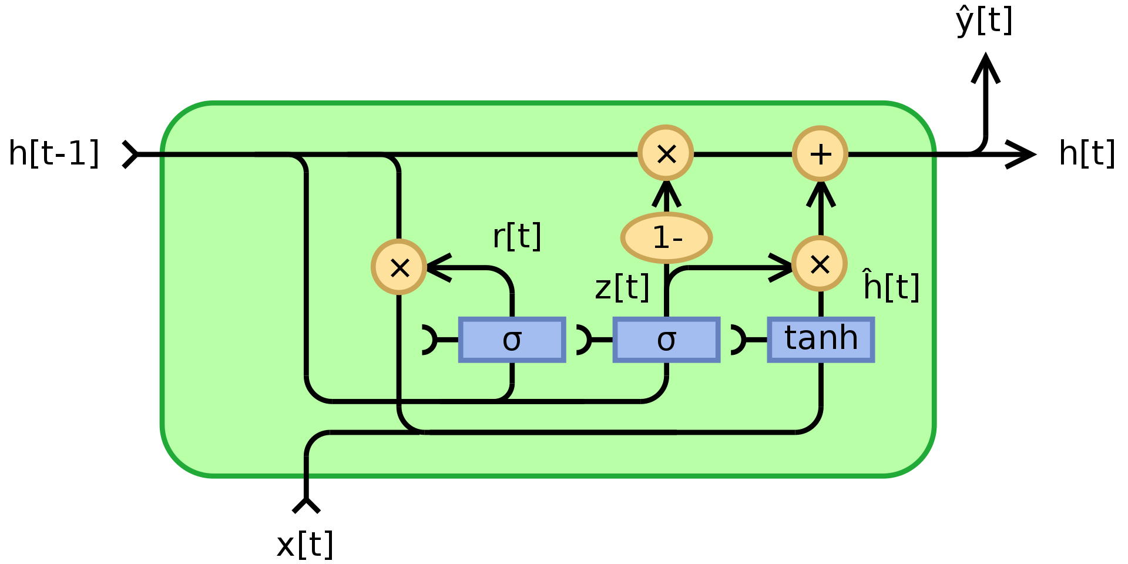
Gated Recurrent Unit
.
By Jeblad - Own work, CC BY-SA 4.0, https://commons.wikimedia.org/w/index.php?curid=66234712

Slide 5
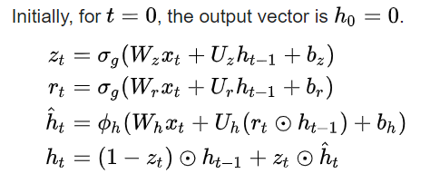
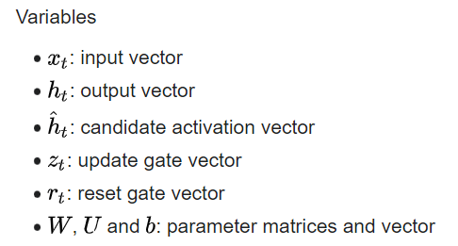
Gated Recurrent Unit
.
By Jeblad - Own work, CC BY-SA 4.0, https://commons.wikimedia.org/w/index.php?curid=66234712

