Slide 1
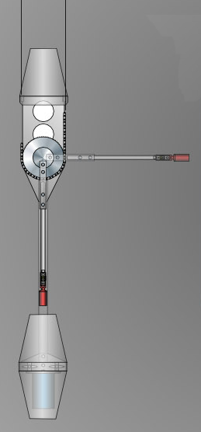
θ

Slide 2
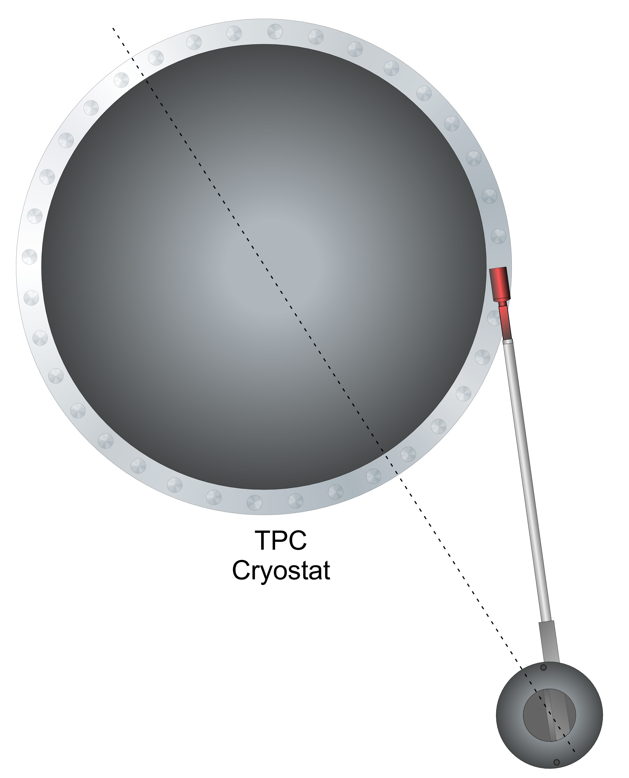
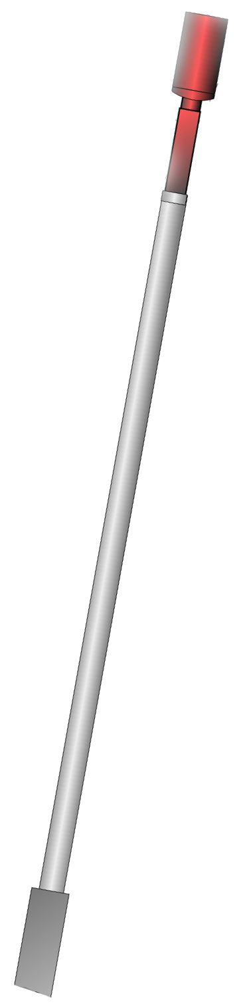
the circle for the
angle makes the
figure larger than
it has to be →
import its png
on the next slide
and crop the
bottom
from:
CALIS_TopView_Cary
32 cm
62 cm
80 cm
TPC
cryostat
φ
deployment
device

Slide 3
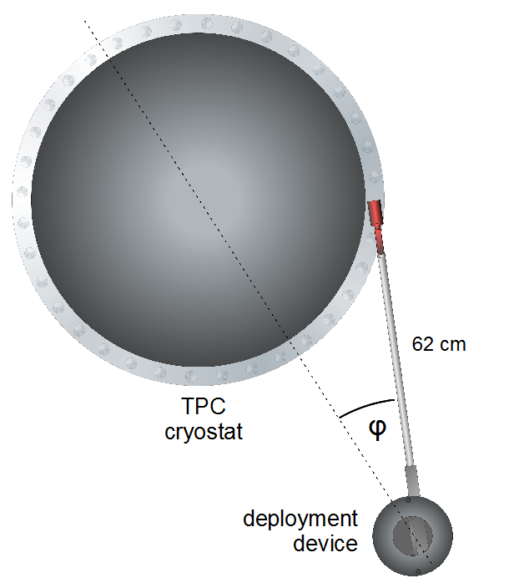

Slide 5
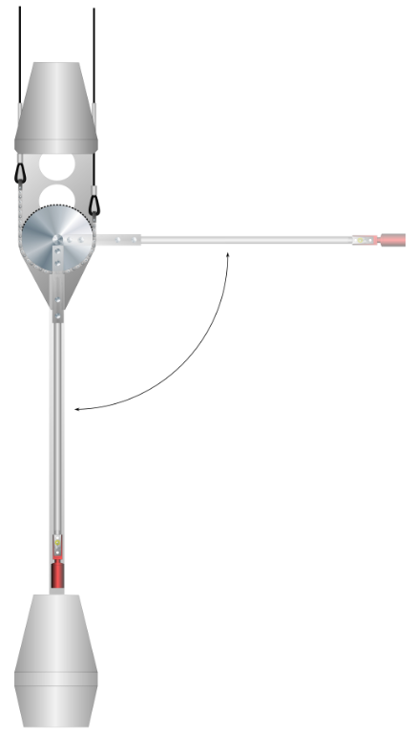
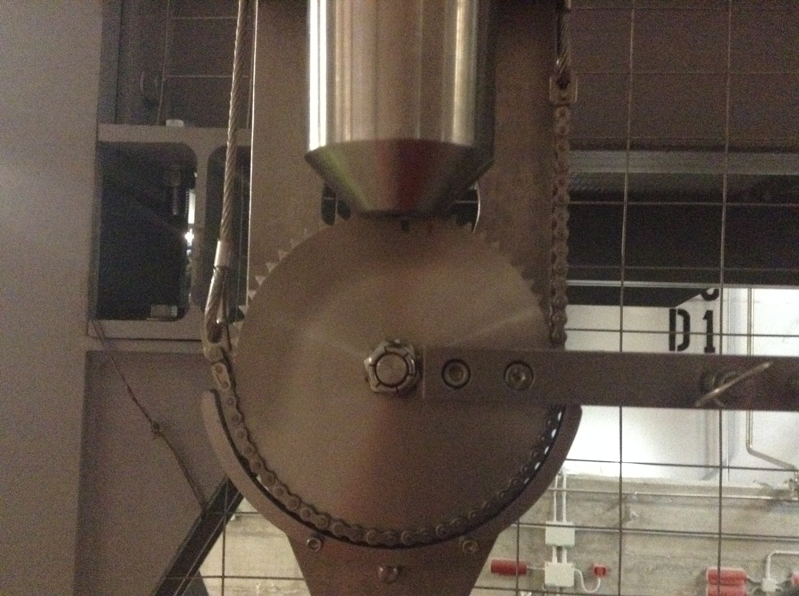
A. lowering
3a
B. articulation
32 cm
6
C. rotation
5
θ
62 cm
2
6
6
80 cm
[B. dearticulation]
4
φ
5
1
3b

Slide 6
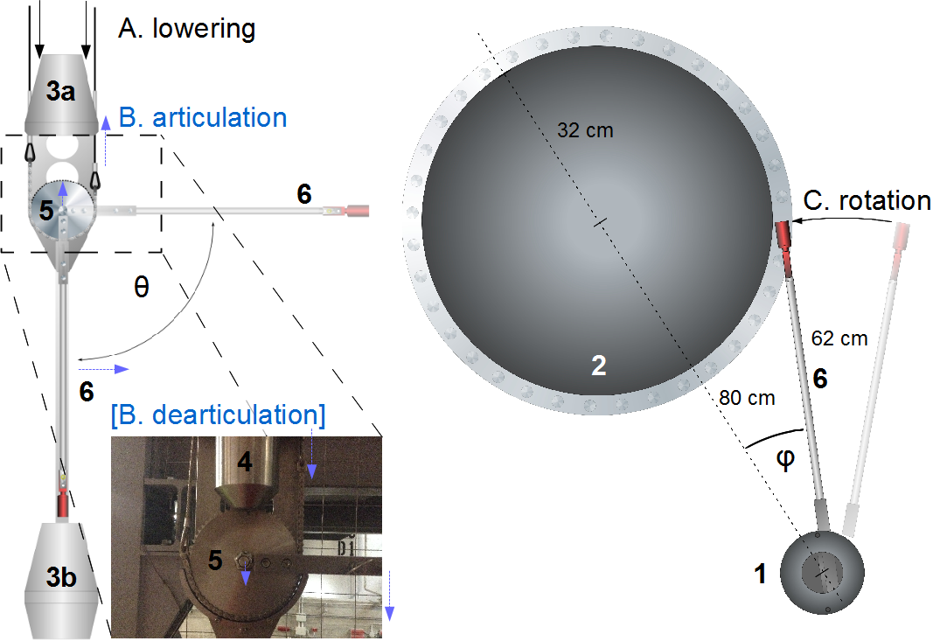

Slide 7
Backup

Slide 8


