Slide 1
Plots for the Calib Campaign
section of the
LNGS April '15 report
Bernd

Slide 2
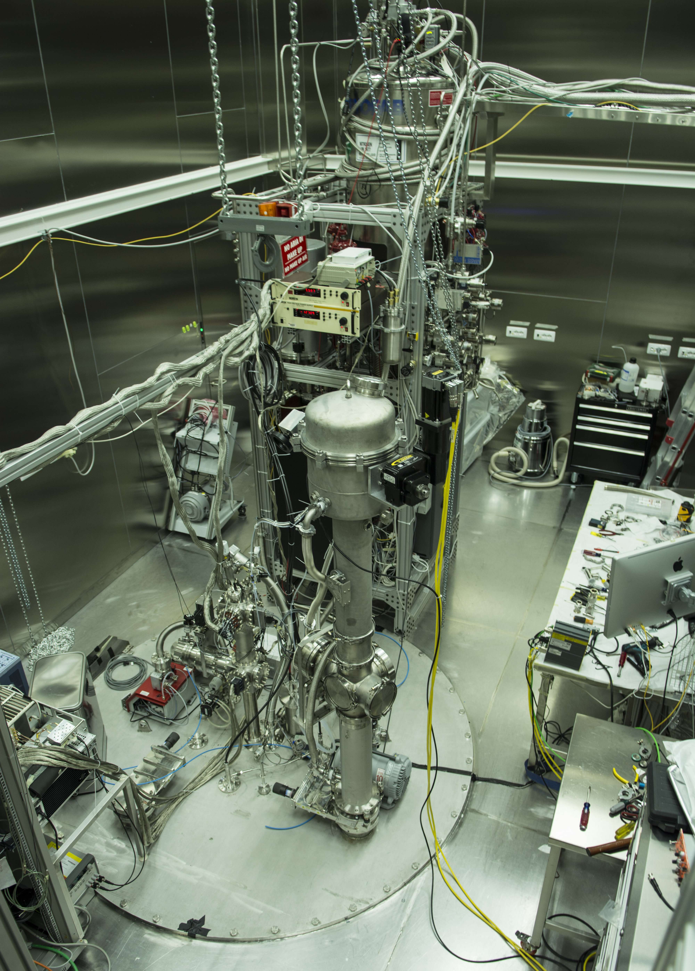
CALIS in CRH
radon-free DarkSide-50 clean room
cryo
tower
CALIS
electronics rack

Slide 3
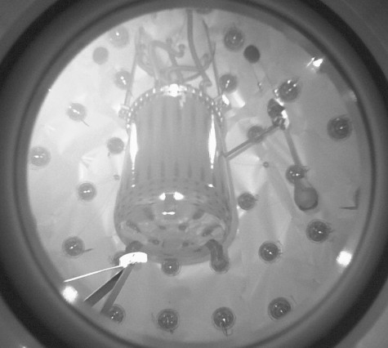
next to cryostat
80 cm
deployment
device
TPC
cryo-
stat
calibration
source

Slide 4
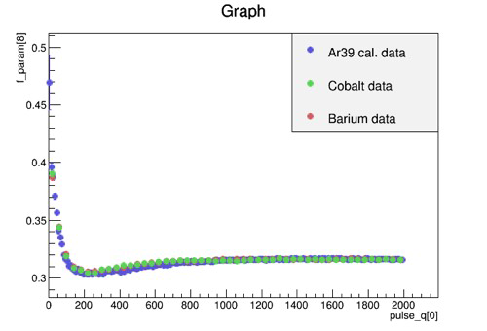
pulse shape discr. F90
preliminary
³⁹Ar, ⁵⁷Co, ¹³³Ba data-data agreement to illustrate the
quality of the calibration data:
(courtesy Davide, Claudio, Paolo)
the source of this plot would be good to have to adjust axes, introduce „preliminary“

Slide 5
Backup

Slide 6
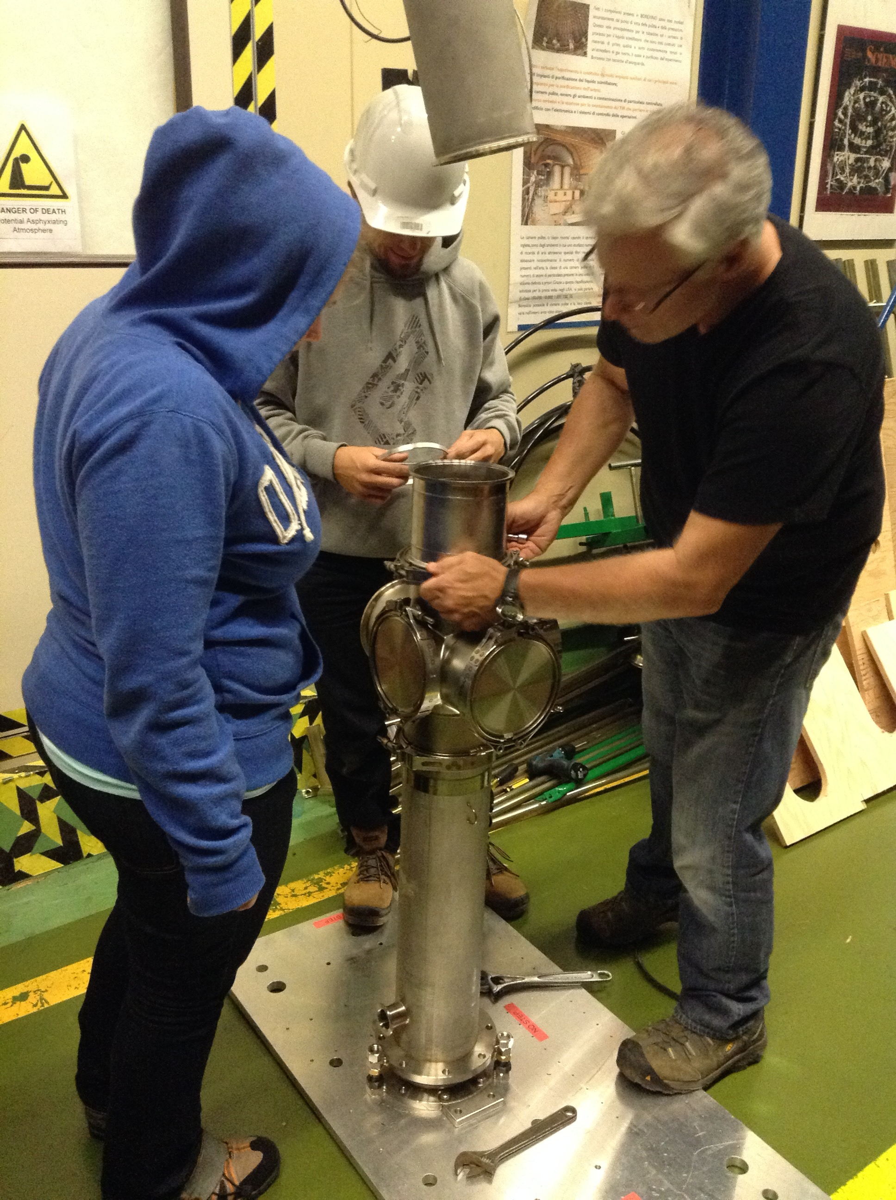
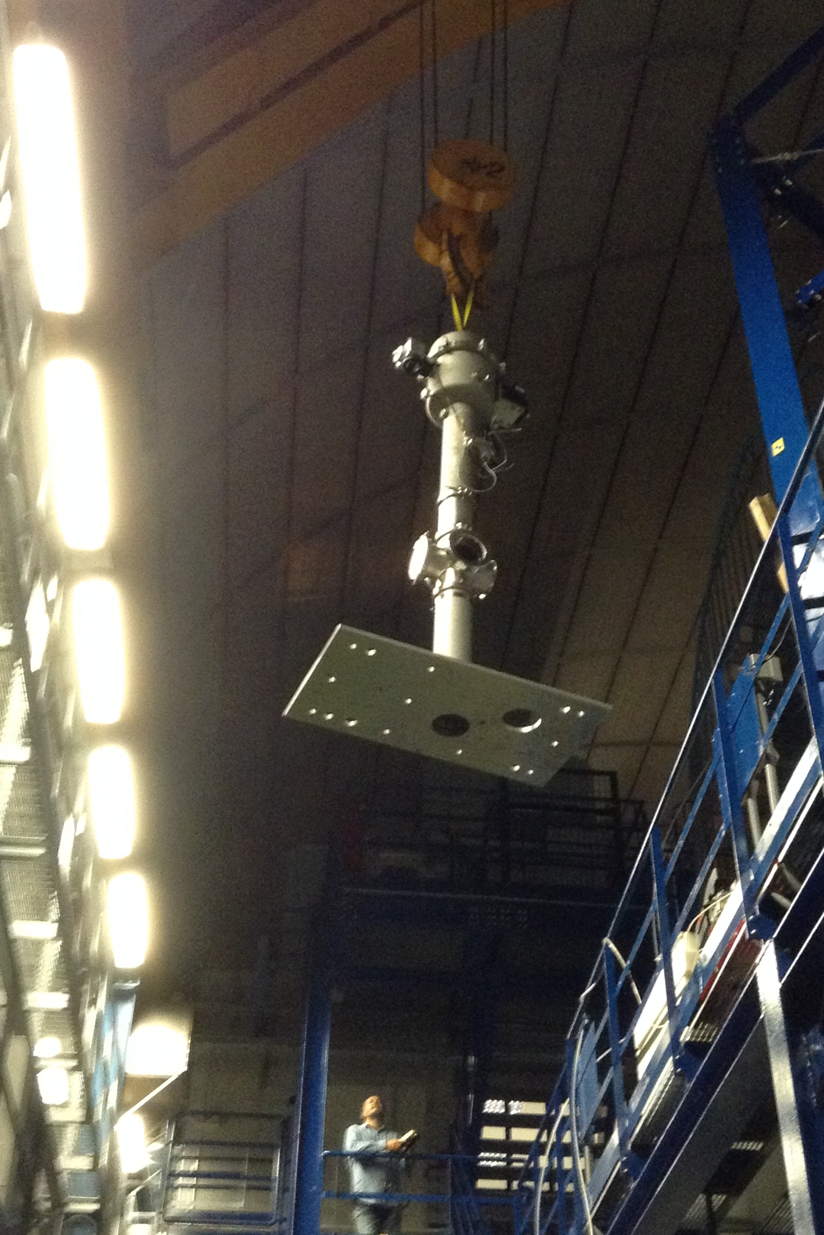
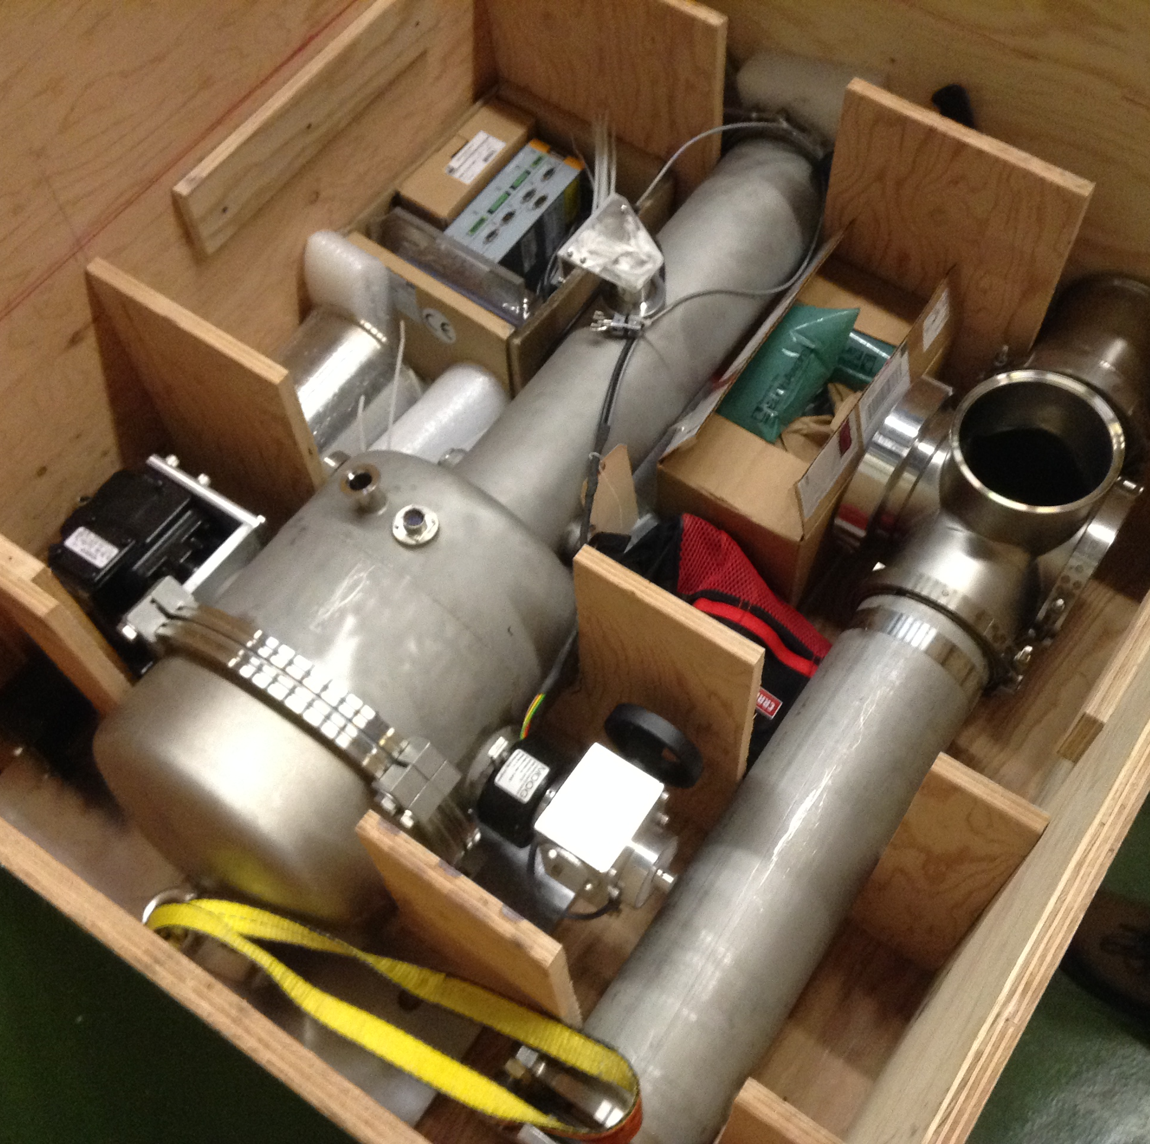
Arrival & Assembly at LNGS

Slide 7
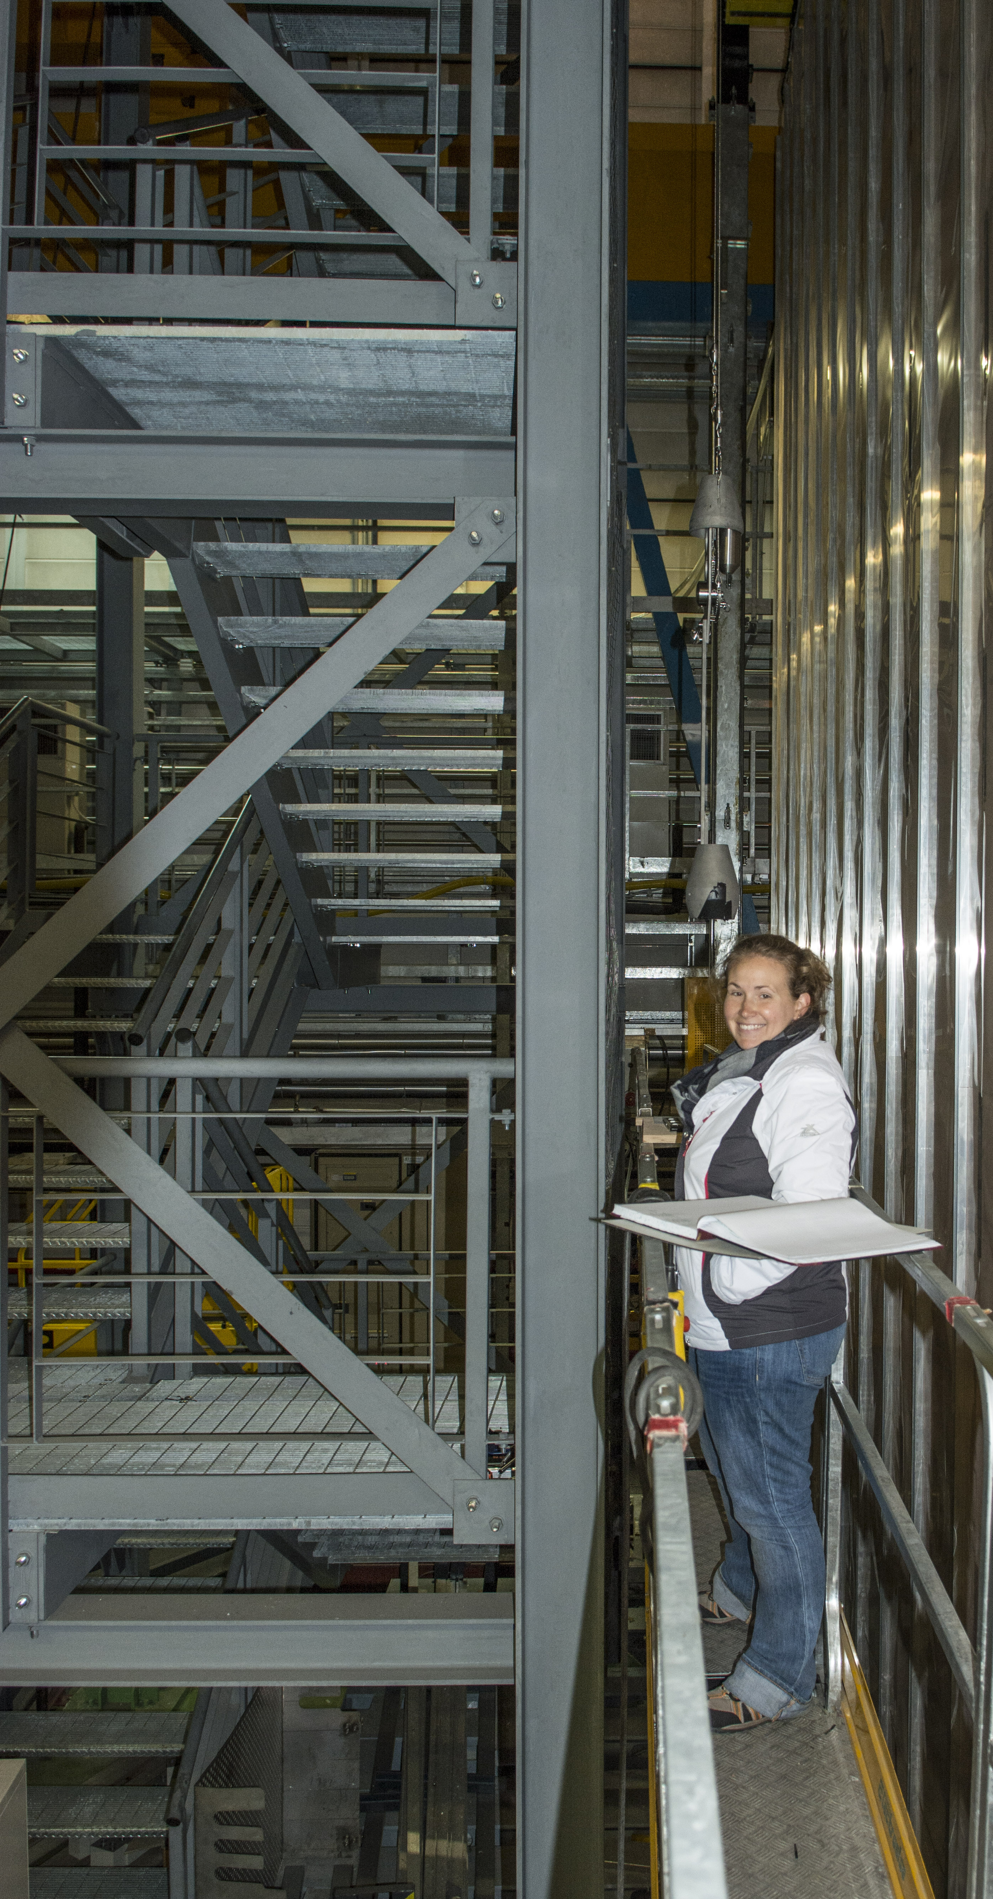
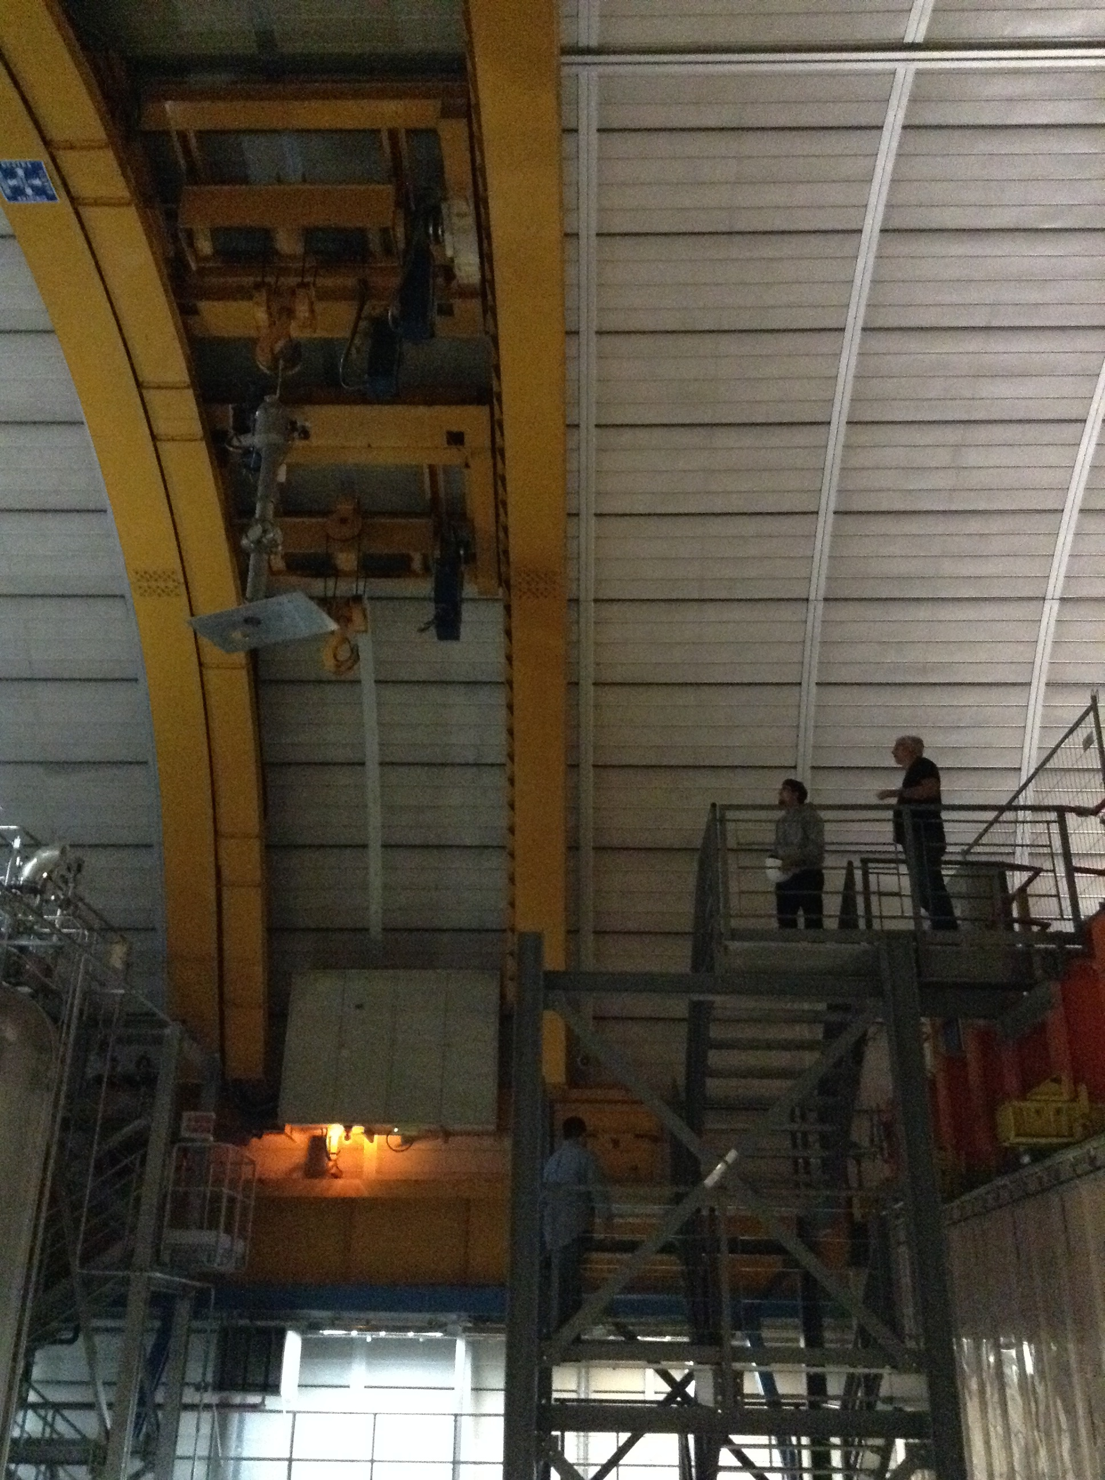
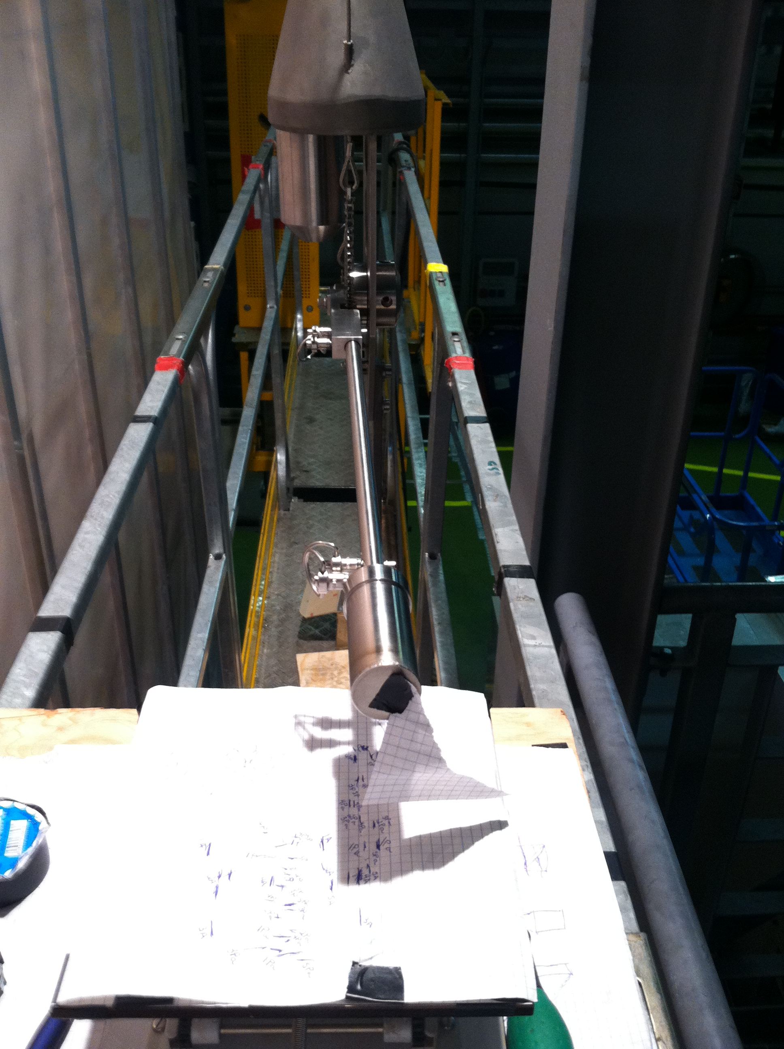
Testing at LNGS

Slide 8
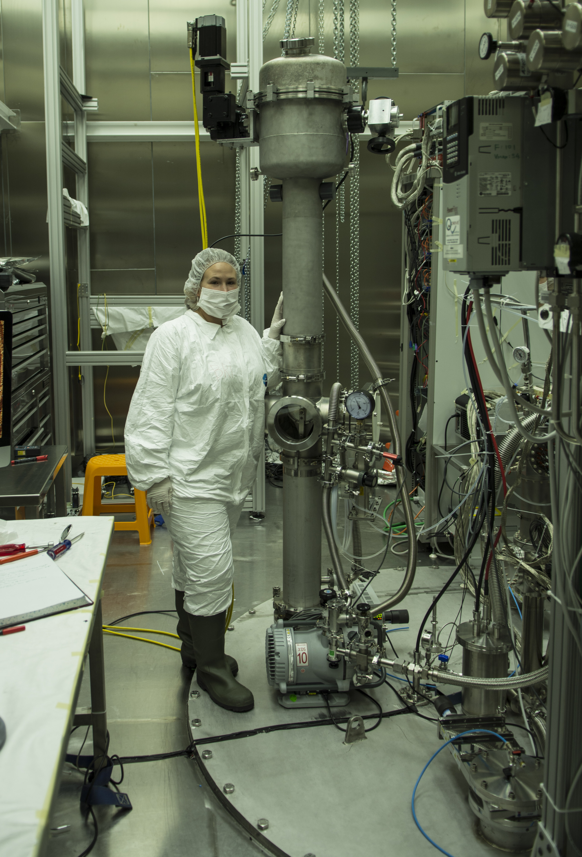
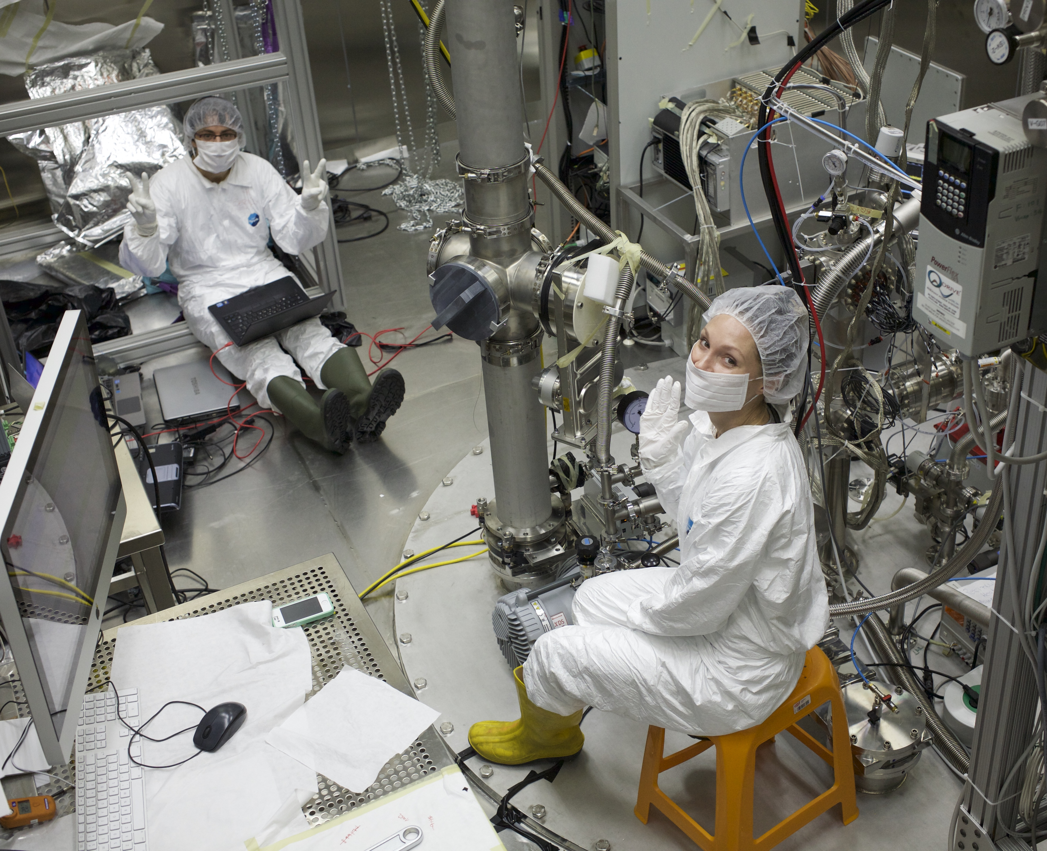
Installation &
Final Commissioning
cryo
tower
CALIS
electronics rack

