Slide 2
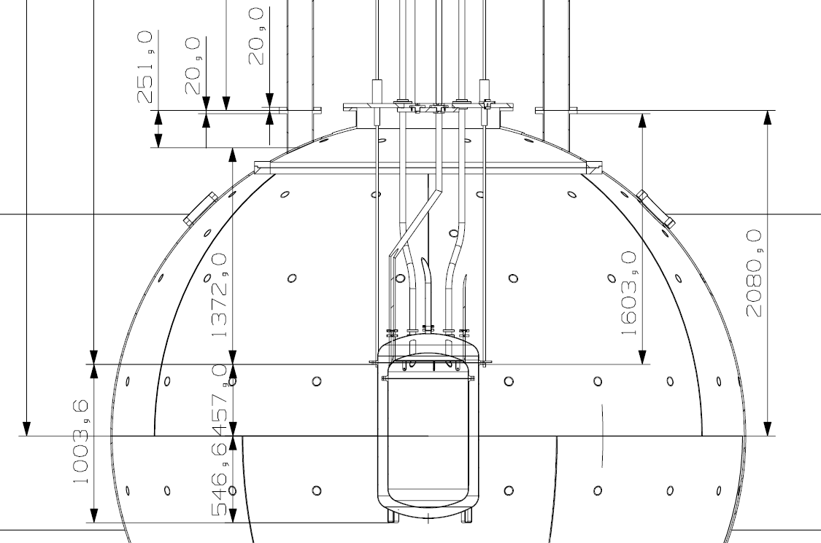
“no fly” zone
organ pipe
“no fly”
zone
cryostat

