Slide 1
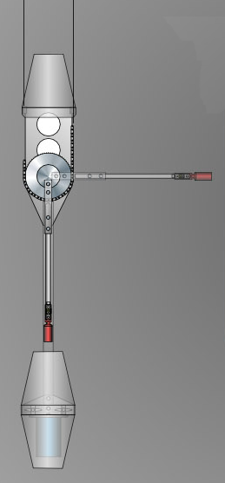
θ

Slide 2
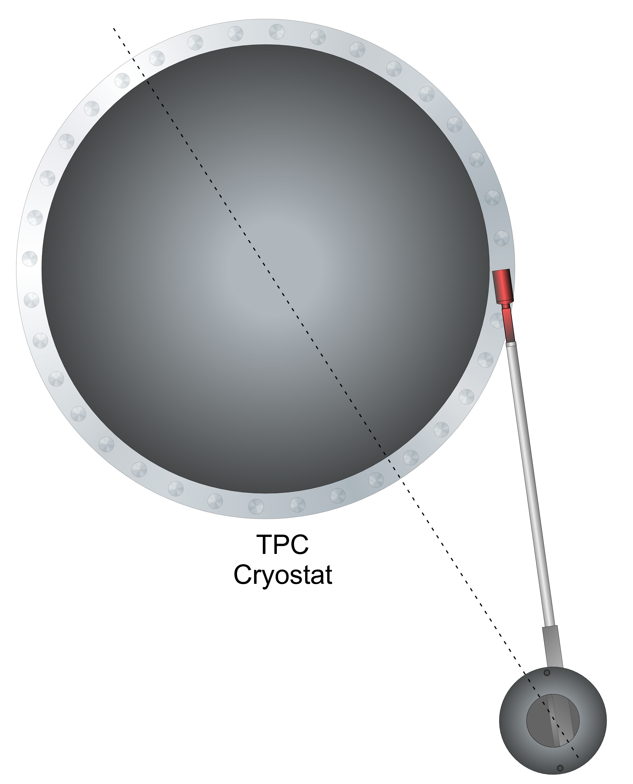
the circle for the
angle makes the
figure larger than
it has to be →
import its png
on the next slide
and crop the
bottom
from:
CALIS_TopView_Cary
62 cm
TPC
cryostat
φ
deployment
device

Slide 3
