Slide 1
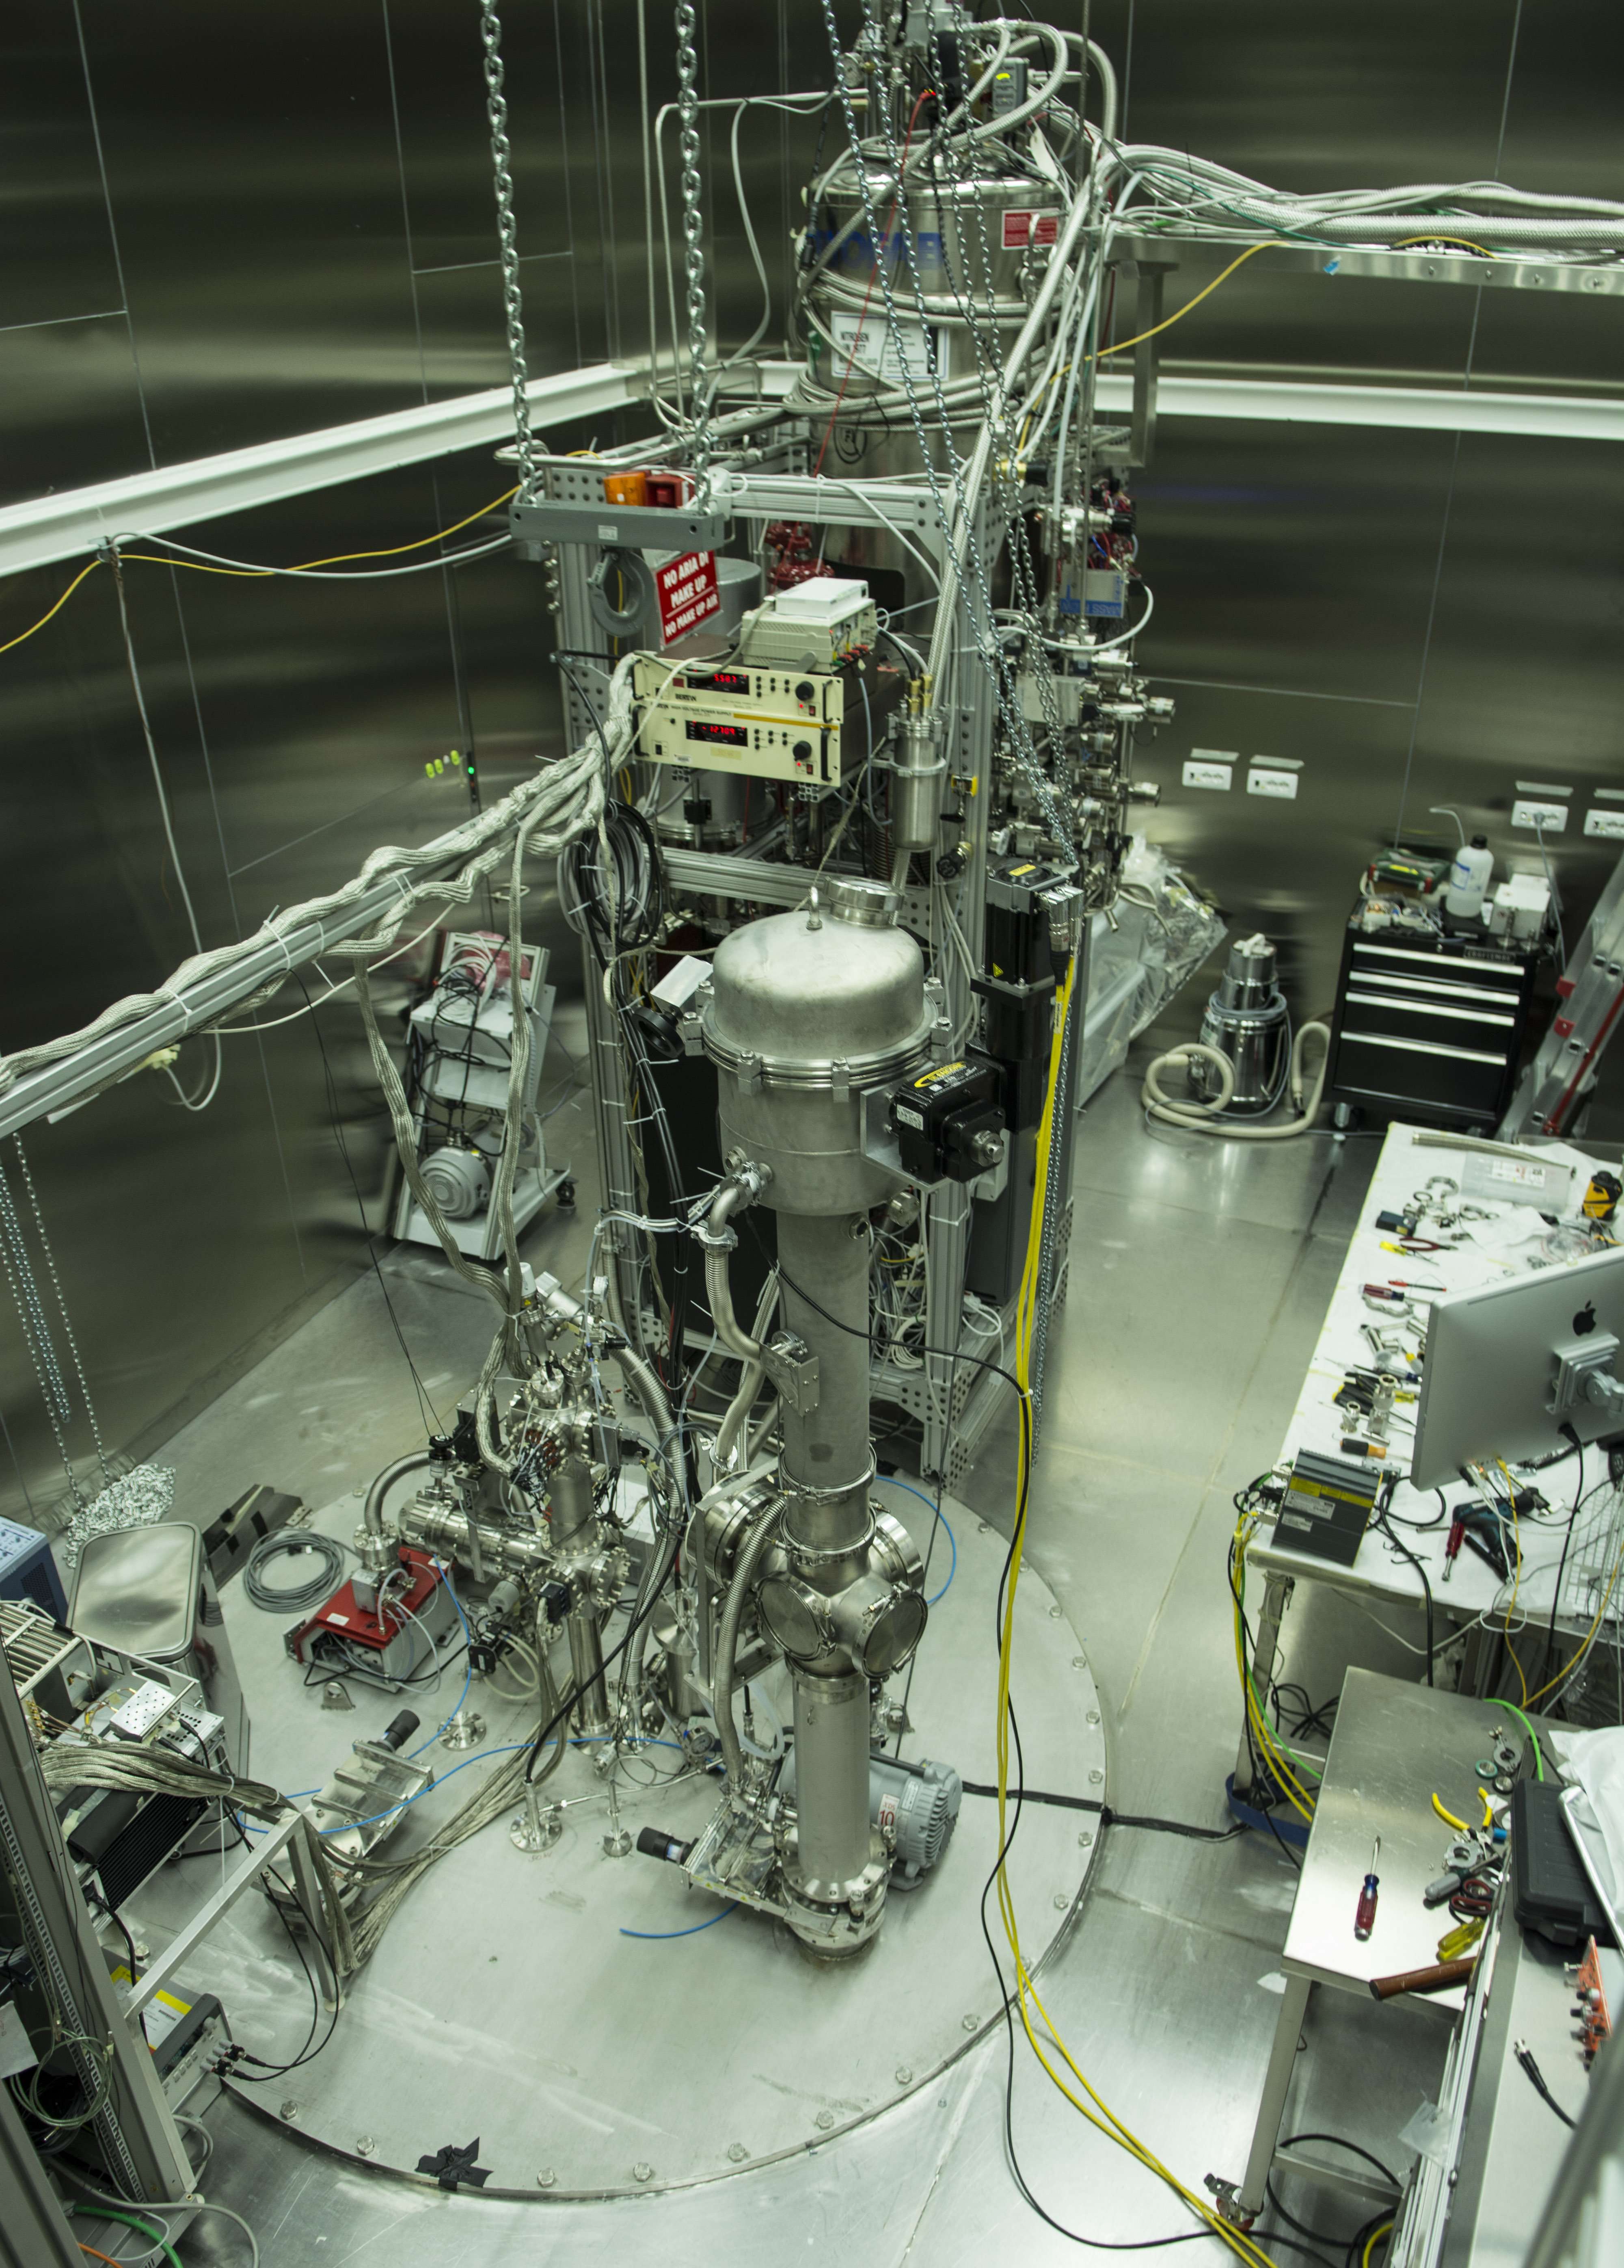
CALIS inside CRH
2. DS-50 radon-free clean room CRH
cryo
tower
1. CALIS
as requested
by Stefano
following Peter's
comment
electronics rack

Slide 2
CALIS inside CRH
radon-suppressed clean room (CRH)
cryo
tower
CALIS
electronics rack

Slide 3
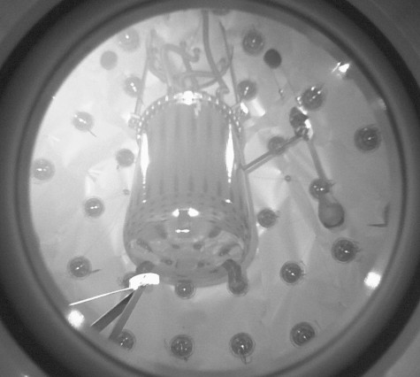
Pig inside LSV (1)
deployment
device
TPC
cryo-
stat
calibration
source

Slide 4
Pig inside LSV (1)
4
6
used in the CALIS paper as inset

Slide 5
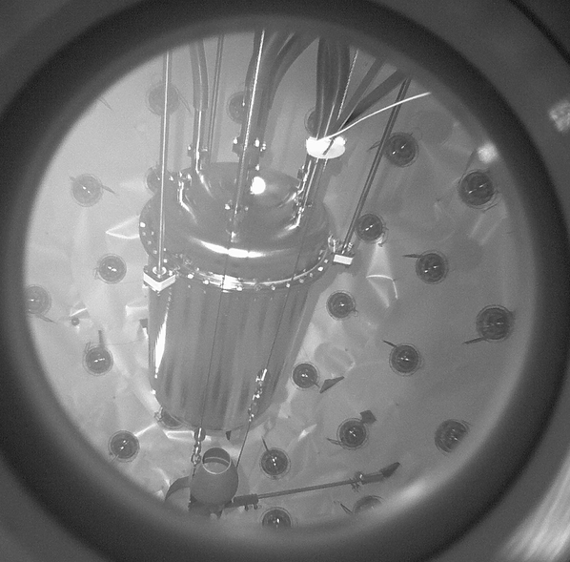
Pig inside LSV (2)
TPC
cryo-
stat
calibration
source
deploy-
ment
device

