Slide 1
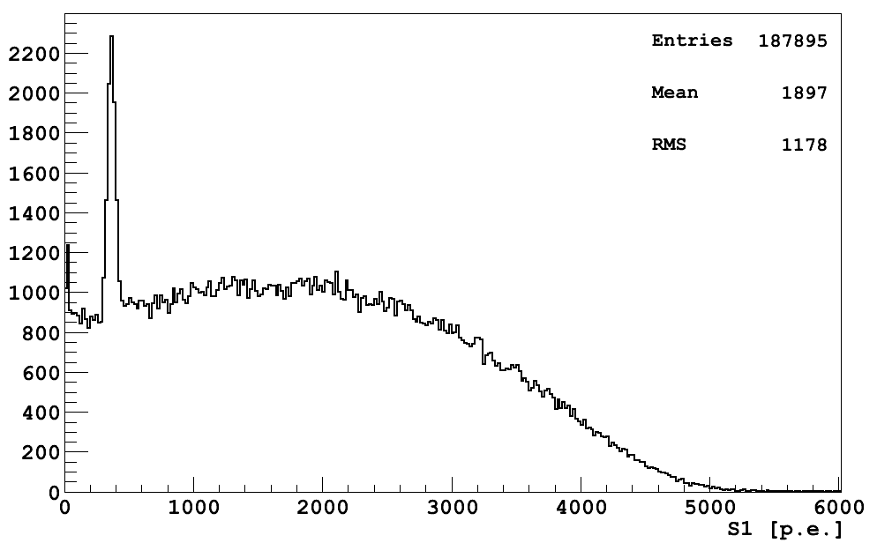
^{83m}Kr (41.5 keV)
⁵⁷Co (122 keV)
¹³³Ba
(356 keV)
¹³⁷Cs
(662 keV)
WIMP region
S1 [PE]

